Slide 1
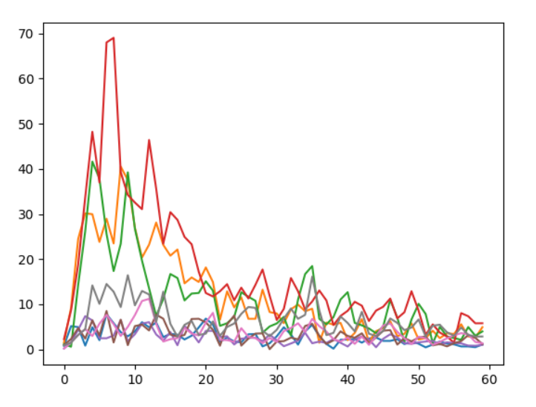
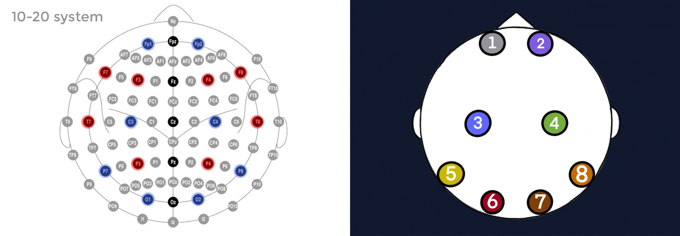
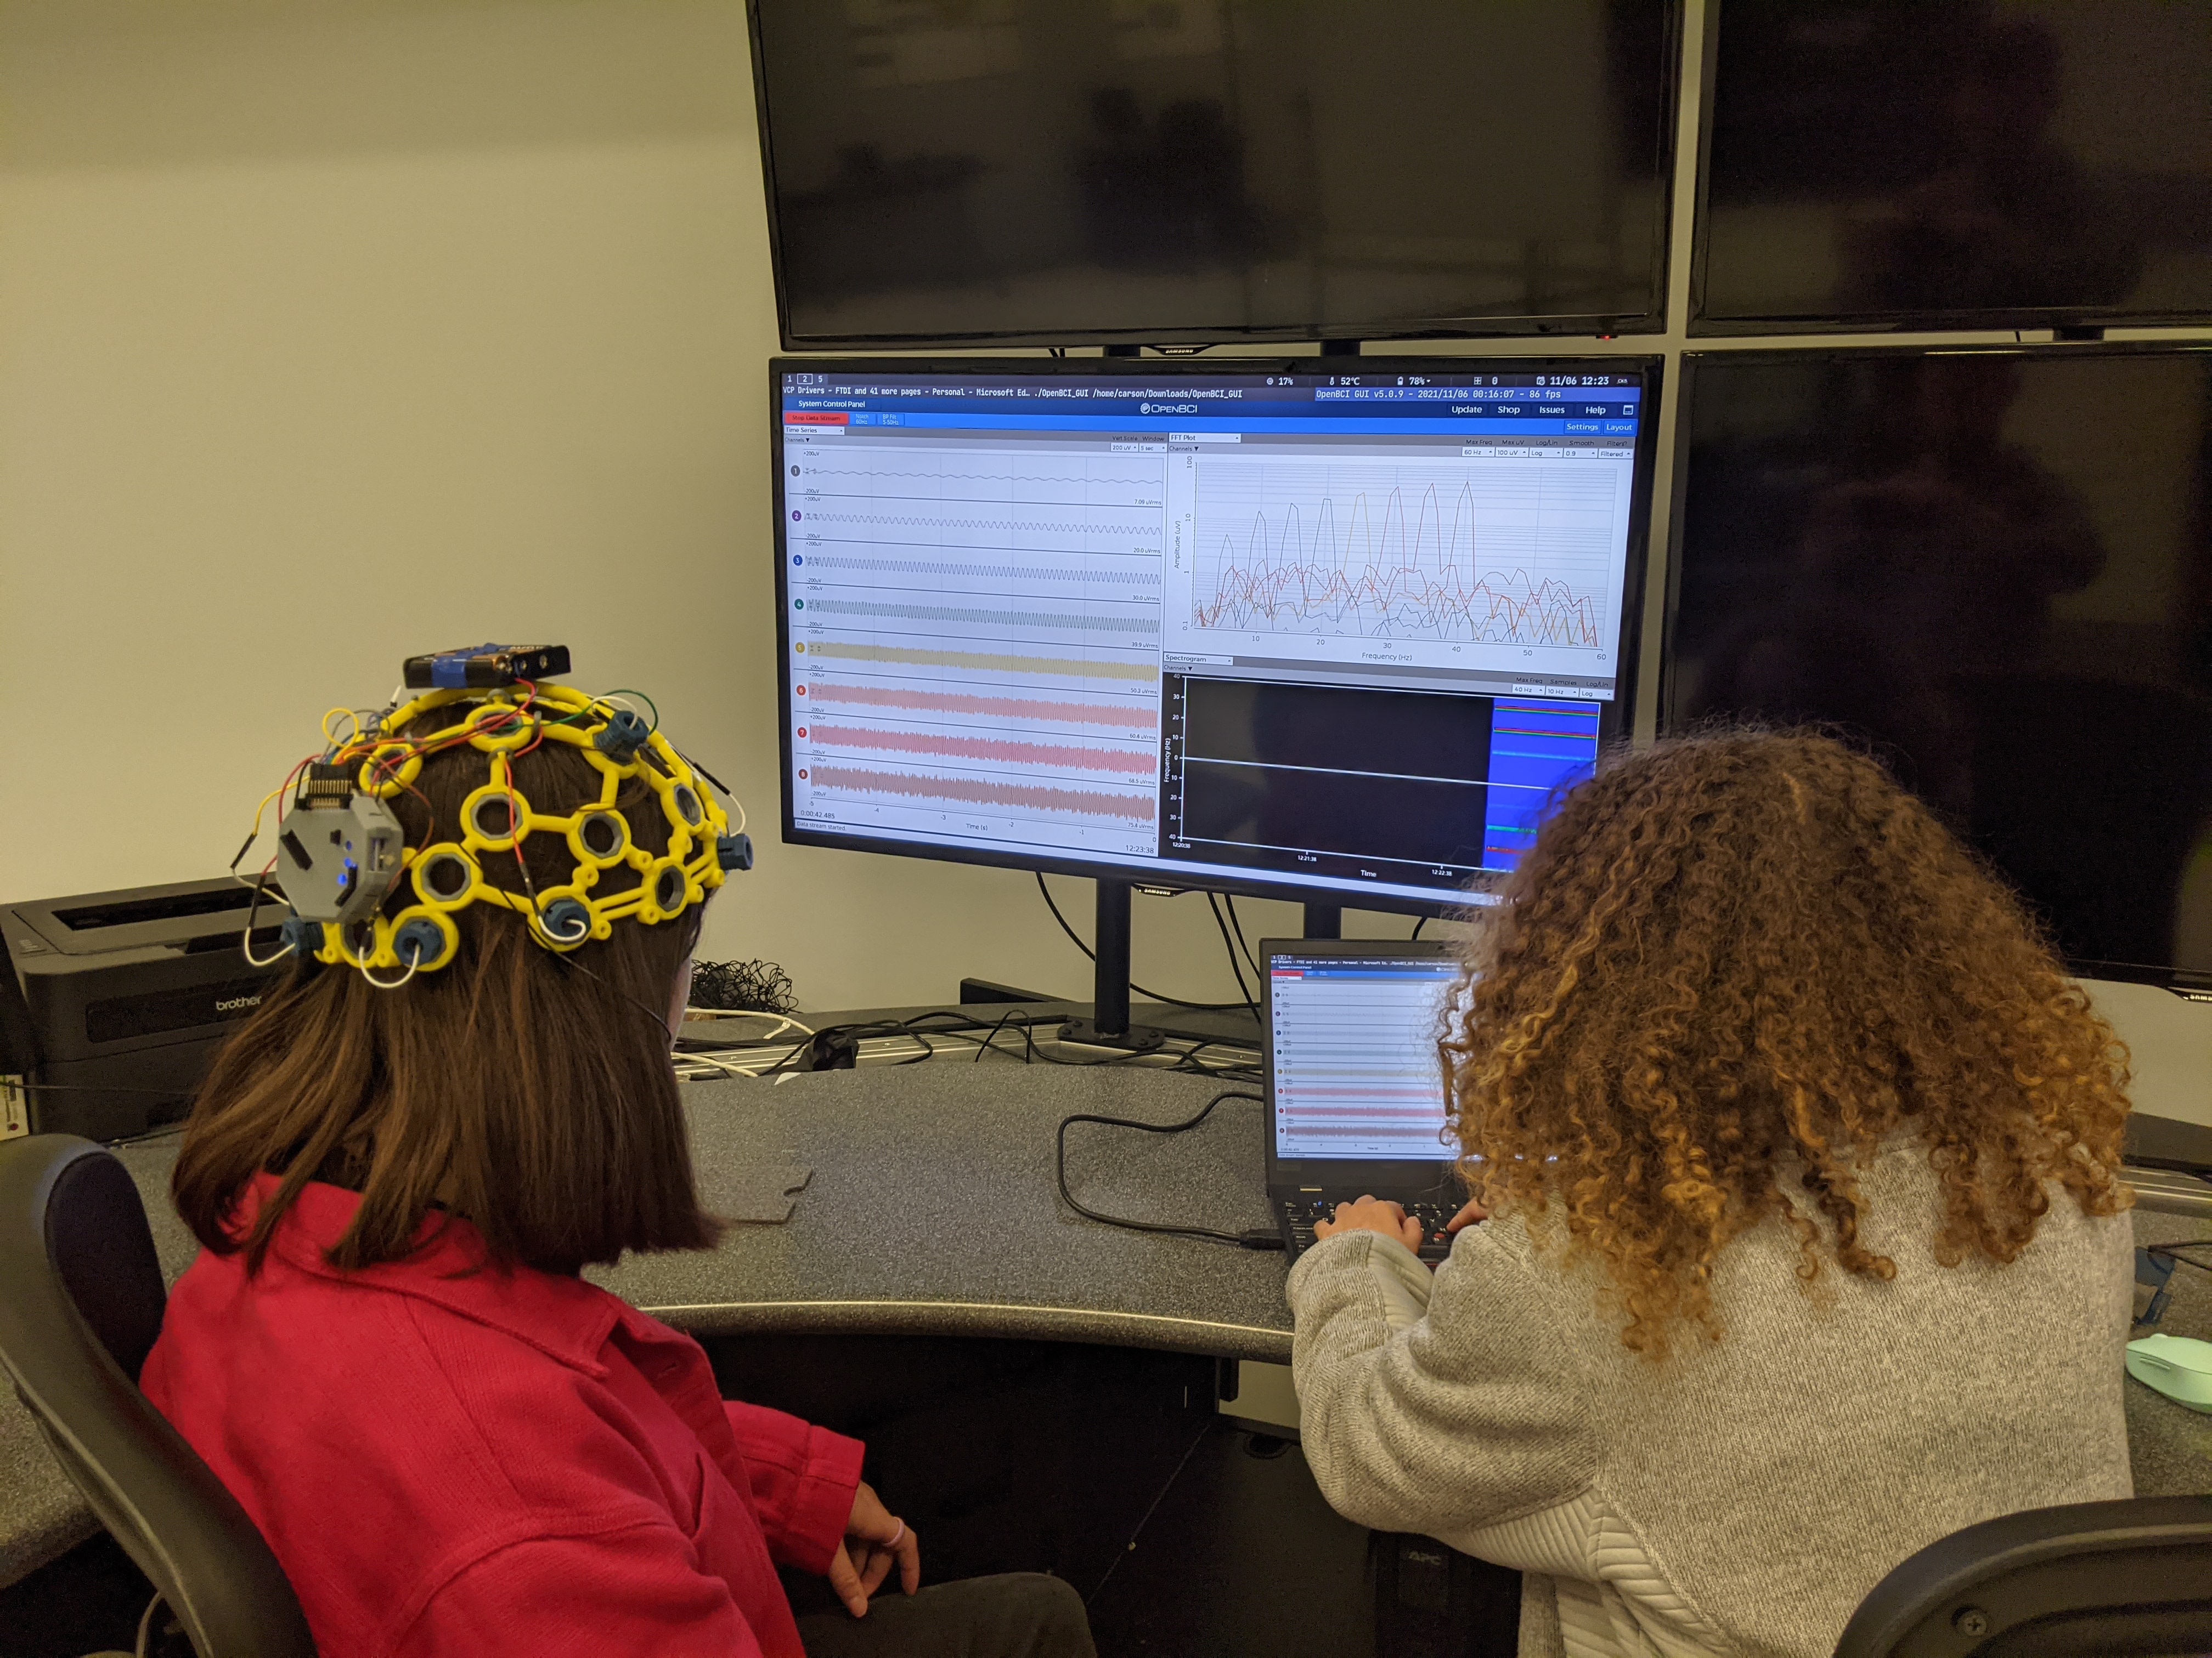
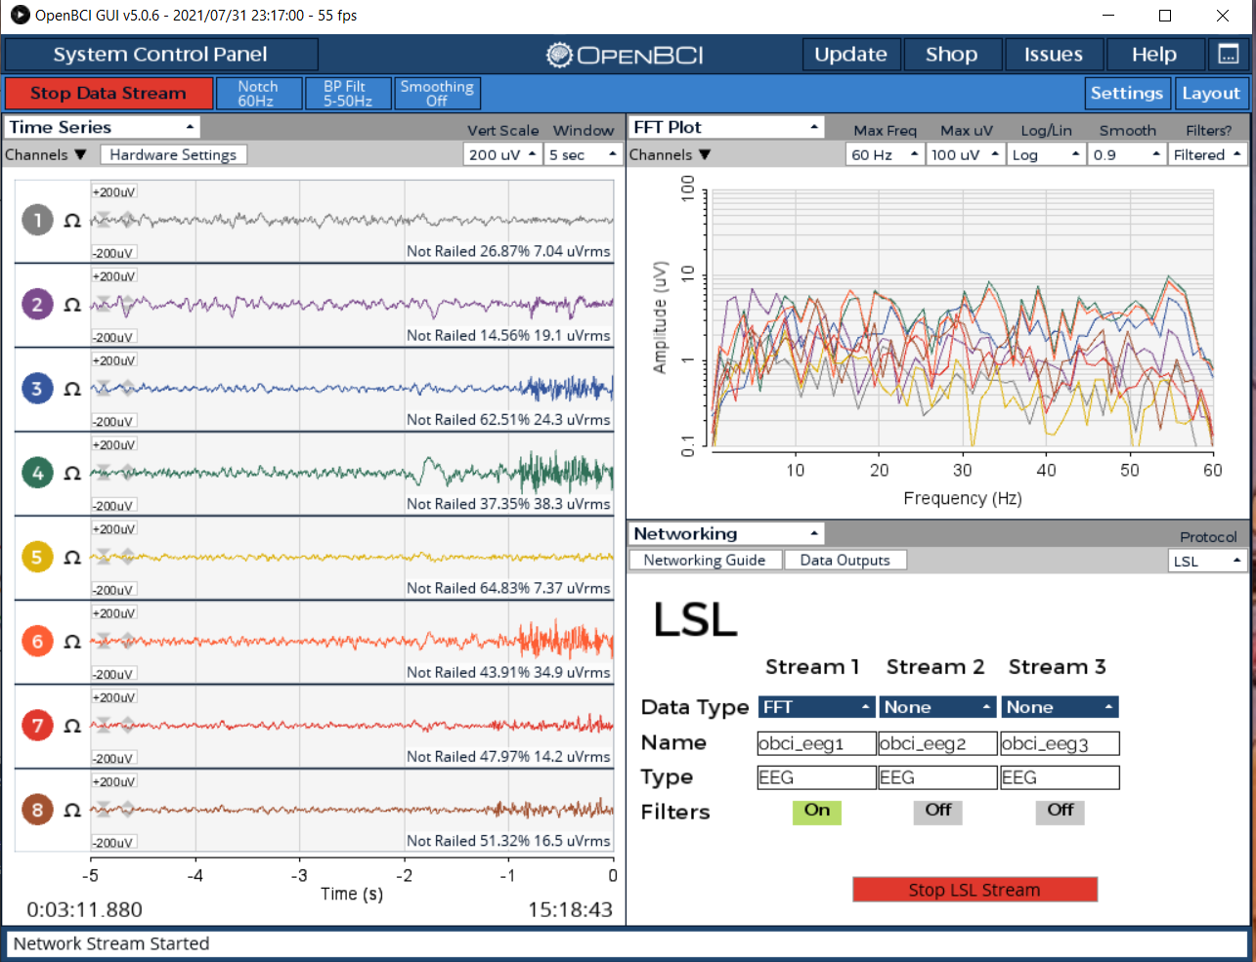
Collection and Analysis of Electroencephalography Signals
Christa Collins, Carson Farmer, and Dr. Hector Medina
Tracer Lab
Abstract and/or Background
Expected Challenges/Results and Conclusion
Background: The implementation of advanced signal processing analysis in analyzing Electroencephalogram (EEG) and Electromyography (EMG) data, has the potential to allow amputee patients to smoothly interact with the natural world. Through extracting specific patterns on EEG and EMG signals we anticipate cultivating a high-speed model and algorithm for processing EEG and EMG signal data. Through replicating an algorithm specifically designed to detect blinking in EEG raw signal data. We anticipate cultivating a high-speed model and algorithm for processing EEG and EMG signal data and quickly implementing it onto computer and robotic hardware.
Methods: The primary signal of the human interface devices we were most intent on analyzing was the EEG signals. EEG signals are more challenging to read because of their low voltage and the high amount of noise intertwine within their signals. Because of this, we began with cultivating an algorithm to detect whether the user was blinking based on raw EEG data. We utilized OpenBCI’s graphic user interface as well as OpenVibe and programed a moving window to implement the signal processing features of this algorithm.
Expected Results: Through implementing the blink algorithm to extract specific data signal processing feature on EEGs will result in the control of robotic systems through brain and muscle wave analysis. The continual improvement of the algorithm will result in one day an amputee patient being able to move a bionic robotic prosthetic limb based on their thoughts and muscle movements. Allowing the patient to better interact with the natural world.
FFT of Brainwave Activity
Expected Challenges:
Extracting the specific features of the EEG data needed to efficiently implement their use on actual robotic/prosthetic applications.
Deducing if the data has been processed in the most efficient way after the utilization of feature extraction and the blink detection algorithm.
Obtaining data results from the electrode sensors with the least amount of noise possible.
Implementing advanced signal processing methods, in order to achieve faster algorithms, models, and results.
Collecting data results that are acceptable with minimum amounts of noise.
Expected Results:
From developing an algorithm which detects blinking from the user the goal is to improve upon and combine previous work that has been attempted to analyze and implement EEG data from BCI programs so they can be used in application. The following are expected to be implemented and reported:
The efficient and quick extraction of data results for application implementation.
Developing software application for signal analysis in human interfaces
Cultivating new algorithms based on the blink algorithm to use brainwave signals in controlling robotic and computer systems
The ability to implement the data and various algorithms into various application such as toy cars, drones, and bionic limbs which grants the user access to control the application through analyzing their brain signals.
Conclusion:
As a result of this study, knowledge will be advanced regarding the data extraction and analyzation of human interfaces. This knowledge will allow better analyzation of EEG signals for treating and detecting health abnormalities within the brain as well as advance the creation of applications for disabled patients for the improvement of their daily lives.
Amplitude (uV)
Figure 1. Created by Christa Collins. Map of OpenBCI electrode placement utilizing the common 10-20 system. The placement of electrodes allow for the data collection of brain waves from various sections of the head for specific feature extraction and signal analysis.
Frequency (Hz)
Introduction
Figure 2. Created by Christa Collins. Fast Fourier Transformation (FFT) graph of a user’s brainwave activity in a limited time frame while the user is blinking. Through analyzing various graphs and transformations such as these, we are able to eliminate noise and extract specific properties on brainwaves for future implementation.
Nearly 15% of the global population suffers from a disability. Half of these disabled patients are unable to afford healthcare, and current prosthetics are expensive. Furthermore, even state-of-the-art prosthetics are unable to smoothly interact with the natural world. 30% of the 10 million amputees around the world are arm amputees. Because of the complexity of limbs and brain anatomy, a highspeed computer hardware is required to process the large amounts of data received. An electroencephalography (EEG) sensor is a medical device which reads and monitors brain signals. An Electromyography (EMG) sensor is a medical device which reads muscle-related electrical signals. Through signal processing and feature extraction, an algorithm can be created to process raw EEG data, which can then be converted to useful signals that can potentially be used to control various robotic and computer systems. However, neuronal signals are difficult to translate due to the signal-to-noise ratio of commercially available non-invasive Brain Computer Interface (BCI) . We hypothesize that more robust signal processing algorithms that rely on either machine learning methods and other signal reconstruction techniques should be employed to resolve the aforementioned problem. As a first step towards that goal, we have cultivated an algorithm which detects blinking in the user’s brainwave signals and eliminate the additional noise found within the EEG signals.
Up
Future Work
Develop a spectral clustering feature extraction algorithm for EEG signals to be utilized on mind-controlled bionic prosthetics, drones, and other robotic systems.
Develop a computer simulation to realistically simulate a bionic prosthetic arms potential movements utilizing EEG signal processing.
Further study the cerebellum’s relationship to EEG signals for advance feature extraction.
Incorporate field programmable gate array (FPGA) algorithms for fast and online implementation.
Methods
Figure 6, 7, and 8. Created by by Christa Collins. Process of EEG recording of data. 1) Brain activity is recorded using a headset integrated with eight electrode sensors. 2) Brain activity is processed through a computer using the OpenBCI’s graphic user interface to identify a user’s desired actions. 3) The data is then sent to the application. The application is then analyzed through computer programmed software. This software is then implemented to carry out the desired commands based on the user’s brain signals..
We began by utilizing a Brain Computer Interface (BCI), which is a system to determine functional intent from reading a patient’s electrochemical signals to record, analyze, and message brain activity. BCI are composed of three main components. They contain a device which measures brain waves, a computer interface to process and analyze this data, and an application to control. We used OpenBCI headset in order to interpret and analyze our EEG data. On the headset are eight sensor electrodes which are placed in the headset around the head. These electrodes read the electrical activity coming from different sections of the heard.
To become more familiarized with the application method of EEG signal data processing and analysis we initially conducted a blinking test. We recorded the EEG signals while a participant was blinking. After which we recorded this raw data into a python detection algorithm and implemented this code onto an LED light. The end goal is that whenever the participant blinks the LED light will turn on based on the EEG signals being processed by the BCI and python blink detection algorithm.
Because of the mass amount of data and noise recorded from the EEG signals we began by utilizing the eeglib python module for feature extraction of the EEG data from the eeglib python library. We also began creating a spectral clustering algorithm so the EEG data could be more accessible to interpret and analyze for data extraction.
1 2 3 4 5 6 7 8 9 10 11 12 13 14
1 2 3 4 5 6 7 8 9 10 11 12 13 14
A
B
References
M. Agarwal and R. Sivakumar, "Blink: A Fully Automated Unsupervised Algorithm for Eye-Blink Detection in EEG Signals," 2019 57th Annual Allerton Conference on Communication, Control, and Computing (Allerton), 2019, pp. 1113-1121, doi: 10.1109/ALLERTON.2019.8919795.
Anjum, M. F., Dasgupta, S., Mudumbai, R., Singh, A., Cavanagh, J. F., & Narayanan, N. S. (2020). Linear predictive coding distinguishes spectral EEG features of Parkinson’s disease. Parkinsonism & Related Disorders, 79, 79–85. https://doi.org/10.1016/j.parkreldis.2020.08.001
Alba-Flores, R., Rios, F., Triplett, S., & Casas, A. (2019). Gesture Recognition Using an EEG Sensor and an ANN Classifier for Control of a Robotic Manipulator. Intelligent Computing, 2, 1181–1186. https://doi.org/10.1009/978-3-030-22868-2_81
Wöhrle, H., Tabie, M., Kim, S., Kirchner, F., & Kirchner, E. (2017). A Hybrid FPGA-Based System for EEG- and EMG-Based Online Movement Prediction. Sensors, 17(7), 1552. https://doi.org/10.3390/s17071552
C
Figure 6. Created by Christa Collins. Collection of raw EEG data like in the article “Gesture Recognition Using an EEG Sensor and an ANN Classifier for Control of a Robotic Manipulator” of six facial gestures for further feature extraction through statistical methods. Through analyzing these signals visually, we will cultivate an algorithm, much like the blink algorithm, to extract specific features based on gestures to control robotic applications.

