Slide 1
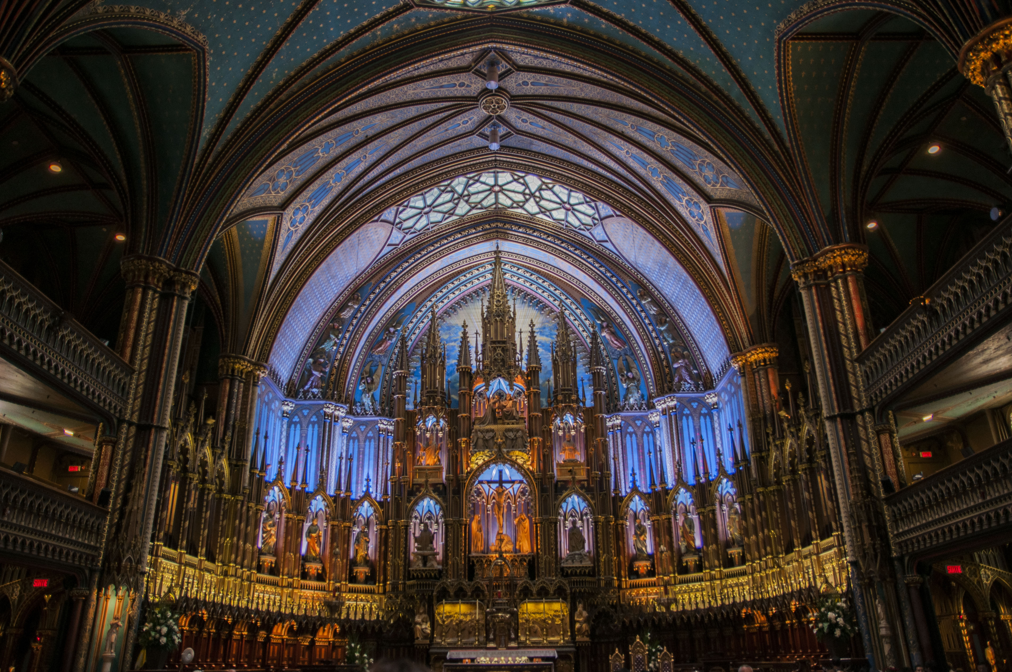
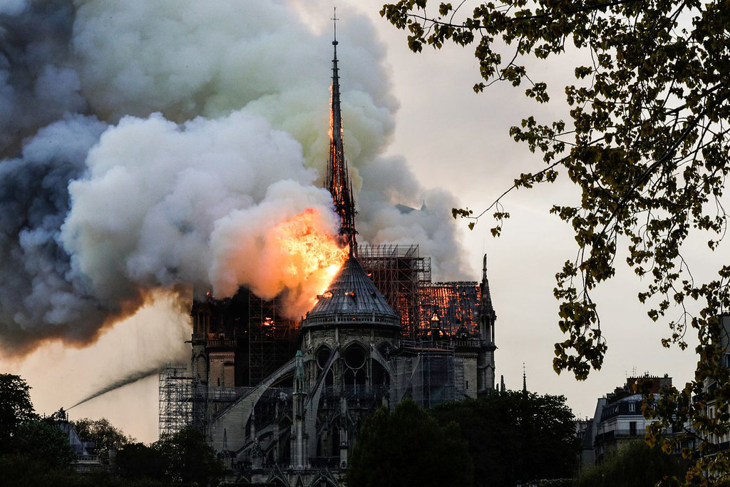
Notes:
Fig. 1 “File:Notre-Dame Roman Catholic Church Basilica - Montreal 01.jpg - Wikimedia Commons.” by Wikimedia Commons is licensed under CC BY-SA 4.0
Fig. 2 “The devastating Notre Dame Cathedral fire, in 19 photos (5… | Flickr.” by Flikr (manhhai) is licensed under CC BY-SA 2.0 and was enlarged to best fit the slide.

