Slide 1
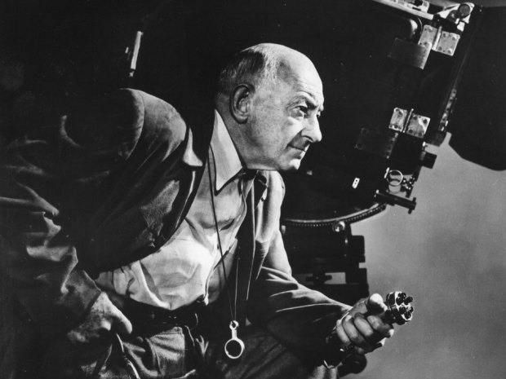
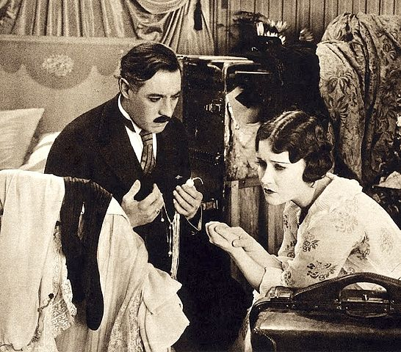
Cecil B. DeMille’s
“Divorce Trilogy:
Old Wives for New
Don’t Change Your Husband
Why Change Your Wife?
“And now you know what every Woman comes to know – that Husbands, at best, are pesky brute; and at worst – are unfit for publication!”
“we Wives are apt to take our Husbands too much for granted. We’ve an inclination to settle down to neglectful dowdiness – just because we’ve ‘landed our Fish’! It is not enough for Wives to be merely virtuous any more, scorning all frills: We must remember to trim our ‘Votes for Women’ with a little lace and ribbon – if we would keep our Man as a ‘Lover’, as well as a ‘Husband’!”
“Pictured is Cecil B. DeMille with his camera.” by Unknown Author is licensed under CC BY-SA
“And now you know what every husband knows: that a man would rather have his wife for his sweetheart than any other woman: but Ladies: if you would be your husband’s sweetheart, you simply must learn when to forget that you’re his wife.”
“Pictured is Elliot Dexter and Gloria Swanson in the film Don’t Change Your Husband.” by Unknown Author is licensed under CC BY-SA
This Photo by Unknown Author is licensed under CC BY-NC

