Slide 1
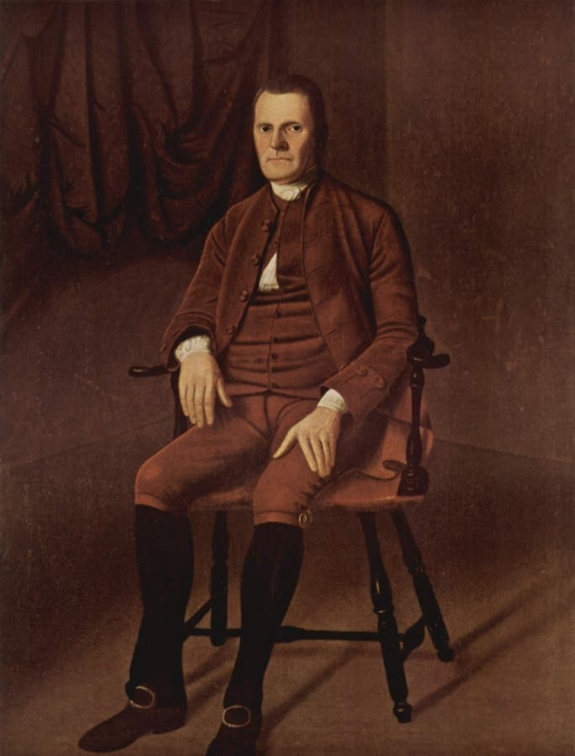
Figure 1. Ralph Earl, Roger Sherman, about 1775–76, oil on canvas, 64 5/8 x 49 5/8 in. (164.2 x 126.1 cm), Yale University Art Gallery, New Haven, Connecticut, WorcesterArt.org.
Notes:
This image is free to share and use (Bing Images)

