Slide 1
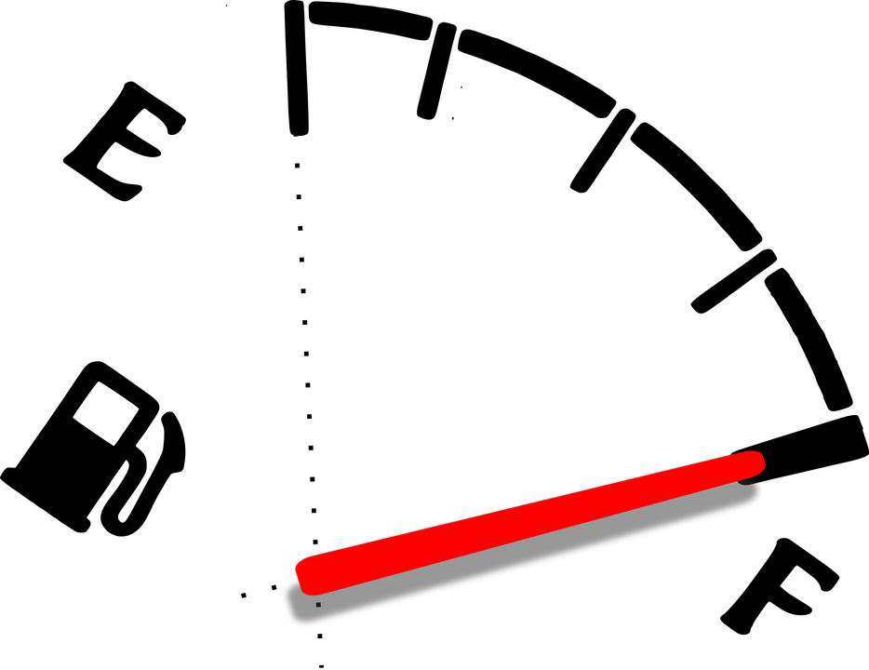
Improving Lightweight Designs by Modeling Deformation Twinning in Magnesium Alloys
Daniel Kenney
Advisor: Dr. Marcos Lugo
Notes:
Sources for Images:
Jaguare XE Frame:
https://commons.wikimedia.org/wiki/File:Jaguar_XE_-_12926287943.jpg
Image of gas gauge:
https://www.needpix.com/photo/31357/fuel-gauge-gasoline-measure-meter-full-gas-tank-dashboard
Image of Magnesium microstructure is from personal research.

