Slide 1
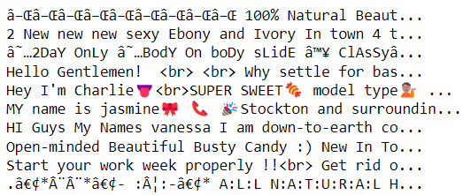
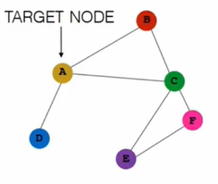
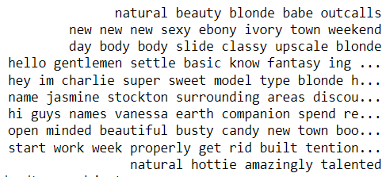
Detecting Human Trafficking Using Graph Neural Networks
Bethany Matsick
Notes:
Note: Images are self-created
- $150 billion global industry — more profitable than drugs or white collar crime.
- More than 40.3 million victims today—1 out of every 185 people in the world.
- About 50,000 people are trafficked into the United States each year, most often from Mexico and the Philippines.
- Occurs in every region of the world, with the highest concentration in Asia and the Pacific region.
- 87.7% of the federal sex trafficking cases active in 2018 were facilitated by the use of the Internet (Currier and Feehs, 2019).
- Various websites provide means to advertise sexual services, including Craigslist, Backpage, and Skip the Games.
How can law enforcement discern between prostitution and trafficking?
- Refers to the practice of giving computers the ability to understand text in a similar way as a human.
- Combines computational linguistics, statistics, machine learning, and deep learning models.
- Examples include voice-operated GPS systems, speech-to-text dictation, and translating text from one language to another.
Replace foreign characters
Lowercase all words
Remove excess whitespace and punctuation
Remove “leftover” HTML (ex. <br>)
Separate words that are combined (ex. hellomynameis)
Correct misspelled words
Remove stop words
We don’t want to remove an accented “a” that is part of the word “cat.” Similarly, wouldn’t want to remove an @ from “c@t.”
Aggregate = collect messages
Update = update each node’s features based on the message
Why graphs?
Used to model entities and connections between them
Can be used to increase model structure
Lots of options!
Edges: directed vs. undirected, weighted vs. binary
Features: none, node-based, edge-based
Temporal aspects: none, features
Combine strong relational inductive bias and generalized feature extraction
May be faster and more accurate
Human analysts have accuracy of 84%. State of the art for this data set is roughly 80%.

