Slide 1
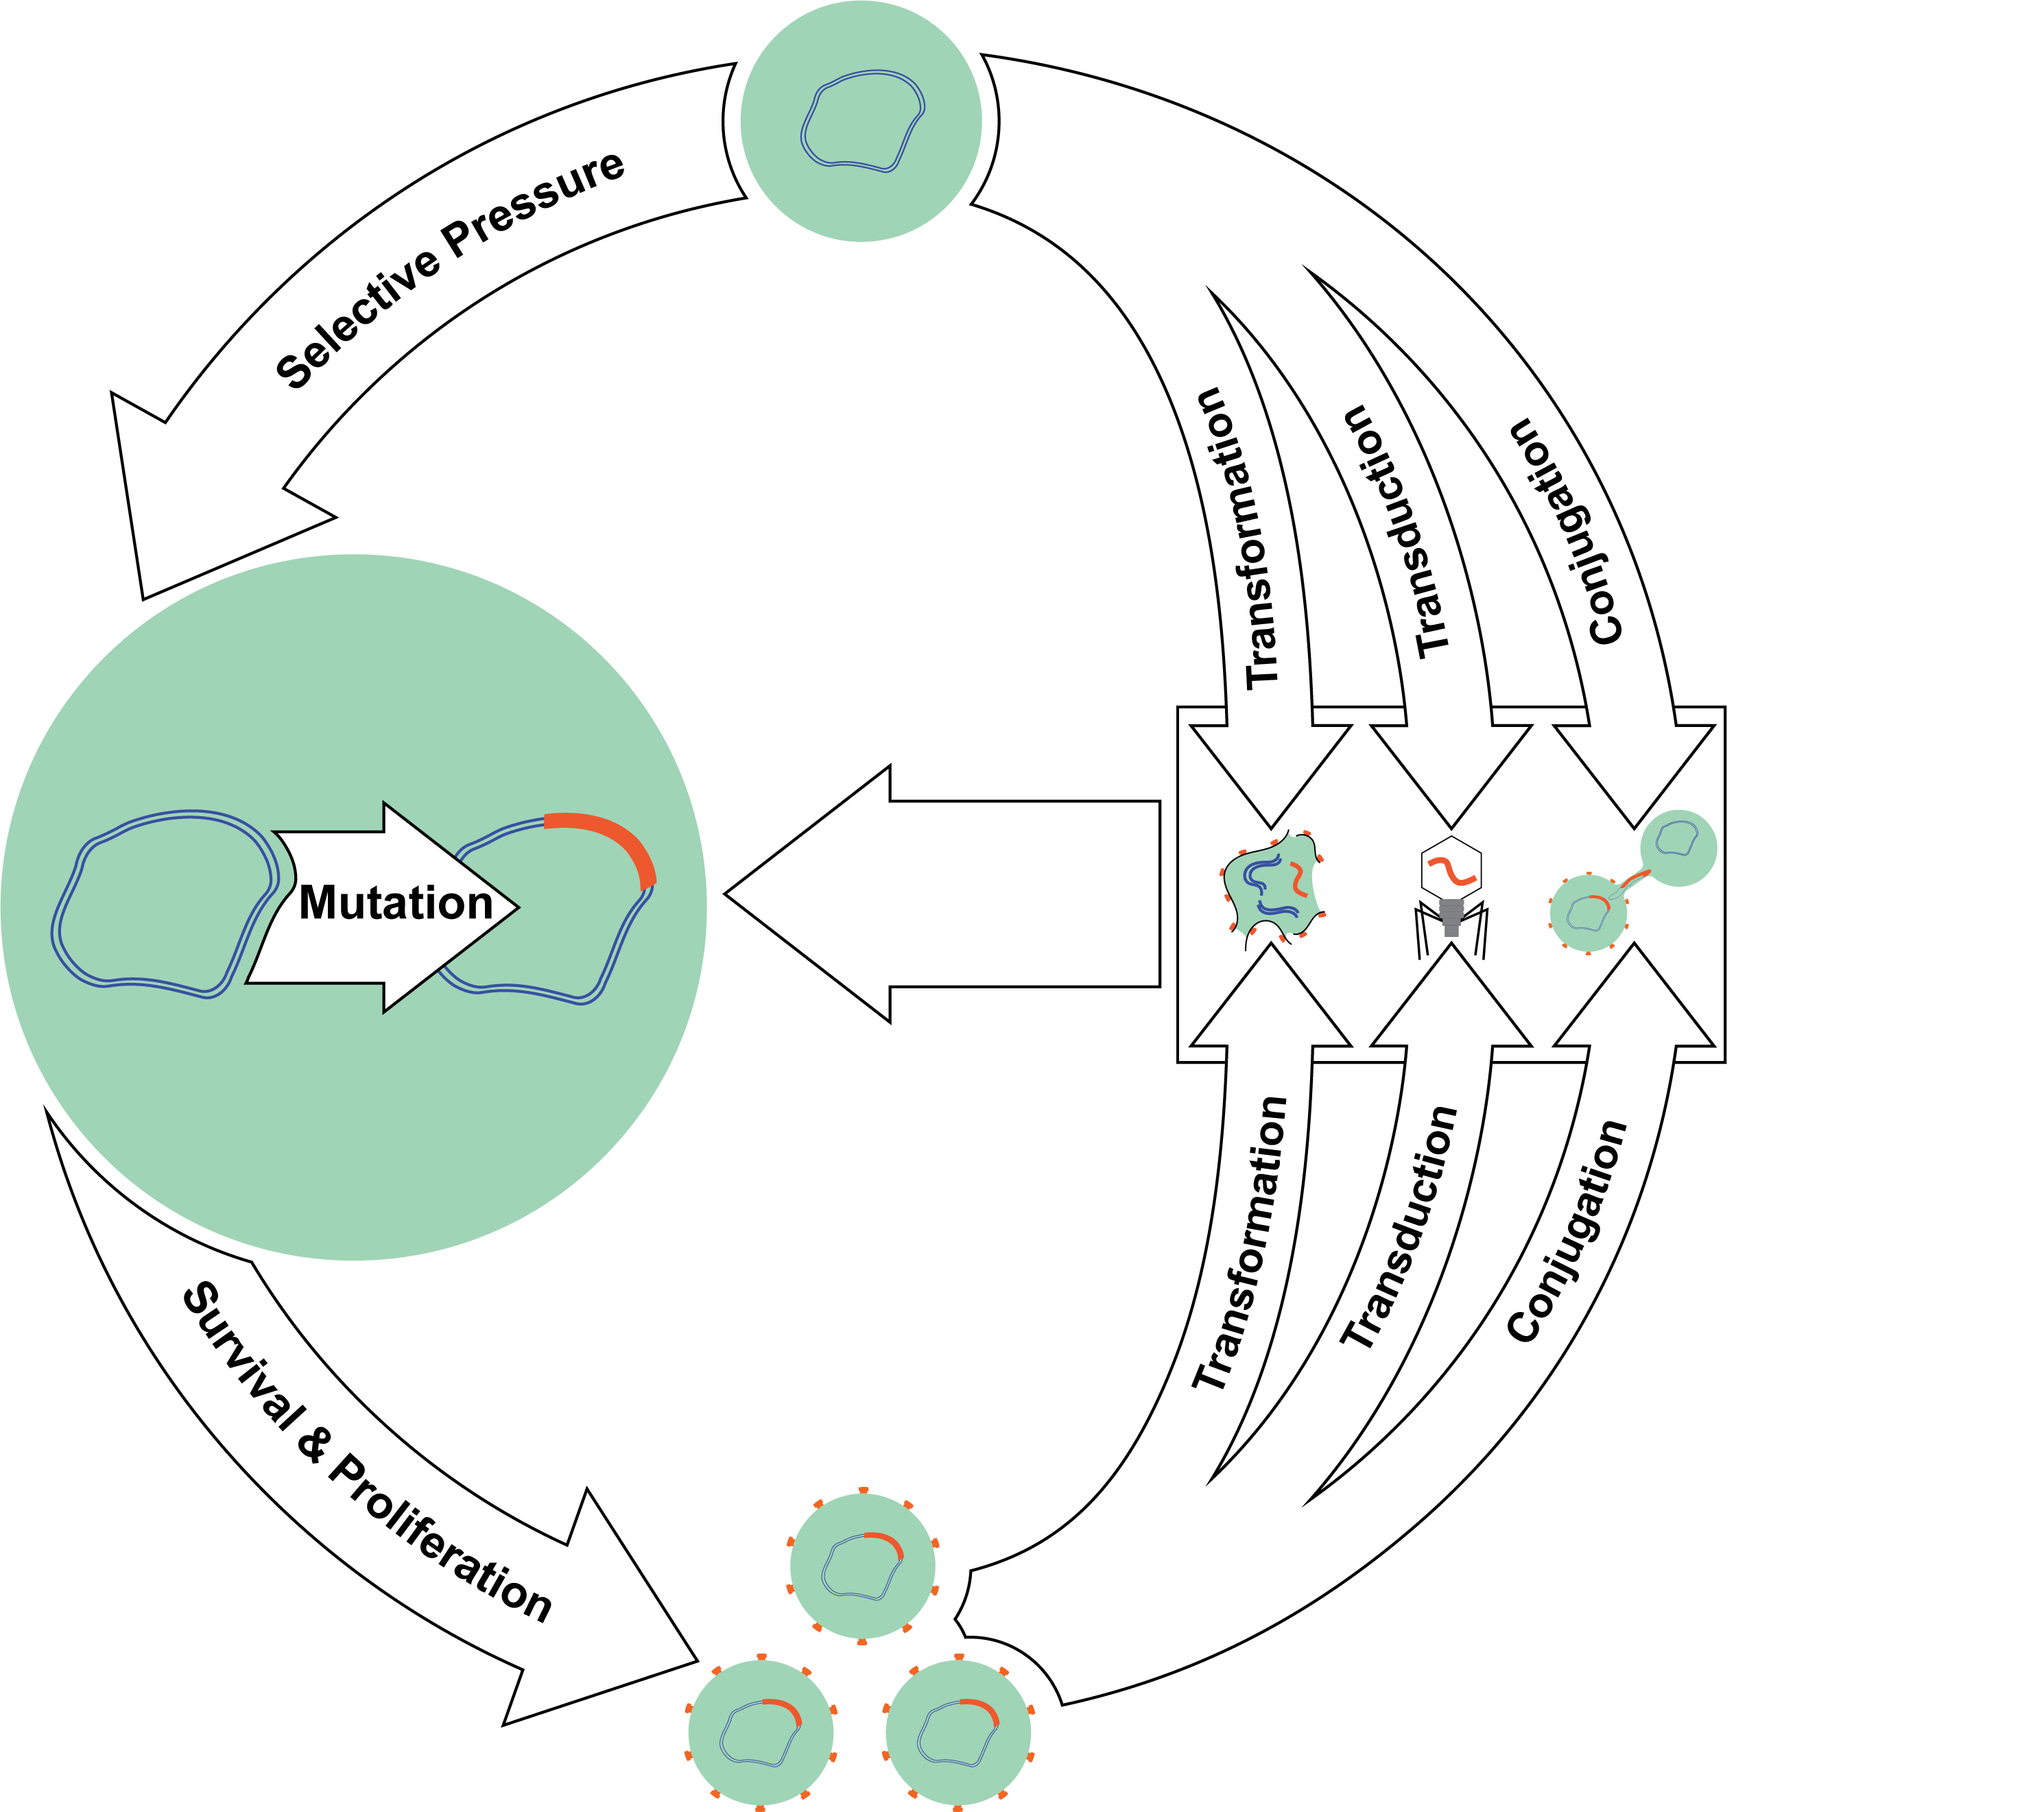
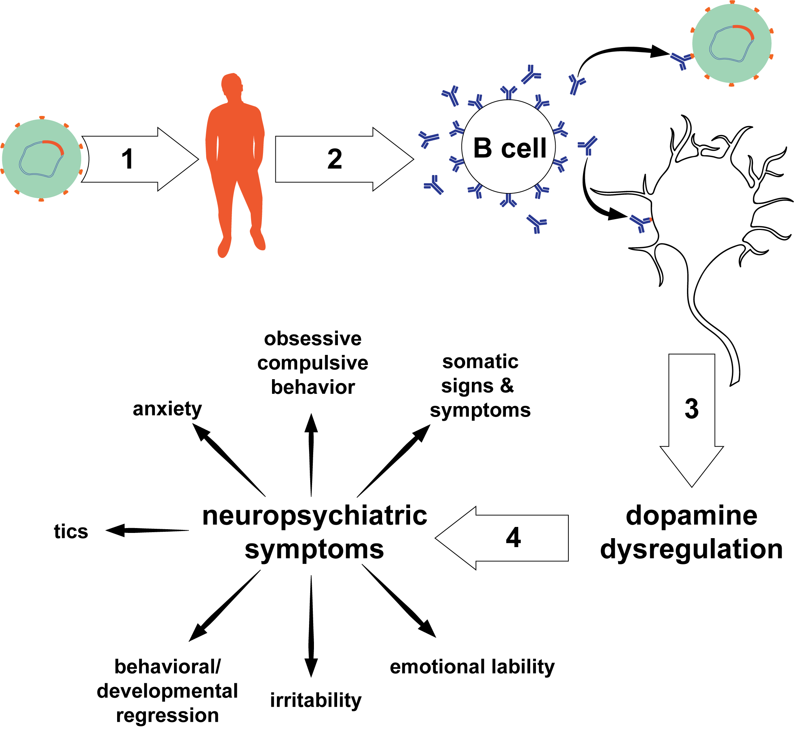
Shifting the Paradigm on Neuropsychiatric Impacts of Infections and Appropriate Treatments
Nicholas Hill
Notes:
Left figure: Depiction of conjugation adapted from ”Plasmid Driven Evolution of Bacteria” in Encyclopedia of Evolutionary Biology by Ridenhour and Top (2016). https://doi.org/10.1016/B978-0-12-800049-6.00237-7
Right figure: Neuropsychiatric symptoms portion adapted from From Research Subgroup to Clinical Syndrome: Modifying the PANDAS Criteria to Describe PANS (Pediatric Acute-onset Neuropsychiatric Syndrome) by Swedo, Leckman, and Rose (2012).

