Slide 1
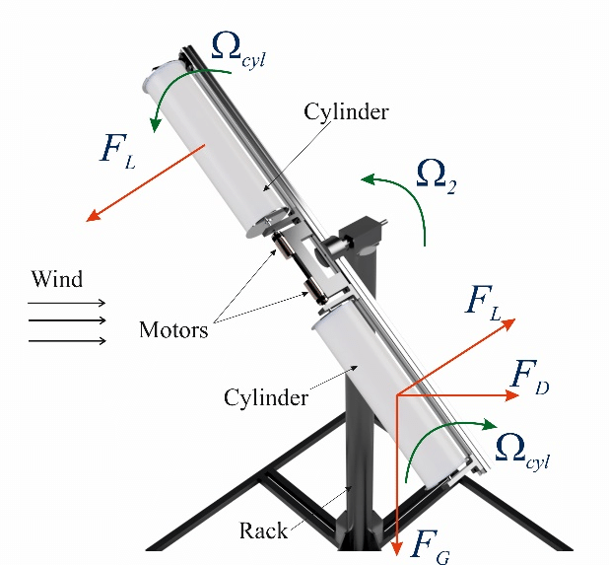
AIRFOIL ALTERNATIVE:
MAGNUS EFFECT FLETTNER ROTORCRAFT
Figure 2. Magnus Wind Turbine: Finite Element Analysis and Control System
Figure 1. Lift of a Rotating Cylinder
Notes:
Figure 1.
Note. From "Life of a Rotating Cylinder" by Nancy Hall, 2021, retrieved from https://www.grc.nasa.gov/www/k-12/airplane/cyl.html.
Figure 2.
Note. From "Magnus Wind Turbine: Finite Element Analysis and Control System" by Galina Demidova et al., retrieved from https://www.researchgate.net/figure/3D-vizualization-of-the-Magnus-Wind-Turbine_fig2_342410847.

