Slide 1
Exploring Elementary School Teachers’ Instructional Decisions on English Language Arts Strategies for English Language Learners: A Case Study
Tameika Hairston-Thomas Ed.D
Liberty University

Slide 2
Background
According to Jimenez-Castellanos & Garcia (2017), “English Language Learners (ELLs) are one of the fastest-growing K–12 populations across the nation.”
More than 4.9 million students were classified as being eligible for ELL accommodations during the fall of 2016 (National Center for Education Statistics [NCES], 2016).
According to Boyd-Batstone, (2016), “The tremendous variation within and among ELL populations makes it impossible to approach the schooling of ELLs with a “one size fits all approach.” Therefore, many educators are hindered in that they do too many or too little strategies that effect students academically.”
In 2015, the Education Department's office for civil rights issued a letter updating how districts should approach ELLs. Districts must use instructional practices and programs that are backed by scientific evidence and effective in helping students speak, listen, read, and write English and meet challenging state content standards. (Sparks,2016)

Slide 3
Problem Statement
The problem is that Fisherton Elementary Education teachers that teach ELL students have too many strategy choices and are overwhelmed with deciding, implementing, and evaluating the strategies.

Slide 4
Purpose Statement
The purpose of this qualitative case study was to determine the instructional strategies and decisions that educators choose, implement, and evaluate while teaching English Language Learners (ELL) during English Language Arts (ELA).

Slide 5
Method/Design
Participants (10)
Regular Education Teachers
Teachers at Fisherton ES
Regular Education teachers observed twice for 30 minutes during ELA with ELLs. Teacher derived artifacts used to instruct lessons to ELLs during ELA photographed at the end of the day. Semi-structured interviews using research questions held with each participant.
DATA COLLECTION
Observations
Photographed artifact retrieval
Semi-structured interviews w/pseudonyms (transcribed by Rev.com transcriptions reviewed by participants)
DATA ANALYSIS
Hand-coded through each data collection piece
Data placed into themes

Slide 6
Five Themes Emerged
Minimal or Nonexistent ESOL Support
Multiple Strategies
Need for ESOL Professional Development
Regular Classroom Teacher Experience vs. ESOL Teacher Experience
Diverse Learning Needs of ESOL Students

Slide 7
Data Identified Themes
Frequency of Identified Themes
Themes | Frequency from Observation | Frequency from Artifacts | Frequency from Interviews
Minimal or Non-Existent ESOL Support | 0 | 0 | 8
Multiple Strategies | 237 | 60 | 10
Need for ESOL Professional Development | 0 | 0 | 8
Minimal Regular Classroom ESOL Experience | 0 | 0 | 10 (7 regular class teachers with less than 10 years exp., 3 ESOL teachers with more than 10 years exp.)
Diverse Learning Needs of ESOL Students | 0 | 0 | 10

Slide 8
Theme 1: Minimal or Nonexistent ESOL Support
Throughout the interviews, the participants indicated that the level of support was either minimal or non-existent.
Participants repeatedly expressed that they wanted or needed more support from the ESOL teachers assigned to them during ELA.
If the regular education teacher did not have an ESOL certification, they could expect 60 minutes of ESOL support daily from a push-in ESOL support teacher.
Kelvin reports, “I guess I get support; she comes in during science and social studies.”
Teachers noted that their ESOL support services were often interrupted and affected due to ACCESS testing (a required summative assessment that assesses academic English language) and other commitments of the ESOL teachers.

Slide 9
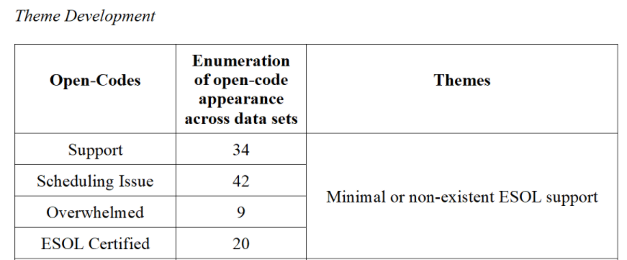
Theme 1: Development

Slide 10
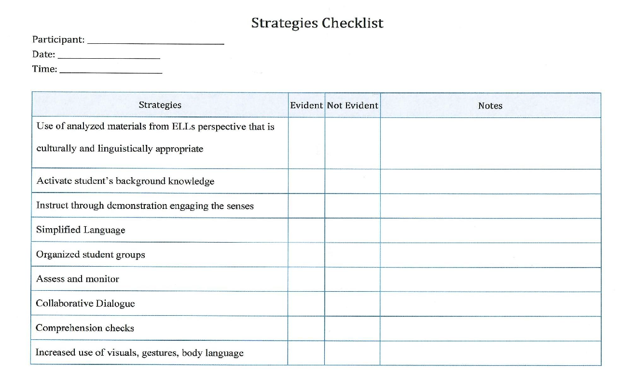
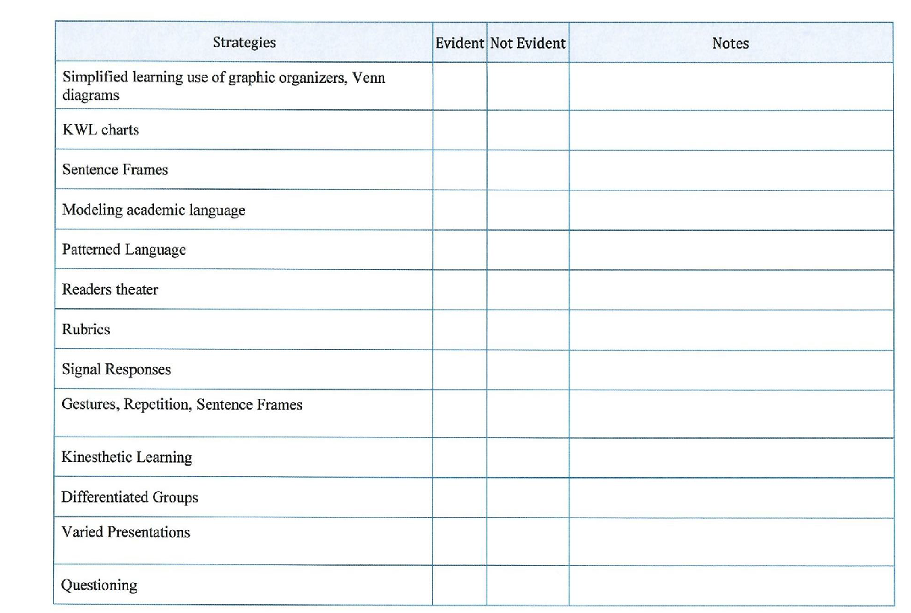
Theme 2: Multiple Strategies
There has been no previous research encompassing 25 strategies identified by Marzano’s (2009) high yield outcomes for ELLs along with SDAIE & GO TO Strategies (Professional Learning Board, 2020) within ELA.
Throughout all the observations, it was evident that teachers were diligently dedicated to utilizing multiple strategies to assist students with their educational barriers during ELA.
Each teacher was eager to work with students and have students display their knowledge and passion for ELA through listening, reading, writing, and speaking English.
Checklist of 25 research based strategies used during observations

Slide 11
Theme 2: Development

Slide 12
Theme 3: Need for ESOL Professional Development
Massey stated: “At our school, there's a large ESOL population, so I think that professional development should be something that is continuous but also innovative.”
Chell indicated how she has gained ESOL knowledge as an educator at FES: ”I guess just by attending different county professional developments, just going back to school, reading more and I guess the best one that would say was just in the classroom experience, the kiddos will let you know what they need just by observing your kiddos.”
Teachers at FES has a desire to receive a solutions-based curriculum or innovative training that precisely reaches the needs of the diverse learners they are teaching.
SDAIE & GO TO Strategies – Marzano’s research-based strategies.
Notes:
GO TO strategies & SDAIE – Marzano’s research-based strategies.

Slide 13
Theme 3: Development

Slide 14
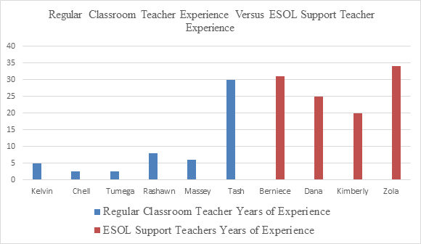
Theme 4: Regular Classroom Teacher Experience vs. ESOL Teacher Experience

Slide 15
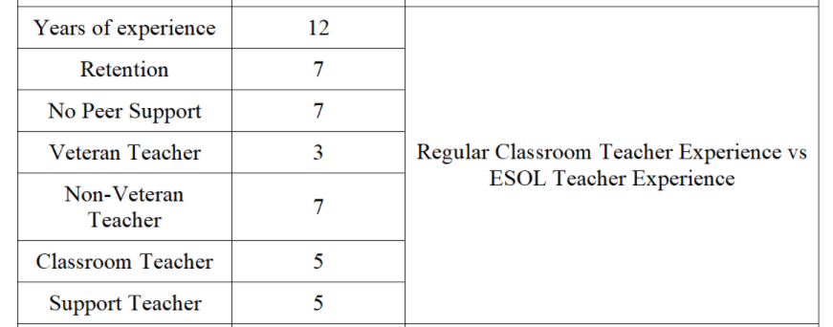
Theme 4: Development

Slide 16
Theme 5: Diverse Learning Needs of ESOL Students
Teachers indicated that though they have a high commitment, the various needs of the learners are often overwhelming.
Several teachers observed, appeared to be juggling the many needs of the learners while taking anecdotal notes. While trying to maintain focus then considering the next steps for each learner.
While conducting the observations of the ten teachers. It was observed various, differentiated small groups were observed.
Zola stated, “Well, you have to know what each child can do. You have to know the students already.”
Teachers continually indicated how they manage the diverse needs : personal knowledge of the students' academic needs, WIDA scores, being culturally responsive and supporting confidence building with each learner.

Slide 17
Theme 5: Development

Slide 18
The Central Question
Central Question
How do elementary teachers at FES choose, implement, and evaluate instructional strategies during ELA with ELL students?
Findings
Teachers at FES choose their instructional strategies in various ways during ELA.
When teachers implement their chosen strategies, they use their professional judgment, previous professional development, along with the guidance of their lesson plans to implement the chosen strategies.
After implementation, teachers are less strategic in evaluating the efficacy of their chosen strategies.
Research Sub Questions
How do FES teachers choose instructional strategies during ELA while teaching ELL students?
How do FES teachers implement instructional strategies during ELA while teaching ELL students?
How do FES teachers evaluate the instructional strategies used for instructing ELL students?

Slide 19
Empirical Implications
The empirical implications of this study are that teachers are challenged with choosing and employing too many strategies during ELA to teach ELL students (Robertson, 2019).
My research confirms the related literature and therefore supports previous findings and expands the researchers' conclusions confirming the use of multiple strategies. (Mozingo, 2017).
My research fills a gap in the related literature as no previous research has focused on ELA teachers instructing ELLs while using Marzano's (2009) 25 high yielding strategies and SDAIE & GO TO Strategies (Professional Learning Board, 2020).
My research contradicts three findings from the related literature (Cruz & Thornton, 2008; Akuma & Callaghan, 2018; Levine et al., 2013) The KWL, timelines, and rubrics.
Further research needs to be conducted to determine why these strategies were not employed or to reconcile the contradictions of these findings.

Slide 20
Theoretical Discussion
Empirical Discussion
Bruner’s (1986) constructivism theory grounded this study because it embodies learning as a methodical process facilitated through insightful instruction.
A tenant of this theory is that instruction needs to be represented in three different modes actions, icons, and symbols (Bruner, 1986).
Teachers used actions equivalent to instructing through engaging the senses, kinesthetic learning, and increased use of visuals, gestures, and body language.
This study concurs with prior findings in which numerous strategies are evident and employed by teachers during ELA for ELL students ( Mozingo, 2017).
In Greenfader and Brouillette (2017), case study teachers were provided a two-year-long professional development within elementary arts and literacy for ELLs.
There were findings in my study that contradicted the findings of Cruz and Thornton (2008) and Marzano (2009). Both researchers indicated that the use of: “What you know”, “What you want to know”, “What you learned (KWL)” charts as essential strategies to enhance learning.
This qualitative study adds to the related literature because it revealed how ELL teachers choose, implement, and evaluate the multiple strategies during ELA.

Slide 21
Practical Implications for Teachers
The practical implications of this study indicated that teachers at FES should develop collaborative ELA teacher leader teams.
Streamlining and evaluating the most effective research-based instructional strategies to employ during ELA along with answering the "why" and "how" of particular strategies for their specific grade levels (Lupinsky et al., 2012, p. 81).
Specific ESOL support during ELA because of its multiple demanding components teaching ELL students.
Receive training strategically focused for the needs of teachers & students at FES to specifically support ESOL student's reading, writing, and speaking skills within ELA.

Slide 22
Practical Implications for Administrators
Fund and hire additional ESOL teachers - 1:1 13 students to a smaller load with a possible ratio of 1:50
Configure the schedules of the ESOL support staff to indicate that each classroom teacher receives a minimum of 90 minutes (about one and a half hours) of direct ELA support weekly.
The administration can use these findings to allocate ongoing and intentionally focused quarterly ESOL academic and cultural sensitivity awareness training for all staff members.
Provide substitutes and stipend to staff that complete all the in-service professional developments.
Administrators can implement quarterly ESOL parent-teacher conferences.
Parents can be offered bilingual instruction that models grade-level specific ELA lessons using streamlined strategies tailored to the specific needs of their ESOL child.
Notes:
ThesThese findings provide regular classroom and ESOL teachers firsthand experiences of choosing, implementing, and evaluating multiple strategies as they juggle the instructional practices needed to facilitate learning during ELA to ESOL learners.e findings provide regular classroom and ESOL teachers firsthand experiences of choosing, implementing, and evaluating multiple strategies as they juggle the instructional practices needed to facilitate learning during ELA to ESOL learners.

Slide 23
Future Research
Influx of immigrants into the United States, the need for ELA and ELL programs will continue to escalate ( Jimenez-Castellanos & Garcia 2017).
Future research on choosing, implementing, and evaluating multiple strategies during ELA to ELL should be conducted in all academic settings that have ESOL populations.
Private or public-school systems and in multiple settings.
Replicated with a phenomenological approach to pre-k through 12^{th-}grade instructional settings within regular education teachers who instruct ELA to ELL.

Slide 24
Questions & Answers

Slide 25
References
Akuma, F. V., & Callaghan, R. (2018). Teaching practices linked to the implementation of inquiry‐based practical work in certain science classrooms. Journal of Research in Science Teaching, 56(1), 64-90. doi:10.1002/tea.21469
Boyd-Batstone, P. (2015). Teaching ELLs to read. New York: Routledge.
Bruner, J.S. (1986). Actual minds. Possible worlds. Cambridge, MA: Harvard University Press.
Cambridge Assessment International Education (2020). Retrieved August 23, 2020, from https://www.cambridge-community.org.uk/professional-development/gswrp/index.html
Cline, Z., & Necochea, J. (2003). Specially designed academic instruction in English (SDAIE): More than just good instruction. Multicultural Perspectives, 5(1), 18–24. doi: 10.1207/s15327892mcp0501_4
Cruz, B. C., & Thornton, S. J. (2008, November). Social studies for all: ESOL strategies for the elementary classroom. Retrieved August 23, 2020, from https://www.socialstudies.org/social-studies-and-young-learner/21/2/social-studies-all-esol-strategies-elementary-classroom
Dean, C. B., & Marzano, R. J. (2013). Classroom instruction that works: research-based strategies for increasing student achievement. Retrieved from https://web-a-ebscohost-com.ezproxy.liberty.edu/ehost/ebookviewer/ebook/bmxlYmtfXzc5NTc2X19BTg2?sid=fadb888e-9d80-453d-a33c-d6f50dccc491@sdc-v-sessmgr02&vid=0&format=EB&rid=1
Greenfader, C. M., & Brouillette, L. (2017). The arts, the common core, and English language development in the primary grades. Teachers College Record, 119(8), 1-38. Retrieved August 23, 2020, from http://www.tcrecord.org.ezproxy.liberty.edu/Content.asp? ContentId=21915
Jiménez-Castellanos, O.H., & Garcia, D. (2017). School expenditures and academic achievement differences between high-ELL-performing and low-ELL-performing high schools, Bilingual Research Journal, 40:3, 318-330, DOI: 10.1080/15235882.2017.1342717
Levine, L. N., Lukens, L., & Smallwood, B. A. (2013). The go to strategies: Scaffolding options for teachers of English language learners, K-12. For Project EXCELL, a partnership between the University of Missouri- Kansas City and North Kansas City Schools, funded by the US Department of Education, PR Number T195N070316. Available online at www.cal.org/excell
Mathew, P., Mathew, P., & Peechattu, P. J. (2017). Reflective practices: A means to teacher development. Asia Pacific Journal of Contemporary Education and Communication Technology (APJCECT), 3(1), 126-131. Retrieved August 23, 2020, from https://apiar.org.au/wp-content/uploads/2017/02/13_APJCECT_Feb_BRR798_EDU-126-131.pdf
Mozingo, T. H. (2017, March 20). Tips for teachers: Promoting the achievement of English learners. Retrieved August 23, 2020, from https://www.acps.k12.va.us/cms/lib/VA01918616/Centricity/Domain/801/Teaching%20Tips%20for%20Teachers%20Vol.%204.pdf
National Center for Education Statistics (NCES) Home Page, part of the U.S. Department of Education. (2018, May). Retrieved December 6, 2019, from https://nces.ed.gov/programs/coe/pdf/Indicator_CGF/coe_cgf_2018_05.pdf
OCDE project GLAD strategies. The New Educator, 13(2), 148-159. doi:10.1080/1547688x.2016.1144123
Professional Learning Board (2020, January). Retrieved June 9, 2020, from https://k12teacherstaffdevelopment.com/tlb/what-are-sdaie-strategies/
Robertson, K. (2019, May 02). No child left behind and the assessment of English language learners. Retrieved August 23, 2020, from
https://www.colorincolorado.org/article/no-child-left-behind-and-assessment-english-language-learners

