Slide 1
Black Men’s Perspectives On Their Student-Faculty Relationships In Higher Education:
A Phenomenological Study
By: Tyson Askew, Ph.D.

Slide 2
Problem Statement
The research problem was higher education is the gateway to success; however, there is a continued problem with Black men not attending college, and when they do, they are not persisting through degree completion (Farmer & Hope, 2015).

Slide 3
Purpose Statement
The purpose of this phenomenological study was to explore the perspectives of Black men’s student-faculty relationships in higher education in the United States.

Slide 4
Theoretical Framework
Noddings’ (1984) Ethics of Care
-the longing for goodness experienced or found in one’s memory of being cared for.
Noddings (1984) described the ethics of care as "encounters between teachers and students in the here and now hence with what we call contact" (Korthagen, Attema-Noordewier, & Zwart, 2014, p. 24).

Slide 5
Method/Design
Participants (13)
  Facebook social media group BGM (Pseudonym)
Data Collection
  Interviews
  Focus Groups
  Documents
Transcribed
  Temi
  Participants reviewed transcription
Data Analysis
  Qualitative Data Analysis Software (QDAS) – Nvivo
  Hand-coding
  Data placed into themes

Slide 6
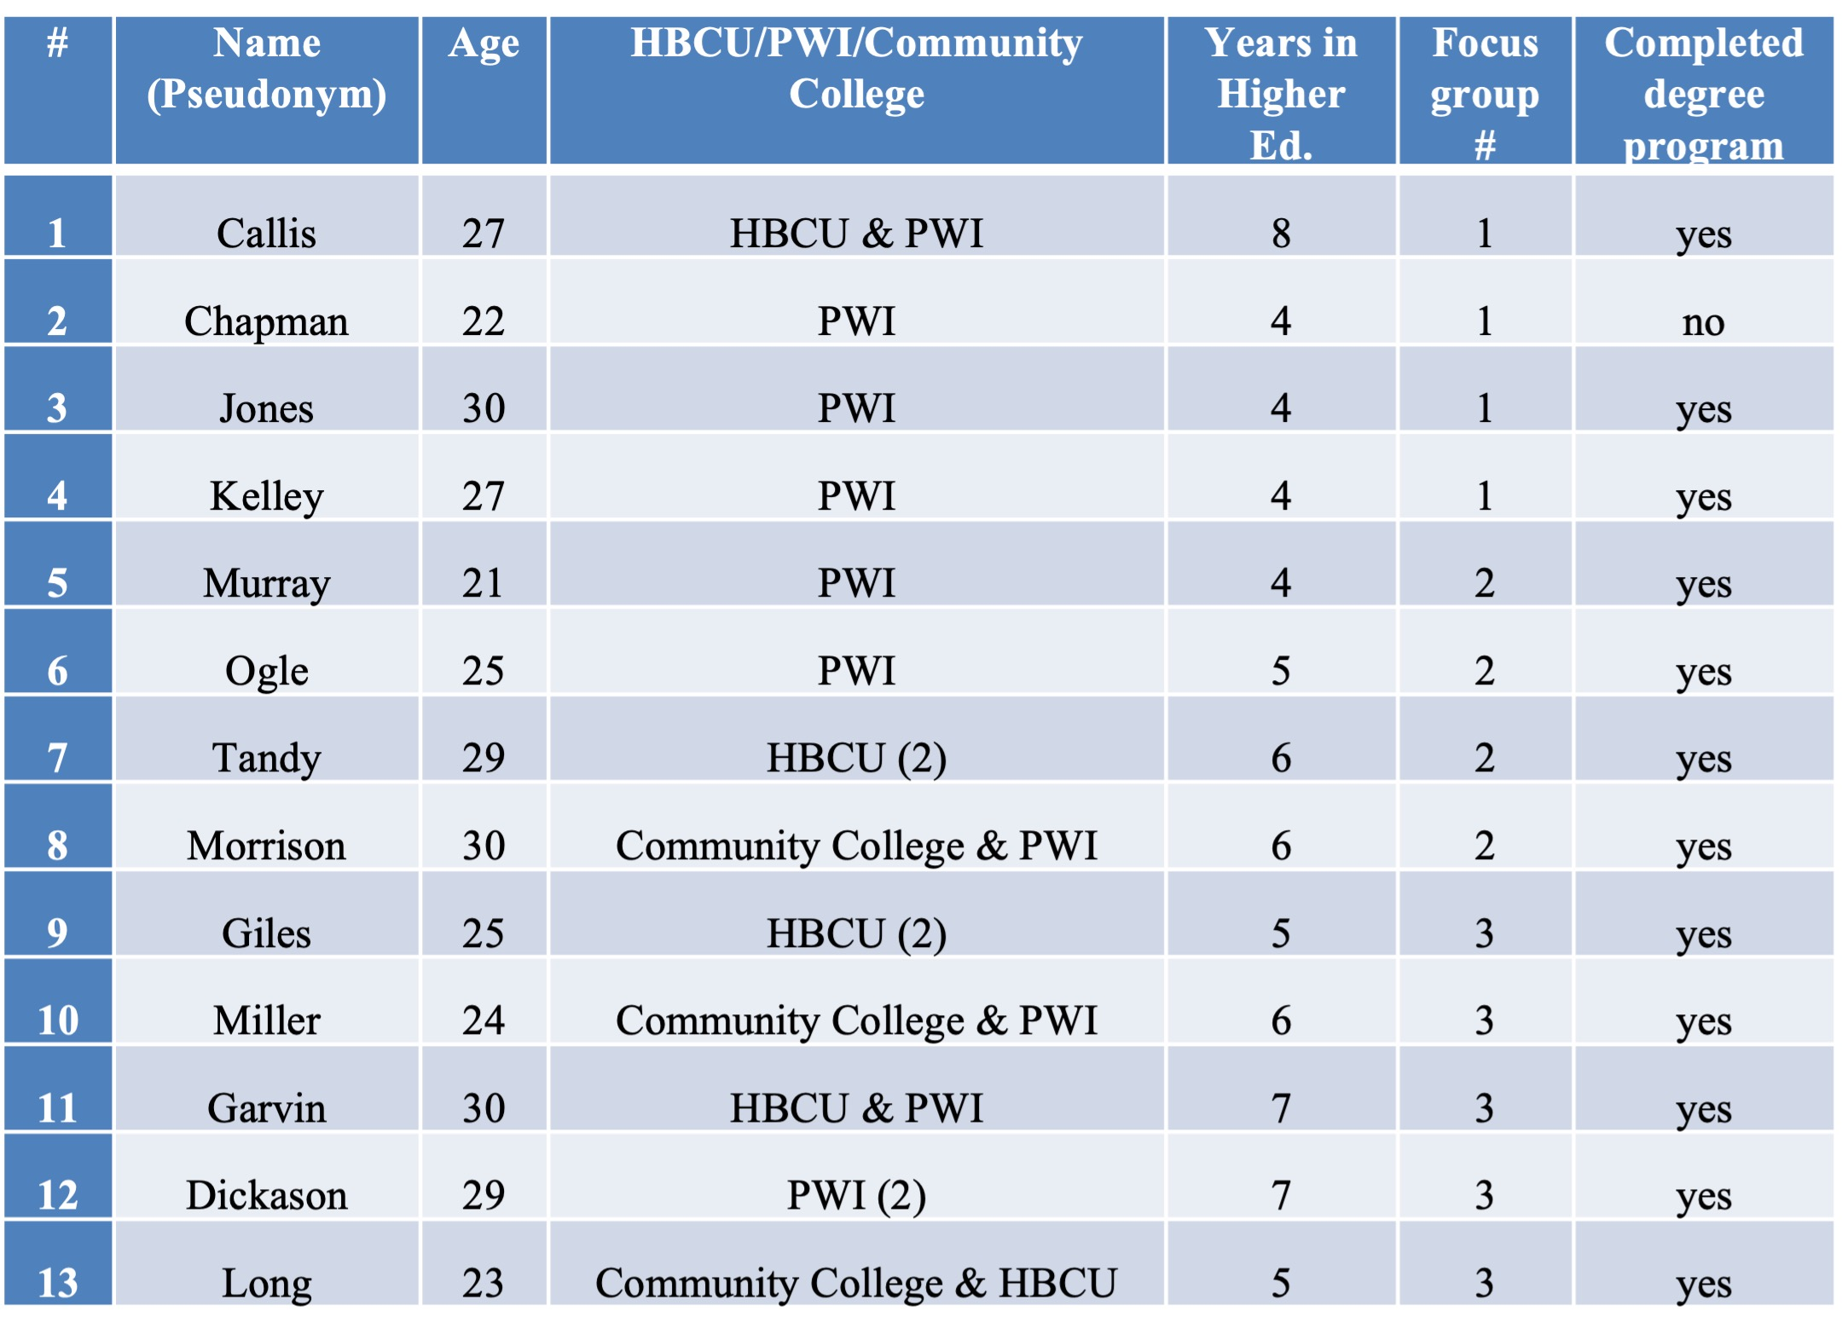
Participant Information

Slide 7
Theme 1: Security of Black Males (SQ3)
Sub-Themes
  Physical Environment
  Emotional Security
  Security with Faculty
  Culture
“I’ve felt very attacked by faculty of the opposite race. I believe it was either because of my intelligence or simply because I was Black. For me, this came from observing how my White faculty would interact with White students. It was more organic, relatable, and just natural in conversation; meanwhile, my conversations with the same faculty were strictly academic and far and in-between. With my Black faculty, I felt safer simply put.”

Slide 8
Theme 2: Desirable Student-Faculty Relationships (CQ)
Sub-Theme
  Parental Role
“…it would be nice to say that I had many relationships with my professors, but I can only say that I remember having a meaningful, fruitful, deliberate, and purposeful relationship with only one …and she was a Black woman who acted much like my mother. She cared for me, and I believed she loved me. She reminded me of my real mother back home.”

Slide 9
Theme 3: Essential Care (SQ1 & SQ2)
Sub-Theme
  Communication
“I felt cared for when my faculty actually talked to me about things that did not necessarily concern work. It was comforting to know that they cared about me as a person outside of my assignments.”

Slide 10
The Central Question
How do Black males describe their relationships with their faculty in higher education?
  Black males described their relationships with their faculty in higher education as either non-existent or a relationship that is built on the foundation of care (Theme 2).

Slide 11
SQ1
How do Black males describe the element of care in their student-faculty relationships in higher education?
  Black males described the element of care as an essential component for student-faculty relationships in higher education (Theme 3).

Slide 12
SQ2
What are Black male's expectations in their student-faculty relationships?
  Black males revealed that they expect to have relational connections based on care and trust with an overall sense of belonging (Theme 3).

Slide 13
SQ3
How do Black males describe the effect of their student-faculty relationships in higher education?
  Black males described the effects of their student-faculty relationships as feelings of thankfulness, achievements, and gratitude (Theme 1).

Slide 14
Theoretical Discussion
Care influences retention and graduation rates (Noddings, 1992).
Care is the bedrock from student success (Noddings, 1992).
Care equals student motivation and graduation (Hawk, 2017; Noddings, 1992; Lucey & White, 2017).
Care is a necessary for student-faculty relationships (Noddings,1984).
Participants agree.

Slide 15
Empirical Discussion
Education can change the lives of Black male students (Hawk, 2017; Goings & Bianco, 2016; Hawley & Flint, 2016; & Peart, 2018).
Institutions should formulate plans for connecting Black males to faculty (Quinlan, 2016; Roberts, 2018; Warren & Bonilla, 2018; Young, 2019; Askew, 2020).
Understanding Black males raise retention rates (Quinlan, 2016; Roberts, 2018; Warren & Bonilla, 2018; Young, 2019; Askew, 2020).
Participants agree.

Slide 16
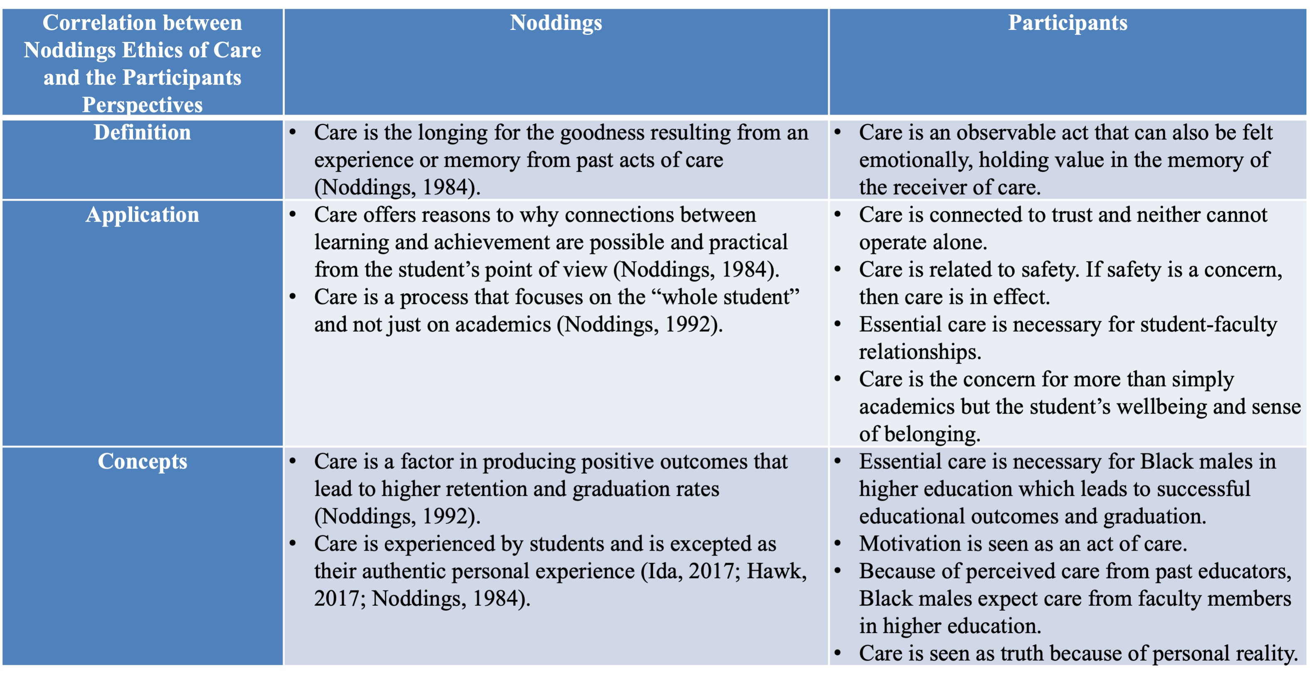
Correlation between Noddings (1984) Ethics of Care Theory and the Participants Perspectives

Slide 17
Theoretical Implications
Uniquely applies the ethics of care theory exclusively on Black males.
Ethics of care theory has a distinction between “caring for” and “caring about” (Hawk, 2017).
Care is expressed through actions.

Slide 18
Empirical Implications
Importance of student-faculty relationships, Black males in higher education, and the retention and graduation rate among Black males.
Social, emotional, and academic skills are benefits of student-faculty relationships (Koca, 2016).
Limited research on the lived experiences of African American men (Farmer & Hope, 2015).
The goal is to help Black males through their education (Xerri et al., 2018 & Strayhorn, 2017).

Slide 19
Practical Implications
Allow Black males to share (Strayhorn, 2008, Sointu, Savolainen, Lappalainen, Lambert, 2017; Nicholas, 2016; Quin, 2017).
Evaluate diversity, equity, and inclusion (DEI) programs effectiveness, relevance, and accountability measures.
Askew’s (2020) Hierarchy of Student Needs

Slide 20
Delimitations
Participants had to be a member of the Facebook group Black Good Men
Participants had to be a Black male between the ages of 18-30.
Participants must have attended a higher educational institution in the United States for at least two years.
Participants had to be a U.S. Citizen.

Slide 21
Limitations
Only Black men, however, undergrad or graduate students.
Study only had 13 participants so there was a limited view.

Slide 22
Future Research
What is the faculty’s perspective on student-faculty relationships?
Study replicated to one specific institution
Using a qualitative methodology
Identify the Black woman’s perspective

Slide 23
Questions?

Slide 24
References
Anderson, V., Rabello, R., Wass, R., Golding, C., Rangi, A., Eteuati, E., Bristowe, Z. & Waller, A. (2020). Good teaching as care in higher education. Higher Education, 79(1), p. 1-19.
Askew, T. J. (2020). Neglected prospects: Developing the lost are of teacher-student relationships. Detroit, MI: University of Moguls.
Farmer, E., & Hope, W. (2015). Factors that influence African American male retention and graduation: The case of gateway university, a historically Black college and university. Journal of College Student Retention: Research, Theory & Practice, 17(1), 2–17.
Goings, R. B., & Bianco, M. (2016). It's hard to be who you don't see: An exploration of black male high school students' perspectives on becoming teachers. The Urban Review, 48(4), 628-646.
Hanson, M. (2021). College dropout rates. https://educationdata.org/college-dropout-rates.
Hawk, T. F. (2017). Getting to know your students and an educational ethic of care. Journal of Management Education, 41(5), p. 669-686.
Hawley, J. D., & Flint, S. L. (2016). It looks like a demon: Black masculinity and spirituality in the age of Ferguson. The Journal of Men's Studies, 24(2), p. 208-212.

Slide 25
References
Koca, F. (2016). Motivation to learn and teacher-student relationship. Journal of International Education and Leadership, 6(2), p. 1-20.
Korthagen, F., Attema-Noordewier, S., & Zwart, R. (2014). Teacher-student contact: Exploring a basic but complicated concept. Teaching and Teacher Education, 40, p. 22-32.
Lucas, Y. (2018). Support structures: Challenges and potential solutions toward persistence in earning a baccalaureate degree for Black male students attending predominantly white institutions. Journal of Business Diversity, 18(1).
Lucey, T. & White, E. (2017). Mentorship in higher education compassionate approaches supporting culturally responsive pedagogy. Multicultural Education, vol. 24, p.11-17.
Nichols, R. L. (2016). One African male in higher education. Multicultural Learning and Teaching, 11(2), 197–214.
Noddings, N. (1984). Caring: A feminine approach to ethics and moral education. Berkeley: University of California Press.
Noddings, N. (1992). The challenge to care in schools. New York, NY: Teachers College Press.
Palmer, R. T., Wood, J. L., Dancy, T. E., & Strayhorn, T. L. (2014). Black male collegians: Increasing access, retention, and persistence in higher education. San Francisco, CA: John Wiley & Sons.
Patterson, D., Perkins, J., Butler-Barnes, S., & Walker, T. (2017). Social belonging and college retention: Results from a quasi-experimental pilot study. Journal of College Student Development, 58(5), 777-782.
Peart, S. (2018). The significance of further education for black males. Education Training, 60(6), p. 544-555.

Slide 26
References
Quin, D. (2017). Longitudinal and contextual associations between teacher–student relationships and student engagement: A systematic review. Review of Educational Research, 87(2), 345–387.
Quinlan, K. (2016). How emotion matters in four key relationships in teaching and learning in higher education. College Teaching, 64(3), 101–111.
Roberts, J. (2018). Professional staff contributions to student retention and success in higher education, Journal of Higher Education Policy and Management, 40(2), p. 140-153.
Sointu, E., Savolainen, H., Lappalainen, K., & Lambert, M. (2017). Longitudinal associations of student-teacher relationships and behavioral and emotional strengths on academic achievement. Educational Psychology, 37(4), 457–467.
Strayhorn, T. (2008). The role of supportive relationships in facilitating African American males’ success in college. NASPA Journal, 45(1), p. 26-48.
Strayhorn, T. (2017). Factors that influence the persistence and success of Black men in urban public universities. Urban Education, 52(9), 1106–1128.
Strayhorn, T., Lo, M., Travers, C., & Tillman-Kelly, D. (2015). Assessing the relationship between well-being, sense of belonging, and confidence in the transition to college for Black male collegians. Spectrum: A Journal on Black Men, 4(1), p. 127-138.
Warren, C. & Bonilla, C. (2018). Care and the influence of student-adult stakeholder interactions on young Black men's college aspirations. Multicultural Perspectives, 20(1), p. 13-24.
Xerri, M., Radford, K., & Shacklock, K. (2018). Student engagement in academic activities: A social support perspective. Higher Education, 75(4).

