Slide 1
China Containment in East Asia
Rachel Solsman

Slide 2
Origin of American Alliances
Japan
South Korea
The Philippines
Taiwan
Figure 1. A map of Southeast Asia. (Photograph from World Map, Download Free Printable Southeast Asia Map, July 30, 2018, https://worldmapwith countries.net/2018/07/30/southeast-asia).

Slide 3
History of China’s Rise
Century of Humiliation
Modern-Day China
American Response
Figure 2. A map of the Chinese Belt and Road Initiative. (Photograph by Mercator Institute for China Studies, BRI Map, November 27, 2019, https://www.cbc.ca/ news/world/china-belt-and-road-cbc-1.5372916).

Slide 4
Benefits and Costs of Alliances
Japan
South Korea
The Philippines
Taiwan
Cohesive Alliance Strategy
Figure 3. Scales. Image by Clipart Library. http://clipart-library.com/clipart/ 1931875.htm.

Slide 5
Chinese Containment
Definition
Military Containment
Geo-Economic
Benefits
Costs
Figure 4. A metaphor for the fight between the US and China. (Photograph by Shutterstock, U.S. China boxing gloves, April 30, 2014, https://thediplomat.com/2014/05/the-us-china-and-the-containment-trap).

Slide 6
Analysis
Alliance Strategy
Commitments
Geo-Economic Strategy
Competition
Figure 5. A depiction of relations in the Asia-Pacific. (Photograph from Summer 2020 Global Attitudes survey, Unfavorable views of China prevail, October 6, 2020, https://www.pewresearch.org/global/ 2020/10/06/unfavorable-views-of-china-reach-historic-highs-in-many-countries).

Slide 7
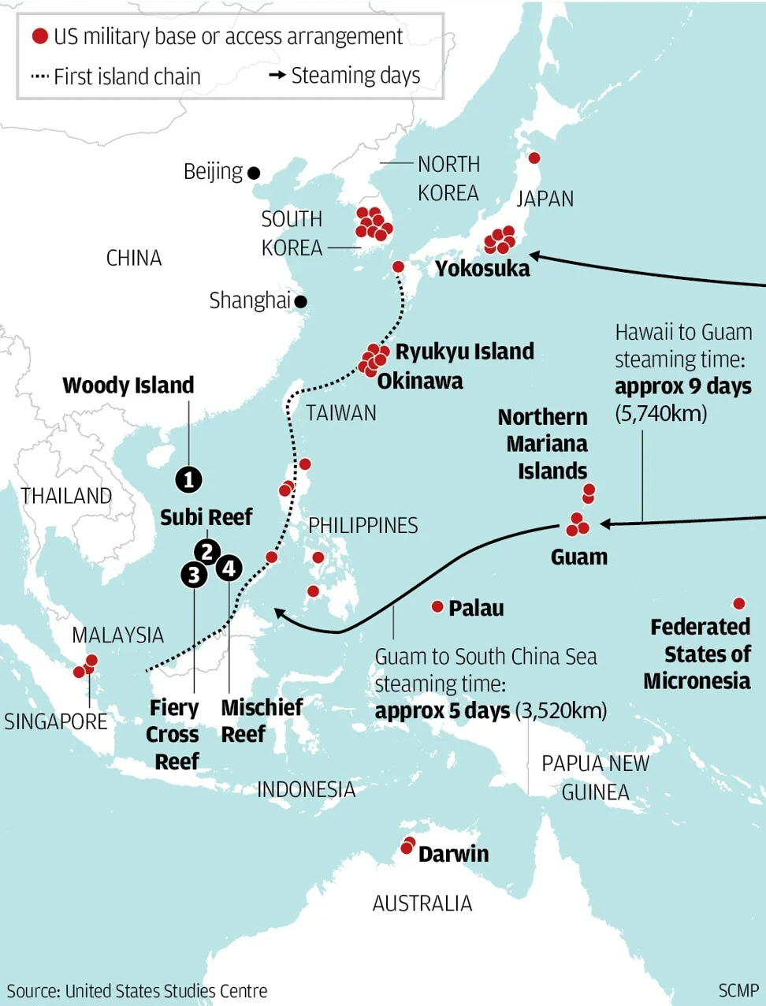
Recommendations
Japan
South Korea
The Philippines
Taiwan
Geo-Economics
Figure 6. A map of the military bases in East Asia. (Photograph from Indo-Pacific News, Southeast Asia, September 19, 2020, https://twitter.com/ IndoPac_Info/status/1307285252176408577).

Slide 8
Questions?

