Slide 1

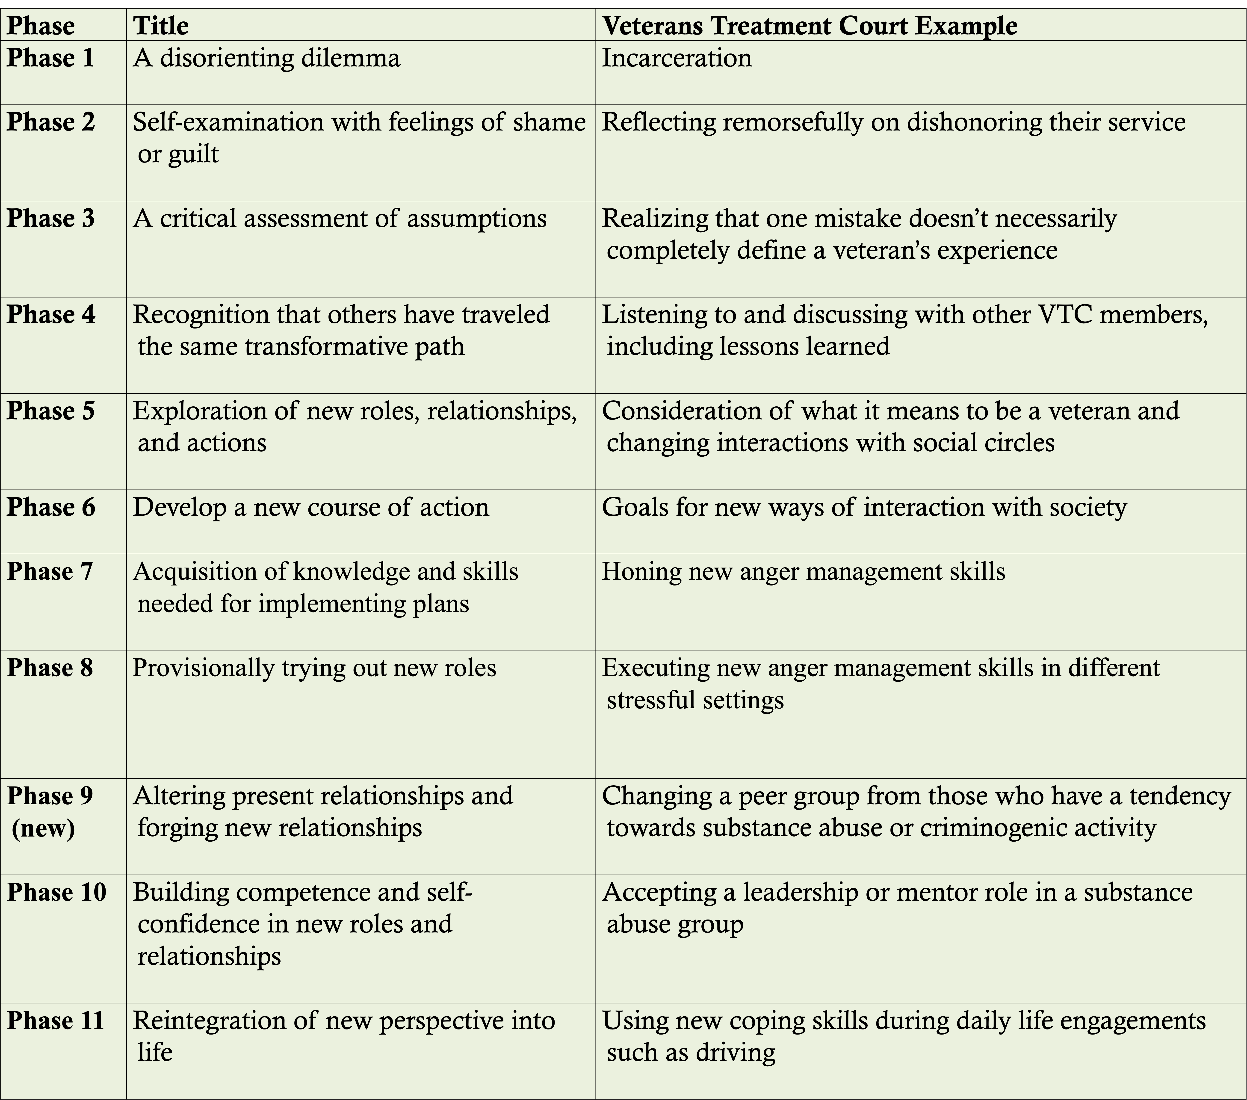
Transformational Learning in a Veterans Therapeutic Court
T Lee Williams, PhD, Col (ret), USAF, PMP
Abstract
Results and Conclusions
Abstract
This qualitative case study describes the transformative learning journey of justice-involved veterans assigned to one of Washington State’s veterans therapeutic courts (VTCs). VTCs are one of several therapeutic jurisprudence models, based upon Wexler and Winnick’s work using direct and tailored engagement between the judge and the defendant (1991). Notably, veterans therapeutic courts are designed to help justice-involved veterans break their criminogenic cycle (e.g., reduce recidivism), but VTC efficacy is still debated and, thusly, served as a genesis for this work. The guiding theory for this study was Mezirow’s theory of Transformational Learning (Mezirow, 1994). When applied to other modalities, transformational learning has proven effective in changing counter-societal behavior, but Mezirow’s work has not been applied against VTCs. Examples of how the veteran’s veterans therapeutic court journey can be mapped against Mezirow’s stages can be found in the “Key Transformational Phases and Phrases” chart (Figure 1). Further, when compared against seven other prominent adult learning theories, Mezirow’s was optimally positioned when evaluating personal transformation and the universality of application to the population (Casebeer & Mann, 2017). So, Mezirow’s theory was used to evaluate if veteran transformative learning indeed occurred in a Washington State VTC.
Results
The study confirmed that transformative learning did indeed occur during the veterans therapeutic court journey and three key themes emerged. First, that relationships, familial and extra-familial, were critical to the veteran’s transformative learning journey. Specifically, the veteran considered what relational actions needed to be started (e.g., with children the veteran had neglected due to prioritizing substance abuse as Ken had done), stopped (e.g., cleaving a relationship with a using, toxic sibling as Hailey had to do), or continued (with a loving, but non-enabling parent as Ken discovered). Further, strong relationships extended beyond family as in the military. Noted non-familial crafted relationships included members of the judicial system including the judge and probation officer, mentors, and even pets. For example, 20% of the veterans interviewed mentioned but for their dogs, they would have committed suicide. The second key finding was vision-casting, which allowed the veterans to be able to see themselves successfully completing the VTC program. Whether this vision was internally or externally (e.g., mentors or court officials) generated, it was an essential component for the veteran’s successful transformational learning journey. The third key finding was a focused rebluing, where life coping skills, including both abilities and knowledge, that had been cultivated previously but neglected or “rusted”, were reengaged and practiced. Such reengagement enabled the veterans’ successful transformative learning journey. As Gina put it, “I know one thing, the day that they took the oath …, what they felt. …. It's, it's given back to 'em freely, through the veterans court. Yeah. And I feel that pride now.” These three key findings adroitly captured the veterans transformative learning journey.
Conclusions
Transformative learning indeed occurred at this Washington State veteran therapeutic court. However, as with all qualitative studies extreme care must be taken when trying to apply the results to other populations. For instance, while this VTC was specifically chosen because it had a mentor program, and mentors were a key component for the veterans’ transformative learning journey, not all VTC programs in the state of Washington or more broadly across the United States offer a mentor program. Further, only veterans active in the program were interviewed. Since the completion of this study, several participants have graduated. However, Transformational Learning does not end with graduation. It would be interesting to conduct a more robust longitudinal study capturing the veteran’s post-VTC journey. For instance, a study laser-focused on a veteran’s journey after the veterans therapeutic court and recidivism, could prove beneficial While several studies tout the recidivism impacts of veteran therapeutic court programs, none were found that were able to withstand stringent academic analysis. Finally, veteran therapeutic courts are funded in different ways including public funding; additional studies, including recidivism, could provide helpful analysis of alternatives when evaluating various funding options for veterans therapeutic courts.
B
Introduction and Research Questions
Introduction
During their military service, veterans are often exposed to mental, physical, and moral trauma not experienced in civilian settings (Frankfurt & Frazier, 2016; Grimell, 2018; Gustavsen, 2016). If left untreated, such trauma, including Post Traumatic Stress Disorder (PTSD), can increase the risk of maladjustment behavior, substance abuse, and other other criminogenic activities. This study focused on the transformative learning experience of criminally charged military veterans who participate in veterans therapeutic courts (also called veterans therapy courts), a four-phase, two-year, program built on Wexler & Winnick’s Therapeutic Jurisprudence model (1991). The veterans therapeutic court is similar to other substance abuse courts, and focuses on breaking the veterans’ criminogenic cycle, balancing justice with therapy services the veteran earned while in uniform. Notably, even though Mezirow’s theory of Transformative Learning has been studied in several professional settings, and VTCs are one of the fastest growing treatment courts in the United States numbering over 400 (Douds & Hummer, 2019; McCall, et al., 2018), there has been no previous study to address the effects of Transformative Learning in a veterans therapeutic court. Finally, the number of steps associated with Mezirow’s Transformational Learning process has been progressively refined since its inception. Mezirow’s 11-step process (Kitchenham, 2008) was selected because one of the key steps (#9) addressed changing relationships, a noted challenge for substance abusers and military transition members.
Research Questions:
Central Research Question: What is the transformative learning experience of criminally charged military veterans who participate in veterans therapeutic courts?
Research Subquestions (SQ):
SQ 1: How do military veterans describe their self-perception relative to their veterans therapeutic court journey?
SQ 2: How do military veterans describe their belief system relative to their veterans therapeutic court journey?
SQ 3: How do military veterans describe their lifestyle habits relative to their veterans therapeutic court journey?
A
Figure 1. Key Transformational Learning Phases And Phrases.
Figure 2. Participant Demographics.
B
Figure 3. Competitive fitness advantage.
Quantification of fitness was based on the direct comparison of log CFUs of one species to another. There was a significant fitness advantage of group A, if not even more with group B through overcoming colonization resistance.
Future Work
This was the first exploration of the effects of transformative learning in veterans therapeutic courts. Based upon this work and boundary decisions made, and the recidivism discussion above, there are several potential pathways to expand this body of knowledge and help veterans. Potential actives could include:
Evaluate another key educational theory in the veterans therapeutic court setting.
Expand the study to include other Washington State veterans treatment courts.
Expand veterans therapeutic court participant pool to include graduates.
Compare veterans therapeutic court with mentor programs against those without mentor programs.
Evaluate veteran treatment courts through Creswell and Poth’s lens of other key qualitative modalities, such as a narrative study.
Figure 3: Data Mining Flowchart.
MG1655
B
1 2 3 4 5 6 7 8 9 10 11 12 13 14
Methods
A
B
Method:
The inductive analysis of the experiences of criminogenically-involved veterans, including potential countervailing explanations, followed the case study analytical protocols of Creswell and Poth (2018) and Yin (2018) as well as Saldaña (2016) and Braun and Clark (2006), by coding, chunking, and analyzing emergent, related, and significant themes. Specifically, to adroitly capture these veterans’ qualitative experiences, a criterion-based group of 23 justice-involved, volunteer Washington State VTC members were contacted and from these volunteers, 10 were selected to participate. Each of these 10 veterans, whose demographic information is recorded in “Participant’s Demographics” chart (Figure 2), were individually interviewed using open ended questions. Further, each participant was passively observed during their individual court sessions, and each veteran’s individual, court mandated reflection essay was analyzed. Then, the veteran’s transformational learning-related key words and phrases were coded, analyzed, and compared for emergent key themes. This methodology is captured in the “Data Mining Flowchart” (Figure 3). To ensure Thematic Saturation, tallies were kept whenever a veterans response mapped against a Transformative Learning stage, as shown in the “Thematic Saturation” chart (Figure 4), with “I” indicating an interview, “E” indicating a personal essay, and “O” indicating a court observation, allowing key triangulation of findings. While there was only one interview per veteran, there were often multiple observations and essays. If multiple date occurrences were captured, a number was paired with the type of data source (E or O) to enable clear traceability to the instance of data capture. Finally, recognizing my bias, I extensively used self-bracketing reflection help identify and inform any personal bias infused analysis.
References
Braun, V., & Clarke, V. (2006). Using thematic analysis in psychology. Qualitative
Research in Psychology, 3(2), 77–101.
Casebeer, D., & Mann, J. (2017). Mapping theories of transformative learning.
Cartographica, 52(3), 233–237.
Creswell, J. W. & Poth, C. N. (2018). Qualitative inquiry & research design:
Choosing among five approaches (4th ed.). Sage Publications.
Douds, A. S., & Hummer, D. (2019). When a veterans' treatment court fails:
Lessons learned from a qualitative evaluation. Victims & Offenders, 14(3), 322-
343.
Kitchenham, A. (2008). The evolution of John Mezirow's transformative learning
theory. Journal of Transformative Education, 6(2), 104-123.
McCall, J. D., Tsai, J., & Gordon, A. J. (2018). Veterans treatment court research:
Participant characteristics, outcomes, and gaps in the literature. Journal of
Offender Rehabilitation, 57(6), 384-401.
Mezirow, J. (1994). “Understanding transformation theory”, Adult Education
Quarterly, 44(4), 222-232.
Saldaña, J. (2016). The coding manual for qualitative researchers (3rd ed.). Sage.
Wexler, D. B., & Winick, B. J. (1991). Therapeutic jurisprudence as a new approach
to mental health law policy analysis and research. University of Miami Law
Review, 45, 979-1004
Yin, R. K. (2018). Case study research and applications: Design and methods (6th
ed.). Sage.
Figure 4: Thematic Saturation.

