Slide 1
Managing Depression in the Workplace
By Ben Mello

Slide 2
What is Depression
Depression is a serious medical illness that negatively affects how you feel, the way you act and how you think.
It causes sadness and loss of interest.
This mental illness affects one in 15 adults every year.
Depression can lead to suicide.

Slide 3
Depression in the United States
In the year 2022 Depression in youth has increased from 9.2% to 9.7% in the U.S.
From the year 2016, 19% of adults experienced mental illness, which is an increase of 1.5 million adults from the previous year
Ever since 2015, 4.3% of Adults have reported having suicidal thoughts.
Around 60% of youths that suffer from depression received no health treatment last year.
In 2021, the percentage of adults with mental illness that are uninsured increased for the first time since the Affordable Care Act (ACA).

Slide 4
Depression in the workplace
Depression is in the top three workplace problems for employee assistance professionals.
Depression costs 51 billion dollars from absenteeism and loss of productivity yearly.
Depression usually affects people in their prime working years and can last a lifetime without treatment.
More than 80% of people with depression can be treated.

Slide 5
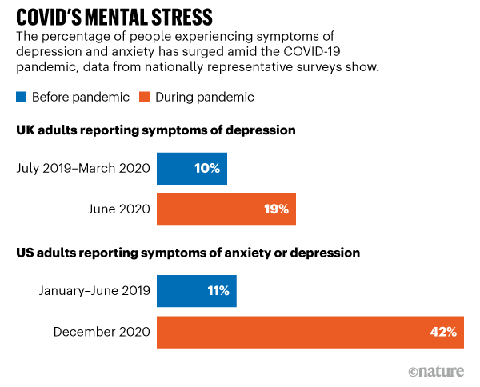
How Covid has affected Depression
Covid-19 has tripled the depression rate among all demographic groups.
More than 42% of individuals surveyed by the US Census Bureau reported symptoms of depression or anxiety.
Source: Office for National Statistics (UK data); Centers for Disease Control and Prevention (US data)

Slide 6
How to Recognize Depression in the Workplace
Employees keep to themselves more often.
Individuals are absent from work or miss meetings.
Workers have difficulty concentrating on work.
Employees frequently in a sad or anxious mood.

Slide 7
What to do about it
Management learns more about depression and educate staff.
Management sets up resources for those suffering (telephone contacts, referrals to help like counselors and psychotherapy, and human resources).
Management talks to staff, but does not diagnose.
HR professional improves work conditions by adding ecotherapy techniques like plants, animals, more personalized workspace, and healthy food options.

Slide 8
What to do about it Cont.
Management offer more flexible scheduling.
Management break up bigger tasks to avoid overwhelming staff.
Employees effectively communicate to each other.
Management and leadership must be prepared to act quickly.

Slide 9
Diving Into Ecotherapy
Ecotherapy is the practice of using nature to boost healing and growth.
One pro of ecotherapy is that it targets mental health.
Putting ecotherapy into action looks like implementing plants, more personalized workspace, healthy foods, or adding more windows.
Management can Include outdoor activities that encourage teamwork.
Notes:
nature therapy or green therapy

Slide 10
Benefits of Ecotherapy
Ecotherapy improves mental health.
It can boost self-esteem.
This method assists individuals returning to work.
Ecotherapy improves physical health.
It can reduce social isolation.
Notes:
Kras, N. (2021). Exploring the benefits of ecotherapy-based activities at an urban community college. Community College Journal of Research and Practice, 45(2), 117-123. https://doi.org/10.1080/10668926.2019.1647902

Slide 11
Benefits of Ecotherapy
Research performed on community college students found that ecotherapy beneficial in three areas:
General satisfaction with experience
Opportunity for self-expression
Awareness of stress reduction.
Ecotherapy can benefit all individuals
71 percent of participants reported decreased levels of depression
90 percent of participants had increased self-esteem
71 percent of participants felt less tense after the green walk.
Notes:
Ecotherapy benefits all humans

Slide 12
Ecotherapy on the Mind
Ecotherapy reduces stress levels and symptoms of anxiety and depression.
This method attempts to prevent employee burnout.
It helps individuals think more clearly.
It Increases creativity in the workplace.

Slide 13
Implementing Psychotherapy
Psychotherapy allows people to openly talk about their mental illnesses and emotional difficulties with a psychiatrists, psychologist, or other trained professionals.
Implementing Psychotherapy gives employees the option to talk to a professional.
It creates a safe space for the individuals.
Psychotherapy helps solve lingering problems and issues.

Slide 14
Benefits of Psychotherapy
Employees understand themselves better.
This creates more comfort in the workplace.
It Improves employee motivation and satisfaction.
Psychotherapy decreases absenteeism.
Psychotherapy causes less turnover.
Employees feel more cared about and wanted.

Slide 15
Statistics on Psychotherapy
About 75% of individuals who go through psychotherapy show some benefit
More than 57% of patients now receive medication without psychotherapy, up from 44%.
Despite substantial advances in treatment and management strategies for major depression, less than 50% of patients respond to first-line antidepressant treatment or psychotherapy.

Slide 16
Conclusion
Depression is a serious medical illness that negatively affects how you feel, the way you act and how you think.
Depression is in the top three workplace problems for employee assistance professionals.
Management needs to educate staff on depression.
Implement resources like Ecotherapy and Psychotherapy for workers .
Always remember the employees are number one.

Slide 17
References
Contributors, W. M. D. E. (n.d.). Depression in the workplace: What to know. WebMD. Retrieved September 21, 2021, from https://www.webmd.com/depression/what-to-know-about-depression-and-work.
December 4th, 2017. (n.d.). Insights. Ecotherapy: Improve your physical and mental health | Northwell Health. Retrieved October 27, 2021, from https://www.northwell.edu/news/ecotherapy-improve-your-physical-and-mental-health.
Depression in the workplace. Mental Health America. (n.d.). Retrieved September 21, 2021, from https://www.mhanational.org/depression-workplace.
Esparza, S. (2017, October 5). Ecotherapy benefits all humans. The Apollos. Retrieved February 27, 2022, from https://www.paulsmiths.edu/theapollos/ecotherapy-benefits-all-humans/
Kras, N. (2021). Exploring the benefits of ecotherapy-based activities at an urban community college. Community College Journal of Research and Practice, 45(2), 117-123. https://doi.org/10.1080/10668926.2019.1647902
LamMar, D., & Laney, B. (n.d.). Five strategies for Dealing with Workplace Depression. StackPath. Retrieved September 21, 2021, from https://www.ehstoday.com/safety/article/21905931/five-strategies-for-dealing-with-workplace-depression.
Mary Van Beusekom | News Writer | CIDRAP News | Sep 03, 2020. (2020, September 3). Depression triples in US adults amid Covid-19 stressors. CIDRAP. Retrieved September 21, 2021, from https://www.cidrap.umn.edu/news-perspective/2020/09/depression-triples-us-adults-amid-covid-19-stressors.

Slide 18
References Cont.
Office for National Statistics (UK data); Centers for Disease Control and Prevention (US data)
Parekh, R., & Givon, L. (n.d.). What is Psychotherapy? What is psychotherapy? Retrieved February 26, 2022, from https://www.psychiatry.org/patients-families/psychotherapy
SingleCare Team | Updated on Jan. 21, Team, S. C., & Team, S. C. (2021, January 21). Statistics about depression in the U.S. The Checkup. Retrieved September 21, 2021, from https://www.singlecare.com/blog/news/depression-statistics/.
The state of mental health in America. Mental Health America. (n.d.). Retrieved September 21, 2021, from https://mhanational.org/issues/state-mental-health-america.
Van Bronswijk, S., Moopen, N., Beijers, L., Ruhe, H., & Peeters, F. (2019). Effectiveness of psychotherapy for treatment-resistant depression: A meta-analysis and meta-regression. Psychological Medicine, 49(3), 366-379. doi:10.1017/S003329171800199X
Younghans, J. (2019, December 9). When depression shows up in the workplace. Health & Wellness Topics, Health Tips & Disease Prevention. Retrieved September 21, 2021, from https://healthblog.uofmhealth.org/health-management/when-depression-shows-up-workplace.
Clay, R. A. (2011, September). Advocating for psychotherapy. Monitor on Psychology, 42(8). http://www.apa.org/monitor/2011/09/psychotherapy

