Slide 1
Compassion Fatigue: Exploratory Analysis for the Risk and Protective factors amongst Substance Abuse Counselors
Thomas Gogolin MA, LICDC and Margaret Lee, MA
Doctoral Student Counselor Education and Supervision Program​
Department of Counselor Education and Family Studies​

Slide 2
OVERVIEW
Figure 1 Tear
Definition and symptoms of Compassion Fatigue
Relevant Data
Risk and Protective Factors
Who is at risk of compassion fatigue?
Current and proposed training, education, and supervision
Christian Worldview
Image from source. Tear. PowerPoint, Microsoft 365

Slide 3
Compassion Fatigue (CF) Defined
CF is a product of Burnout and Secondary
Traumatic Stress
Burnout- Emotional Depletion
resulting in the course of helping others
STS- Results from internalization of a client’s trauma.
Compassion Fatigue
(CF)
Burnout
(STS)
Figley, 2002
Notes:
Under most circumstances being empathic and compassionate of others comes with cost. According to Figley 2002 , the behavior and emotional response to knowing about a traumatizing event of a loved one and the stress of helping presents with characteristics of Post Traumatic Stress Disorder (PTSD) is Secondary Traumatic Stress (STS) also referred to as Compassion Fatigue. Compassion Fatigue is the emotional part of STS (Steinheiser, 2018; Moreno‐Jiménez et al., 2020). In this presentation STS described as a phenomenon in which counselors who provide treatment to traumatized clients themselves become indirectly traumatized and experience adverse reactions after witnessing clients battle with the effects of trauma

Slide 4
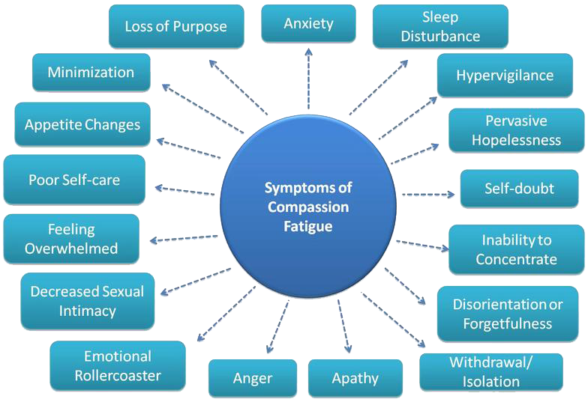
Compassion Fatigue and Effects
Figure 2 String from woman
Image from Source. Adobe Stock, Microsoft 365
Notes:
Secondary Trauma Pintercom

Slide 5
Relevant Data
Study indicates 54% turnover rate consistent with global turnover for SUD counselors of 50%
Mental Health Counseling turnover 39%
10% of population suffer from AoD disorder
Drug overdose deaths over 100,000 annually
Table 1 Turnover Rate
Table 1. Counselor turnover, Hatch-Mailette et al., 2019, p.217

Slide 6
Risks Factors
Negative Coping
High level of stress
Low Social support
History of trauma
Working with at risk population
Empathy

Slide 7
Protective Factors
Regular Counseling
Clinical Training
Self-care
Social Support
Spiritual Factors
Compassion Satisfaction
Supervision that is reflective

Slide 8
Current Education, Training, and Supervising Standards
CACREP (2016)
Substance abuse counselor- state by state guidelines
Supervisory requirements
Continuing Education requirements
Self Care requirements
Continual assessment
8 Core Competencies

Slide 9
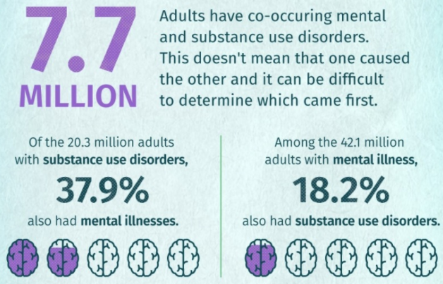
Call for Awareness: Are we prepared to treat?
40-81% lifetime trauma prevalence
841,000 Overdose deaths since 1999
Surpassed 100,000 overdose deaths in 2021
60-90% of SUD clients have experienced Trauma or abuse
STS reported in 15.2% of social workers and 19% in SUD counseling
Table 2 Comorbidity
Table 2 Comorbidity: By National Institute on Drug Abuse. Retrieved from https://nida.nih.gov/drug-topics/trends-statistics/infographics/comorbidity-substance-use-other-mental-disordersInstitute on Drug Abuse (NIH), 2018

Slide 10
Theoretical Model: Strengthen Protective Factors and Minimize Risk Factors for Compassion Fatigue
Training: Required internship/ practicum hours in a dual diagnosis or addiction counseling setting
Education: Additional education for addiction, co-occurring disorders, and trauma
Continuing Education: Required CEU for addiction, co-occurring disorders, and trauma
Supervision: Requirement for self-care measures implemented
Notes:
Addiction professionals shall continuously self-monitor in order to meet their professional obligations. (NAADAC, 2021).
Addiction professionals shall offer and provide assistance as needed to peers, coworkers, and supervisors who are demonstrating professional impairment, and shall intervene to prevent harm to clients.
The NAA AD professional Standards mandates advocacy of its members when employers institutional policy and service systems hampers resident/client potential and/or prevents access to service. the certified member must attempt to change the employer’s policy and/or systems.
CACREP Standards mandate students-in- training as addiction counselors to possess the knowledge and skills necessary to address a wide range of issues in the context of addiction counseling (CACREP Standards, 2016).

Slide 11
Implications
CF is rising
Preparedness is lacking
Demand is increasing
Stigma persists
God prevails

Slide 12
Christian Worldview
Figure 3
Jesus Wept (John 11:35 KJV)
Compassion
Empathy
(Mark 2:17 NIV) Jesus said to them, “It is not the healthy who need a doctor, but the sick. I have not come to call the righteous, but sinners.”
Counselor’s competencies
Image from Source. PowerPoint. Microsoft 365

Slide 13
Questions & Answers
?

Slide 14
References
Ewer, P. L., Teesson, M., Sannibale, C., Roche, A., & Mills, K. L. (2015). The prevalence and
correlates of secondary traumatic stress among alcohol and other drug workers in australia: Secondary traumatic stress. Drug
and Alcohol Review, 34(3), 252- 258. https://doi.org/10.1111/dar.12204
Figley, C. R. (2002). Compassion fatigue: Psychotherapists’ chronic lack of self care. J. Clin. Psychol. 58, 1433–1441.
doi: 10.1002/jclp.10090
Moreno‐Jiménez, J. E., Blanco‐Donoso, L. M., Rodríguez‐Carvajal, R., Chico‐Fernández, M., Montejo, J. C., & Garrosa, E. (2020).
The moderator role of passion for work in the association between work stressors and secondary traumatic stress: A Cross‐Level
diary study among health professionals of intensive care units. Applied Psychology : Health and Well- being, 12(3),
907- 933. https://doi.org/10.1111/aphw.12215
Steinheiser, M. (2018). Compassion fatigue among nurses in skilled nursing facilities: Discoveries and challenges of a conceptual model
in research. Applied Nursing Research, 44, 97 – 99. https://doi-org.ezproxy.liberty.edu/10.1016/j.apnr.2018.10.002.
Stewart, D. W. (2009). Casualties of War: Compassion Fatigue and Health Care Providers. Medsurg Nursing, 18(2), 91-4; quiz
95. 2%3Faccountid%3D12085
Zhang, L., Ren, Z., Jiang, G., Hazer-Rau, D., Zhao, C., Shi, C., Lai, L., & Yan, Y. (2020;2021;).
Self-oriented empathy and compassion fatigue: The serial mediation of dispositional mindfulness and counselor's
self- efficacy. Frontiers in Psychology, 11, 613908- 613908. https://doi.org/10.3389/fpsyg.2020.613908
Code of ethic of the NCCAP. Retrieved from https://www.nccap.org/assets/Code%20of%20Ethics.pdf
Danielle R. Adams, Nathaniel J. Williams, Emily M. Becker-Haimes, Laura Skriner, Lauren Shaffer, Kathryn DeWitt, Geoffrey
Neimark, David T. Jones, Rinad S. Beidas Adm Policy Ment Health. Author manuscript; available in PMC 2020 Nov 1.
Published in final edited form as: Adm Policy Ment Health. 2019 Nov;
46(6): 713–723. doi: 10.1007/s10488-019-00949-8

Slide 15
Refernces
NAADAC, the Association for Addiction Professionals (2021). NAADAC/NCC AP Code of
Ethics. Alexandria, VA: NAADAC. Retrieved from: https://www.naadac.org/assets/2416/naadac_code_of_ethics_112021.pdf
CACREP Section Five: Addiction Counseling. Retrieved from
https://www.cacrep.org/section-5-entry-level-specialty-areas-a-addiction-counseling/
Perkins, & Sprang, G. (2013). Results from the Pro-QOL-IV for Substance Abuse Counselors
Working with Offenders. International Journal of Mental Health and Addiction., 11(2),
199– 213. https://doi.org/10.1007/s11469-012-9412-3
Hatch-Maillette, M. A., Harwick, R., Baer, J. S., Masters, T., Cloud, K., Peavy, M., Wiest, K., Wright, L.,
Beadnell, B., & Wells, E. A. (2019). Counselor turnover in substance use disorder treatment research:
Observations from one multisite trial. Substance Abuse, 40(2),
214-220. https://doi.org/10.1080/08897077.2019.1572051
Adams, D. R., Williams, N. J., Becker-Haimes, E. M., Skriner, L., Shaffer, L., DeWitt, K., Neimark, G., Jones,
D. T., & Beidas, R. S. (2019). Therapist Financial Strain and Turnover: Interactions with System-Level Implementation of Evidence-Based Practices. Administration and policy in mental health, 46(6),
713–723. https://doi.org/10.1007/s10488-019-00949-8
Fahy, A. (2007). The Unbearable Fatigue of Compassion: Notes from a Substance Abuse Counselor Who Dreams
of Working at Starbuck’s. Clinical Social Work Journal, 35, 199-205.

