Slide 1
#Trending: How Social Media Influencers Impact Students’
COVID-19 Vaccine Decisions
Presented by: Katelyn White
Mentored by: Professor Denise Thomas

Slide 2


Figure 1
Visualization of Number of Vaccinated Individuals in the U.S.
Note. Images from Person icon. PowerPoint, Microsoft Office.

Slide 3
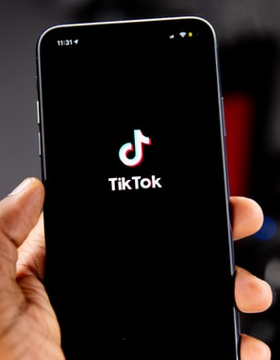
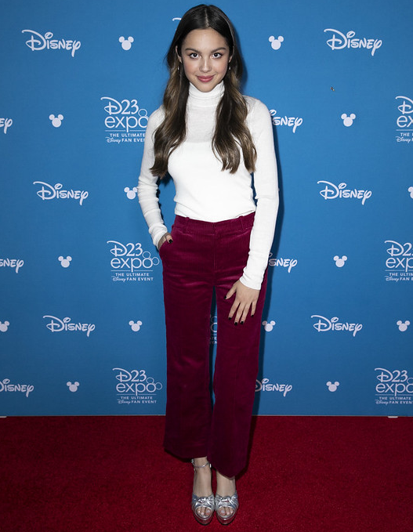
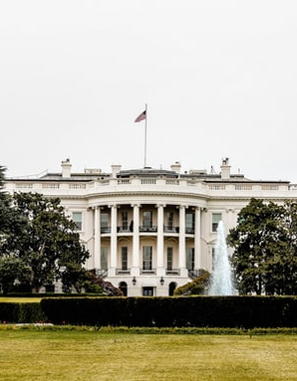
Figure 2
TikTok App
Figure 3
Olivia Rodrigo
Figure 4
The White House
Note. From “Person holding an iPhone running TikTok” by Feyissa, 2020, retrieved from https://unsplash.com/
photos/Yaw9mfG9QfQ. CC BY 2.0.
Note. From “Olivia Rodrigo at D23 Expo 2019” by Walt Disney Television, 2019, retrieved from https://www.flickr.com
/photos/91795856@N02/48611650853. CC BY-ND 2.0.
Note. From “White House circa 2012” by DeAnda, 2020, retrieved from https://unsplash.com/photos/zfKlCKK-Ql0. CC BY 2.0.

Slide 4
Research Question
How are social media influencers and other celebrity endorsements of the COVID-19 vaccine in the United States affecting whether 18- to 24-year-olds adopt the vaccine?

Slide 5
Literature Review
Summary of What is Known & Gaps to Fill

Slide 6
Methods
Mixed-Methods Survey to Measure Quantitative & Qualitative Data

Slide 7
Results
Overview of Results & Accompanying Data

Slide 8
Figure 5
Type of Messages Shared by Majority of Influencers
Note. Created by Katelyn White. Pie chart showing the distribution of responses to a survey question.

Slide 9
Figure 6
Type of Messages Shared by Majority of Influencers
Note. Created by Katelyn White. Pie chart showing the distribution of responses to a survey question.

Slide 10
Figure 7
Most Influential Factor Affecting Vaccine Decision on a Scale of 1 to 5
Note. Created by Katelyn White. Bar chart showing the distribution of responses to a survey question.

Slide 11
Figure 8
Least Influential Factor Affecting Vaccine Decision on a Scale of 1 to 5
Note. Created by Katelyn White. Bar chart showing the distribution of responses to a survey question.

Slide 12
discussion
Significance of Results & Review of Objectives

Slide 13
Significance & Review
Confirms that influencer credibility is not always effective
Disproves use of social media to market vaccines
Social proof does not apply but points to another theory
Contributes to critical studies by expanding knowledge of social media’s role in COVID-19 vaccine adoption

Slide 14
Figure 2
TikTok App
Figure 3
Olivia Rodrigo
Figure 4
The White House
Note. From “Person holding an iPhone running TikTok” by Feyissa, 2020, retrieved from https://unsplash.com/
photos/Yaw9mfG9QfQ. CC BY 2.0.
Note. From “Olivia Rodrigo at D23 Expo 2019” by Walt Disney Television, 2019, retrieved from https://www.flickr.com
/photos/91795856@N02/48611650853. CC BY-ND 2.0.
Note. From “White House circa 2012” by DeAnda, 2020, retrieved from https://unsplash.com/photos/zfKlCKK-Ql0. CC BY 2.0.

Slide 15
References
Amato, M. (2021, August 31). Want to be a social media influencer? Here are some tips for getting started. Los Angeles Times. https://www.latimes.com/entertainment-arts/business/story/2021-08-06/what-is-a-social-media-influencer-online-brand-guide
Carvalho, H. C., & Mazzon, J. A. (2020). Embracing complex social problems. Journal of Social Marketing, 10(1), 54-80. https://doi-org.ezproxy.liberty.edu/10.1108/JSOCM-03-2019-0049
Centers for Disease Control and Prevention. (2021). COVID-19 vaccination coverage and vaccine confidence [Interactive data table]. U.S. Department of Health and Human Services. Retrieved November 21, 2021, from https://www.cdc.gov/vaccines/imz-managers/coverage/covidvaxview/interactive.html
Cialdini, R. B. (2009). Social proof: Truths are us. Influence: The psychology of persuasion [eBook edition]. HarperCollins Publishers. https://learning.oreilly.com/library/view/influence/9780061899874/
DeAnda, R. (2020). White House circa 2012 [Photograph]. Unsplash. https://unsplash.com/photos/zfKlCKK-Ql0
Feyissa, S. (2020). Person holding an iPhone running TikTok [Photograph]. Unsplash. https://unsplash.com/photos/Yaw9mfG9QfQ
Jose, S. (2021). COVID vaccine and Generation Z–A study of factors influencing adoption. Young Consumers, 1-17. https://doi-org.ezproxy.liberty.edu/10.1108/YC-01-2021-1276

Slide 16
References
Miller, Z. (2021, September 9). Sweeping new vaccine mandates for 100 million Americans. AP News. https://apnews.com/article/joe-biden-business-health-coronavirus-pandemic-executive-branch-18fb12993f05be13bf760946a6fb89be
New International Bible. (2011). Zondervan. (Original work published 1978)
Tan, C. S. L. (2021). Do I care that you are credible and we are similar? Examining credibility and similarity as experienced by social media followers. Communication Today, 12(1), 62-78. https://ezproxy.liberty.edu/login?url=https://search.ebscohost.com/login.aspx?direct=true&db=ufh&AN=150051598&site=ehost-live&scope=site
Twum, K. K., Ofori, D., Agyapong, G. K. Q., & Yalley, A. A. (2021). Intention to vaccinate against COVID-19: A social marketing perspective using the theory of planned behaviour and health belief model. Journal of Social Marketing, 1-26. https://doi-org.ezproxy.liberty.edu/10.1108/JSOCM-04-2021-0085
Walt Disney Television. (2019). [Olivia Rodrigo at D23 Expo 2019] [Photograph]. Flickr. https://www.flickr.com/photos/91795856@N02/48611650853
World Health Organization. (2021). WHO coronavirus (COVID-19) dashboard: United States of America. [Interactive data map]. Retrieved November 21, 2021, from https://covid19.who.int/region/amro/country/us

