Slide 1
Voices of Courage
A Comparison of the Treatment of Evangelicals and Dissidents under Khrushchev

Slide 2
Introduction
Interest
Key Question
Methods

Slide 3
Background

Slide 4
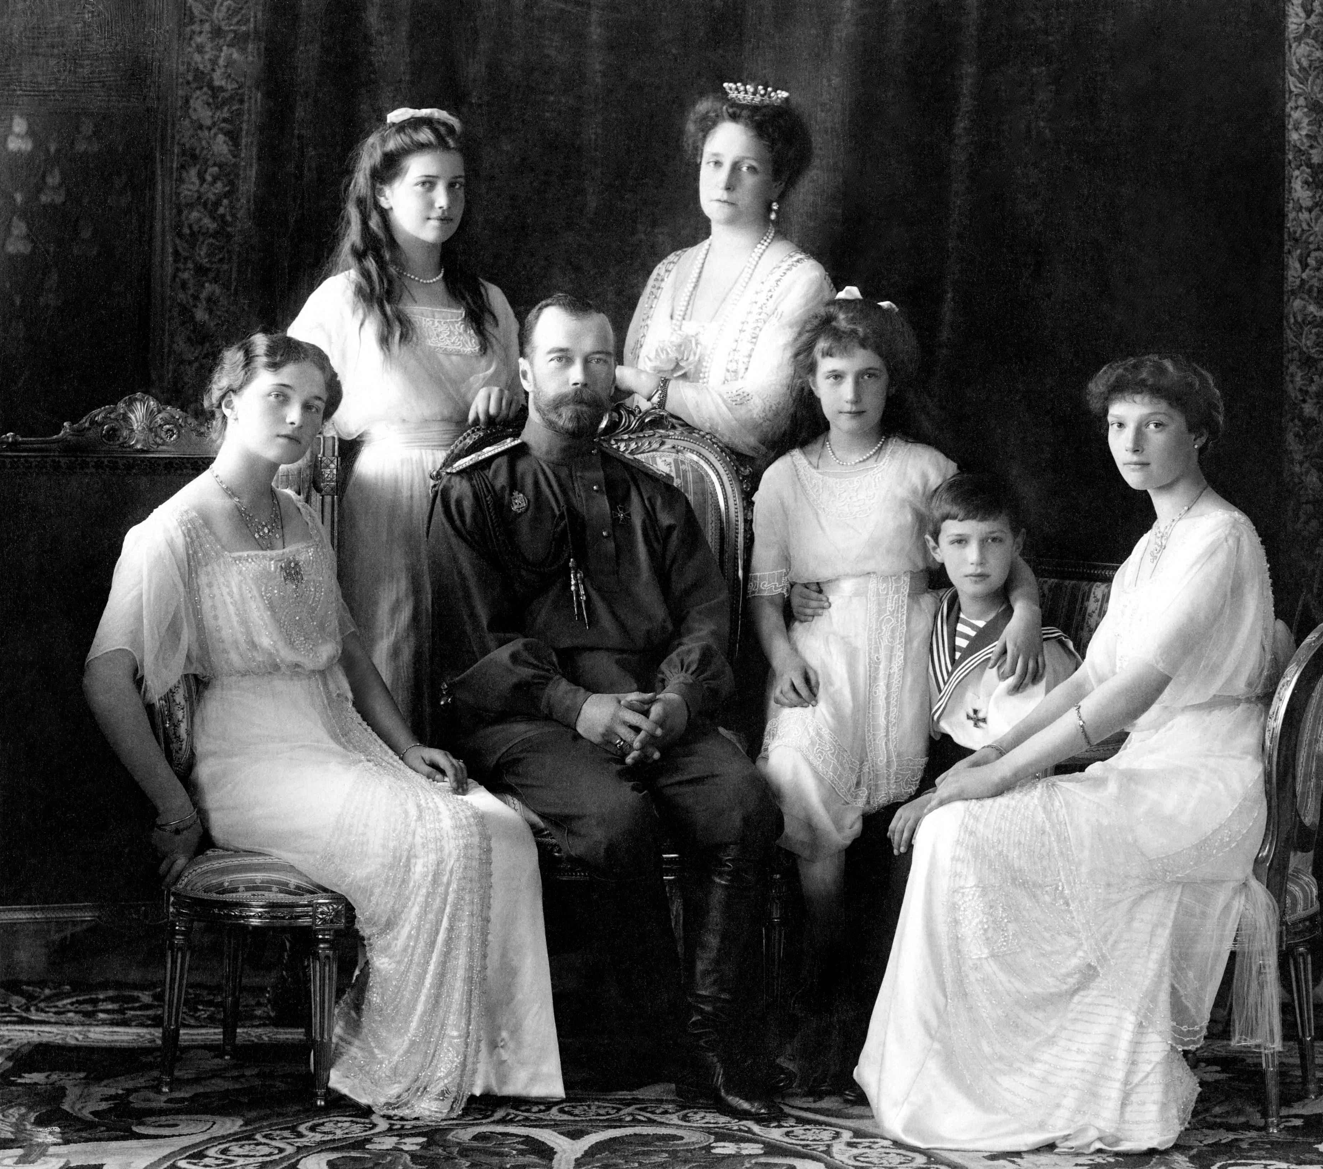
Rise of the Soviet Union
Overthrow of Romanov dynasty (1917)
Lenin (1917 – 1922)
Stalin (1922 – 1953)
Khrushchev (1953 – 1964)
Fig. 1. The overthrow of the Romanov dynasty in 1917 marked the end of the Russian Empire. (Photograph by Levitsky Studio, Livadiya, Nicholas II of Russia with the Family, 1913, https://commons.wikimedia.org/wiki/File:Russian_Imperial_Family_1913.jpg).

Slide 5
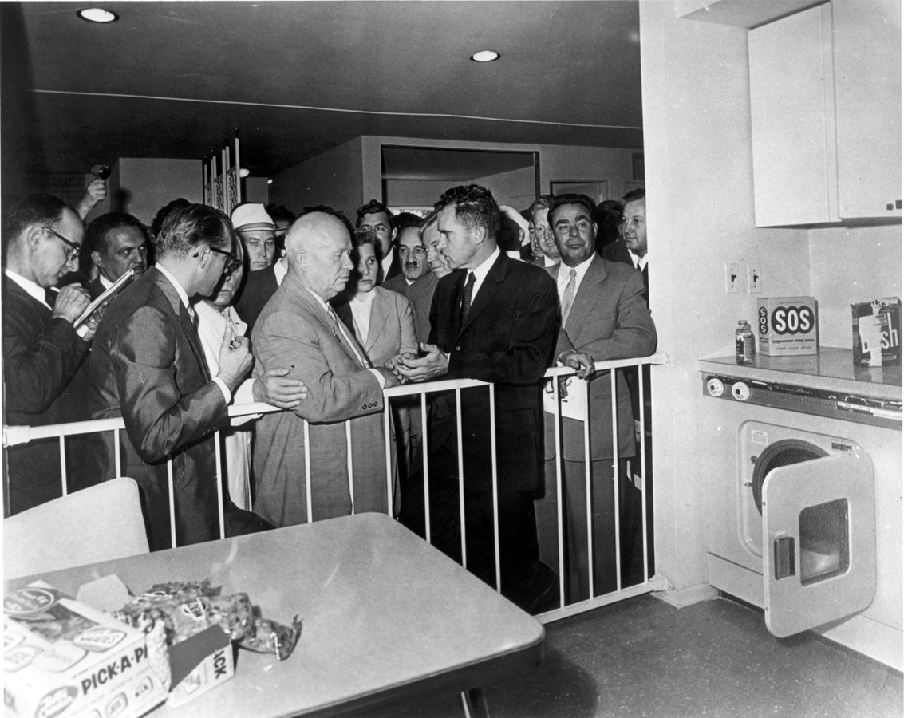
Overview of Khrushchev’s Time in Office
The “Khrushchev thaw”
Denunciation of Stalin
Reforms:
  Agriculture
  Industry
  Education
Fig. 2. Khrushchev’s interactions with the West gave the impression of a “thaw.” (Photograph by unknown, Vice-President Nixon Spars with Premier Khrushchev, Jul. 24, 1959, https://commons.wikimedia.org/wiki/File:1959_Khrushchev,_Nixon,_Brezhnev.jpg).

Slide 6
Khrushchev & evangelicals

Slide 7
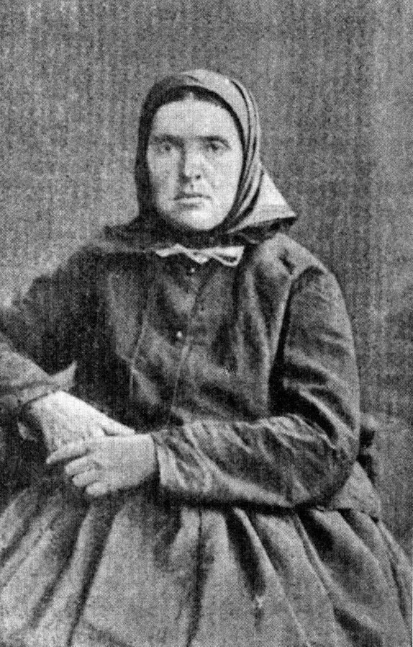
History of Evangelicals in Russia & the USSR
Emergence (1860s)
Early Soviet period
Increased pressure (1920s – 1930s)
New Religious Policy (1939)
Khrushchev – last major anti-religion campaign (1959-1964)
Fig. 3. Shtundists, such as the women photographed, served as one of the early inspirations for the evangelical movement. (Photograph by unknown, Depicted Shtundist Woman from Village in Russian Empire, 1893, https://commons.wikimedia.org/wiki/
File:Shtundistka.jpg).

Slide 8
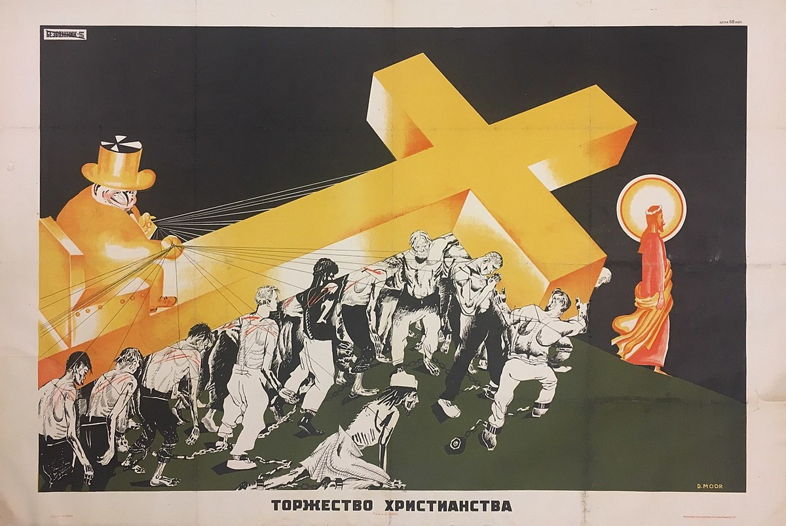
Under Khrushchev – Phases of Persecution
Sawatsky (1981) identifies several phases in the 1959-1964 anti-religious campaign:
  Leninist Legality
  Resistance and Toughened Legislation
  Reevaluation
  Differentiated Policy
Fig. 4. Anti-religious propaganda painted Christianity as abusive, outdated, and unnecessary. (Image by Dmitry Moor, Torzhestvo Khristianstva, c. 1922 – 1930, https://commons.wikimedia.org).

Slide 9
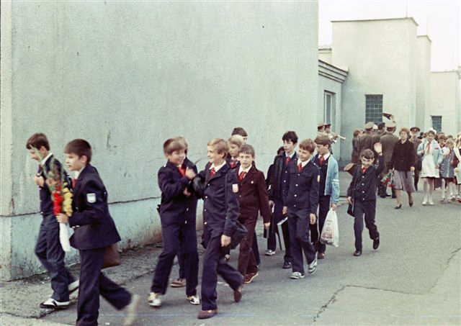
Impact of Persecution
Restrictions - Education
Compromise - Pacifism
Creativity – Preaching
Disunion - Initsiativniki
Fig. 5. Although evangelical children attended elementary and secondary school, they were often restricted from pursuing higher education. (Photograph by Anatoly Savin, Soviet Pupils in Milovice, Sept. 1, 1985, https://commons.wikimedia.org/wiki/File:
Milovice_soviet_pupils.jpg).

Slide 10
Khrushchev & other dissidents

Slide 11
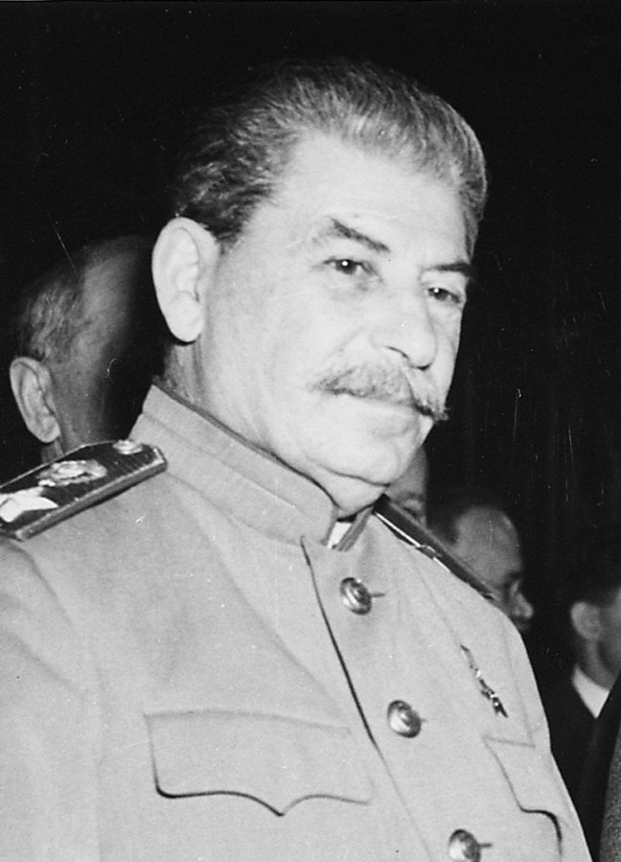
History of Dissent in Russia & the USSR
The intelligentsia
Early Soviet period (1917-1921)
The “Great Purge” (1930s)
Fig. 6. Stalin’s “Great Purge” of the 1930s severely suppressed dissent throughout the Soviet Union. (Photograph by unknown, Soviet Prime Minister Josef Stalin, President Harry S. Truman, and British Prime Minister Winston Churchill Pose for the First Time Before the Opening of the Potsdam Conference, Jul. 17, 1945, https://commons.wikimedia.org/wiki/File:Josef_Stalin_-_NARA_-_198797.jpg).

Slide 12
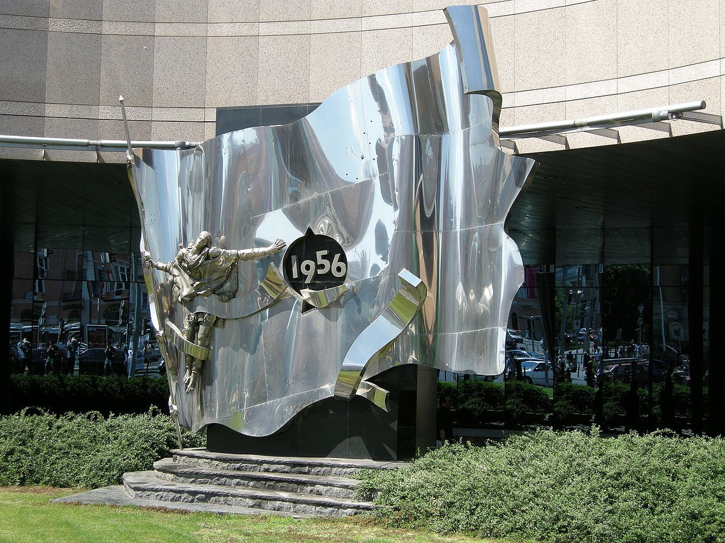
Dissent During the Khrushchev Period
Diversity of Khrushchev-era dissent
Importance of nationalist movements
Marxist nature of dissidents
Use of samizdat
Fig. 7. Nationalist movements, such as the 1956 Hungarian Revolution commemorated by this monument, served as a motivating factor for dissidents. (Photograph by Yoav Dothan, Memorial of the 1956 Hungarian Revolution by Ferenc Arvai (2001), May 23, 2009, https://commons.
wikimedia.org/wiki/File:Memorial_of_the_1956_Hungarian_Revolution_by_Ferenc_%C3%81rvai_(2001)._- L%C3%B6v%C5%91h%C3%A1z_street,_BudapestDSCN3988.jpg).

Slide 13
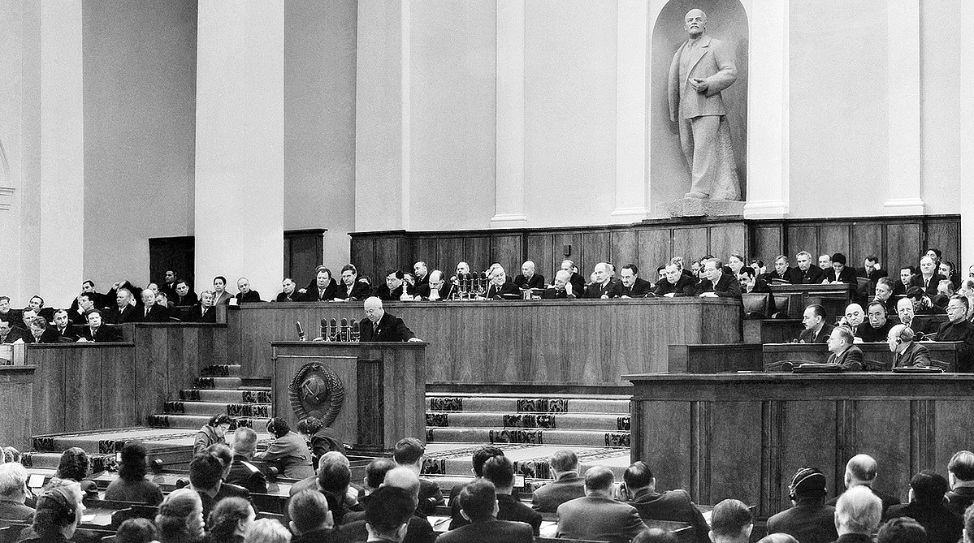
Treatment Under Khrushchev
The “Khrushchev thaw”
  The “secret speech”
  One Day in the Life of Ivan Denisovich
1950s - “‘Firefighting’ approach” (Hornsby, 2011)
Late 1950s – refinement of methods
Fig. 8. “Nikita Khrushchev, speaks at the 20th CPSU Congress in the Kremlin, 1956.” by unknown author is licensed under CC BY-SA 4.0.

Slide 14
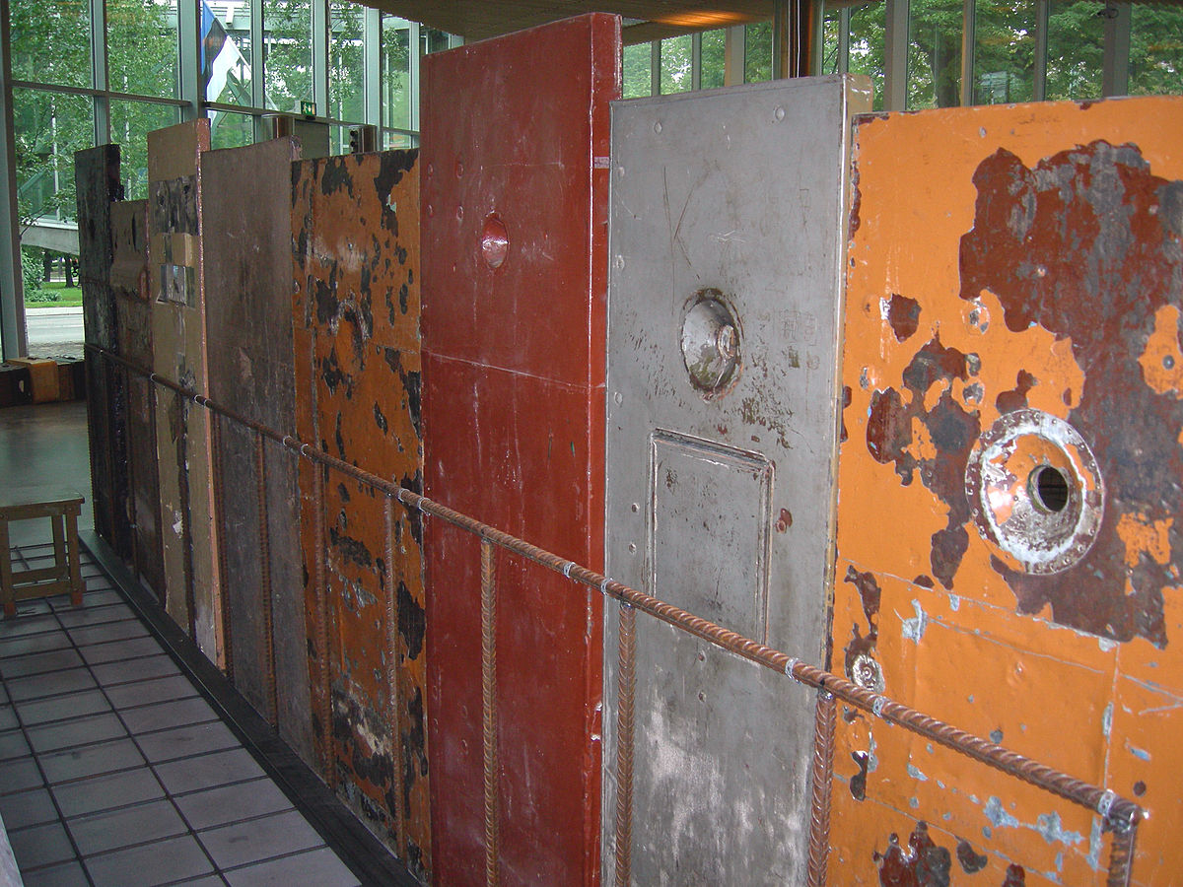
Treatment Under Khrushchev
Methods:
  Media attacks
  Collective pressure
  The “prophylactic chat”
  Imprisonment & use of psychiatric wards
Fig. 9. Prison was a very real threat for both evangelicals and other dissidents. (Photograph by Wilson44691, Soviet Prison Doors on Display in the Museum of Occupations, Tallinn, Estonia, July 2007, https://commons.wikimedia.org/wiki/
File:SovietPrisonDoorsTallinn.JPG).

Slide 15
comparison

Slide 16
The Soviet government “implicitly differentiated between religious, nationalist and political dissent, hardly ever clamping down on more than one of the three at any given time and often employing distinct methods to deal with each of them.” (Hornsby, 2013)

Slide 17
Comparison
Timing
  Evangelicals – steadiness of persecution (1959-1964)
  Dissidents – greater variability
Methods
  Evangelicals – depriving of parental rights
  Dissidents – psychiatric wards

Slide 18
conclusion

Slide 19
Bibliography
Primary Sources:
Council of Churches of Evangelical Christian-Baptists. “Pervoe Poslanie.” Dokumenty Initsiativnoĭ Gruppy i Orgkomiteta po Sozybu Vsesoiuznogo Sʺezda Tserkvi Evangel’skih Kristian-Baptistov, Soveta Tserkveĭ EHB (Avgust 1961 – Maĭ 1966). (1961-1966?). Keston Digital Archives. Baylor University. https://digitalcollections-baylor.quartexcollections.com/Documents/Detail/dokumenty-initsiativnoi-gruppy-i-orgkomiteta-po-sozyvu-vsesoiuznogo-sezda-tserkvi-evangelskikh-khristian-baptistov-soveta-tserkvei-ekhb-avgust-1961-g.-mai-1966-g./1056346?item=1056357.
Dyck, Eva. “Interview with Eva Dyck.” Interview by Nadezhda Beliakova. Protestant Communities in the USSR, April 27, 2014. https://www.dhi.ac.uk/
protestantizm/section/interview/?section=children&interview=AHI025883-1-35-1C.
Khrushchev, Nikita. Khrushchev Remembers: The Last Testament. Ed. and trans. Strobe Talbott. Boston: Little, Brown and Company, 1974.
Nevler, K. “Naprasnyĭ trud.” Poster. 1965. Keston Digital Archives, https://digitalcollections-baylor.quartexcollections.com/Documents/Detail/naprasnyi-trud/1064109.
Polnoe Sobranīe Zakonovʺ Rossīĭskoĭ Imperīi. Sobranīe Tretīe. Tomʺ XXV. 1905. Otdielenīe I. Otʺ No. 25605—27172 i Dopolnenīia. Saint Petersburg: Gosudarstvennaia Tipografīia, 1908.
Record of Conversation of General Consul of the USSR in Cluj L. P. Akulov with First Secretary of the Regional Party Committee of the RWP of the Magyar Autonomous Region L. Chupo about Inter-Ethnic Problems, Attitude to the Catholic Church, and Other Issues. March 20, 1953, Wilson Center Digital Archive. Translated by Svetlana Savranskaya. https://digitalarchive.wilsoncenter.org/document/118467.

Slide 20
Newspapers:
Cooke, Alistair. “Washington Wonders About Stalin’s Successor: Fears That Malenkov May Follow with More Aggressive Policy.” The Manchester Guardian, March 5, 1953, 5.
Keller, Bill. “Major Soviet Papers Says 20 Million Died As Victims of Stalin: Stalin’s Victims Put at 20 Million.” New York Times, February 4, 1989, 1.
Levine, Isaac Don. “Big Triumph of Democracy: Revolution in Russia, A Dramatic Overthrow of Autocracy.” The Baltimore Sun, March 16, 1917, 1.
Schwartz, Harry. “Church Closings in Soviet Tallied: 1,500 Were Shut in Year, U.S. Visitors Were Told.” New York Times, December 29, 1961, 4.
Topping, Seymour. “Party’s Dictate Stuns Russians: Some View Ban on Dissent as Return to Stalin Era.” New York Times, March 12, 1963, 3.
Zorza, Victor. “Moscow Bears Down on Dissident Young Poets.” The Washington Post, January 28, 1962, A20.
Secondary Sources:
Alekseeva, Ludmilla. Soviet Dissent: Contemporary Movements for National, Religious, and Human Rights. Middletown, CT: Wesleyan University Press, 1985. ACLS Humanities Ebook.
Anderson, John. Religion, State and Politics in the Soviet Union and Successor States, 1953-1993. 1994. Reprinted, Cambridge: Cambridge University Press, 2010. Cambridge Core.

Slide 21
Secondary Sources (cont.):
Bergman, Jay. “Soviet Dissidents on the Russian Intelligentsia, 1956-1985: The Search for a Usable Past.” The Russian Review 51, no. 1 (January 1992): 16-35. https://www.jstor.org/stable/131244.
Cambridge Dictionary, s.v. “dissident,” accessed September 4, 2021, https://dictionary.cambridge.org/us/dictionary/english/dissident
Cohn, Edward D. “Coercion, Reeducation, and the Prophylactic Chat: Profilaktika and the KGB’s Struggle with Political Unrest in Lithuania, 1953-64.” The Russian Review 76, no. 2 (April 2017): 272-293. https://onlinelibrary.wiley.com/doi/pdf/10.1111/russ.12131.
Coleman, Heather. Russian Baptists and Spiritual Revolution, 1905-1929. Bloomington: Indiana University Press, 2005. ProQuest Ebook Central.
Congdon, Lee. Solzhenitsyn: The Historical-Spiritual Destinies of Russia and the West. DeKalb, IL: Northern Illinois University Press, 2017.
Conquest, Robert, ed. Religion in the U.S.S.R. The Contemporary Soviet Union Series: Institutions and Policies. New York: Frederick A. Praeger, 1968.
Davies, Sarah. Popular Opinion in Stalin’s Russia: Terror, Propaganda and Dissent, 1934-1941. Cambridge: Cambridge University Press, 1997.
Durasoff, Steve. The Russian Protestants: Evangelicals in the Soviet Union, 1944-1964. Rutherford: Fairleigh Dickinson University Press, 1969.
Erdozain, Dominic. “Introduction: The Rhythm of the Saints.” In The Dangerous God: Christianity and the Soviet Experiment, edited by Domininc Erdozain, 3-11. DeKalb, IL: Northern Illinois University Press, 2017.
Hornsby, Robert. “The Outer Reaches of Liberalization: Combating Political Dissent in the Khrushchev Era.” In Khrushchev in the Kremlin: Policy and Government in the Soviet Union, 1953-1964, edited by Jeremy Smith and Melanie Ilic, 61-78. New York: Routledge, 2011.
Hornsby, Robert. Protest, Reform and Repression in Khrushchev’s Soviet Union. Cambridge: Cambridge University Press, 2013.

Slide 22
Secondary Sources (cont.):
Kenez, Peter. A History of the Soviet Union From the Beginning to the End. Cambridge: Cambridge University Press, 2006.
Kolarz, Walter. Religion in the Soviet Union. New York: St. Martin’s Press, 1961.
Powell, David E. “Controlling Dissent in the Soviet Union.” Government and Opposition 7, no. 1 (Winter 1972): 85-98. https://www.jstor.org/stable/44483700.
________. Antireligious Propaganda in the Soviet Union. Cambridge: MIT Press, 1975.
Reich, Rebecca. State of Madness: Psychiatry, Literature, and Dissent After Stalin. DeKalb, IL: Northern Illinois University Press, 2018.
Sakwa, Richard. Soviet Politics in Perspective. 2nd ed. New York: Routledge, 1998.
Sawatsky, Walter. “Protestantism in the USSR.” In Religious Policy in the Soviet Union, edited by Sabrina Ramet, 319-349. 1992. Reprinted, Cambridge: Cambridge University Press, 2009.
________. Soviet Evangelicals Since World War II. Scottsdale, PA: Herald Press, 1981.
Schapiro, Leonard. “‘Putting the Lid on Leninism’: Opposition and Dissent in the Communist One-Party States.” In “The Dead End of the Monolithic Parties.” Special issue, Government and Opposition 2, no. 2 (February 1967): 181-203. https://www.jstor.org/stable/44481820.
Shatz, Marshall S. Soviet Dissent in Historical Perspective. 1981. Reprinted, Cambridge: Cambridge University Press, 2010.
Thompson, William J. Khrushchev: A Political Life. 1995. Reprint, New York: St. Martin’s Griffin, 1997.
Walters, Philip. “A Survey of Soviet Religious Policy.” In Religious Policy in the Soviet Union, edited by Sabrina Ramet, 3-30. 1992. Reprinted, Cambridge: Cambridge University Press, 2009.

