Slide 1
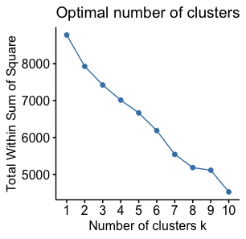
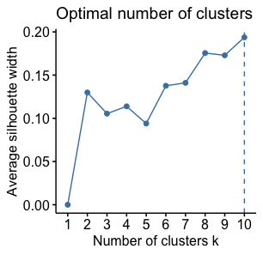
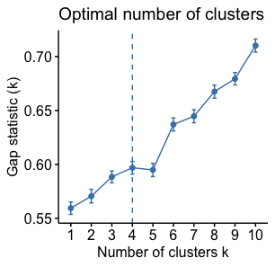
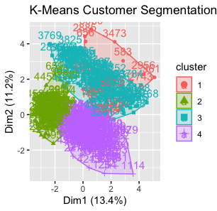
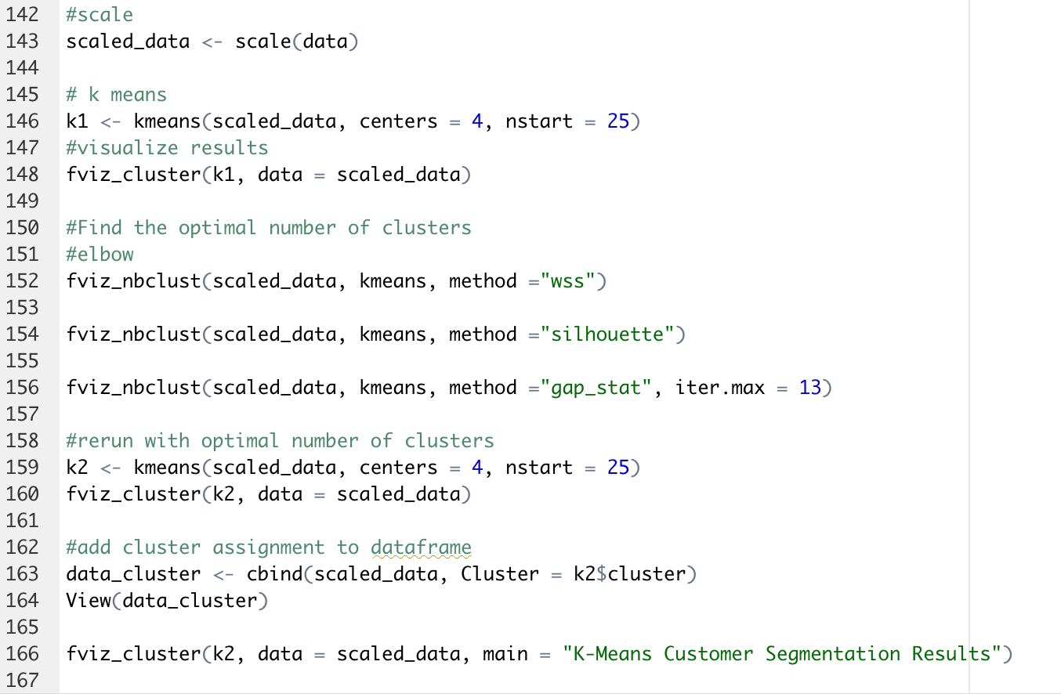
The Implementation of Market Segmentation for Marketing Strategy
Amanda Condict
Abstract
Results and Conclusion
Abstract: Many businesses offer customers valuable products and services but fail to recognize the differing desires their audience has, limiting profitability. To address this issue, marketers use customer segmentation, which involves locating patterns within their audiences to create clusters of customers with similar desires. Marketers can then create targeted promotions that cater to the needs of each unique segment. This research provides segmentation for Optimal Health (pseudonym), a health and wellness store in Bedford, Virginia, so that the owner can gain a better understanding of how to design a marketing strategy for the business. Data were downloaded from Data Axle, a large, privately-owned consumer database. Geographics, demographics, psychographics, and purchase behaviors all play a role in the way that customers shop, and groups can be formed on the similarity of these characteristics. The data used in this work were filtered by zip codes, lifestyles, age, marital status, children present, ethnicity, gender, religion, political party, homeownership, home value, and income. The data were then uploaded into R, a statistical software, to be organized and analyzed. Cluster analysis methods, both standard (hierarchical) and nonstandard (K-means) algorithms, are the methodology used in this poster to provide segmentation. The elbow, silhouette, and gap statistic methods were used for the identification of the optimal number of clusters for Optimal Health to target for future marketing promotions. These findings provide Optimal Health with customer groupings that increase marketing value for the organization. Optimal Health can use these segments to target paid ads on social media platforms, send unique promotional mailers, and make informed decisions about new product offerings. Future recommendations include using the data knowledge gained in this research to develop or provide new insights for a loyalty program. This study can also provide other similar small businesses a framework to follow for their own segmentation needs.
Calculating Optimal Number of Segments
Results: The results of the market segmentation strategy were positive, and the purpose of the study was fulfilled. The optimal number of segments to target for future campaigns was determined. Due to the small business nature of Optimal Health, the number of segments that are most feasible are 4 segments. As seen in the K-means cluster, some of the segments have overlap, meaning some of the strategies utilized will hold value for multiple segments. This overlap can streamline marketing, saving businesses time and money.
Conclusion: Customer segmentation strategies are helpful, but they can only provide an idea of the next best steps. These strategies should never be used individually to determine next steps. A mix of strategies should be used in conjunction with marketers' good judgement to produce the greatest result.
Many businesses are limited on the ability to follow the suggested number of segments because of:
Lack of funds to reach each suggested segment
Lack of expertise to create the content needed for each segment
Lack of practicality if the segment is not deemed “large enough” to be worth the time invested
Market segmentation hold great promise for businesses of any size. It allows businesses to save time and money by focusing their efforts intentionally on segments, leading to greater sales.
WSS
(B) Silhouette Plot
Indicates that 4 or 8 clusters are optimal
Indicates that 10 clusters are optimal
(C) Gap Statistic
Introduction
Future Work
It can feel overwhelming for a company to navigate the large amounts of information they store about their customers. As businesses prepare campaigns that must know who their target audience is. The potential number of segments to target can feel endless as there are many differences between customers. This market segmentation strategy provides marketers a model to follow to find patterns in an audience based on similar characteristics.
Translating data about customers into actionable digital campaigns.
Search engine optimization (SEO).
Website development.
Physical direct mailers.
E-commerce personalization.
Indicates that 4 clusters are optimal
K-Means calculates distance of segments
Sample of R Script
1 2 3 4 5 6 7 8 9 10 11 12 13 14
1 2 3 4 5 6 7 8 9 10 11 12 13 14
Methods
References
Calculating Optimal Number of Segments
Elbow method (WSS)- allows marketers to group customers with the most similarity
Silhouette method- measures the level of closeness each point in a set of data has with the other points
Gap statistic method- allows marketers to calculate the number of differences within each defined cluster (“Determining the Optimal Number,” 2018).
Calculating Distance of Segments
K-means- a commonly used flexible, nonstandard calculation. Can be utilized for ordinal and nominal data. Must have predetermined number of clusters and distance set (Gelbard, 2007).
R
All calculations made in R, a statistical software
A
B
Determining the optimal number of clusters: 3 must know methods. Datanovia.
(2018, October 21). Retrieved February 24, 2022, from https://www.datanovia.com.
Gelbard, R., Goldman, O., & Spiegler, I. (2007). Investigating diversity of clustering methods: An empirical comparison. Data & Knowledge Engineering, 63(1), 155-1.66. https://doi.org/10.1016/j.datak.2007.01.002
C

