Slide 1

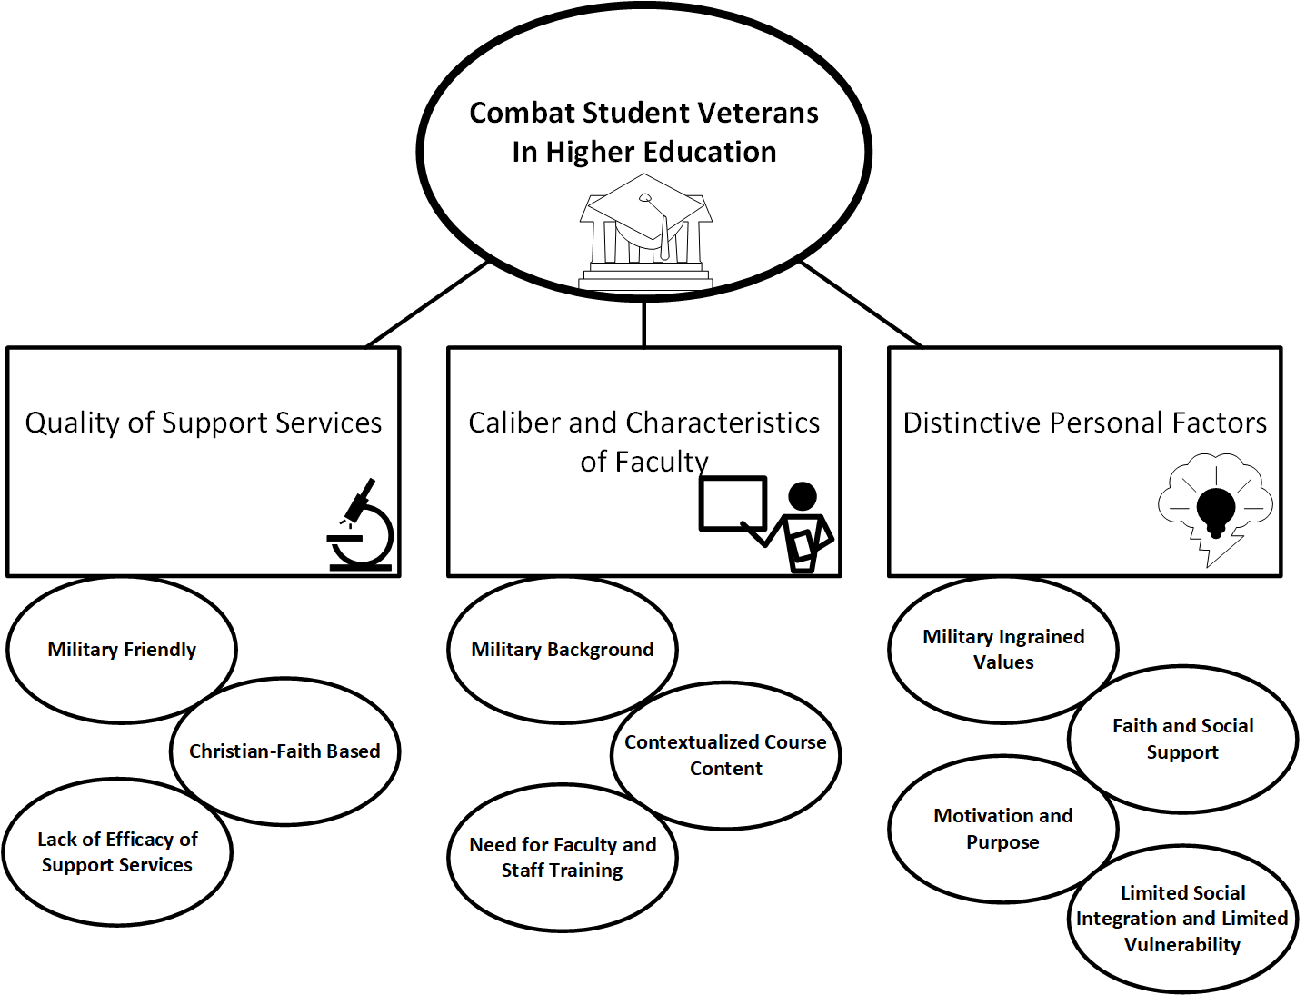
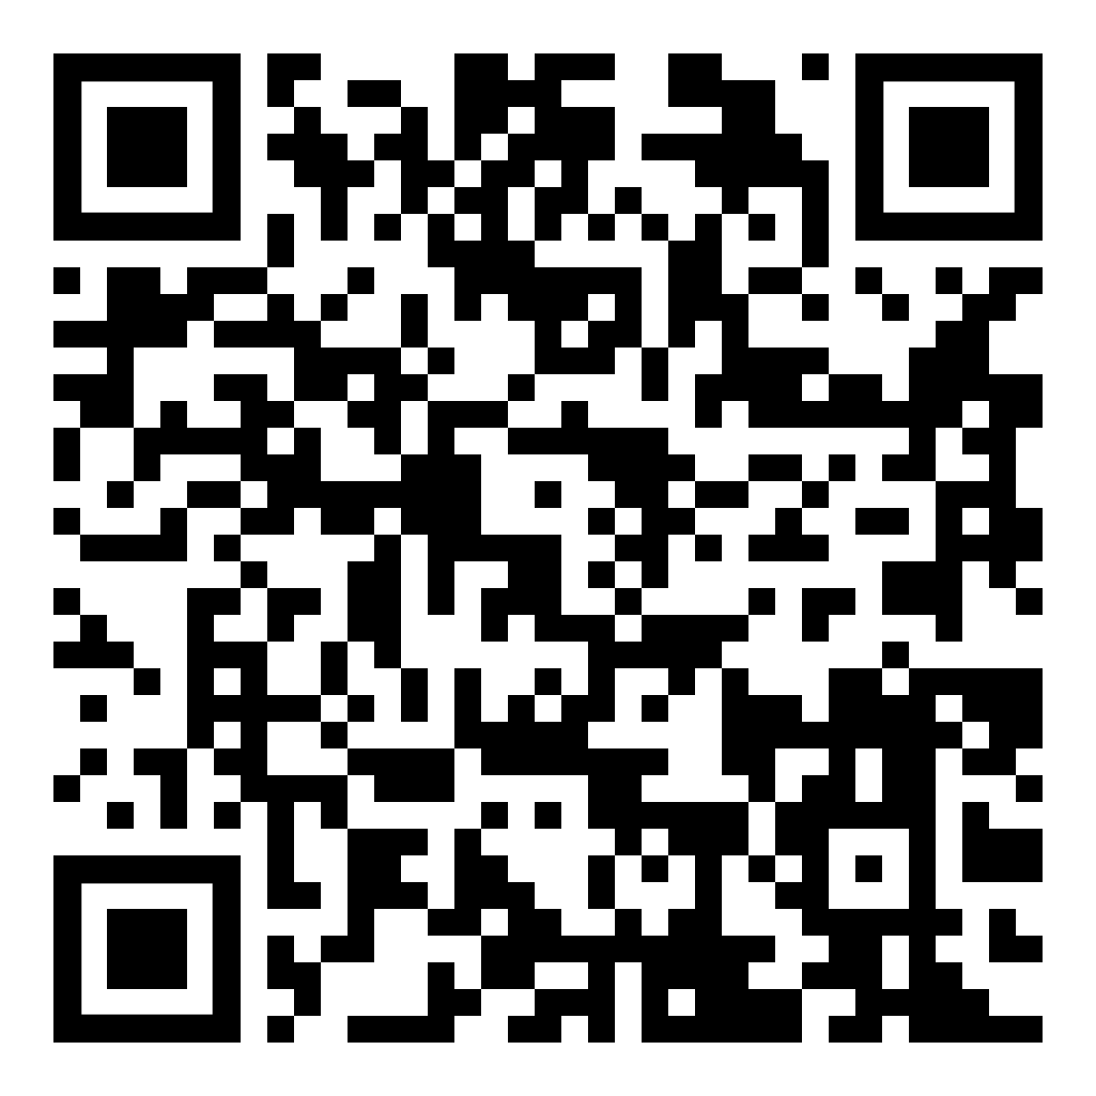
Combat Veteran Success in Higher Education
Mona Fazzina, PT, Ph.D.
Background
Figure 1. Path to engagement with support services. From “A Case Study of Combat Student Veteran Success in Higher Education by Mona Fazzina. Retrieved from https://digitalcommons.liberty.edu/cgi/viewcontent.cgi?article=4209&context=doctoral
Results
The purpose of this case study was to gain a deeper understanding of the factors that support combat student veterans in a private institution of higher education. Astin’s developmental theory of student involvement for higher education and Vacchi’s model of student veteran support provided the theory and conceptual framework respectively, explaining the relationship between what student veterans bring to the academic experience, the role of educators, and factors contributing to, or detracting from their success in higher education. Combat student veterans, and staff of support services participated in interviews and focus groups. Discussions explored factors supportive of combat student veterans. Sub-questions were designed to develop an in-depth description and analysis of key issues related to combat student veterans in higher education. Transcripts of collected data were analyzed to identify common themes and contextual information that were coded to develop and interpret meaning of the cases and lessons learned by using case assertions.
The quality of support services, caliber and characteristics of faculty and staff, and distinctive personal factors of combat student veterans were most supportive of combat student veterans.
There is a need for a veteran-specific orientation session or course, and for targeted training for staff and faculty at institutions of higher education.
Neutral and detracting factors were related to processes and intentions, rather than methods and strategies.
Using a strengths’ perspective rather than a deficit model of the understanding of the college student’s experience helped reveal the strengths and weaknesses in a military friendly higher education institution.
The link between non-college reference groups and veteran success in college is doubly significant because military socialization extends into their post-military college lives.
Participants exposed to blast waves and blast-induced concussions had considered this inconsequential and unimpactful to their daily functioning.
Many combat student veterans are not using healthcare and some with PTSD are not engaged in VHA care (Friedman, 2004; Kim et al., 2010; Sharp et al., 2015).
Vestibular rehabilitation was largely underutilized in combat student veterans.
Future Work
Study on undergraduate students to determine more accurately the challenges that combat student veterans have in the higher education environment.
Study on combat student veterans with increased severity of invisible injuries to determine their need for and tendency to use disability support services in higher education.
Study exploring the use of disability services by students with a history of concussions or mTBI.
Multi-site study to increase generalizability to larger populations.
Study involving public universities to capture student veterans from varied socio-economic and faith backgrounds.
Quantitative analysis to quantify the relative strength of the inputs in Astin’s I-E-O model with combat student veterans over traditional students to determine the relative impact of inputs and the environment to the output.
Phenomenological study to capture the essence of distinctive factors of combat student veterans and their uniqueness in higher education.
Life history narrative of a single participant with multiple types of data collected longitudinally to view data over time and yield a rich understanding of the participant within a larger social and institutional dimension.
Study including staff at Veterans offices to participate in in-person interview and discussions to create a multidimensional understanding of the research problem.
Research Question
The central research question sought to identify factors supportive of combat student veterans at a private institution of higher education. Sub-questions focused on institutional services, academic interactions, personal characteristics, and support relationships of combat student veterans as related to their success in higher education.
Methods
Qualitative Study
Design: Single case study with multiple embedded units of analysis
Participants:
Combat student veterans (8), staff and faculty (8), at Atlantic State University
Interviews, focus groups, document analysis.
Within-case analysis, extracted themes and subthemes.
References
Ackerman, R., DiRamio, D., & Mitchell, R. L. G. (2009). Transitions: Combat veterans as college students. Special Issue: Creating a veteran-friendly campus: Strategies for transition and success, 126, 5–14. https://doi.org/10.1002/ss.311
Astin, A. W. (1984). Student involvement: A developmental theory for higher education. Journal of College Student Development, 40 (5), 518-529.
Diamond, A. M. (2012, October 19). The adaptive military transition theory: Supporting military students in academic environments. [Paper presentation]. Annual conference of the Northeastern Educational Research Association, Rocky Hill, CT, United States.
DiRamio, D., & Jarvis, K. (2011). Veterans in higher education: When Johnny and Jane come marching to campus. Jossey-Bass. https://doi.org/10.1353/rhe.2012.0055
DiRamio, D., Ackerman, R., Mitchell, R. L. (2008). From combat to campus: Voice of student- veterans. National Association of Student Personnel Administrators Journal 45, 73–102. https://doi.org/10.2202/1949-6605.1908
Vacchi, D. (2011, November). Who are student veterans and what do they need? Demystifying this special population and framing an approach to understanding the needs of student veterans. Scholarly paper presented at the annual conference of the Association for the Study of Higher Education (ASHE), Charlotte, NC.
Vacchi, D. (2012). Considering student veterans on the twenty-first-century college campus. About Campus, 17(2), 15-21. https://doi.org/10.1002/abc.21075
Vacchi, D. (2013, April). Perceptions of veteran-friendliness: Giving student veterans a voice. Research paper presented at the annual conference of the New England Educational Research Organization (NEERO), Portsmouth, NH.
Vacchi, D. (2018). Understanding progress toward degree completion for student veterans in the post 9-11 era: A focused life history narrative. [Unpublished doctoral dissertation]. https://scholarworks.umass.edu/dissertations_2/1301.
1 2 3 4 5 6 7 8 9 10 11 12 13 14
DOWNLOAD DISSERTATION HERE
Notes:
Move QR code ot the middle. Or say ‘download dissertation here.
Work on font fo rwords and make flowchart much bigger.

