Slide 1
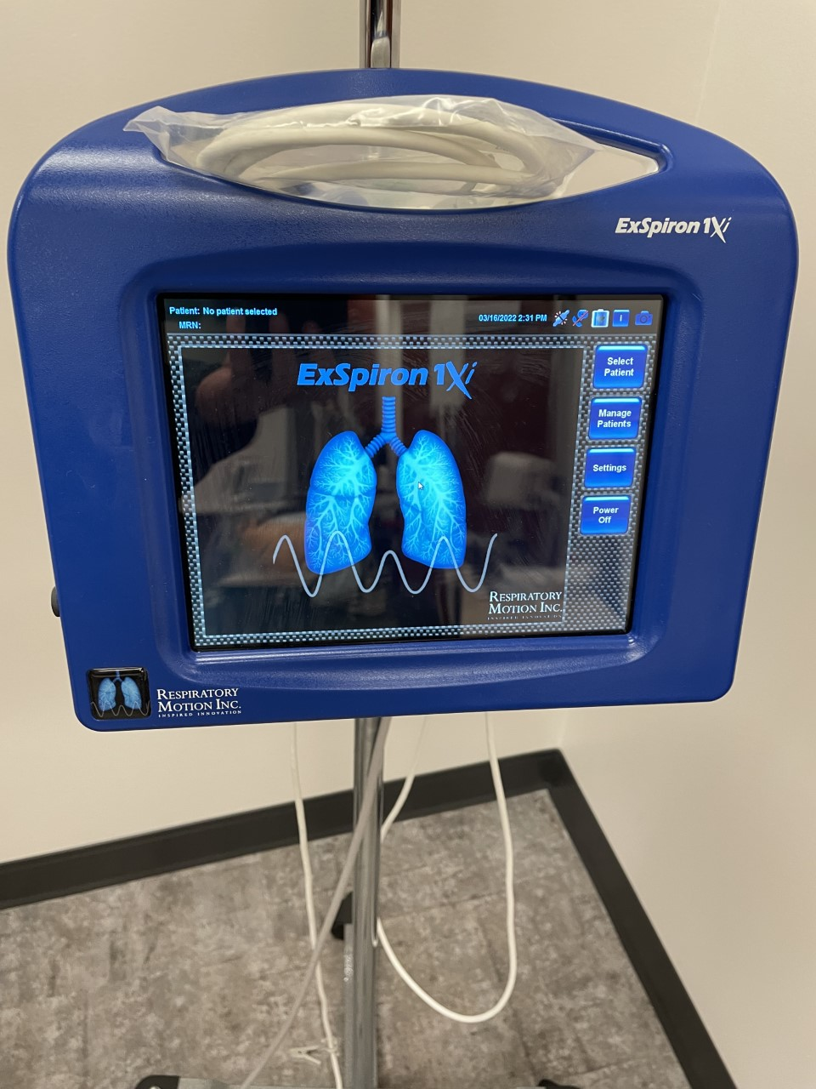
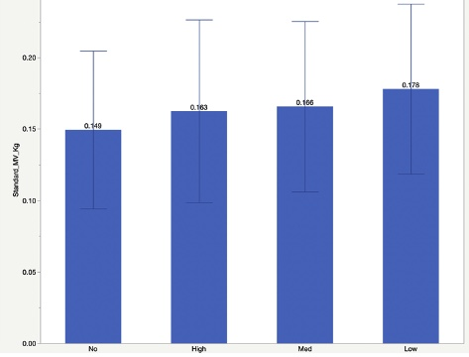
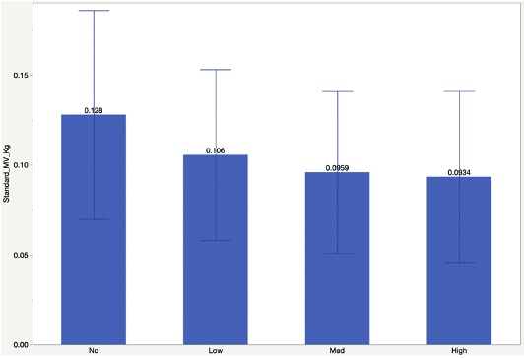
Effects of High Velocity Nasal Insufflation on Respiratory Efficiency
Macey York
Background
Results and Conclusion
High velocity nasal insufflation is a form of respiratory support that provides flows that are believed to be in excess of a patient’s inspiratory and expiratory flow rates. In the last decade, a proliferation of high flow nasal cannula devices (Figure 1. Vapotherm) and dosing recommendations (L/min) has been introduced into the clinical setting without consideration of mechanism of action. The high velocity nasal flow facilitates a well-described mechanism of improving ventilatory efficiency by way of eliminating carbon dioxide (CO₂) traditionally stacked in anatomical dead space of the upper airway. HVNI is a form of High Flow Nasal Cannula (HFNC) that differs from other members of the modality by delivering a higher velocity stream of gas at the same flow rate. Mathematical modeling has shown this creates greater turbulent flow which assists with clearing CO₂ more effectively from the upper airways between inspirations.
Results:
Figure 4 represents the standardized specific MV in L/min of PBW during rest by flow category. Figure 5 represents the standardized specific MV in L/min of PBW during light exercise by flow category.
In 12 normal subjects the application of low to high HVNI resulted in a 17%, 25% and 27% respectively reduction in minute ventilation from baseline (Figure 4). During light exercise the application of HVNI resulted in an increase in MV from baseline of 9% (high), 11% (med) and 19% (high) (Figure 5).
Conclusion:
At rest, the application of 0.2-0.4 L/min PBW of HVNI appears to reduce upper airway dead space thereby improving respiratory efficiency enough to reduce MV. However, during light exercise, the application of HVNI does not appear to improve respiratory efficiency enough to result in a decrease MV.
Figure 2. ExSpiron Monitor (measures respiratory frequency, tidal volume, and minute ventilation). Source: Dr. Jonathan Waugh.
Research Question
Does High Velocity Nasal Insufflation (HVNI) flush CO₂ from upper airway dead space and is the optimal flow rate for this removal related to predicted body weight?
Future Work
Similar testing is needed with subjects who have pulmonary disease or acute respiratory insufficiency.
Reflexive mechanisms during exercise are complex and may override typical resting responses. Another form of increasing minute ventilation without involving an exercise of large muscle groups could be helpful for addressing unanswered questions.
Figure 1. Vapotherm High Velocity Nasal Insufflation device. Source: Dr. Jonathan Waugh.
Figure 3. Sentec Transcutaneous Monitor (measured carbon dioxide and heart rate). Source: Dr. Jonathan Waugh.
Methods
1 2 3 4 5 6 7 8 9 10 11 12 13 14
Following IRB approval, a prospective, randomized trial of three different flow rates (0.2 Low, 0.3 Med & 0.4 High L/Kg/min PBW) HVNI at 0.21 F_{I}O₂ were used to evaluate ventilation efficiency of normal subjects by measuring minute ventilation (MV) (Figure 2, ExSpiron monitor) at rest and during light exercise (increase the heart rate of subjects by 25%) on a stationary bike to mimic tachypneic patients in respiratory distress. Transcutaneous carbon dioxide (CO₂) was measured with a digital device (Figure 3. Sentec monitor) and used to standardize the specific minute ventilation (mL/Kg) to a CO₂ of 40 mmHg.
B
Acknowledgments
Special thanks to Dr. Brian K. Walsh and Dr. Jonathan Waugh for giving me the opportunity of performing this research study.
Flow
Flow
Figure 4. Minute ventilation measured with High Velocity Nasal Insufflation in place at different flow rates based on PBW while at rest (Baseline). Source: Dr. Brian K. Walsh.
Figure 5. Minute ventilation measured with High Velocity Nasal Insufflation in place at different flows based on PBW with an increased work of breathing on an exercise bike. Source: Dr. Brian K. Walsh.

