Slide 1
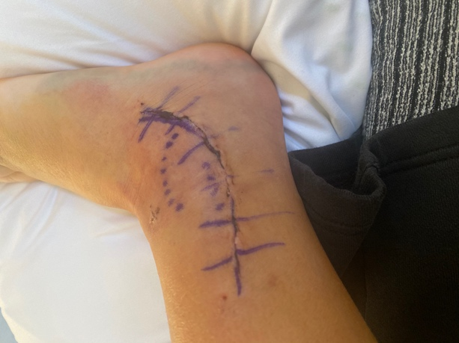
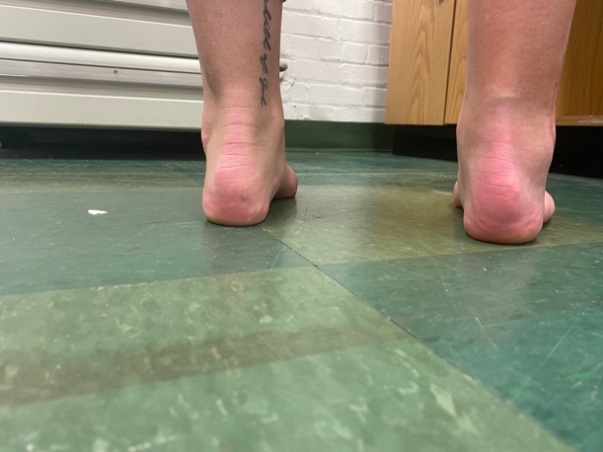
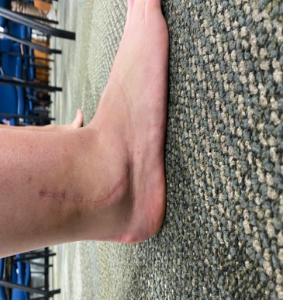
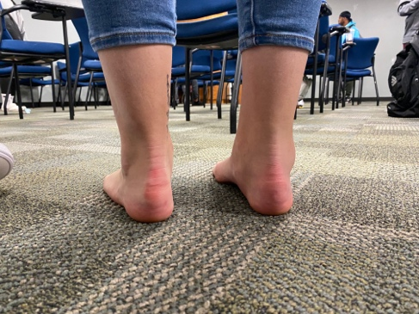
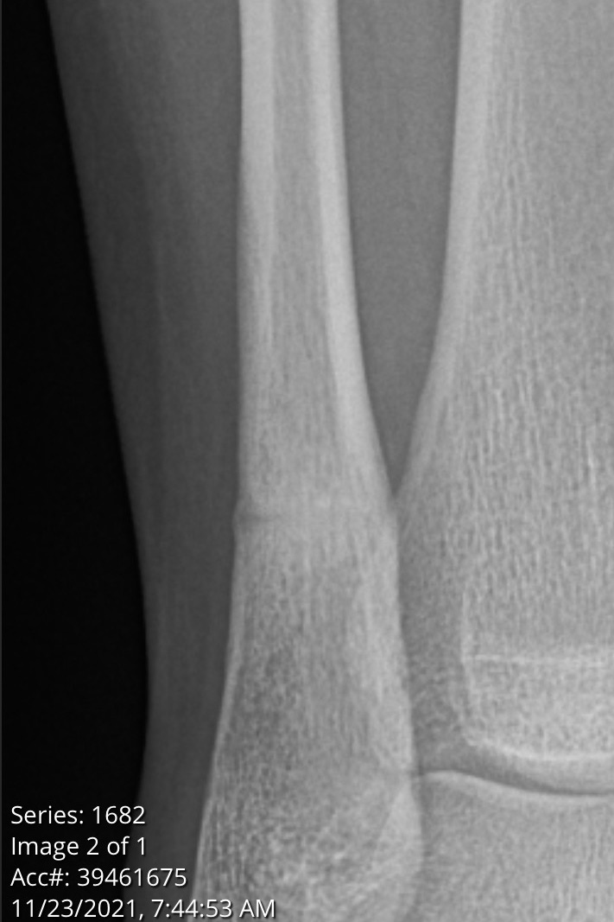
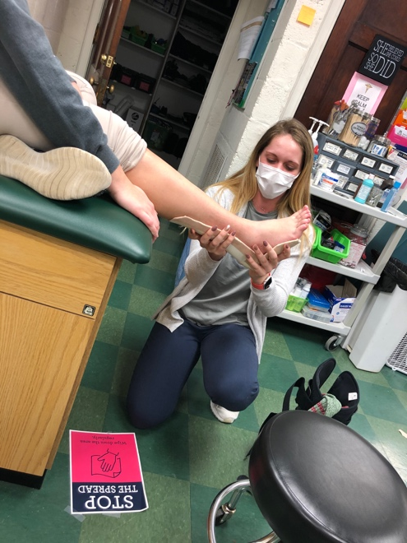
Surgical Intervention of Peroneal Tendon to Chronic Regional Pain Syndrome- A Rare Case Study
Erquiaga, C. M. & Coots, J. G. – Liberty University – 2022
Abstract and/or Background
Results and/or Conclusion
When the ankle is injured, the most common structures tested is the anterior talofibular ligament (ATF). Due to the superficial positioning of the ligament over the sinus tarsi, plantarflexion combined with inversion is the most common mechanism for a lateral ankle sprain (LAS) of the ATF. Located near the ATF is the Peroneal Tendons which connect the Peroneal Longus and Brevis muscles of the lower leg to the 5th metatarsal head and bottom of the foot. Any violent forceful contraction of the tendon into dorsiflexion and inversion can cause it to sublux. In most cases, the tendon subluxes by popping out of the peroneal groove; but, in severe and symptomatic cases, it can sublux all the way over the lateral malleolus.^{1,2} When these pathologies coincide, pain over the lateral malleolus often becomes unable to be treated conservatively and surgery is often warranted.
While surgical intervention is likely to cause relief through repairing the tendon and deepening its groove under the malleolus, it is not guaranteed. In this rare case study, the surgery led to a complete fracture of the fibula, pitting edema, and loss of sensation of the dorsal foot over the lateral tarsal-metatarsal joints. The patient was later diagnosed with Chronic Regional Pain Syndrome and continues to struggle with pain and abnormal sensations to this day. The purpose of this rare case study is to provide information from former studies that support the surgical intervention of athletes with Chronic Ankle Instability and symptomatic peroneal tendon subluxation as well as test the reliability of post-surgical therapeutic rehabilitation. A further goal of this study was to increase awareness of LAS and PTS to improve early detection and surgical intervention in athletes without causing chronic disability.¹
Phase 1: Post-Surgical Evaluation and Treatment: Decrease pain, edema (NWB) (2/10/21-2/27/21)
Time: | Status: | Treatment/Intervention:
Weeks 6-8 post-op: | (02/10/21) – First treatment LEFS- 38 (2/28/21) – Orthoplast night splint made | RICE- Combo (E-stim with Ice), boot, grade 1 DF/PF joint mobs, stretches, foam roller, muscle milk massage
Phase 2: Treatment: ROM and Strength (WB with brace/tape) (2/28/21-3/16/21)
Weeks 9-11 post-op: | (03/3/21) – Took boot off (3/16/21)- Cardiorespiratory Endurance Workout | Dynamic cupping, Friction massage, grade 2-3 joint mobs, wall sits, squats, calf raises
Phase 3: Treatment: Strength & NMC (Fully WB) (3/17/21-4/9/21)
Weeks 12-15 post-op: | (03/18/21)- Aquatic Therapy (03/20/21)- Surgeon clearance for Inversion and Eversion (04/09/21)- LEFS: 54 | Grade 1-2 IN/EV joint mobs, NMC in pool, lunges, glute strengthening, calf raises
The clinical bottom line of this study is that trauma to the lateral ankle structures merit a thorough evaluation in order to properly diagnose and treat injuries conservatively. Once PTS becomes symptomatic, surgery is most often warrented.¹⁻⁴ A rehab plan for LAS must have specific goals based around the patient’s activity levels. If the first sprain is properly treated, the athlete's pre-disposure to instability, tendon subluxation, and permanent decrease in function is less likely. The surgical intervention in this study was successful in reconstructing the torn anatomical structures. However, it is unclear how effective the peroneal groove deepening was. The post-surgical intervention was effective in decreasing pain and edema and increasing strength and proprioception. It focused on the whole lower kinetic chain, not just the distal extremity. The approach was multifaceted, repeatable, and well-researched; and, because of that, the functional limitations of the patient decreased significantly.
Range of Motion measurements and girth were taken on the last visit and had improved significantly from the first visit. A lower extremity functional scale was re-assessed, and the patient scored 54/80 (Table 1). The minimal detectable change (MDC) and minimal clinically important difference (MCID) in the administration of a LEFS is 9 points.⁶ This scale has a .96 internal reliability and .86 test-retest reliability which makes it a great patient related outcome measure.⁶ The only aspects of daily living that did not significantly improve were concerning pain and function with running and hopping. Due to the recurrence of clicking in the lateral ankle, these were unable to be addressed until further consult with the surgeon took place. A return to play will not be indicated until surgeon approval following her appointment in May.
In November of 2021, the patient returned for her pre-operation appointment wear the x-ray in figure 8 was taken. The new surgeon scheduled for her second surgery told her that the fibula was healing well, and surgical intervention was no longer warranted. She was told that the pain and abnormal sensations was due to Chronic Regional Pain Syndrome and that it may last forever. She was assigned to a Physical Therapist to address the symptoms she was still having and told to try to live a normal life until symptoms decreased. Since her last appointment, the patient has been doing self-joint mobilizations to increase dorsiflexion and plantarflexion that are still limited. She reports that her symptoms have decreased but she still has some limitations in strength, motion, and dermatome stimulation.
Lateral and Posterior view of subtalar joint bilaterally: Post-Surgical 1/11/21
Introduction and/or Research Question
Lateral and Posterior view of subtalar joint bilaterally: Post-Treatment 4/17/21
A 22-year-old intermural athlete reported of shooting pain in her lateral ankle and up her lower leg after kicking a ball in an intermural kickball game. She quoted “I felt my tendon snap all the way over my malleolus and just stay there for a second and then come back”. Her pain was a 7/10 but quickly went away and remained a 2/10. She had no numbness or tingling but felt popping and clicking every time she walked during push-off. She remembers feeling like the peroneal tendon was not only snapping out of the peroneal groove, but over the entire lateral malleolus. She reported feeling unstable when she walked. No treatment was done other than wrapping it with an ACE bandage in hopes of increasing stability.
The patient said she has had chronic ankle pain since middle school, having 5 or 6 lateral ankle sprains and not wearing her ankle brace in pre-season However, she has had clicking and popping in her lateral ankle during eversion ever since high school. She said, “I always thought it was just popping from all the injuries”. Her high school ATC rehabbed her for two weeks and then she returned to play.
Misdiagnosis is sadly often the cause of further injury in the world of competitive sports.^{2,3} While ankle sprains are very common and can be treated conservatively, they are also often over-diagnosed not adequately managed.^{2,5} These two factors can lead to Chronic Ankle Instability due to a degeneration of vital stabilizers such as the SPR and peroneal tendons. Chronic Ankle Instability and PTS often occur together in patients with recurrent ankle sprains which can often warrant surgical intervention due to a decline in ankle and knee function.⁵ Therefore, clinicians must always consider damage to the retinaculum or subluxation to the peroneal tendons when evaluating an ankle injury.
Future Work
Arthroscopic procedure for the superior peroneal retinaculum to clear debris and help prevent Peroneal Tendon Subluxation from being able to occur.
Determine how long Chronic Ankle Instability takes to form in a patient and what criteria must be met for it to be considered chronic ankle instability.
Research the most effective way to perform a Peroneal Debridement and repair without needing any fibular involvement which in this case led to a chronic fracture of the fibula.
Determine the physiological components relating chronic pitting edema with superficial sensation loss of the dorsal foot and lateral ankle post-surgically as well as the best treatments for them and ways to avoid them from avoiding concurrently.
Application of an Orthoplast Night Splint to help increase ankle dorsiflexion.
Most recent imaging of the fibula and sub-talar joint showing healing of the fibular fracture caused by surgery.
Methods
Table showing treatment and patient related outcome measures throughout rehabilitation.
1 2 3 4 5 6 7 8 9 10 11 12 13 14
In November of 2020, the patient went to an orthopedic surgeon in her hometown. She was referred for an MRI where the damage to the anterior talofibular ligament (ATF), peroneal tendons and lateral retinaculum was confirmed. The surgeon recommended surgical repair to the tendon and ATF as well as an Arthroscopic Chondroplasty and peroneal groove deepening. Her surgical intervention was on December 28, 2020. According to the surgical notes, the procedure included deepening of her peroneal groove, reconstruction of the ATF ligament and an arthroscopic repair and debridement of the articular cartilage. The patient was discharged the same day as her procedure. Her lower leg and foot was put in a cast for 2 weeks per physician protocol. When the cast was removed, she remained non-weightbearing in a ProCare Xceltrax Air walking boot. From weeks 4-6, the patient began weightbearing and at week 8, the boot was removed. At this time, the patient was given an ankle brace to wear as needed. However, she states she did not wear it very often. Heat, various types of massage, therapeutic Ultrasound, Electrical Stimulation, Eccentric Rehabilitation exercises, cupping, Aquatic Therapy and Passive Joint Mobilizations were all used in addition to the non and partial weight bearing braces and casts to decrease pitting edema, increase range of motion, strength, neuromuscular control and decrease pain. While these were successful, the underlying fibula fracture caused the ankle to never return to full function.
At the last visit with ATS on 4/9/21, the patient stated that she felt a clicking in active eversion, similar to what she felt pre-surgery. The clicking was not painful but began to be visible. Range of Motion measurements and girth were taken on the last visit and had improved significantly from the first visit however, pain had not resided. May of 2021, the patient returned to the surgeon who performed her surgery to discover that her fibula that was partially cut into in surgery was still fractured all the way through the bone. The surgeon explained that while this was not planned, it was probably the cause of her recurrent pain, edema, and loss of function. She was encouraged to continue in Physical Therapy and schedule another surgery for December.
1 2 3 4 5 6 7 8 9 10 11 12 13 14
A
B
References and/or Acknowledgments
Roth JA, Taylor WC, Whalen J. Peroneal tendon subluxation: the other lateral ankle injury. British journal of sports medicine. 2010;44(14):1047-1053.
Hu M, Xu X. Treatment of Chronic Subluxation of the Peroneal Tendons Using a Modified Posteromedial Peroneal Tendon Groove Deepening Technique. The Journal of foot and ankle surgery : official publication of the American College of Foot and Ankle Surgeons. 2018;57(5):884-889.
Purnell ML, Drummond DS, Engber WD, Breed AL. Congenital dislocation of the peroneal tendons in the calcaneovalgus foot. J Bone Joint Surg Br. 1983;65(3):316-319.
Guillo, S., Odagiri, H., van Rooij, F. et al. All-inside endoscopic anatomic reconstruction leads to satisfactory functional outcomes in patients with chronic ankle instability. Knee Surg Sports Traumatol Arthrosc 29, 1318–1324 (2021).
Contributors P. Lower Extremity Functional Scale (LEFS). Physiopedia. https://www.physio-pedia.com/Lower_Extremity_Functional_Scale_(LEFS). Published 2021.
Coetzee C, Ebeling P. Ankle Ligament Reconstruction Rehabilitation Protocol. Tcomn.com. https://tcomn.com/wp-content/uploads/2014/08/Ankle_Ligament_Reconstruction.pdf. Published 2021.
**Special thank you to Dr. John G. Coots for being the faculty sponsor on this Case Study Research Presentation.
C

