Slide 1
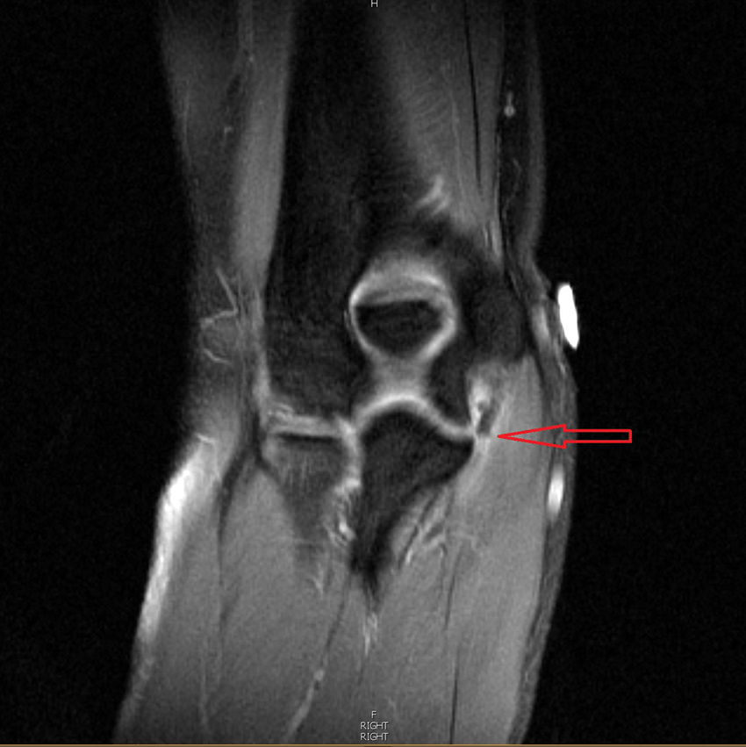
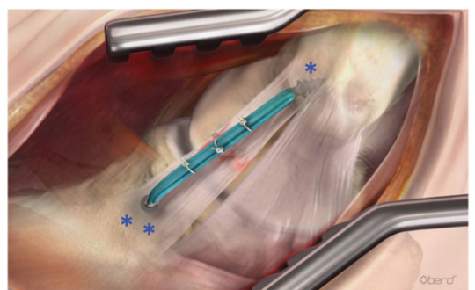
Throwing the Distance: Recovery from an Ulnar Collateral Ligament Repair Surgery – A Case Study
Dofflemyer, T. B.; Wilson, N. A.; Coots, J. G. – Liberty University – 2022
Abstract and/or Background
Methods
Results and/or Conclusion
Background: A Liberty University Track & Field athlete had an Ulnar Collateral Ligament repair surgery in the summer of 2021. The athlete/patient came back to campus post-surgery and started rehabilition at the University’s Athletic Training Facilities. The patient followed up with physicians and physical therapist who assisted in athlete’s rehabilitation treatments. The purpose of this case study is to track the effectiveness of this patient’s rehabilitation/treatment progression plan and to compare how the patient progressed based on other evidence-based research statistics. Methods: The patient’s rehabilitation began prior to the intentions of using this patient as a case study research subject. The measurements used to assess the patient’s progression throughout the rehabilitation/treatment process were obtained through Certified Athletic Trainers and physicians notes, in addition to all other various healthcare providers documentation notes taken. All documentation notes were included throughout the course of the rehabilition of this patient. Results: Even though the patient is currently still undergoing their rehabilitation/treatment plan (not having been fully cleared to return to competition); the patient’s rehabilitation/treatment plan progression has been deemed effective. The patient has been in compliance and has remained on track based on the short- and long-term goals throughout the entire rehabilitation process. However, there have been a couple setbacks in the rehabilitation plan which had caused about a day loss in the expected progression. Overall, the patient is now back on track and is where they need to be. Conclusions: The patient is still in the rehabilitation/treatment process and gaining progress to return to competition. The health care providers selected therapeutic exercises and modalities appear to be effective in obtaining the rehabilitation/treatment plan goals enabling the patient to meet the desired performance standards and timeline consistent with other evidence-based researched rehabilitation/treatment plans of UCL repair surgeries. Although, it must be noted that there were some setbacks and adjustments along the way which were implemented to keep the patient pain free and moving along appropriately. These did not have a negative impact on the overall positive outcomes achieved by the patient throughout the rehabilitation/treatment process. Future research could be done to determine any modifications or additions could be implemented to accelerate the healing process and efficiently enable the patient to the return to play/competition at a faster pace.
In this study, we assessed the patient's progression according to their ability to progress through the stages of rehabilition. We used different modalities throughout the rehabilition to achieve proper progression. For pain we would use ice bags and TENS units. As time went on, we would perform so passive ROM exercises to allow the patient to move the arm eventually though full pain free ROM. After weeks of pain management as passive ROM, we progressed to some active ROM and strengthening. We not only focused on strengthening the elbow, but we also targeted muscles around the elbow with rehabilition exercises. Rehabilition exercises involving the wrist and shoulder were added to achieve these goals. Through the weeks we would progress the athlete through more challenging rehabiliation exercises that become more functional and sports specific. We were able to achieve this goal by throwing a volleyball. Then moved to a baseball and started to increase the distance. Lastly, we have the athlete now throwing a light javelin at 90 feet.
Results: This case study demonstrated that this patient’s rehabilitation/treatment plan outcomes were consistent with the current evidence-based research. The timeline implemented were not exact replicas of the three different sources but provided consistent results. This was due to some factors within this patient’s case study that were outside of the researcher’s control.^{1,2,3} These would include that some days were taken off due to fatigue, soreness, or the inability to perform the task in a pain free motion. Some of these required the rehabilition to be slowed down or regressed to meet the needs of the patient. Some other factors were time management. Meaning that somedays the researchers were not able to complete the rehabilition workout due to other commitments. For example, when the patient had progressed to throwing a javelin, the researchers could not go out and throw as planned because they needed to keep all ATC and ATS in the clinic to treat other patients. All of these played a role in affecting the overall timeline of the patient’s recovery. All other healthcare professionals involved with this patient, such as team physician, surgeon, and physical therapist, were all pleased by the patient’s progression throughout the rehabilitation process. Even the patient felt the progressing was positive and was pleased with the performance improvements from over the course of the rehabilitation/progression process. However, currently the patient has not completed al of the rehabilitation/treatment progressions necessary to return to full participation/competition. So final patient outcomes will still need to be determined. Conclusions: Even though the patient has not completely returned to play and participate in the javelin throwing event, the researchers will continue with the patient’s rehabilitation/treatment plan. The patient is cleared to perform in lower body events, so these events will enable the researchers to assist the patient in maintaining the psychosocial and mental aspects of remaining a contributing member of the track and field team. When it comes to the comparison of other researchers on the topic of the return to play timeframe of a patient with UCL repair, it is evident that this patient’s rehabilitation/treatment plan was very effective and met all the patient’s needs and goals throughout the recovery process including the necessary adjustments. The measurements taken demonstrate that the patient progressed in a health way and eliminated risking reinjury. These supporting factors can be advocated by the other healthcare professionals involved with the researchers throughout the course of the case study. These additional healthcare professionals are comprised of the team physician, surgeon, and physical therapist. Some additional factors that could have played a role in the outcomes data may be the patient’s hormone cycle and diet. Being a female, hormones have been proved to play a role in the healing process. An improper diet can leave out essential nutrients which can hinder the healing process. Future research is needed to fully understand the topic.
5
6
Figure B. Artist rendering of medial side of the right elbow. Ulnar collateral ligament repair with augmentation using an Internal Brace. Surface tied into the ligament for repair are incorporated into the anchor and seated into the epicondyle and/or sublime tubercle.
Retrieved from: Nicolette GW, Gravlee JR. Ulnar collateral ligament injuries of the elbow in female division I collegiate gymnasts: a report of five cases. Open Access Journal of Sports Medicine. 2018;Volume 9:183-189. doi:10.2147/oajsm.s159624
Future Work
Figure A. This image is of a torn UCL in a baseball pitcher. This is not the image of the tear that had occurred in the subjected that was studied in this case study. The arrow is to identify where the relevant structure would be.
Retrieved from: Rich Hill Elbow Surgery Discussion. Twins Daily. Accessed March 8, 2022. https://twinsdaily.com/blogs/entry/11884-rich-hill-elbow-surgery-discussion/
Future research can address many different aspects revealed within this case study. The first would be what other routes of surgery would have done for the recovery time. The two ways that they surgery can be preformed is an allograft or autograft. These methods will either use the ligament from the patients own body or use a ligament from a cadaver. This research is in consideration of the integrity of a cadaver’s ligament, while be preserved, it is still decomposing. Another research idea is the use of other modalities. Two of the modalities that I would want to focus on I the future are low light laser therapy and Russian setting for electric stimulation. Low light laser therapy is still being researched for its usefulness, but the reason for my interest is that can potentially accelerate tissue healing. The other modality is Russian setting for electric stimulation. Russian has been shown to restore a small amount of strength and reeducate muscles. I feel like if this was to be used more aggressively then we possibly see decrease in the amount of recovery time through the strengthening and ROM phases of rehabilition. The last suggestion I have is to see how this will affect the patient when they are able to compete again in their respective events. This would view the patient in different dimensions. Firstly, we could evaluate how they patient throws comparing post-injury versus pre-injury results . Secondly, I would like to ask the patient how they feel physically when they are throwing to make sure they are pain free and able to fully participate. Lastly, I would look at the mental aspect (psychosocial). Coming back from a surgery and being out of participation/competition does affect patient’s psychosocial health and wellbeing. We are also asking the patient to perform the same task that caused the initial injury to begin with. This will enable us to competently evaluate how the patient deals with both the physical and mental aspects toward improving patient rehabilitation/treatment progressions before they return completely to activity.
Introduction and/or Research Question
PATIENT Rehabilitation/Treatment Record/Plan
Exercise | Settings | Repetitions | Date
 |  |  | 23-Sep | 27-Sep | 28-Sep | 4-Oct | 5-Oct | Set change | 7-Oct | 8-Oct | 11-Oct | 12-Oct
Shoulder Pendulums | (each direction) | 1 set x 20 reps | X | X | X | X | X
Shoulder Raises | Flexion | 2 sets x 10 reps. | X | X | X | X | X | 3 sets x 10 reps. (4 lbs.) | X | X | X | X
 | Extension | 2 sets x 10 reps. | X | X | X | X | X | 3 sets x 10 reps. (4 lbs.) | X | X | X | X
Shoulder Shrugs |  | 1 set x 30 reps. | X | X | X | X | X
Biceps Curls | Palms Up | 1 set x 15 reps. | X | X | X | X | X
 | Thumbs Down | 1 set x 15 reps. | X | X | X | X | X | 3 lbs. | X | X | X | X
Prone Rows |  | 2 sets x 5 reps. | X | X | X | X | X | 3 lbs. | X | X | X | X
Prone Shoulder | Extension | 1 set x 30 reps. | X | X | X |  | X
 | Horizonal Rotation | 1 set x 30 reps. | X | X | X |  | X
Shoulder Squeeze |  | 1 set x 30 reps. | X | X | X |  | X
Side Lying | External Rotation | 1 set x 30 reps. | X | X | X | X | X |  | X | X | X | X
 | Abduction | 1 set x 30 reps. | X | X | X | X | X | 3 sets x 15 reps. (2 lbs.) | X | X | X | X
Thera tubing Triceps | Extension | 3 x 10 reps. | X | X | X | X | X
Towel Squeezes |  | 1 set x 30 reps. | X | X | X |  | X
Wall Isometric | Flexion | 1 set x 15 reps x 5 sec. | X | X | X |  | X
 | Extension | 1 set x 15 reps x 5 sec. | X | X | X |  | X
 | Abduction | 1 set x 15 reps x 5 sec. | X | X | X
 | Internal Rotation | 1 set x 15 reps x 5 sec. | X | X | X
 | External Rotation | 1 set x 15 reps x 5 sec. | X | X | X
Table Ball Roll-Outs |  | 1 set x 25 reps | X | X | X | X | X |  |  | X
Wrist | Flexion/Extension | 1 set x 30 reps. | X | X | X | X | X |  |  | X
 | Radial Deviation | 1 set x 30 reps. | X | X | X | X | X |  |  | X
 | Pronation/Supination | 1 set x 30 reps. | X | X | X | X | X |  |  | X
4
This case study examined the rehabilitation/treatment standards and timeline of a patient following a UCL repair surgery. Within the sport of track and field, especially in javelin throwing athletes, clinicians encounter repeated injuries to the UCL which necessitate the need for further medical attention. Specifically, this case study involves a division one track and field javelin thrower directly following UCL repair surgery. The timeline initiates from the day after surgery until patient’s currently status, which is not fully able to return to competition. Certified Athletic Trainer reviewed medical notes/documentations from involved physicians, surgeons, and physical therapists. The patient’s ability to progress through the rehabilitation process comfortably without too much strain and pain was also taken into consideration. The desired question to investigate was be presented above. After that, the following section will be my methods, results, future work, and conclusions.
Hypothesis: Is the rehabilitation/treatment implemented with this case study patient effective and efficient in comparison with current evidence-based practices for rehabilitation/treatment of UCL repair surgeries. Researcher used the timelines that current data suggested and with current exercises employed. Two evidence-based sources were used to compare this patient’s rehabilitation protocols. The first was a UCL repair rehabilition from UVA and the second was from Johns Hopkins. Both of these studies provided valid and reliable guidelines and timelines to follow. Overall objective of this case study was to comparing these evidence –based protocols with the outcomes determine throughout this patient’s rehabilitation/treatment plan
1 2 3 4 5 6 7 8 9 10 11 12 13 14
1 2 3 4 5 6 7 8 9 10 11 12 13 14
A
B
Figure C. The following chart is an image of one of the rehabilition workout sheets that the patient filled out to track there rehabilition workouts. The longitudinal boxes are to mark days that they came into the clinic to do rehabilition. The vertical is to show what exercises they are to complete in that time frame. The boxes in-between are marked to see what they performed fully and those that were not filled in were not completed.
References and/or Acknowledgments
C
Medial Ulnar Collateral Ligament Reconstruction. Techniques in Shoulder & Elbow Surgery. 2017;18(4):151. doi:10.1097/bte.0000000000000138
Bakker's Post-Op Protocol. Elbow Radial Collateral/Ulnar Collateral Ligament Repair. Accessed March 8, 2022. https://tcomn.com/wp-content/uploads/2016/06/Elbow-Radial-Collateral-Ulnar-Collateral-Ligament-Repair.pdf
‌Holtkamp K. Elbow Ulnar Collateral Ligament (UCL) Repair Rehabilitation Protocol. Accessed March 8, 2022. https://www.orthoillinois.com/wp-content/uploads/2016/12/Elbow-UCL-Reconstruction-2017.pdf
Noah Wilson MS ATC, in-person, 2021
Rich Hill Elbow Surgery Discussion. Twins Daily. Accessed March 8, 2022. https://twinsdaily.com/blogs/entry/11884-rich-hill-elbow-surgery-discussion/
Nicolette GW, Gravlee JR. Ulnar collateral ligament injuries of the elbow in female division I collegiate gymnasts: a report of five cases. Open Access Journal of Sports Medicine. 2018;Volume 9:183-189. doi:10.2147/oajsm.s159624
**Special thank you to Dr. John G. Coots for being the faculty sponsor on this Case Study Research Presentation.

