Slide 1
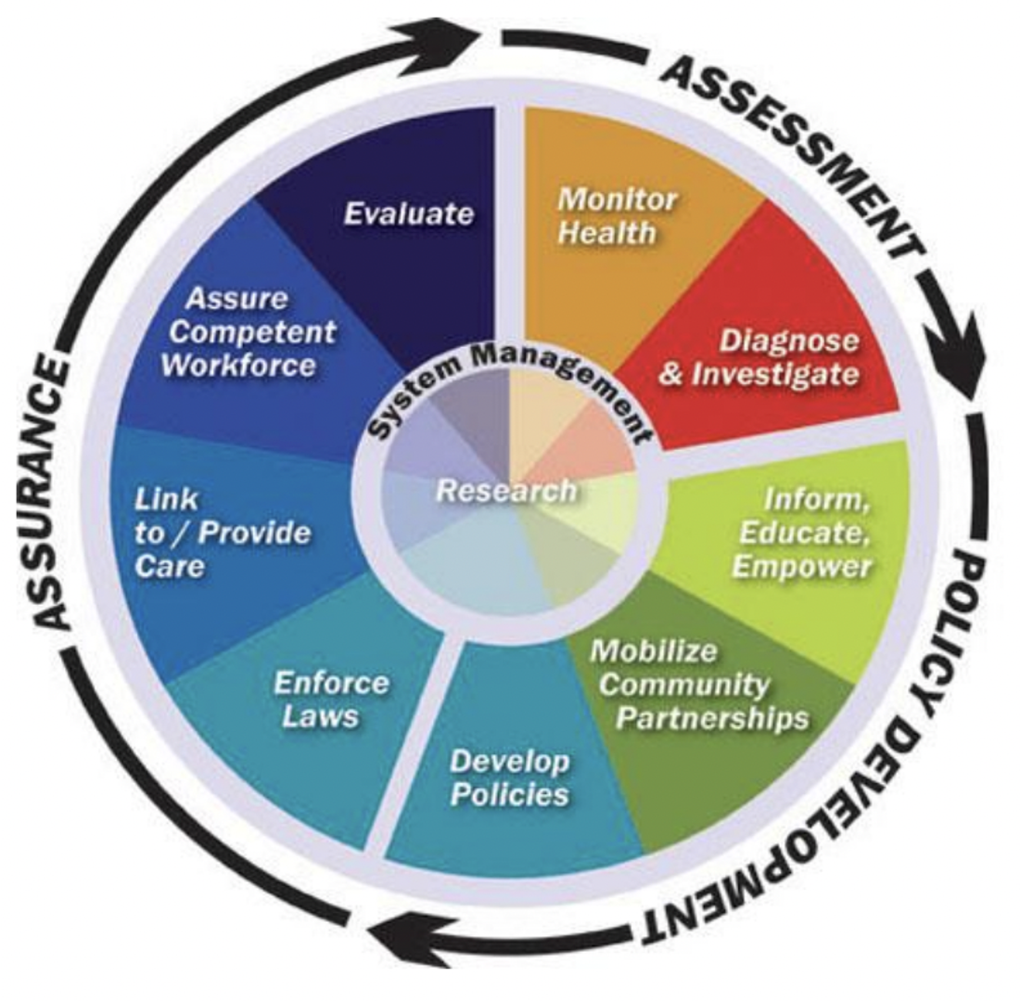
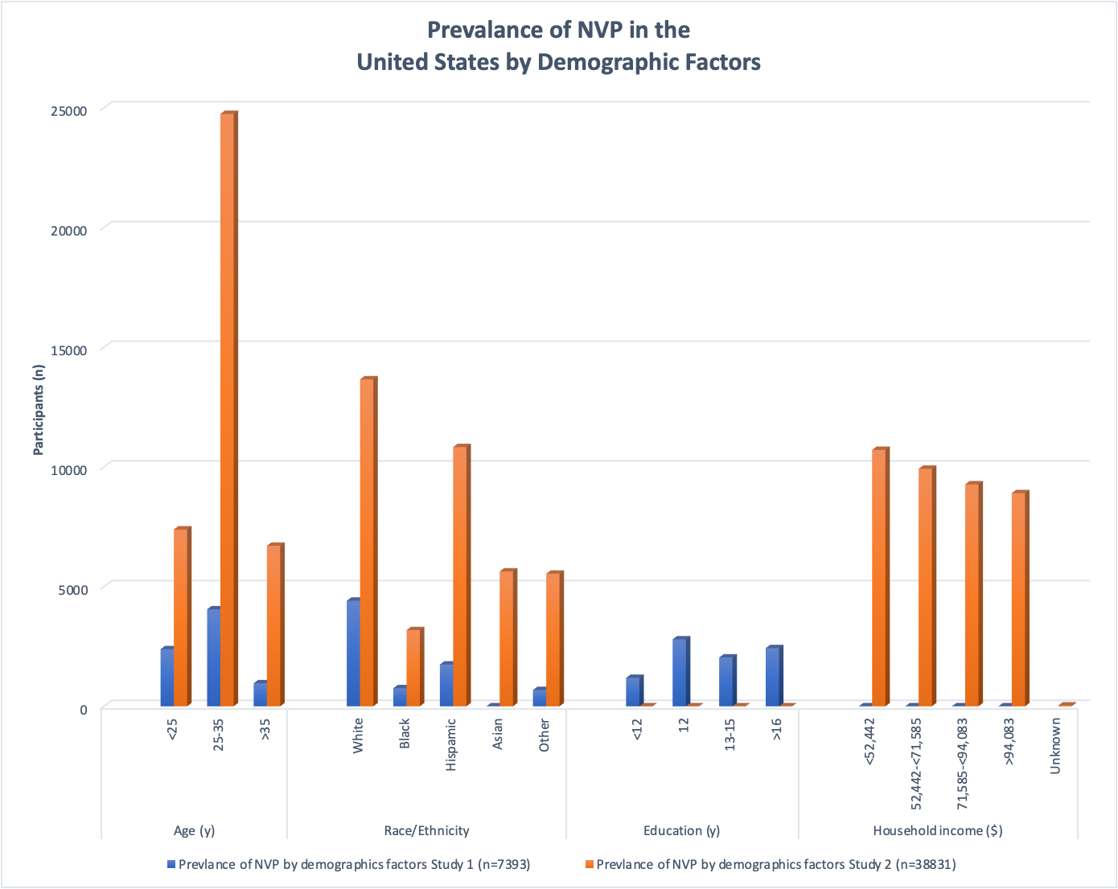
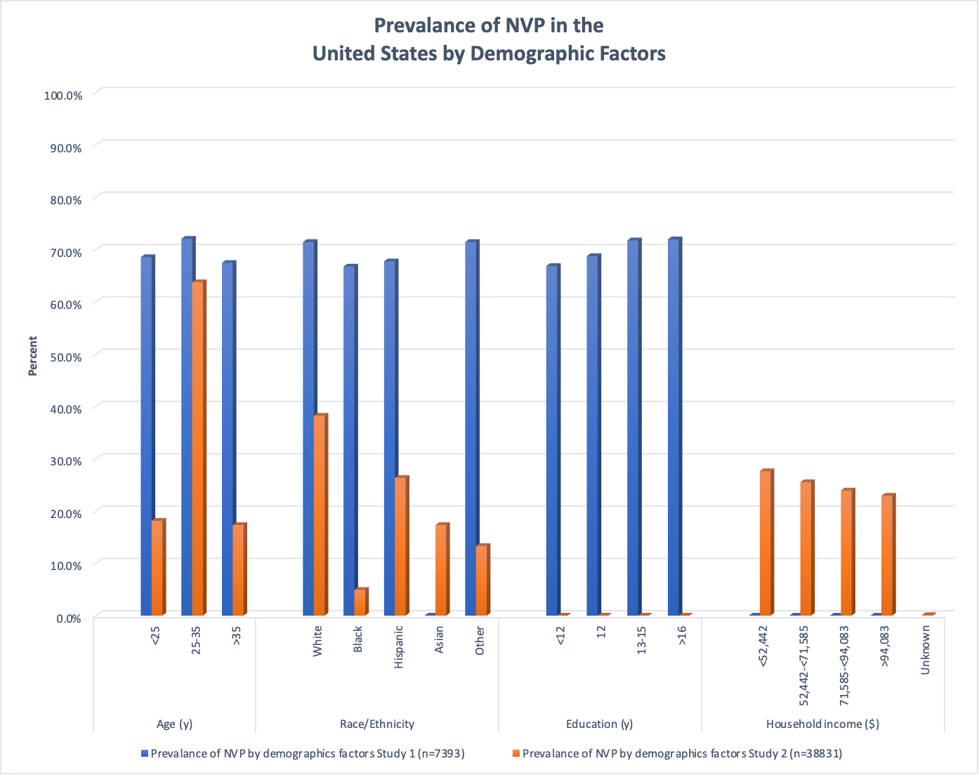
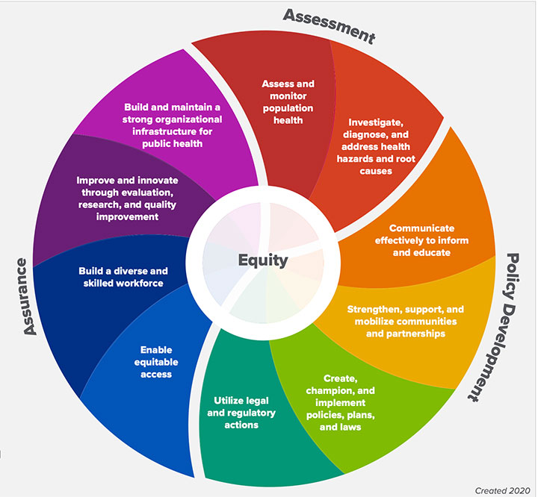
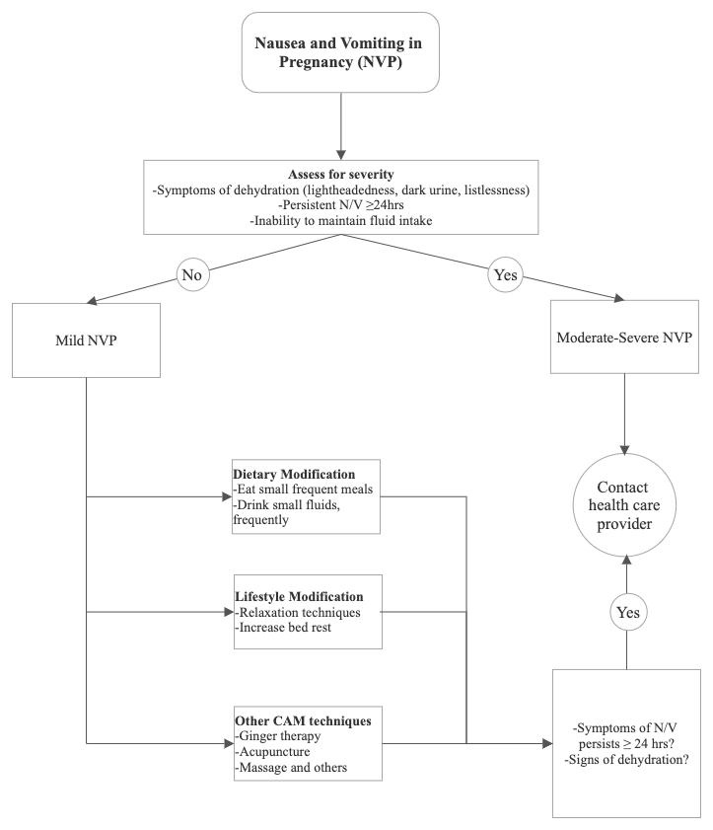
Use of Complementary Alternative Medicine to treat Nausea and Vomiting during Pregnancy across Disparate Demographics and Vulnerable populations: Application of a Conceptual Equity Framework
Stephanie C. Ogbonda, Glodi Bokanya, Som Subba, Yasmeen Fathima, Linnaya Graf, PhD, MCHES
Abstract
Table 1: Prevalence of NVP by demographic factors
 | Study 1 (n=7393) | Study 2 (n=38831)
Age (y)
<25 | 2384 | 7384
25-35 | 4050 | 24,742
>35 | 959 | 6705
Race/Ethnicity
White | 4408 | 13654
Black | 754 | 3181
Hispanic | 1746 | 10826
Asian | n/a | 5631
Other | 679 | 5539
Education (y)
<12 | 1184 | N/A
12 | 2793 | N/A
13-15 | 2038 | N/A
>16 | 2428 | N/A
Household income ($)
<52,442 | N/A | 10708
52,442-<71,585 | N/A | 9919
71,585-<94,083 | N/A | 9269
>94,083 | N/A | 8901
Unknown | N/A | 34
Results & Conclusion
Background: Nausea and vomiting affect 70–80% of pregnant women. Pregnant women seek pathways to relieve symptoms and public health and medical professionals must understand their decision-making process. The current study presents a comprehensive synthesized literature review updating a published dissertation, Perceptions of Using Complementary Alternative Medicine During Pregnancy for Nausea and Vomiting which had a homogenous sample size and critiques the published work using the 10 Essential Public Health Services (EPHS) 2020.
Methods: The research design utilized a matrix system to collate current literature. Articles from electronic databases including ProQuest Central database, PubMed, and other scholarly sources. Search criteria were set for the publication year (2017–2022), document type (peer-reviewed), language (English), not included in the original dissertation and were limited to the United States.
Results: The initial search yielded 76 peer-reviewed articles. Of these articles, 35 met inclusion criteria. A secondary search limited to PubMed yielded 15 articles. Of those, 11 of 15 selected articles were excluded for sufficient relevance. Results from the synthesized literature support the potential effectiveness of CAM in management of NVP. The hypothesized difference across demographic populations was also supported.
Conclusions: Better understanding of the use of CAM for NVP is important for public health programming, health promotion strategies, and sound medical health education across different populations. Future research must apply equity principles and seek decision making experiences through strategies that include priority sampling for diverse populations.
B
Results
The initial search produced 76 peer-reviewed articles, with 35 meeting criteria for inclusion. After deleting duplicates, a search of the PubMed database generated an additional 15 articles. Of those, 11 out of the 15 were eliminated due to insufficient relevance to NVP and CAM. The final pool contained 39 papers for analysis. Sample sizes for studies ranged from 33 to 184,581. Herbal medicine, massage, acupuncture/acupressure, vitamin B6, and ginger treatment were among the most often utilized complementary and alternative medicine (CAM) techniques. Comparison between the original dissertation and the updated literature review revealed similarities in management protocol utilized by pregnant women. However, differences across racial and ethnic groups, educational and income background documented the need for improved research focused on understanding the use of CAM across disparate demographic pools.
Discussion
The original dissertation, although limited, fulfilled a former directive of public health essentials focused on research. However, the current 10 essential public health services requires a focus on equity and the identified demographic differences across studies highlights a need for improved equity in data collection procedures. Future research recommendations include applying a more rigorous assessment of population health using a modified measure from the original dissertation study through a sampling strategy that includes priority sampling for diverse populations. Future work must consider recent core essential public health services and seek to create culturally appropriate data collection and intervention tools establishing an acceptable dialogue regarding CAM therapies.
Conclusion
Our findings demonstrate the potential efficacy of CAM in the management of NVP, particularly in pregnant women with mild to moderate symptoms. However, future research must seek data and observations from diverse population groups. Understanding the significance of core public health services to health promotion should guide future research on NVP management to ensure equity.
A
Introduction
Table 2: Prevalence of NVP by demographic factors
 | Study 1 (n=7393) | Study 2 (n=38831)
Age (y)
<25 | 68.50% | 18.10%
25-35 | 72.00% | 63.70%
>35 | 67.40% | 17.30%
Race/Ethnicity
White | 71.40% | 38.20%
Black | 66.70% | 4.90%
Hispanic | 67.70% | 26.30%
Asian | N/A | 17.30%
Other | 71.40% | 13.30%
Education (y)
<12 | 66.80% | N/A
12 | 68.70% | N/A
13-15 | 71.70% | N/A
>16 | 71.90% | N/A
Household income ($)
<52,442 | N/A | 27.60%
52,442-<71,585 | N/A | 25.50%
71,585-<94,083 | N/A | 23.90%
>94,083 | N/A | 22.90%
Unknown | N/A | 0.10%
▪ Nausea and vomiting during pregnancy (NVP) commonly occurs among pregnant women during gestation. In the United States, between 70-80% of pregnant women experience NVP.¹
▪ NVP is a prevalent illness that affects pregnant women in their first trimester, with 23.5% still having symptoms far into the third trimester.²
▪ Even in its milder forms, NVP can often produce a negative impact on women’s psychological and physiological levels of stress, to include their daily activities, social functions, and work capabilities.³
▪ Complementary Alternative Medicine (CAM) is a potential natural treatment that can be used for pregnant women as a pathway to reduce symptoms of NVP. The expansion of traditional and complementary medicine (CAM) have become a worldwide trend, according to the World Health Organization (WHO). ⁴
▪ Some forms of CAM include aromatherapy, acupuncture, homeopathy, massage therapies, and reflexology.
▪ Several population studies have found that ethnic disparities exist in NVP incidences and symptomatology.⁵ However, current studies have not explored population differences in how CAM is used despite differences of how NVP appears to be experienced.
▪ The aim of the current research is to critique and update literature from a recently published dissertation on CAM and NVP, comparing the published dissertation demographics with identified demographic differences from a synthesized literature review. Further, the 10 Essential Public Health Services (EPHS) 2020 model is applied as a conceptual framework to make recommendations for a more robust and disparate study through applying principles of equity.
Recommendations & Future Work
A future study applying the core function Assessment to conduct a more rigorous assessment of population health using a modified measure from the original study.
Improved investigation of health hazards and root causes applying the core function of Equity through a sampling strategy that includes priority sampling for diverse populations.
The use of participatory approaches and culturally sound ethics for future tools that include stakeholders in the development of health education, promotion, and strategies to assist pregnant women in making informed decisions about the use of CAM in the treatment of NVP.
B
1 2 3 4 5 6 7 8 9 10 11 12 13 14
Fig. 1: Original (1994) vs. Revised (2020) Essential Public Health Services Source: https://www.cdc.gov/publichealthgateway/publichealthservices/essentialhealthservices.html
B
Methods
References
Database | ProQuest Central Database, PubMed JF LU Library, Google Scholar.
Year of study interval | 2017-2022
Search Terms | Nausea, Vomiting, NVP, Pregnancy, Complementary Alternative Medicine Boolean Operators [AND], [OR]
Inclusion Criteria | Peer-reviewed, English publications, 2017-2022, Not previously used in the published dissertation, Affiliated with institution in the United States
Screening | Articles retrieved and synthesized independently by two authors for relevance
Literature Matrix Methodology | Study description- year, article reference keywords Study design- purpose of the study, basic study design. IV/DV Variables, Research question Study quality: Ethical concerns or bias
Table 3: Complementary Alternative Medicine (CAM) as a modality
Prayer
Music therapy
Psychotherapy
Humor therapy
Music Therapy
Hypnosis (Hypnobirthing, Calm birthing)
Meditation
Homeopathic remedies
Imagery techniques
Reiki/therapeutic touch
Traditional Chinese Medicine (TCM)
Self-hypnosis
Bowen therapy
Reflexology
Yoga
Fig 2: Flowchart showing management of NVP
Bustos M, Venkataramanan R, Caritis S. Nausea and vomiting of pregnancy - what's new? Auton Neurosci. 2017;202:62–72. doi:10.1016/j.autneu.2016.05.002
Heitmann K, Nordeng H, Havnen GC, Solheimsnes A, Holst L. The burden of nausea and vomiting during pregnancy: severe impacts on quality of life, daily life functioning and willingness to become pregnant again - results from a cross-sectional study. BMC Pregnancy and Childbirth, 2017;17:75. doi:10.1186/s12884-017-1249-0
Revell. Self-care of nausea and vomiting in the first trimester of pregnancy. Int J Childbirth Educ. 2017;32(1):35-39.
World Health Organization. Complementary and Integrative Medicine. https://www.who.int/westernpacific/health-topics/traditional-complementary-and-integrative-medicine. Published November 7, 2016. Accessed March 13, 2022.
Liu C, Zhao G, Qiao D, et al. Emerging progress in nausea and vomiting of pregnancy and hyperemesis gravidarum: challenges and opportunities. Front Med. 2022;8:809270. doi:10.3389/fmed.2021.809270
Demographics Homogeneity of the Original Study, N=12
Ethnicity: 100%, N=12 are White
Education: 92%, N=11 have post secondary education Married: 92%, N=11 are married
Employed: 92%, N=11 are employed (some variation in type and hours)
Income: 58%, N=7 make over 100K+, (income is categorized very broadly)
Table 4: Herbs
Aloe Vera
Ginger – Zingiber officinale
Bitter gourd – Momordica
Betel Nuts – Areca catechu
Black seed – Nigella sativa
Evening Primrose oil
Olive oil
Kola nuts
Lime leaves – Citrus aurantifolia
Neem – Azadirachta indica
Guava leaves
Prune – Prunus domestica
Turmeric

