Slide 1
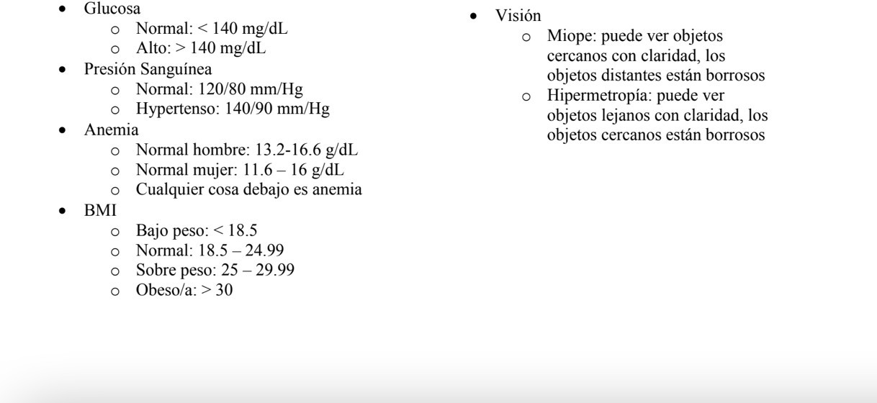
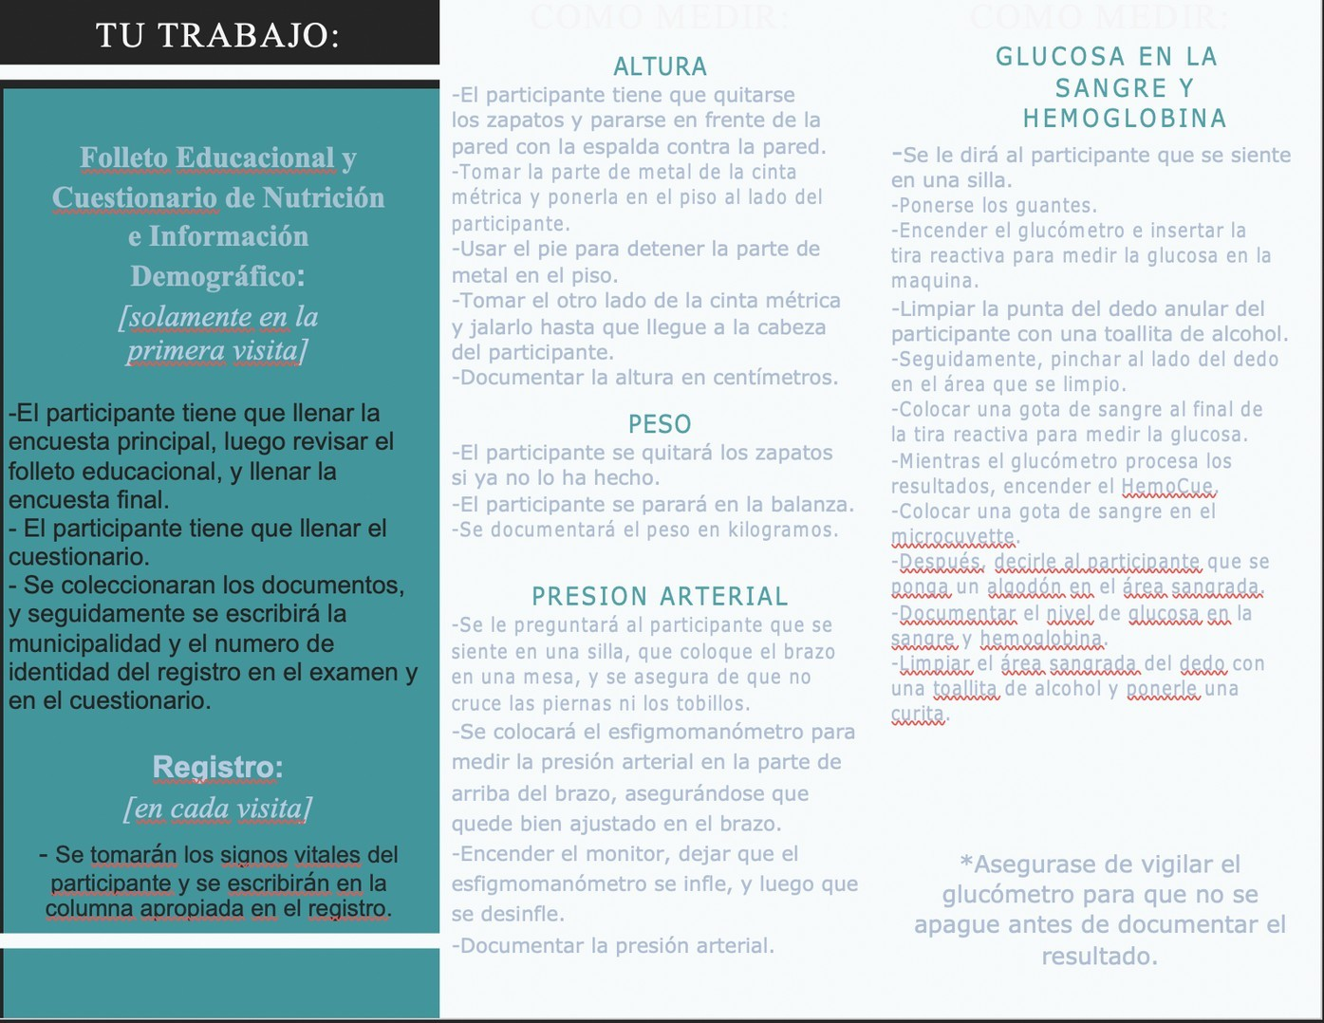
Community Health Workers in Guatemala
Rebecca Brown MPHc; Andrea Harper, RN,MPH; Dr. Oswald Attin, MSHS, PhD
Abstract
Table 1 Demographic Characteristics of Total Participants in Health Screening in Zacapa, Guatemala
Characteristic |  | Frequency | Percent
Gender (n=182)
Male |  | 44 | 24.2
Female |  | 138 | 75.8
Age (n=182)
11-17 |  | 32 | 17.6
18+ |  | 150 | 82.4
Results and Conclusions
This research discusses the benefits and outcomes of utilizing Community Health Workers (CHW) in three rural communities in Guatemala. A team of public health professionals, graduate students, and faculty at Liberty University collaborated with a local community church in Zacapa, Guatemala to offer health screenings to their communities. The collaboration also included the opportunity to train members of the church on how to use the equipment, as well as training leaders in the other locations visited. The health screenings included demographic data, nutritional data, height and weight, blood glucose check, hemoglobin check, and blood pressure reading. Utilizing community health workers in the areas we reached in Guatemala is vital so that the work will continue when our group must leave. Our group provided access to health screenings to a total of 237 participants. Most of the participants were over the age of 17, and about 76% of them were female. We created a registry in these communities where members could continue to check their blood glucose and blood pressure after the recommendations were made from the doctor. Finally, with the data collected, we analyzed and determined what other interventions could be made to provide better health care for the future visits.
Figure 1: Normal and Abnormal Values used for reference in health screens
Results
The data collected was inputted and analyzed. The interpretation are displayed in the results section. Most of the participants were over the age of 17 (82.4%). There were also more female participants than male (75.8% and 24.2%, respectively). Educational efforts were measured by accurate demonstrations and correct answer to questions at the end of the sessions. Information about the participants diet were received to understand nutritional habits and identify health risks in the community.
Conclusions
Using the methods described above, it allowed for access to the community where our group could provide education and supplies to improve this populations health. These methods allowed for 237 participants screenings to be analyzed in this study. Some limitations of this study are the gap year experienced in the 2020 COVID-19 Pandemic and the consideration that some participants were too young to have samples taken, but education was provided.
Participants Average BMI, Blood Sugar, Hemoglobin, and Systolic Blood Pressure, by Age, Zacapa, Guatemala, 2021
Recommendations and Future Work
Introduction and Research Question
Implement a first aid response for first responders to provide medical care while the patient waits for emergency medical services.^{4,5}
Future studies are needed to understand if training community health workers will help educated the communities in Guatemala.
Future studies to understand if Community Health Workers are accessible to provide treatment for Chronic Diseases in Guatemala.
Future studies to understand if education is beneficial to prevent Chronic Disease.
Understanding each population and community to develop interventions that are specific to them.
Community Health Workers (CHW) have been around for many years, being especially helpful in middle- and low-income countries.¹ The benefits of CHW’s are tenfold, with the communities in which they interact receiving the most benefit.^{2,3} This research serves to discuss the outcomes and benefits of the involvement of CHW’s in health screenings done in three rural communities in Guatemala. Additionally, this paper details the health screenings that were conducted by a group of public health professionals, graduate students, and faculty at Liberty University while working alongside a church in Zacapa, Guatemala.
BMI
Blood Sugar
Health Screens
Hemoglobin
Systolic Blood Pressure
0
20
40
60
80
100
120
140
Average value of BMI, Blood Sugar, Hemoglobin, SPB
Methods
18+ years
11-17 years
The health screenings performed included a detailed questionnaire that collected demographic and nutritional data, height and weight, blood glucose check, hemoglobin check, and blood pressure reading. Following the measurements, the participant would then receive a consult from a doctor that would review their results and conduct a brief assessment of their overall health or any concerns. The volunteers that worked alongside the health care professionals and graduate students were involved in every step of the screening, including the questionnaire, health assessment tests, and evaluation. This ensured familiarity with the community members and training opportunities. After the health screenings were completed for the day, an in-depth educational session was done with the community health workers to go over how to do the measurements needed for the assessments. The teach back method was used to verify effectiveness of teaching and reinforcement was done to ensure all CHW’s felt comfortable doing the various tasks in the health screening.
CHW Return Demonstration
References and/or Acknowledgments
20%
1) Huang W, Long H, Li J, et al. Delivery of public health services by community health workers (CHWs) in primary health care settings in China: a systematic review (1996–2016). Global Health Research and Policy. 2018;3(1). doi:10.1186/s41256-018-0072-0
2) Lapidos A, Lapedis J, Heisler M. Realizing the Value of Community Health Workers — New Opportunities for Sustainable Financing. New England Journal of Medicine. 2019;380(21):1990-1992. doi:10.1056/nejmp1815382
3) Lehmann U, Sanders D. Community health workers: What do we know about them? The state of the evidence on programmes, activities, costs and impact on health outcomes of using community health workers. World Health Organization. https://www.who.int/hrh/documents/community_health_workers.pdf. Published January 2007. Accessed June 6, 2021.
4) Delaney PG, Figueroa JA, Eisner ZJ, et al. Designing and implementing a practical prehospital emergency trauma care curriculum for lay first responders in Guatemala. Trauma Surg Acute Care Open. 2020;5(1):e000409. Published 2020 Apr 2. doi:10.1136/tsaco-2019- 000409
5) Kironji AG, Hodkinson P, de Ramirez SS, et al. Identifying barriers for out of hospital emergency care in low and low-middle income countries: a systematic review. BMC Health Serv Res. 2018;18(1):291. Published 2018 Apr 19. doi:10.1186/s12913-018-3091-0
47%
33%
1st Try
2nd Try
3rd Try
Figure 2: Brochure in Spanish translated by members of the team for use in the educational portion of the CHW training
Visual representation of the percentage of community health workers who performed a correct return demonstration by attempt

