Slide 1
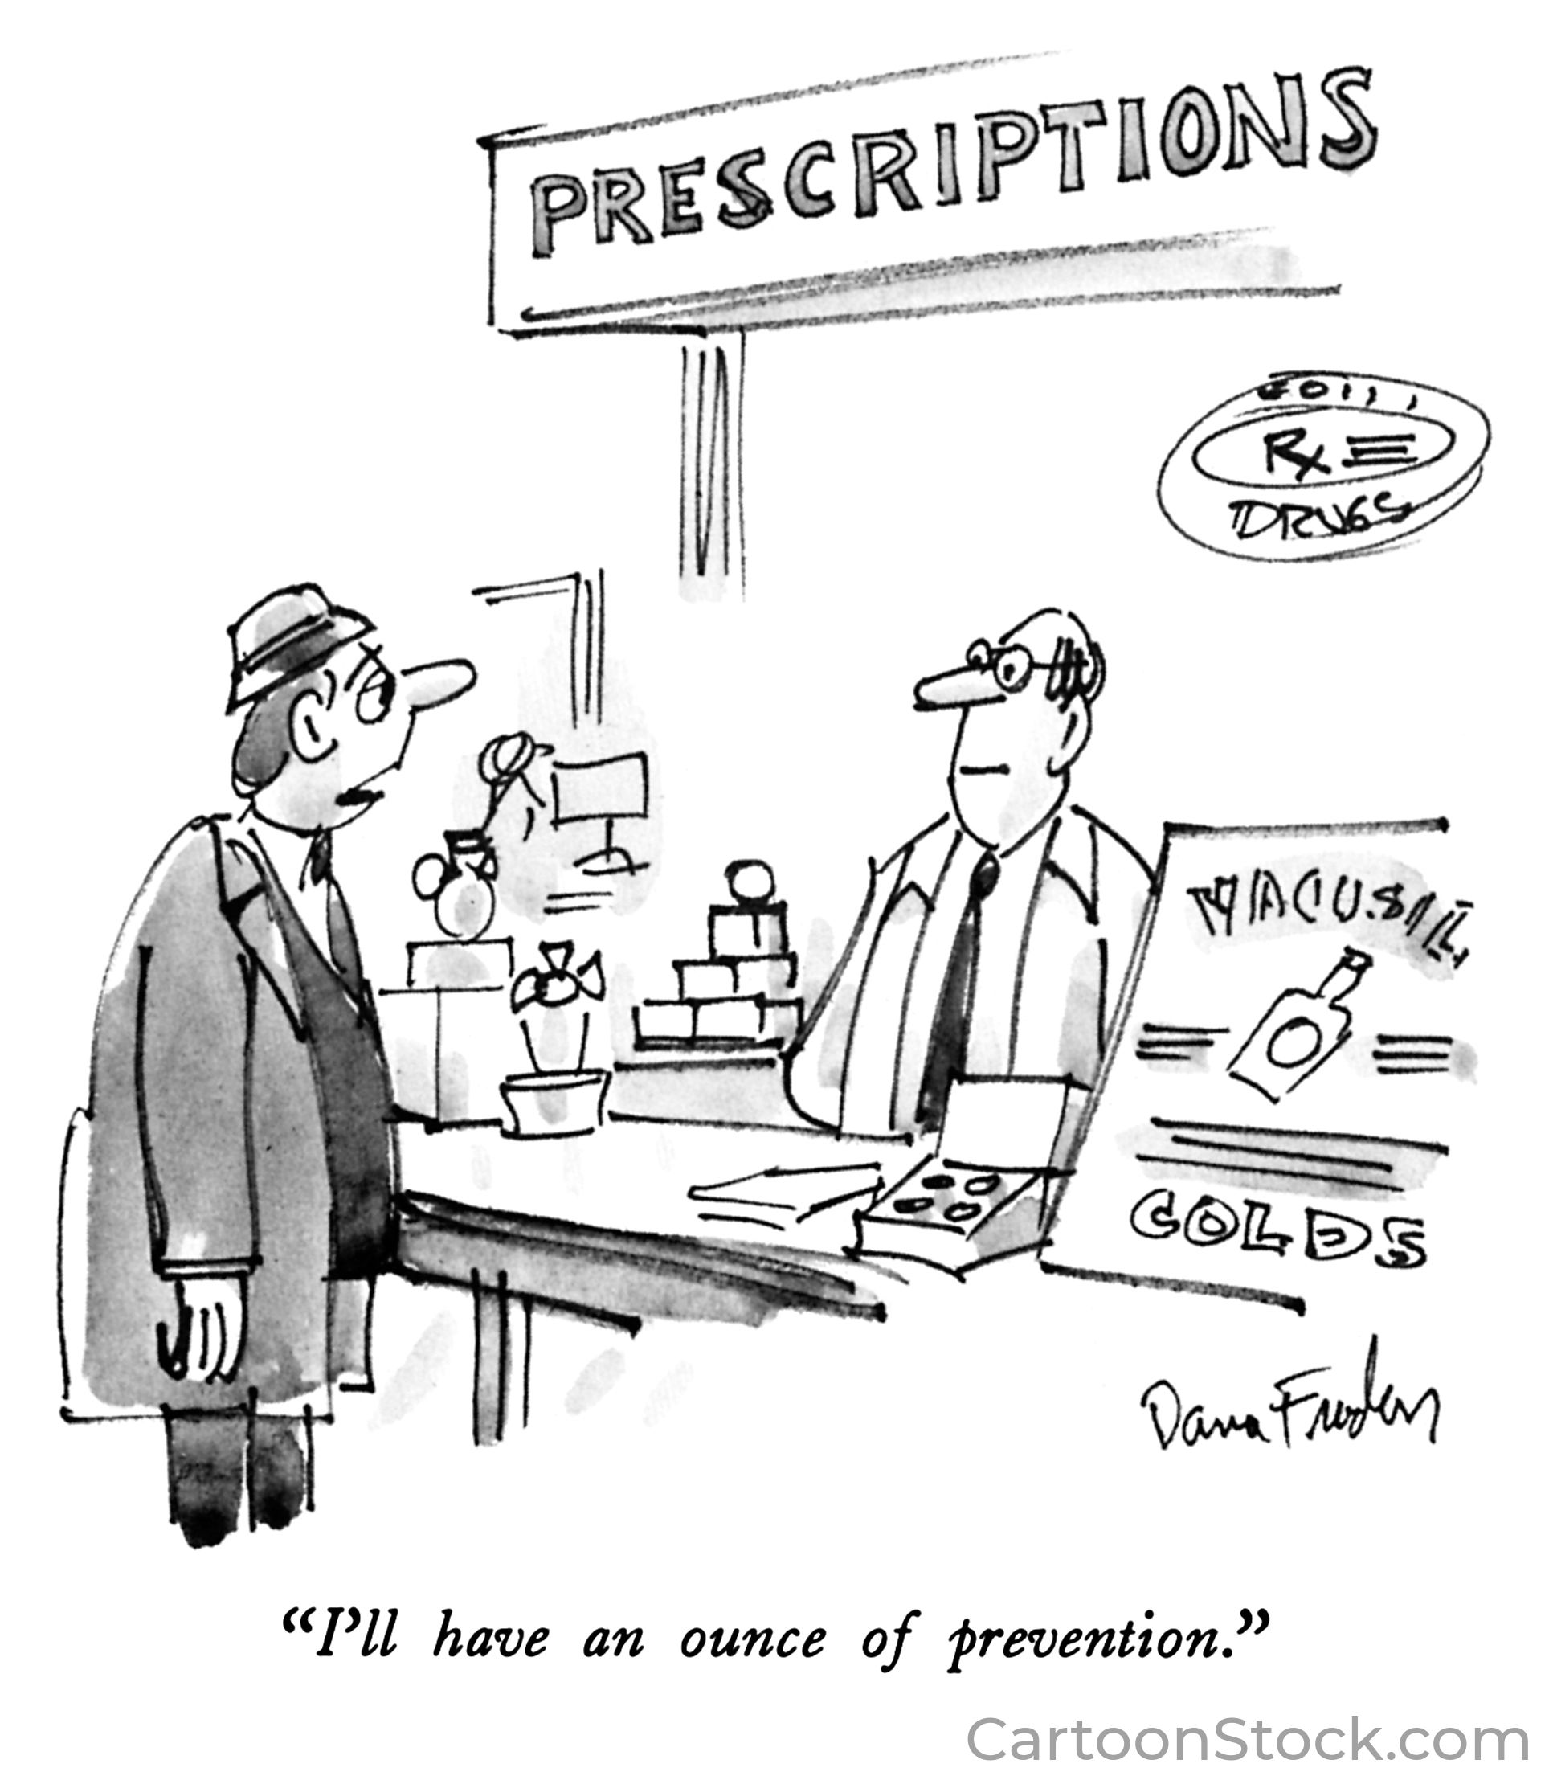
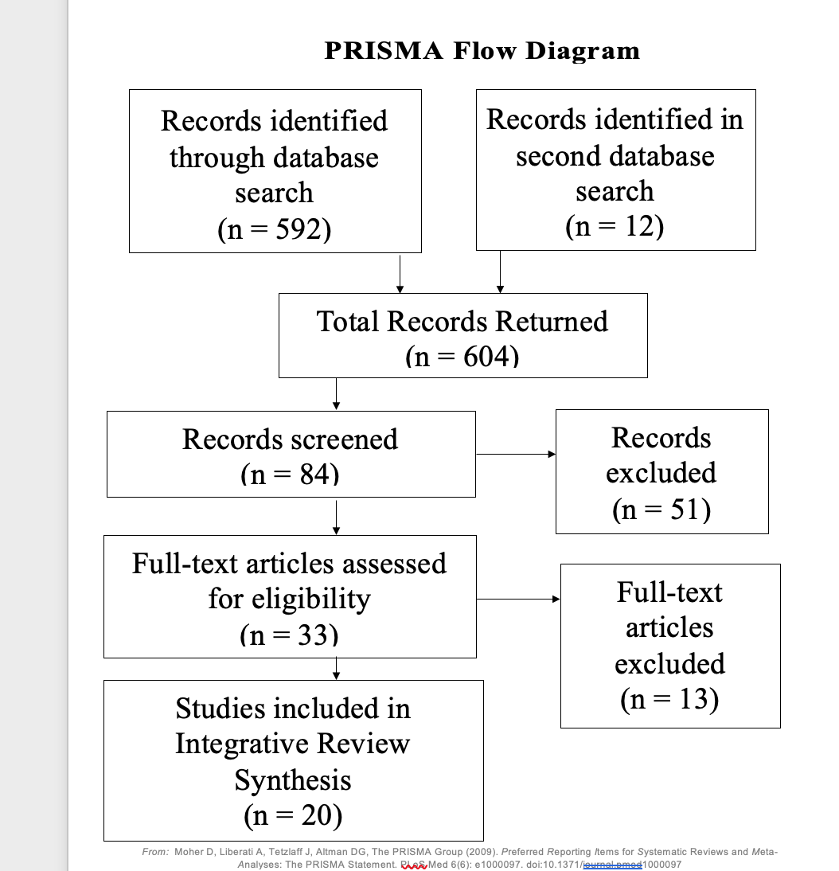
Is an Ounce of Simulation Worth a Pound of Safety?
Simulation as a Patient Safety Solution: A Review
Kathy Miller kmiller114@liberty.edu 417-880-9363
(Mentor: Dr. Rachel Joseph-Liberty School of Nursing)
Abstract
Results
Conclusion
Background:
Medication errors and failure to rescue (FTR) events jeopardize patient safety.
Novice nurses transitioning to practice may lack competency
Safety-focused simulation can provide targeted learning opportunities to increase competence in the medication administration process and in the care and management of a deteriorating patient.
Purpose: To examine the efficacy of simulation on reducing medication errors and FTR events.
Methods: An integrative review of twenty studies evaluating the outcomes of safety-focused simulation on nursing students and new graduate registered nurses (NGRNs).
Findings: A range of simulation fidelity levels and types were used with most outcome measures trending positive if not statistically significant.
Conclusion: While more research is needed, this review captures the numerous translational benefits of simulation that can directly impact the competency of novice nurses and consequently, the safety of patients.
 | Medication Administration (MA) | Failure to Rescue/Deteriorating patient (FTR/DP) | Both MA and FTR/DP
Nursing Students | Aggar et al. (2018) Avraham et al. (2021) Brauneis et al. (2021) Chan et al. (2019) Craig et al. (2021) Jarvill et al. (2018) Kuo et al. (2020) Kelly et al. (2018) Hayes et al. (2017) Mariani et al. (2017) Sanko & McKay (2017) | Breen et al. (2019) Goldsworthy et al. (2019) Haddeland et al. (2018) Park & Kim (2021) Sapiano et al. (2018) | Woda et al. (2019)
NGRNs |  |  | Chan & Burns (2021)
Both |  | Cooper et al. (2017) Orique & Phillips (2018)
The evidence synthesized in this review revealed that simulation can positively impact patient safety in the following ways:
Medication Administration Safety
Increase competence (Knowledge, Performance, Confidence)
Increase preparedness to administer medications
Enhance understanding of the nursing role in safe medication administration
Failure to Rescue Events
Increase knowledge which corrects the “failure to recognize” deficit
Enhance performance which corrects the “failure to react” deficit
Enhance communication skills which corrects the “failure to relay information” deficit (Burke et al., 2022)
B
A
Figure 1. “I’ll have an ounce of prevention” by Dana Fradon, 1987, https://www.cartoonstock.com/cartoon?searchID=CC36572. Used with permission.
Figure 2. Created by Kathy Miller
Implications for Future Research
Simulation
Preparation for clinical practice
Improve Technical Skills
Expert Modeling
Situated Feedback
Role Formation
Critical Communication
Repetition for Proficiency
Time management
Prioritization
Situational Awareness
Managing distractions
High Quality Studies are needed using similar and validated measurement tools to provide evidence as to which type of simulation works best
Additional studies that focus on the impact of safety-focused simulation on patient outcomes (decline in medication errors or failure to rescue events) involving NGRNs
Studies using simulation that focus on other nurse sensitive safety issues such as hospital-acquired infections and discharge teaching
Research Question
Can the use of safety-focused simulation lead to decreased medication administration errors and failure to rescue events among pre-licensure nursing students and new graduate registered nurses?
Methods
References & Acknowledgments
Databases Searched
CINAHL
Health Source
MEDLINE
Cochrane
Criteria
Peer-Reviewed/Full-Text
English
2017-2022
Any type of simulation
Key Words
Simulation
Nursing Student*
New Graduate Nurse*
Novice Nurse*
Patient Safety
Medication Error*
Failure to Rescue
Deteriorating Patient
MG1655
Avraham, R., Shor, V., & Kimhi, E. (2021). The influence of simulated medication administration learning on the clinical performance of nursing students: A comparative quasi-experimental study. Nurse Education Today, 103, 104947. https://doi.org/10.1016/j.nedt.2021.104947
Burke, J.R., Downey, C., & Almoudaris, A. M. (2022). Failure to rescue deteriorating patients: A systematic review of root causes and improvement strategies. Journal of Patient Safety, 18(1), e140-e155. https://doi.org/10.1097/pts.0000000000000720
Chan, G.K., & Burns, E. M. (2021). Quantifying and remediating the new graduate nurse resident academic-practice gap using online patient simulation. The Journal of Continuing Education in Nursing, 52(5), 240-247. https://doi.org/10.3928/00220124-20210414-08
Moher, D., Liberati, A., Tetzlaff, J., & Altman, D.G. (2009). Preferred reporting items for systematic reviews and meta-analyses: The PRISMA statement. PLoS Medicine, 6(7), e1000097. https://doi.org/10.1371/journal_pmed1000097
B
A
B
Log10 Optical Density at 600nm
as
Figure 3. From Moher et al. (2009)
Figure 4. Created by Kathy Miller

