Slide 1
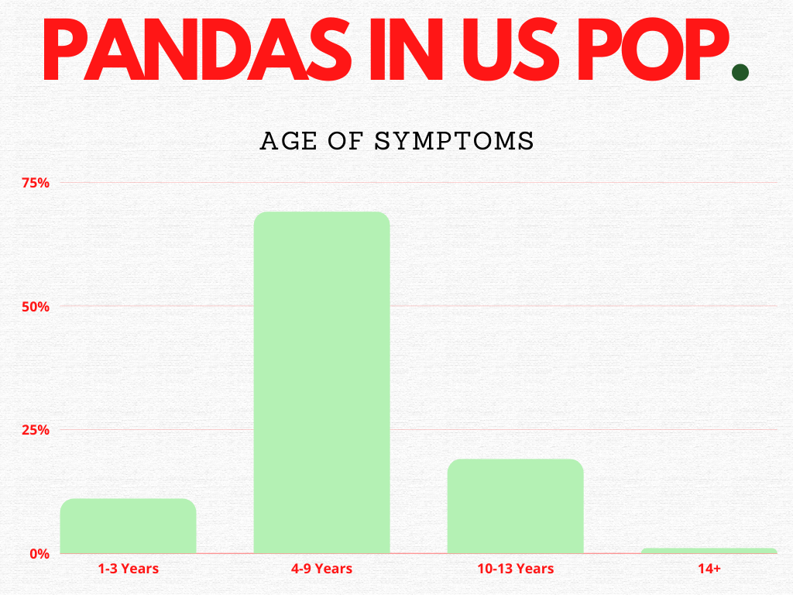
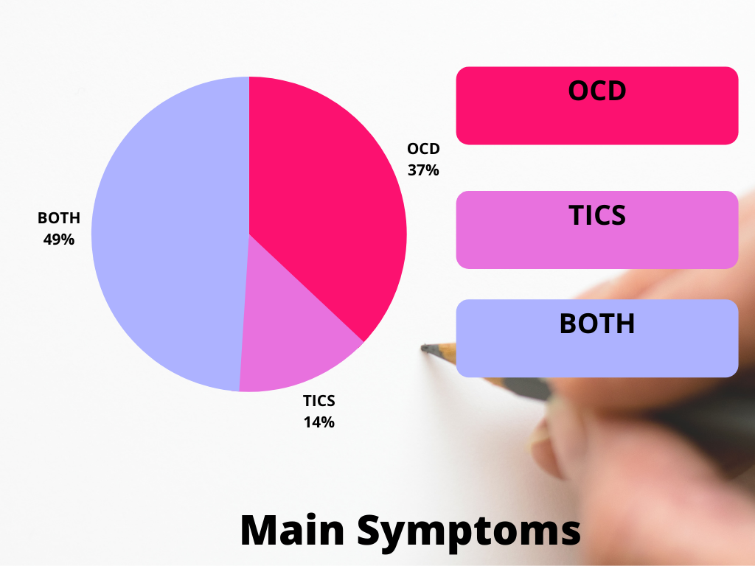
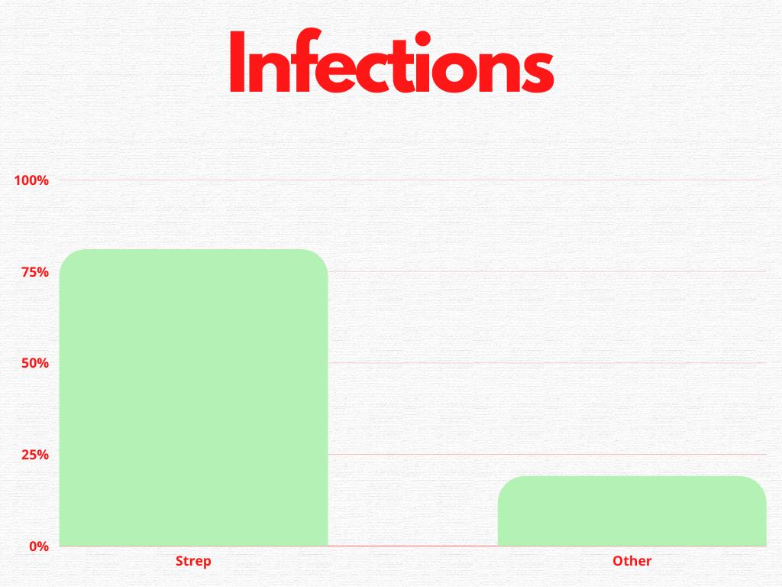
Using Antimicrobials with PANDAS DISORDER
Michelle Tonkin (L29381110)
Abstract
Results and/or Conclusion
Abstract:
PANDAS (Pediatric Autoimmune Neuropsychiatric Disorders) (The Epidemic, 2021), is an auto-immune infection triggered by the bacteria Streptococcus, which can result in neuropsychiatric disorders (Genetic and Rare Diseases Information Center, 2016). This infection caused disorder was brought to light Dr Sue Swedo, now head “of the Pediatrics & Developmental Neuroscience Branch at the U.S. National Institute of Mental Health” (Kinderlehrer, 2020, para 6, line 2-4). It is estimated that roughly 1 in 200 children in the USA have PANDAS (The Epidemic, 2021).
Results
Certain medical professionals are now seeing the value of combing both western and alternative medicine to help the body in recovery and prevention of PANDAS. Alternative antimicrobials that work well against strep bacteria like barberry, goldenseal, and oregano oil (Singh, 2021) have been used. Some Integrative practitioners are also treating not only the infection(s) that can cause PANDAS, but are also concerned with possible inflammatory triggers like gluten (Kinderleher, 2020), treating gut health, addressing cellular issues, and assisting the body in detoxification. (Song, 2021).
Introduction
Figure 1. Percentage of the Age of Symptoms of PANDAS in the USA Population. This is based on a survey of 700 participants. Stats from: PANDAS Network Healing Youth with PANS/AE, (2022), Statistics https://pandasnetwork.org/get-involved/statistics/
Future Work
Introduction
Based on a survey done in 2014, its estimated that at least 35% of children with PANDAS symptoms take three years or longer to get an official diagnosis (Song, 2021). Children are also frequently misdiagnosed and prescribed behavioral medication not effective for this condition (Song, 2021) Antibiotics are often the route of choice to treat PANDAS and can be effective (Genetic and Rare Diseases, 2015). Some studies also show that streptococcus bacteria alone may not be responsible for PANDAS (Kinderlehrer, 2020). Viruses and bacteria like Herpes Simplex, Epstein Barr, Varicella Zoster, HIV, Mycoplasma pneumonia, Bartonella, Lyme bacteria, chronic sinusitis and even the common cold could be potential initiators (Kinderlehrer, 2020).
Future Work
The PANDAS Physician network has also developed a website complete with different therapies that can help practitioners treat PANS and PANDAS and its many symptoms based on both research and physician’s experiences with clients. (Pandas Physicians Network, 2022) Suggested treatments could include: antibiotics, steroids, NSAIDS, IVIG, Plasmapheresis, CBT, SSRI’s, antifungals, antihistamines, Vitamin D and Tonsillectomy (Pandas Physicians Network, 2022).
References
Methods
The Epidemic PANS PANDAS (2021) https://epidemicanswers.org/pans-pandas/ Genetic and Rare Diseases Information Center, (2015, 2016, 2021,) Pediatric autoimmune neuropsychiatric disorders associated with Streptococcus infections https://rarediseases.info.nih.gov/diseases/7312/pediatric-autoimmune-neuropsychiatric-disorders-associated-with-streptococcus-infections
Kinderlehrer, D (2020), Does your child have a mental illness or a medical disorder? Many symptoms of tick-borne diseases can easily be misidentified as mental illness, David A. Kinderlehrer M.D. LymeDisease.org LymeTimes and Community Membership Does your child have a mental illness or a medical disorder? - PANS and PANDAS (lymedisease.org) National Institute of Mental Health, (2019), PANDAS-Questions and Answers NIMH » PANDAS—Questions and Answers (nih.gov) PANDAS Network Healing Youth with PANS/AE, (2022), Statistics https://pandasnetwork.org/get-involved/statistics/ Pandas Physicians Network, 2022, Treating PANS\PANDAS PANS/PANDAS Treatment | PPN (pandasppn.org) Singh, A (2021, April 21). Episode #144: PANS and PANDAS with Dr. Anju Usman Singh, MD, Better Health Guy https://www.betterhealthguy.com/episode144 Song, Elisa (2021, October 11) Does Your Child Have PANS/PANDAS? Healthy Kids Happy Kids Advice and Adventures with holistic mama doc, Elisa Song, MD. https://healthykidshappykids.com/2020/10/11/does-your-child-have-pans-pandas/
Methods
Since there are no official tests that can confirm a diagnosis of PANDAS, practitioners have developed certain standards for diagnosis (National Institute of Mental Health, 2019) “The diagnostic criteria are:
Presence of OCD, a tic disorder, or both
Pediatric onset of symptoms (i.e., age 3 to puberty)
Episodic course of symptom severity (see information below)
Association with group A Beta-hemolytic strep infection, such as a positive throat culture for strep or history of scarlet fever
Association with neurological abnormalities, such as physical hyperactivity or unusual, jerky movements that are not in the child’s control
Very abrupt onset or worsening of symptoms” (National Institute of Mental Health, 2019), para 8)
A blood test to see if streptococcus infection is prevalent can be done if symptoms have gone on longer than a one-week period (National Institute of Mental Health, 2019). Other symptoms of PANDAS that can coincide with tic or OCD issues can include: ADD like symptoms, separation anxiety, mood swings, sleep issues, frequent urination and/or bedwetting, motor skill changes, and joint discomfort (National Institute of Mental Health, 2019).
For specific PANDAS type testing: “Serum ASO titer (Anti-Streptolysin O): This is produced between one week to one month after the onset of an infection.
Serum ASDB titer (Anti-Streptococcal DNase B): This peaks four to six weeks after infection and remains elevated longer than ASO” (The Epidemic, 2021, para 49-50).
Figure 2. Percentage Main Symptoms of PANDAS in the USA Population. This is based on a survey of 700 participants. Stats from: PANDAS Network Healing Youth with PANS/AE, (2022), Statistics https://pandasnetwork.org/get-involved/statistics
Figure 3. Percentage of the types of infections associated with PANDAS in the USA Population. This is based on a survey of 700 participants. “Other” infections i.e. Lyme Disease, Mycoplasma etc. Stats from: PANDAS Network Healing Youth with PANS/AE, (2022), Statistics https://pandasnetwork.org/get-involved/statistics

