Slide 1
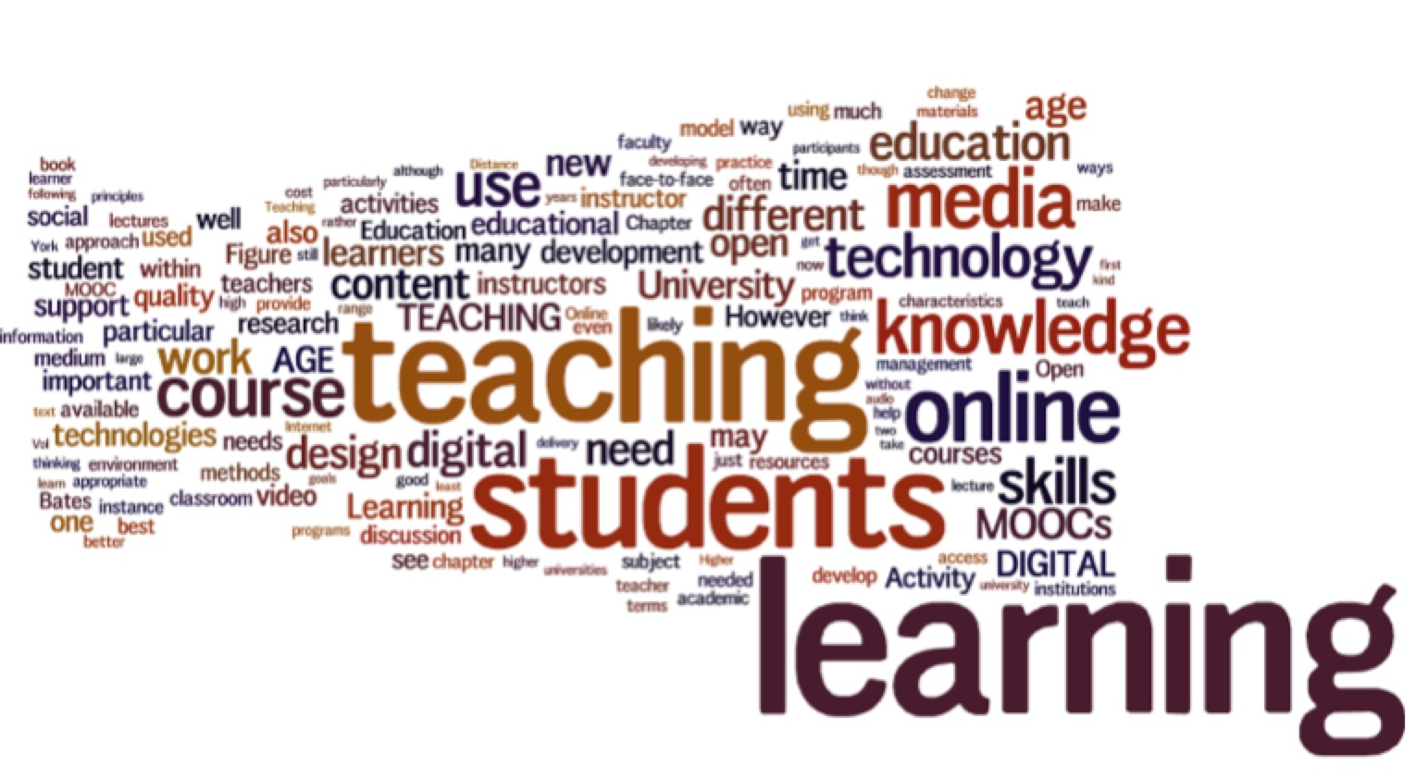
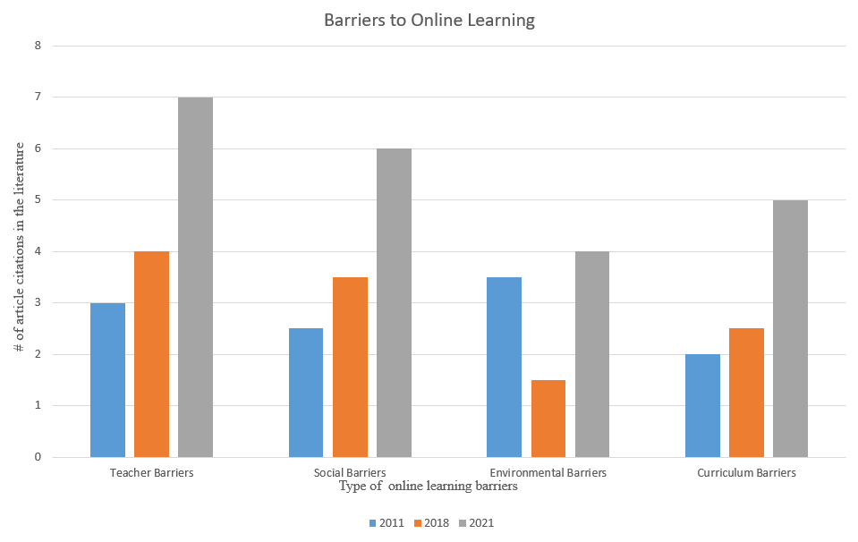
Barriers to Online Learning
Ashley E. Moffett Ashley.e.moffett.mil@mail.mil (318) 557-0982
Mentor: Rachel Joseph, PhD. CCRNK
Abstract
Evaluation and Analysis
The availability of online learning in the United States has increased by 10% over the last decade.
The Covid-19 pandemic has strained traditional educational systems world-wide, leading to an increased demand for online learning methods.
Despite advantages like flexibility, accessibility, and accommodation provided by online courses, studies have identified barriers to online learning.
There is a consensus across all 15 articles that barriers to online learning currently exist, varying from teacher, social, environmental, and curriculum sources (Figure 2).
The most common barrier identified for educators teaching online was lack of confidence using newer technologies, despite having robust experience and proficiency in the field.
There is a dire need for academic institutions to invest in their faculty’s online teaching competencies to enhance the learning experience.
B
Fear of Change
Poor Technical Skills
Barriers to Online Learning
Introduction
Online learning is defined as using electronic technology and media to allocate, support, and advance learning between students and educators through online content.
The Covid-19 pandemic has led to a sudden shift in learning methods – from traditional classroom settings to online delivery. This shift, however, poses unique barriers to learning.
Barriers to student online learning include fear of adopting new emerging technologies, reduced real-time instructor-student communication, poor internet connectivity, limited computer literacy/technical skills, and suboptimal student discipline (Figure 1) .
A
Implications for Future Research
The effectiveness of higher education in the United States may be at jeopardy due to a large-scale “incompetence” to facilitate learning using online methods.
Unforeseeable conditions around the world will demand an increased production of well-prepared professionals who are ready to meet global challenges.
Efforts to mitigate existing barriers to online learning should focus on teaching faculty how to effectively use online instructional tools.
Computer Literacy
Lack of Access to Communicate Personably with Teachers
FFigure 3. Adapted from Tony Bates (my-book-in-wordle-2.jpg (1530X842) (tonybates.ca).
Lack of Institutional Strategies
Figure 1. Common barriers to online learning. Adapted from (O’Doherty, D., Dromey, M., Lougheed, J., Hannigan, A., Last, J., & McGrath, D. (2018). Barriers and solutions to online learning in medical education - an integrative review. BMC Medical Education, 18(1), 130. https://doi.org/10.1186/s12909-018-1240-0).
Methods
References
Databases: MEDLINE, EBSCO, and ProQuest Central
Keywords: barriers to online education, nursing online, and nurse educator challenges.
Inclusion criteria: Nursing educators and online students suffering from mental health disabilities, foreign national students, and various age and race groups throughout the U.S.
Exclusion criteria: Studies conducted prior to 2015, studies identifying only Covid-19 barriers, and articles that lacked diversified data collection.
Results: 15 studies met inclusion criteria for this review.
Alshwiah, A. A. (2021). Barriers to online learning: Adjusting to the “new normal” in the time of covid-19. Turkish Online Journal of Distance eEducation, 224(4), 212-228.
Anwar, M., Khan, A., & Sultan, K. (2020). The barriers and challenges faced by students in online education during covid-19 pandemic in pakistan. Gomal University Journal of Research, 36(1), 52–62.
Dost, S., Hossain, A., Shehab, M., Abdelwahed, A., & Al-Nusair, L. (2020). Perceptions of medical students towards online teaching during the COVID-19 pandemic: A national cross-sectional survey of 2721 UK medical students. BMJ open, 10(11), e042378. https://doi.org/10.1136/bmjopen-2020-042378
Li, W., Gillies, R., He, M., Wu, C., Liu, S., Gong, Z., & Sun, H. (2021). Barriers and facilitators to online medical and nursing education during the COVID-19 pandemic: Perspectives from international students from low- and middle-income countries and their teaching staff. Human Resources for Health, 19(1), 1–14. https://doi.org/10.1186/s12960-021-00609-9
McManus, D., Dryer, R., & Henning, M. (2017). Barriers to learning online experienced by students with a mental health disability. Distance Education, 38(3), 336–352. https://doi.org/10.1080/01587919.2017.1369348
O’Doherty, D., Dromey, M., Lougheed, J., Hannigan, A., Last, J., & McGrath, D. (2018). Barriers and solutions to online learning in medical education - an integrative review. BMC Medical Education, 18(1), 130. https://doi.org/10.1186/s12909-018-1240-0
Roman, T. A., Callison, M., Myers, R. D., & Berry, A. H. (2020). Facilitating authentic learning experiences in distance education: Embedding research-based practices into an online peer feedback tool. TechTrends: Linking Research & Practice to Improve Learning, 64(4), 591–605. https://doi.org/10.1007/s11528-020-00496-2
Raza, S. A., Khan, K. A., & Rafi, S. M. T. (2020). Online education & MOOCs: Teacher self-disclosure in online rducation and a mediating role of social presence. South Asian Journal of Management Sciences, 14(1), 142–158. https://doi.org/10.21621/sajms.2020141.08
MG1655
B
A
B
Log10 Optical Density at 600nm
I am a military service members. This work was prepared as part of my official duties. Title 17 U.S.C. 105 provides that “Copyright protection under this title is not available for any work of the United States Government.” Title 17 U.S.C. 101 defines United States Government work as a work prepared by a military service member or employee of the United States Government as part of that person's official duties. The views expressed in this poster are those of the author and do not necessarily reflect the official policy or position of the Department of the Navy, Department of Defense or the U.S. Government.
Figure 2. Categorical online learning barriers over the last decade (2011-2021). Adapted from (Alshwiah, A. A. (2021). Barriers to online learning: Adjusting to the “new normal” in the time of covid-19. Turkish Online Journal of Distance Education, 22(4), 212–228).

