Slide 1
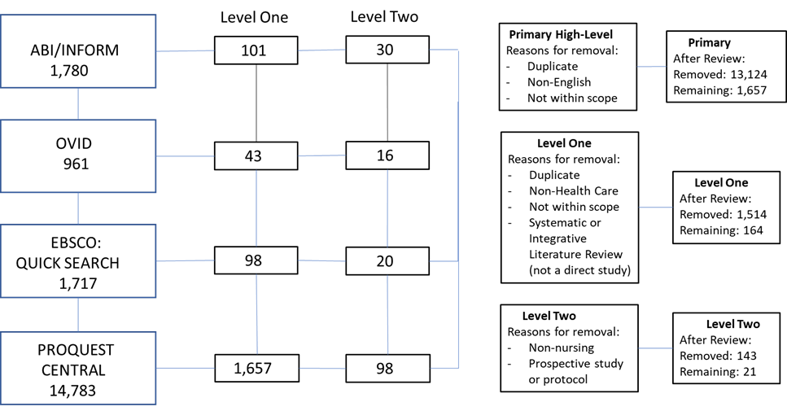
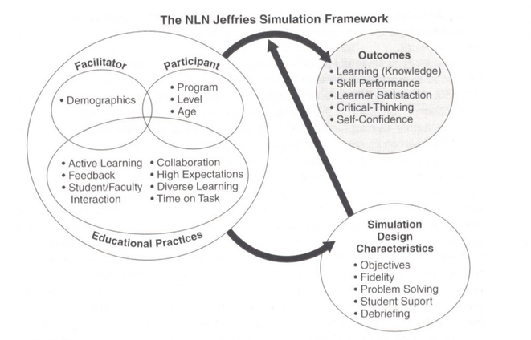
The efficacy of simulation-based training in nursing education compared to traditional teaching methods
Nancy Jütte, MSN, RN
Abstract
Methodology
Evaluation and Analysis
Background:
Clinical experience is an essential component of nursing education.
Substituting simulation for a portion of the required clinical training is acceptable.
Research Question: Does the use of simulation for a portion of clinical training result in equivalent or better outcomes compared to students having 100% traditional clinical practice training.
The review assessed the impact of various types of simulation-based training on required skills, qualitative behaviors, and communication.
The review compared conventional education to simulation.
Methods:
Search terms: “evaluation of the use of simulation in nursing education compared to traditional education” AND “nursing students” AND “clinical”
Databases: ABI/INFORM, OVID, EBSCO, and ProQuest
Inclusion criteria:
Nursing education-related, assessing use of simulation
Exclusion criteria
Non-English articles, non-healthcare related, non-nursing related
Of the final 21 articles, 12 articles assessed the use of simulation compared to traditional education ( Figure 1)
Results:
Using simulation for a portion of clinical training results in equivalent or better outcomes compared to students having 100% traditional clinical practice training.
Conclusion:
The use of simulation for a portion of nursing training compared to 100% traditional training demonstrated equivalent or better outcomes.
Figure 1: Search Process: Simulation-based Training Figure 2: Sample Virtual Simulation Screens
Compared to Traditional Methods
Retrieved from Elsevier, 2022
Figure 3: Results Level of Evidence Figure 4: The NLN Jeffries Simulation Framework
Retrieved from Jeffries (2016) p. 5.
Originally printed in Jeffries, P.R. (Ed.). (2012).
Simulation in nursing education: From conceptualization to evaluation. (2nd ed.). New York: National League for
Nursing, p. 37).
Assessment Process:
Outcome data and discussions were assessed for completeness.
Potential bias was identified
Variables Assessed:
The primary outcome variables included were knowledge and performance.
Secondary variables included self-efficacy, student perception of the process, and student grades.
All the variables measured are congruent with the NLN Jeffries Simulation Framework's identified variables (Jeffries, 2016).
Results:
12 of the studies evaluated simulation as a substitution for a portion of traditional education.
All 12 studies demonstrated equivalent or better outcomes compared to the 100% traditional education.
Conclusion:
Using simulation as a substitution for a portion of traditional education does not decrease the student outcomes.
The positive results demonstrate substitution of a portion of traditional education with simulation-based education maintains or improves students’ outcomes (AACN, 2021; Jeffries, 2016).
B
A
Introduction
Implications for Future Research
Clinical practice experience, an essential component of nursing education, is in short supply.
Substituting simulation, acceptable for a portion of clinical training may assist in meeting the clinical practice requirements.
Research Question:
Does the use of simulation for a portion of clinical training result in equivalent or better outcomes compared to students having 100% traditional clinical training.
The review assessed the impact of various types of simulation-based training on required nursing skills, qualitative behaviors, and communication.
The review assessed nursing education with a portion of simulation compared to conventional education.
Type of Design | Total | LOE | Authors
Quantitative | 5 | III | Chen et al., 2018 Jorgensen et al 2018 Tseng et al., 2021 Sarasnick et al., 2017 Soccio, 2017
Quantitative | 7 | II | Blanié et al., 2020 Du et al., 2021 Lee et al., 2019 Topbaş et al., 2019 Turrise et al., 2020 Vardar et al., 2020 Vural Doğru et al., 2020
Conduct research with a broader scope, comparing clinical education and simulation.
Conduct research with a goal to concretely demonstrate the validity and potential use of simulation as a substitute for a portion of nursing clinical through:
Utilizing an accepted framework such as the NLN Jeffries Simulation Framework.
Researching across multiple locations.
Including a larger volume of control and experimental subjects.
Clarifying differences between types of simulation and outcomes.
MG1655
References & Acknowledgments
Methods
B
Literature Review:
Search terms: “evaluation of the use of simulation in nursing education compared to traditional education” AND “nursing students” AND “clinical”
Databases: ABI/INFORM, OVID, EBSCO, and ProQuest
Inclusion criteria:
Nursing education-related, assessing use of simulation
Exclusion criteria
Non-English articles, non-healthcare related, non-nursing related
Systematic reviews, Integrative reviews, Prospective protocol or study
In the final review 21 articles were included.
Of the final 21 articles, 12 articles assessed the use of simulation compared to traditional education ( Figure 1)
A
B
Elsevier (2022) Sample virtual simulation screens. Retrieved March 4, 2022, from https://evolve.elsevier.com/education/simulations/shadowhealth/
Jeffries, P. R. (2016). The NLN Jeffries simulation theory, Wolters Kluwer. Philadelphia.
Jorgensen, B. E., Larsen, M., & Gram, B. (2018). Simulation as an educational tool in acute nursing care: A controlled intervention study. Nurse Education in Practice, 32, 28-33. https://doi.org/http://dx.doi.org/10.1016/j.nepr.2018.07.001
Luchini, C., Veronese, N., Nottegar, A., Shin, J. I., Gentile, G., Granziol, U., Soysal, P., Alexinschi, O., Smith, L., & Solmi, M. (2021). Assessing the quality of studies in meta‐research: Review/guidelines on the most important quality assessment
tools. Pharmaceutical Statistics: The Journal of the Pharmaceutical Industry, 20(1), 185-195. https://doi.org/10.1002/pst.2068
Sarasnick, J. A., Pyo, K. A., & Draper, J. (2017). Using simulation and case studies combined to improve student knowledge: A retrospective study. Nursing Education Perspectives, 38(3), 126-130. https://doi.org/http://dx.doi.org/10.1097/01.NEP.0000000000000139
Soccio, D. A. (2017). Effectiveness of mental health simulation in replacing traditional clinical hours in baccalaureate nursing education. Journal of Psychosocial Nursing and Mental Health Services, 55(11), 36-43. https://doi.org/10.3928/02793695-20170905-03
Full list of references will be available.
Acknowledgment: Dr. Rachel Joseph, Ph.D. CCRN-K, Mentor

