Slide 1
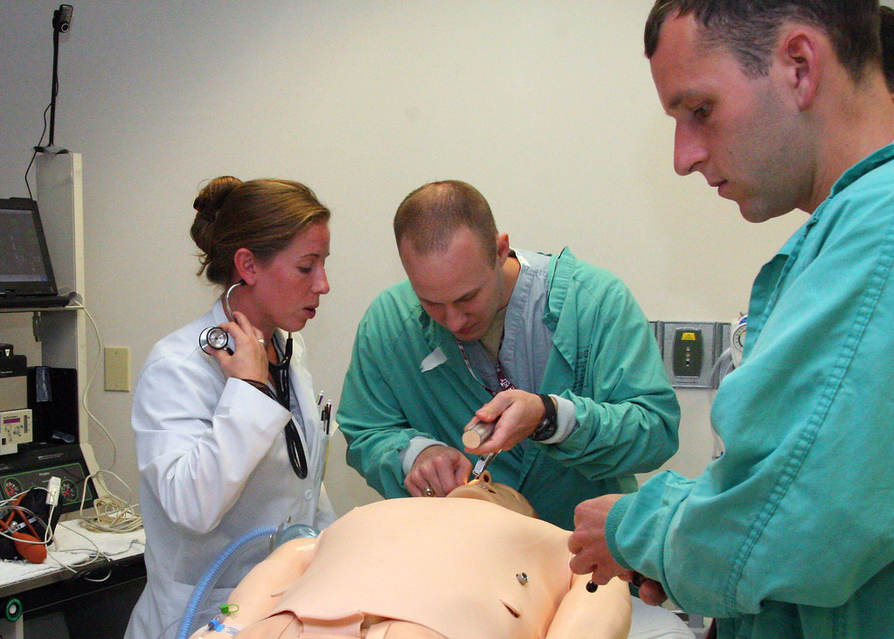
Faculty Experiences of Simulation Debriefing Practices in Nurse Practitioner Education
Jodi B. Duncan
Abstract
Debriefing Best Practices (INACSL, 2021)
Conducted in an appropriate and structured manner
Debriefer has been trained and is competent in debriefing process
Debriefing session promotes self-reflection and systems analysis
Planned and structured in accordance with a theoretical framework
Methods
The International Nursing Association for Clinical Simulation and Learning has recommended that a debriefing session be held after each simulation event. Though INACSL recommendations for debriefing include using an evidenced-based structured format, no particular technique has been recommended for use. Debriefing is considered the pinnacle of the simulation experience and the transfer of learning occurs during this time. Though research into debriefing has been conducted at the undergraduate nursing level, little is known about the debriefing practices in nurse practitioner programs. Up to 98% of NP programs use simulation, but hours cannot be substituted for clinical time, as they can be in undergraduate nursing programs. More research is needed in NP simulation so that future considerations can be made regarding the substitution of clinical hours by simulation. This can alleviate clinical placement shortages and ensure high quality NP preparation.
Keywords: nursing simulation, debriefing
Design: qualitative, phenomenological
Sample: Convenience sample of NP Faculty in the United States
Data Collection: semi-structured interviews
Data Analysis: Braun’s and Clarke’s six phases of data analysis will be used for thematic analysis
Dissemination: Dissertation, journal publication, presentations
Future Work
Learning/patient outcomes of nurse practitioner students participating in simulation education
Determination of appropriate amount of clinical hours substitution for nurse practitioner programs
Research Questions
What debriefing practices are used in nurse practitioner simulation education, and why? What training did the faculty receive to conduct debriefing sessions? How do faculty facilitators describe a high-quality debriefing session? What are the facilitators and barriers of conducting debriefing sessions? How do debriefing facilitators address psychological safety?
Purpose
The proposed study aims to describe nurse practitioner faculty simulation education debriefing practices and experiences in using various debriefing methods after simulation events.
References and/or Acknowledgments
Alhaj Ali, A., Miller, E., Ballman, K., Bakas, T., Geis, G., & Ying, J. (2020). The impact of debriefing modalities on nurse practitioner students’ knowledge and leadership skills in managing fatal dysrhythmias: A pilot study. Nurse Education in Practice, 42, 102687. https://10.1016/j.nepr.2019.102687
Braun, V., Clarke, V. (2006) Using thematic analysis in psychology, Qualitative Research in Psychology, 3:2, 77-101, DOI: 10.1191/1478088706qp063oa
Díaz, D. A., Gonzalez, L., Anderson, M., MacKenna, V., Hoyt, E., & Hill, P. P. (2020). Implications of subject matter expertise as a requirement for debriefing: A randomized control trial. Simulation &amp; Gaming, 51(6), 770-784. https://10.1177/1046878120945743
INACSL Standards of Best Practice: SimulationSM Debriefing. (2021). Clinical
Simulation in Nursing, 12, S21–S5. https://doi.org/10.1016/j.ecns.2016.09.008
"Medical Simulation" by Army Medicine is marked with CC BY 2.0.

