Slide 1
Apathy or a Loving Hand - What will be Given to our Fellow Man?
How the Orthodox Presbyterian Church Responded to the Horrors of the Holocaust
Holly A. Sproule
Liberty University 2022

Slide 2
Research Methodology
Primary Sources:
Orthodox Presbyterians monthly Publication The Presbyterian Guardian Publications 1935 to 1944.
Presbyterian monthly Publication Christianity Today Publications 1937 to 1939.
Digital Archives of the United States Holocaust Museum
  Literature, Letters, Statistics, Newspapers, Newsreels, Radio Broadcasts, Photographs.
Scholarly Sources:
American Jewish History.
Journal of the American Academy of Religion.
The Annals of the American Academy of Political and Social Science.
The Journal of Presbyterian History.

Slide 3
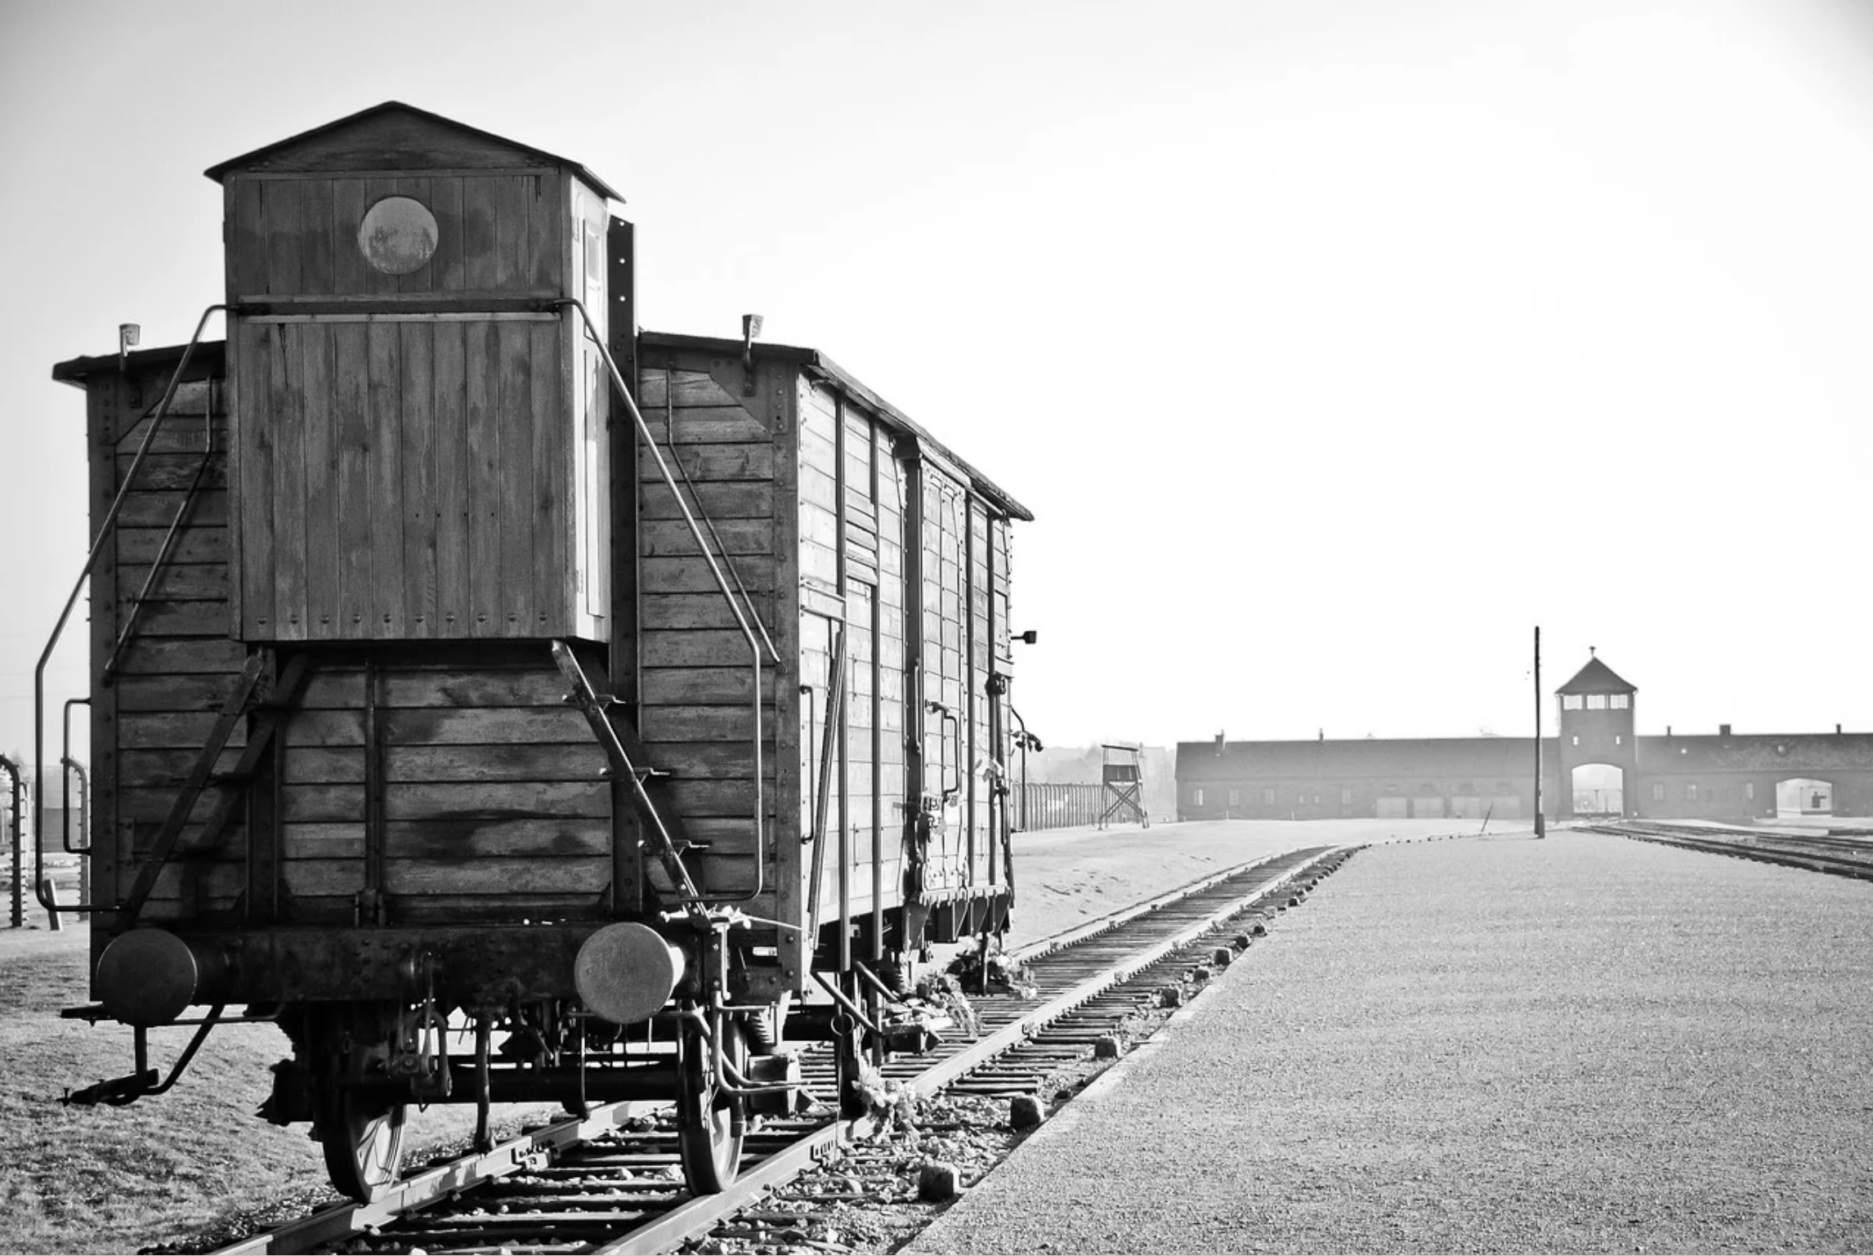
“What Will Happen to Us?”
Figure 1.
Figure 1. Cattle car that would take hundreds of thousands of European Jews to Nazi concentration camps. (Auschwitz Cattle Car, Published July 31, 2017, https://pixabay.com/photos/auschwitz-birkenau-war-holocaust-2559130/).

Slide 4
Timeline 1935-1940
Nuremberg Laws – Racial laws denying Jews political, social, religious, economic, and material rights
1939 Wagner-Rogers Bill proposed admitting 20,000 German refugee children (mainly Jews) to the United States outside of immigration quotas was defeated in Congress
Federal Council of Churches of Christ of the United States compose the resolution “American Churches to Hitler”
United States halts all immigration from Nazi Germany
1936 Founding of the Orthodox Presbyterian Church (OPC)
1940
1935
1936
1938-1939
1937
1936 Berlin Olympics
Jewish athletes excluded from representing Nazi Germany
Founding of The Presbyterian Guardian magazine - Orthodox Presbyterian views
Kristallnacht 1938
Nazi destruction, murders, and arrests of Jewish businesses and individuals in Germany and Austria
Presbyterian Christianity Today journal publishes on Hitler’s Nazi “Gospel”

Slide 5
American Public Opinion 1938
(5,000 polled)
Approve or disapprove of the Nazi treatment of Jews in Germany?
Approve: 5% Disapprove: 88%
53% of Americans viewed Jews as “different,” avoided mingling with them.
32% wanted to restrict Jewish business methods.
Should larger number of Jewish exiles from Germany to come to the United States to live? Yes: 23% No: 69%
We should encourage Jews to come even if we have to raise our immigration quotas? 4.9% Agreed.
We should allow them to come but not raise our immigration quotes:
18.2% Agreed.
With conditions as they are, should Jews be kept out?
67.4% Agreed.

Slide 6
The Presbyterian Guardian and Jewish Representation
1935 - Orthodox Presbyterian Church founded their monthly magazine The Presbyterian Guardian.
1936 - Founding of the Orthodox Presbyterian Church
(originally Presbyterian Church of America until 1939).
Guardian first issue (1935) documents Jewish plight in Nazi Germany.
Jews viewed as social liability.
Western world denies Jews refuge due to lack of formal political representation.
Jews could not legally leave their adopted country or claim asylum in another country.

Slide 7
Raising a Voice of Support
1937 - Christianity Today publishes “German Protestants to Vote on Nazi “Gospel.””
1937 - “American Churches to Hitler” is published.
Booklet accused Adolf Hitler of destroying religious freedom and Christianity in Germany.
Presbyterians called out Nazis persecution of the Jews.
Jews praised Presbyterians for their humanitarian work and their willingness to forge a relationship with them.

Slide 8
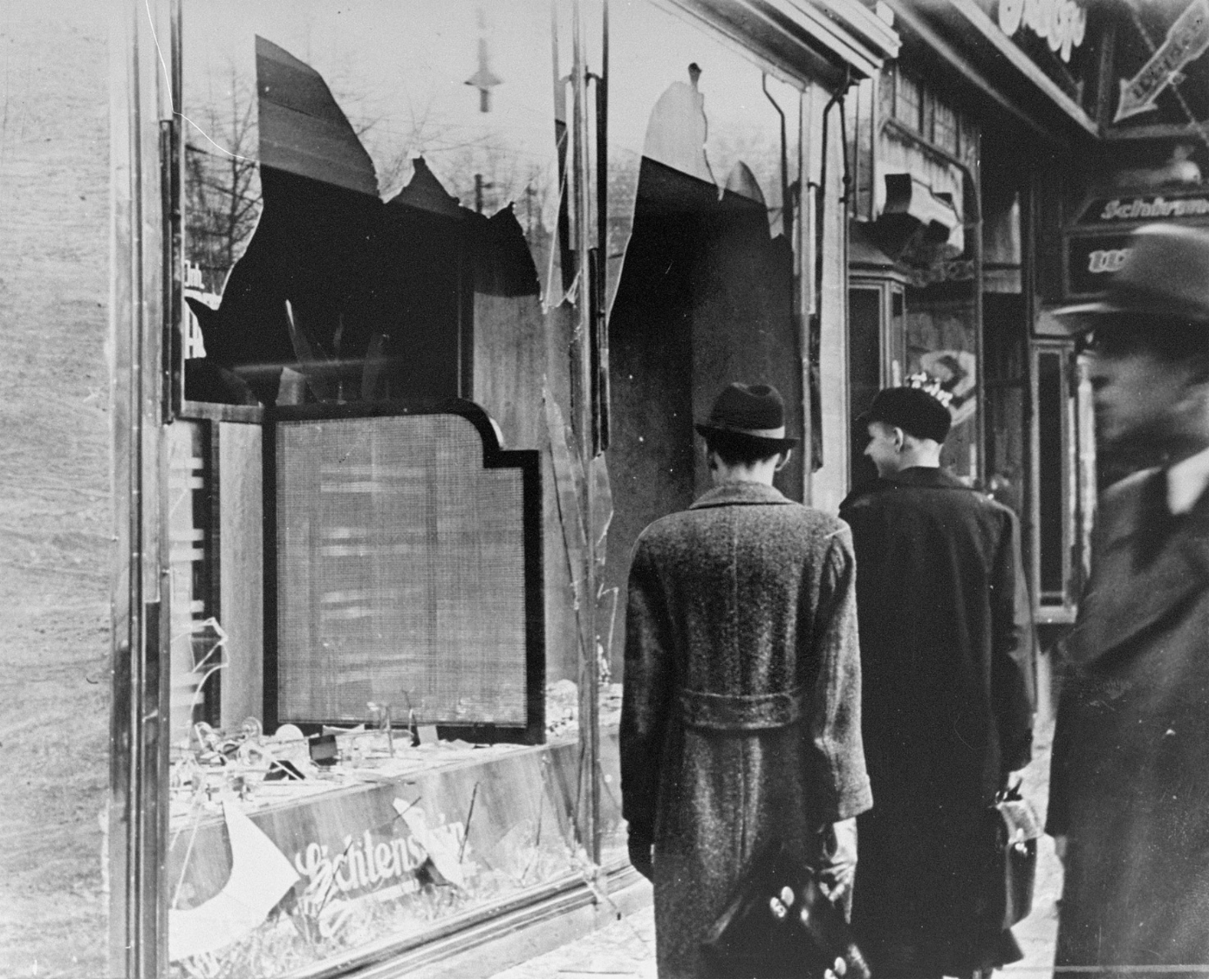
The Rise of Humanitarian Work
Figure 1.
Figure 1. The destruction of a Jewish business after Kristallnacht
1938. (Germans survey Destroyed Jewish Business, November 10, 1938, National Archives and Records Administration, College Park Source Record ID: Duker Dwork--OSS-731918. Bildarchiv Abraham Pisarek. https://collections.ushmm.org/search/catalog/pa16792).

Slide 9
“Jewish Friends and Neighbors”
“I pray that if there are any misunderstandings in your mind concerning the Christian’s feelings for Jews,
that they may be dispelled…”
“I want to be your friend. I want you to be my friend…”
~Reverend Hugh M. Newland

Slide 10
Recognizing Evil
1938 - Dr. Henry Leiper in Christianity Today, “The land of Luther and Goethe has made the Christian and the Jew homeless, a refugee…”
1939 - Presbyterian Guardian published
“Totalitarian Governments and Religion.”
Publicly criticized Nazi Germanys racial persecution of the Jews.
Nazi Germany denied the rights of the Church.
The establishment of racial laws to eradicate the Jews.
Germany’s actions were against the core principles of the Bible.

Slide 11
Friendship, Conversion, and the Holocaust
Humanitarian efforts and generosity of the Orthodox Presbyterians.
First reference to the Holocaust.
Defined the German means of extermination: gas vans, concentration camps, and public massacres.
To save the Jews was to love them, initiating conversions.

Slide 12
“Will We Be Forgotten?”

Slide 13
Q&A

