Slide 1
KRAS Regulation of ER-Mitochondria Calcium Flux in Colorectal Cancer
Nicholas Hill

Slide 2
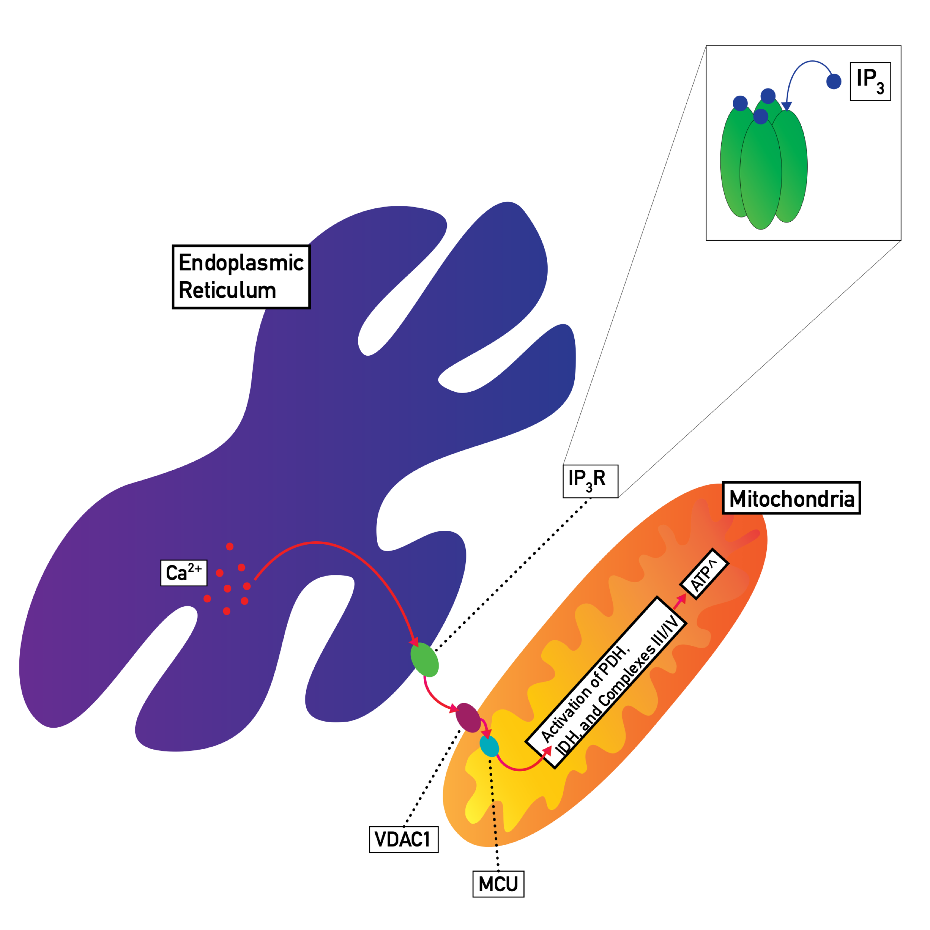
Background
Ca²⁺ as a regulatory molecule
Ca²⁺ in cancer biology
ER-mitochondria Ca²⁺ flux
The MAM
IP₃R, VDAC1, & MCU
KRAS
Figure 1. Calcium flux at the MAM
Notes:
Figure 1 illustration by Dr. Abigail Solitro and Nicholas Hill

Slide 3
Gap in Knowledge
Why are KRAS mutations associated with cancer development?
How do KRAS mutations affect Ca²⁺ flux?

Slide 4
Hypothesis
The over-proliferative nature of cancer requires increased ATP availability that is met through a KRAS-mediated upregulation of MAM proteins.

Slide 5
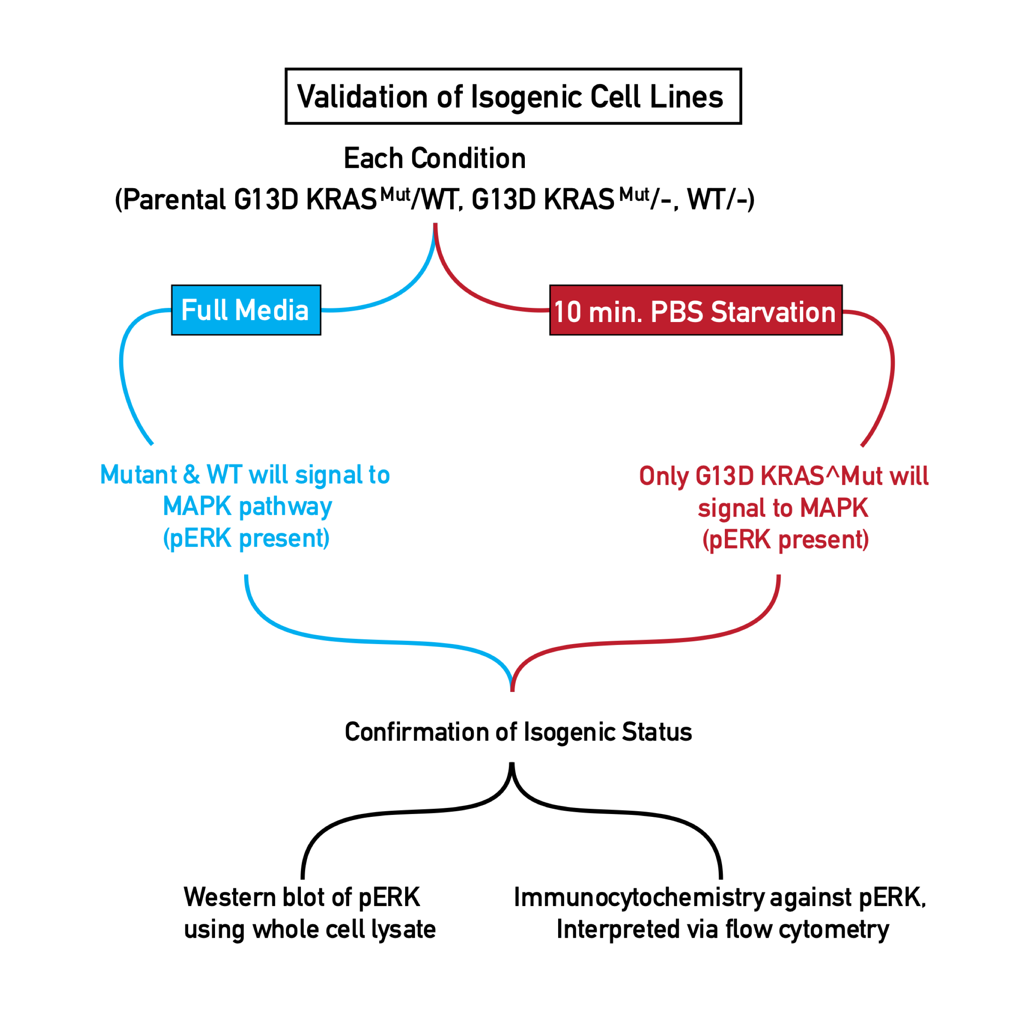
Methods
Figure 2. Experimental step one.
Notes:
Figure 2

Slide 6
Methods
Figure 3. Data collection methods.
Notes:
Figure 3 diagrams created by Nicholas Hill based on experimental design of Dr. Abigail Solitro.

Slide 7
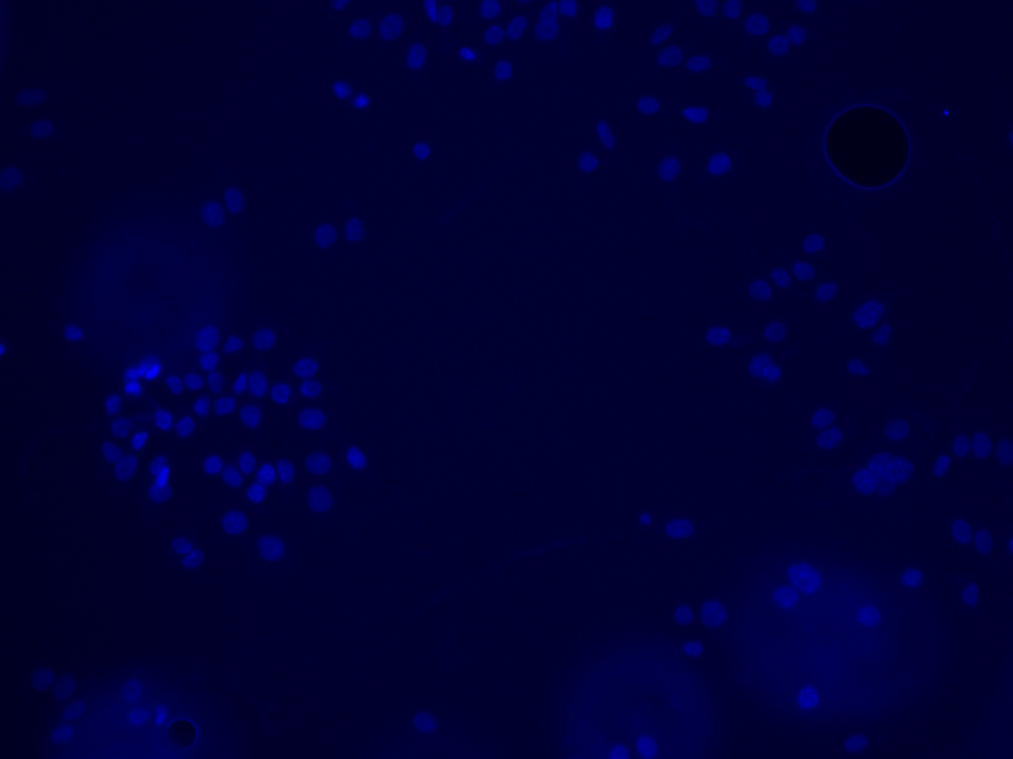
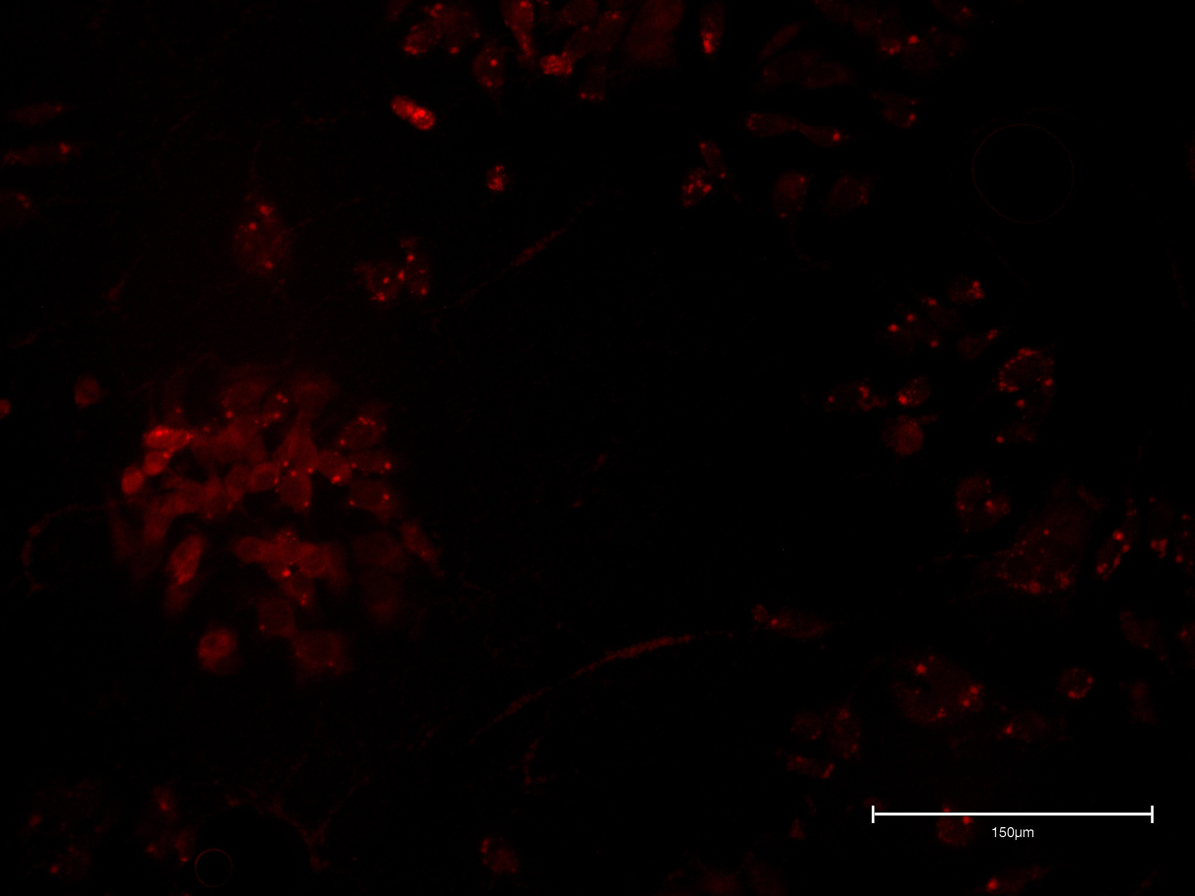
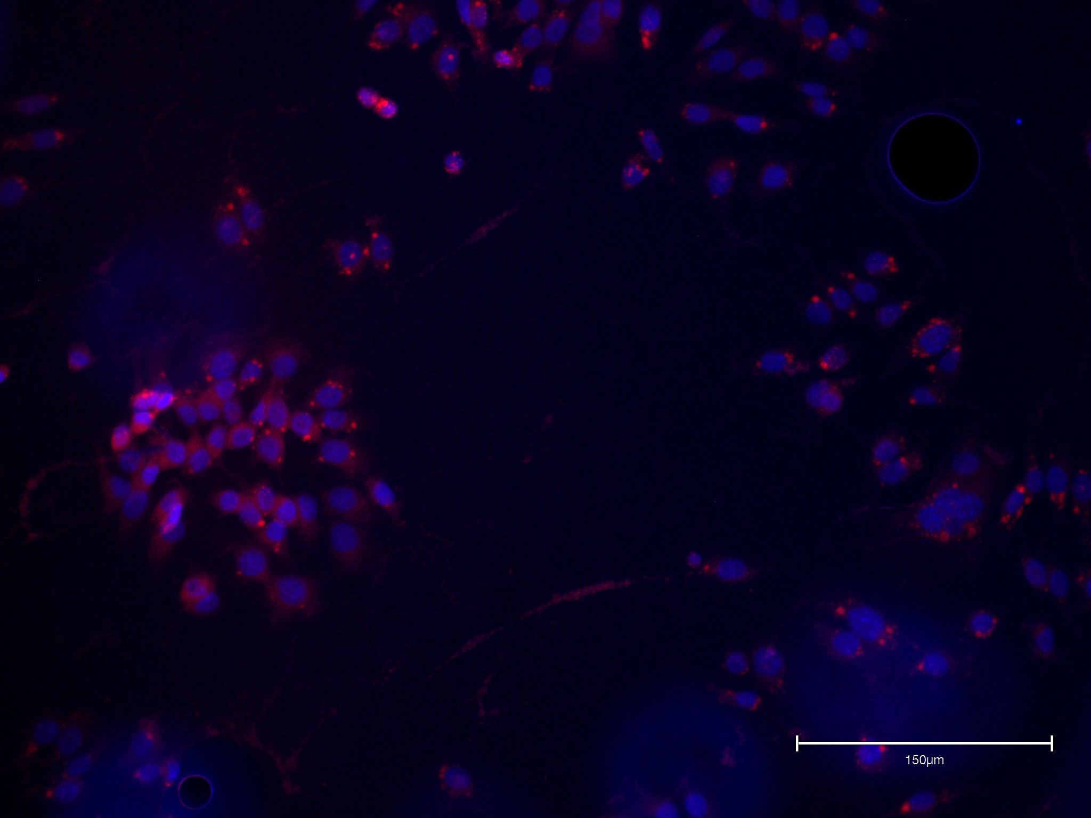
Results
DAPI (nuclear) stain
Mitochondria tracker
overlay
Figure 4. Fluorescent staining of parental line.
Notes:
Figure 4 images taken by Nicholas Hill via Invitrogen Evos M5000 fluorescent microscope.

Slide 8
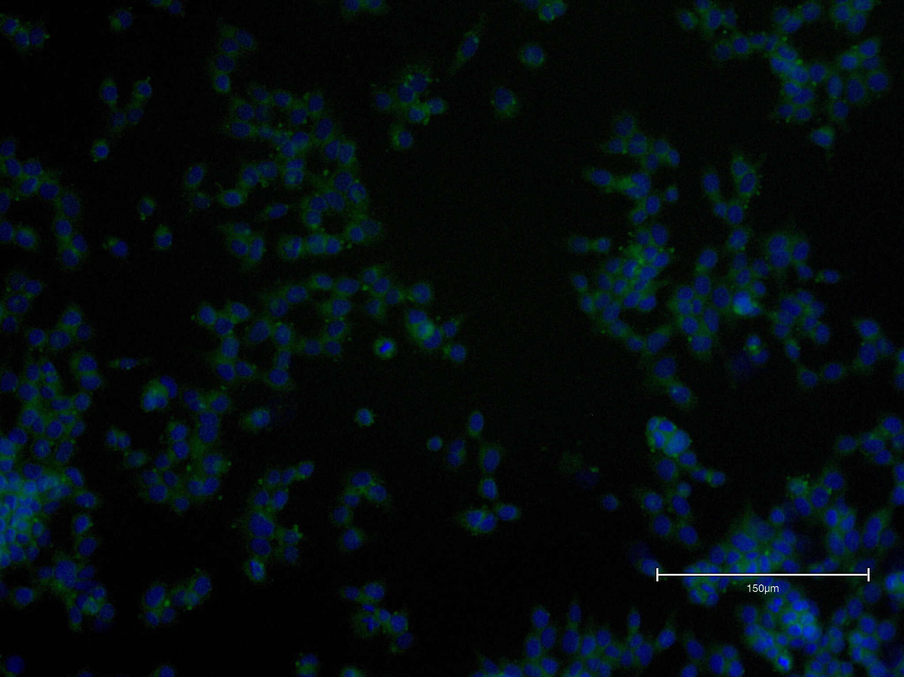
Results
Figure 5. DAPI and ER-tracker fluorescent staining post-starvation.
Notes:
Figure 5 image taken by Nicholas Hill via Invitrogen Evos M5000 fluorescent microscope.

Slide 9
Conclusions and Future Directions
Optimization of protocols
Confocal microscopy
Incorporation of flow cytometry

Slide 10
Translational Impact
Elucidation of the effects of constitutive KRAS activation on Ca²⁺ flux
Insight into role of KRAS in malignant transformation
New targets for therapies

