Slide 1
Varied Injustice: The Complex Legal Experience of Freedmen in Antebellum Virginia
Grace Hoisington

Slide 2
Who are Freedmen?
In this study, those free from slavery in the antebellum United States
Free by manumission
Free through maternal descent

Slide 3
Early Legal Obstacles in Virginia
1793- county registration law, “Freedom Papers”
1801-prohibition of employment outside of county of registration
1806- newly freed men to leave Virginia within one year of manumission
1831- prohibition of gatherings for educational purposes

Slide 4
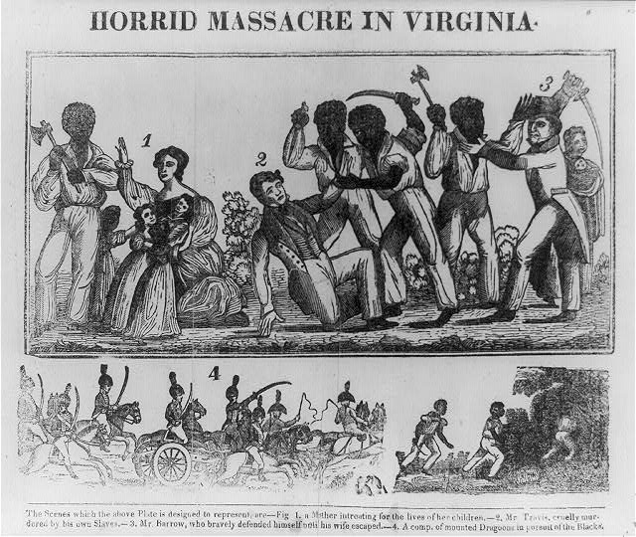
Turning Point
Nat Turner’s Rebellion
Slavery Debates 1831-32
Pro-Slavery Arguments
Anti-Slavery Arguments
Legal effects on Freedmen
Horrid Massacre in Virginia. Southampton County Virginia, 1831. Photograph courtesy of the Library of Congress

Slide 5
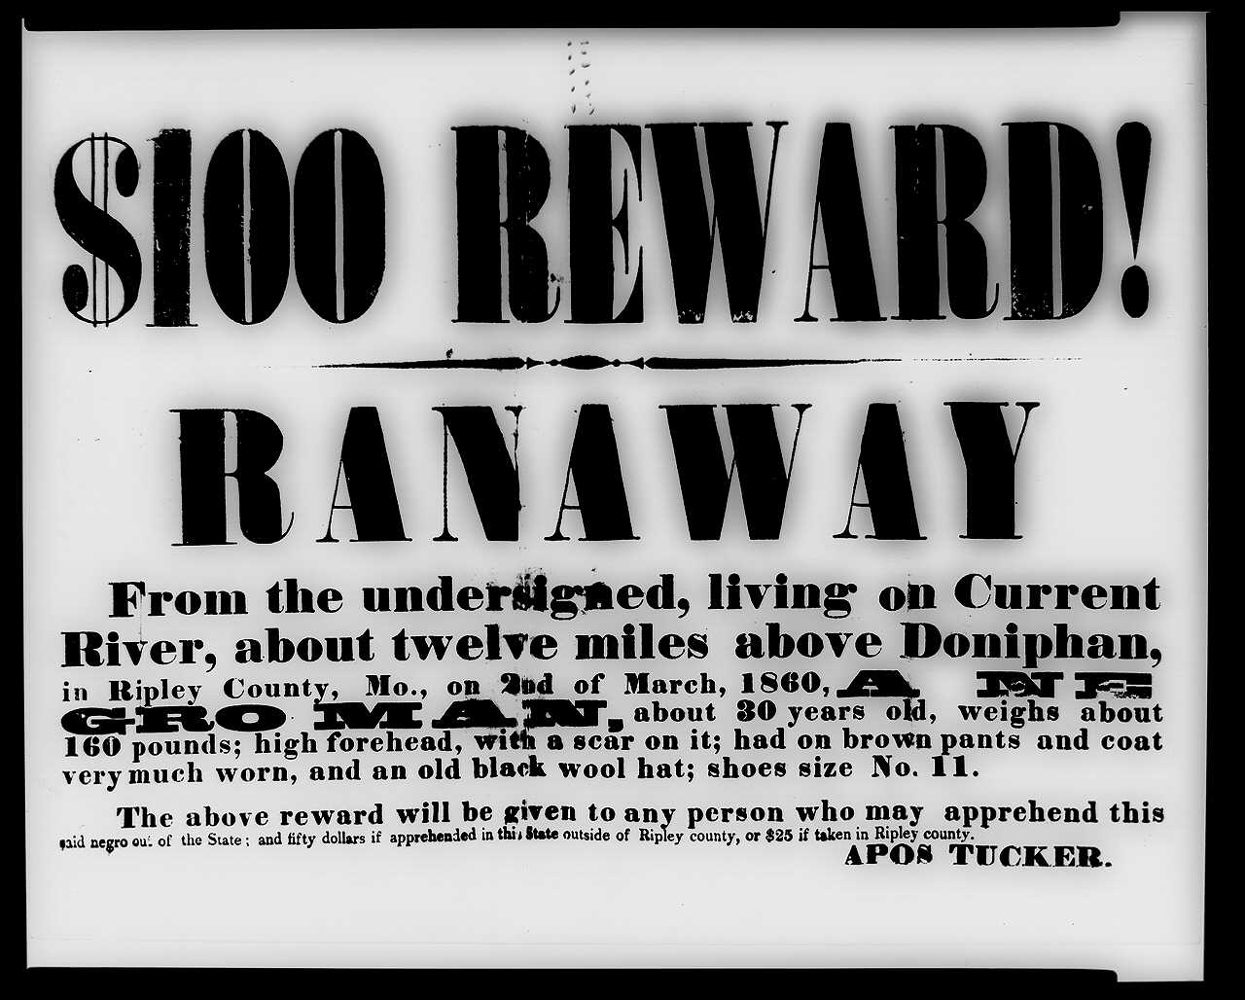
Impact on Virginia Freedmen
Urban
Norfolk
Petersburg
Rural
Prince Edward County
Albemarle County
Cumberland County
$100 Reward! Ranaway from Ripley County, Mo., Missouri, 1860, Photograph courtesy of the Library of Congress.

Slide 6
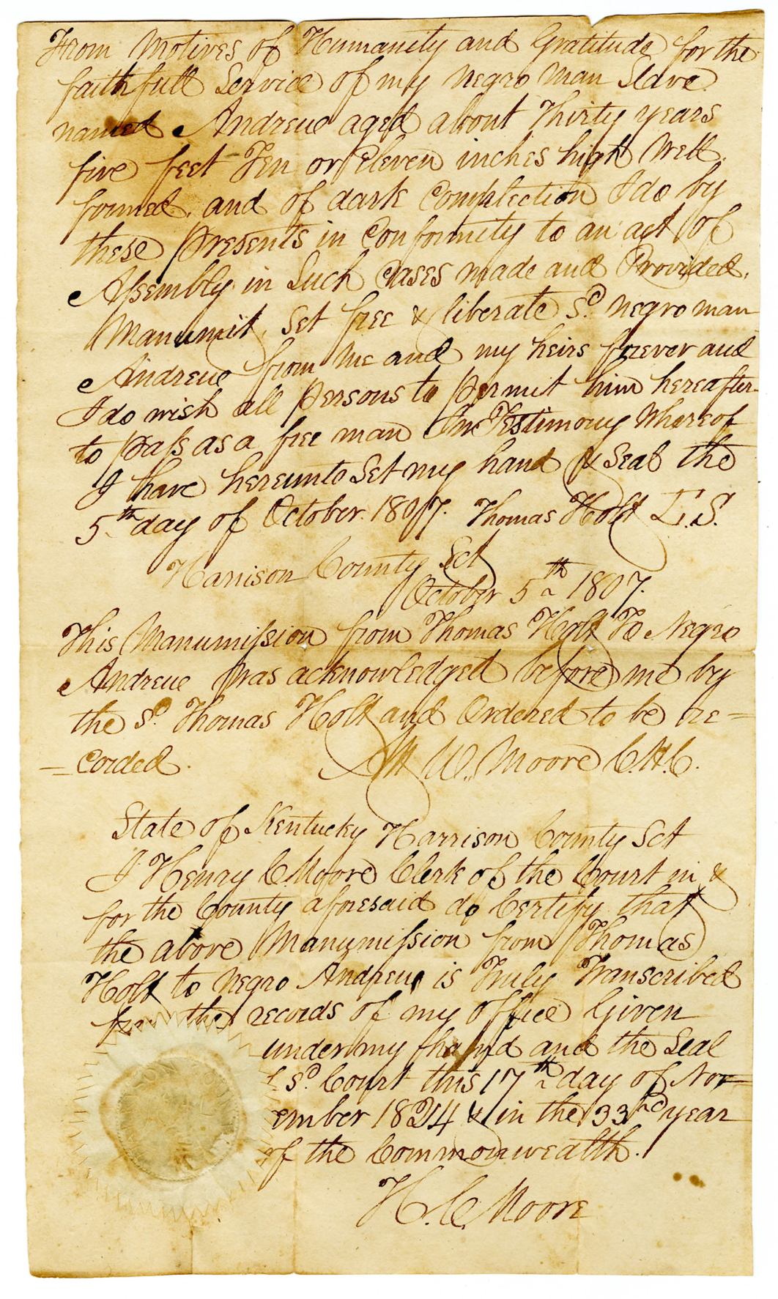
Andrew Holt
Born in Kentucky, 1807 manumission
Vocation as wheelwright and Baker, New London property purchases, 1822-35
Campbell County vs. Andrew Holt case, 1842
Donation of African Methodist Episcopal Church, 1851
Andrew: Deed of Manumission. Campbell County, 1807, Image courtesy of the Library of Virginia.

Slide 7
Dennis Holt
Manumitted by Father Andrew Holt between 1854-57
Petitioned for Re-Enslavement to remain with wife, Nancy
He “greatly prefers to enslave himself to the said David Hoffman to going out of the state.”
Holt, Dennis: Petition for Re-enslavement, Campbell County, 1857, Image courtesy of the Library of Virginia,

Slide 8
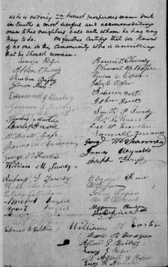
Billy Williamson
Set free by the last will of D. Williamson in ca. 1850
Petitioned to remain in Virginia
Stable family life, married since 1830 to unnamed enslaved woman
Occupation as a Farmer
Character references
Signed by 47 community members
Williamson, Billy: Petition, Campbell, 1851, Image courtesy of the Library of Virginia

Slide 9
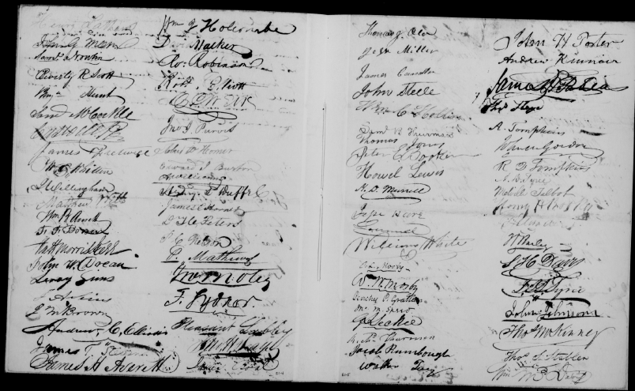
Ned Adams
Manumitted in ca. 1833 by late master
Petitioned to remain in Virginia in 1834
Supported by over 150 community members
Adams, Ned: Petition, Campbell County, 1834, Image courtesy of the Library of Virginia

Slide 10
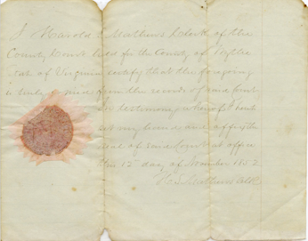
Milly and Children
Born free, but held slave status
Filed a freedom suit against the Commonwealth of Virginia
Claimed free status of maternal line
Native American descent
Milly: Freedom Suit, Campbell County, 1852 Image courtesy of the Library of Virginia

Slide 11
Experience of Campbell County Freedmen
Faced intense legal opposition from State level
County opposition on some cases
Several cases reflect community support
Further studies needed

Slide 12
Bibliography
Primary Sources and Photos
“$100 Reward! Ranaway from Ripley County, Mo.” Missouri, 1860. Photograph, Library of Congress.
“Adams, Ned: Petition,” Campbell County, 1834, Legislative Petitions Digital Collection, Library of Virginia, Richmond, VA.
“Andrew: Deed of Manumission,” Campbell County, 1807, Virginia Untold: The African American Narrative Digital Collection, Library of Virginia, Richmond, VA.
“Campbell Free Negroes and Mulattos,” Campbell County, 1833, Virginia Untold: The African American Narrative Digital Collection, Library of Virginia, Richmond, VA.
“Capture of Nat Turner.” Constitutional Whig, November 7, 1831.
Dew, Thomas. Review of the Debate in the Virginia Legislature of 1831 and 1832. Richmond, 1832.
“From the Norfolk Herald of Jan. 16.” Constitutional Whig, January 19th, 1832.
“Holt, Dennis: Petition for Re-enslavement,” Campbell County, 1857, Virginia Untold: The African American Narrative Digital Collection, Library of Virginia, Richmond, VA.
“Horrid massacre in Virginia.” Southampton County Virginia, 1831. Photograph, Library of Congress.
“Legislative Debate Continued.” Richmond Enquirer, February 4th, 1832.
“Milly: Freedom Suit,” Campbell County, 1852. Virginia Untold: The African American Narrative Digital Collection, Library of Virginia, Richmond, VA.
Perdue, Charles L., Thomas E. Barden, and Robert K. Phillips. Weevils in the Wheat: Interviews with Virginia Ex-Slaves. Bloomington: Indiana University Press, 1980.
“Removal of Free Negroes.” Richmond Enquirer, February 9, 1832.
Sterling, Dorothy. We Are Your Sisters: Black Women in the Nineteenth Century. New York: W.W. Norton and Company, 1984.
“The Freedmen's village, Hampton, Virginia.” photographed by G. Washington. Hampton Virginia, 1865. Photograph, Library of Congress.
Virginia, Acts Passed at a General Assembly of the Commonwealth of Virginia, 1830-1831. Richmond, 1831.
Virginia. Campbell County. Common Law Order Book 7, p. 11, 1842. Circuit Court Records, City of Rustburg
Virginia. Campbell County. Deed Book 18, p. 332-333, 1831. Circuit Court Records, City of Rustburg.
Virginia. Campbell County. Deed Book 20, p. 270, 1835. Circuit Court Records, City of Rustburg.
Virginia. Campbell County. Deed Book 28, p. 441-442, 1851. Circuit Court Records, City of Rustburg.
“Williamson, Billy: Petition,” Campbell, 1851, Legislative Petitions Digital Collection, Library of Virginia, Richmond, VA.
Secondary Sources
Berlin, Ira. Slaves Without Masters; the Free Negro in the Antebellum South. New York: Pantheon Books, 1975.
Bethel, Elizabeth Rauh. The Roots of African American Identity: Memory and History in Free Antebellum Communities. New York: St. Martin’s Press, 1999.
Bodenhorn, Howard. “A Troublesome Caste: Height and Nutrition of Antebellum Virginia's Rural Free Blacks.” The Journal of Economic History 59, no. 4 (1999): 972-96.
. The Color Factor: the Economics of African American Well-Being in the Nineteenth-Century South. New York: Oxford University Press, 2015.
Bogger, Thomas. Free Blacks of Norfolk Virginia, 1790-1860: The Darker Side of Freedom. Charlottesville: University of Virginia Press, 1997.
Cornelius, Janet Duitsman. Slave Missions and the Black Church in the Antebellum South. Columbia, S.C: University of South Carolina Press, 1999.
Delaney, Ted. Free Blacks of Lynchburg, Virginia, 1805-1865. Lynchburg: Warwick House, 2001.
Ely, Melvin Patrick. Israel on the Appomattox: a Southern Experiment in Black Freedom from the 1790s through the Civil War. New York: Vintage Books, 2005.
Eslinger, Ellen. “Free Black Residency in Two Antebellum Virginia Counties: How the Laws Functioned.” The Journal of Southern History 79, no. 2 (2013): 261–98.
Freehling, Alison Goodyear. Drift Toward Dissolution: the Virginia Slavery Debate of 1831-1832. Baton Rouge: Louisiana State University Press, 1982.
Gates, Henry Louis, and Donald Yacovone. The African Americans: Many Rivers to Cross. Carlsbad: Hay House Ltd, 2013.
Helg, Aline, and Lara Vergnaud. Slave No More: Self-Liberation before Abolitionism in the Americas. Chapel Hill: University of North Carolina Press, 2019.
Johnson, Michael, and James Roark. Black Masters: A Free Family of Color in the Old South. New York: W.W. Norton & Company, 1984.
Katz, Ellen. “African American Freedom in Cumberland County, Virginia- Freedom, Personal Liberty, and Private Law.” Chicago-Kent Law Review. 70, no. 3 (1995): 927-991.
Lebsock, Suzanne. The Free Women of Petersburg: Status and Culture in a Southern Town, 1784-1860. New York: Norton, 1984.
Levine, Lawrence W. Black Culture and Black Consciousness: Afro-American Folk Thought from Slavery to Freedom. Oxford: Oxford University Press, 2007.
McCleskey, Turk. The Road to Black Ned's Forge: A Story of Race, Sex, and Trade on the Colonial American Frontier. Charlottesville: University of Virginia Press, 2014.
Mitchell, Henry H. Black Church Beginnings: the Long-Hidden Realities of the First Years. Grand Rapids: W.B. Eerdmans Publishing, 2004.
Russell, John H. The Free Negro in Virginia, 1619-1865. New York: Dover Publications, 1969.
Schwarz, Philip J. Slave Laws in Virginia. Athens: University of Georgia Press, 1996.
Schweiger, Beth Barton. “The Literate South: Reading before Emancipation.” Journal of the Civil War Era 3, no. 3 (2013): 331–59.
Schweninger, Loren. Black Property Owners in the South, 1790-1915. Champaign: University of Illinois Press, 1997.
Stampp, Kenneth M. “An Analysis of T. R. Dew’s Review of the Debates in the Virginia Legislature.” The Journal of Negro History 27, no. 4 (1942): 380–87.
Wilkie, Jane Riblett. “The Black Urban Population of the Pre-Civil War South.” Phylon (1960-) 37, no. 3 (1976): 250–62.
Winch, Julie. Between Slavery and Freedom: Free People of Color in America from Settlement to the Civil War Lanham, Maryland: Rowman & Littlefield, 2014
Wolf, Eva Sheppard. Almost Free: a Story About Family and Race in Antebellum Virginia Athens: University of Georgia Press, 2012.

