Slide 1
An Approach Toward a United Korea
Megan Chaney & Danbi Jung

Slide 2
Key to the Unification:
Soft Power
: the ability of a country to persuade others to do what it wants without force or coercion (Nye, 2004)

Slide 3
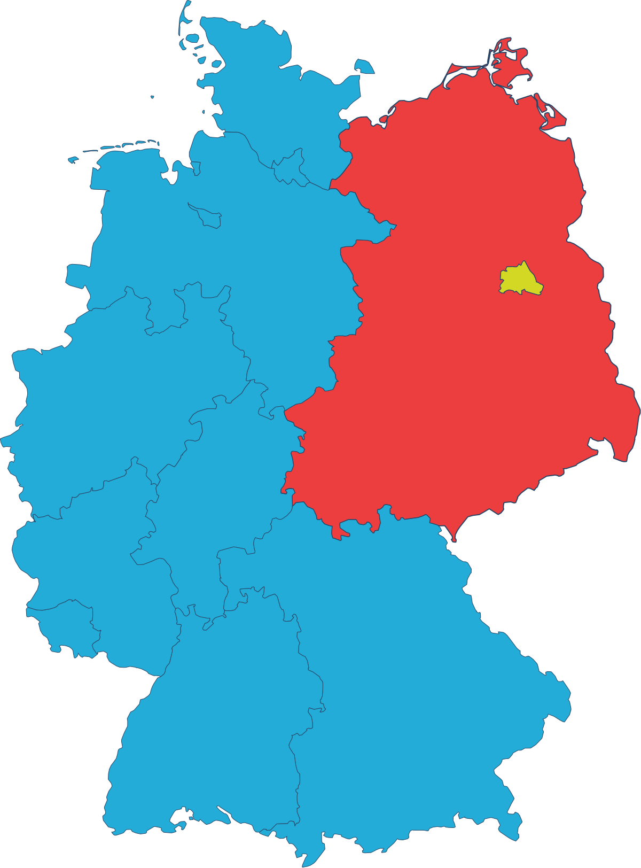
The German Unification
Cultural
Political
Foreign Affair
Fig. 1.

Slide 4
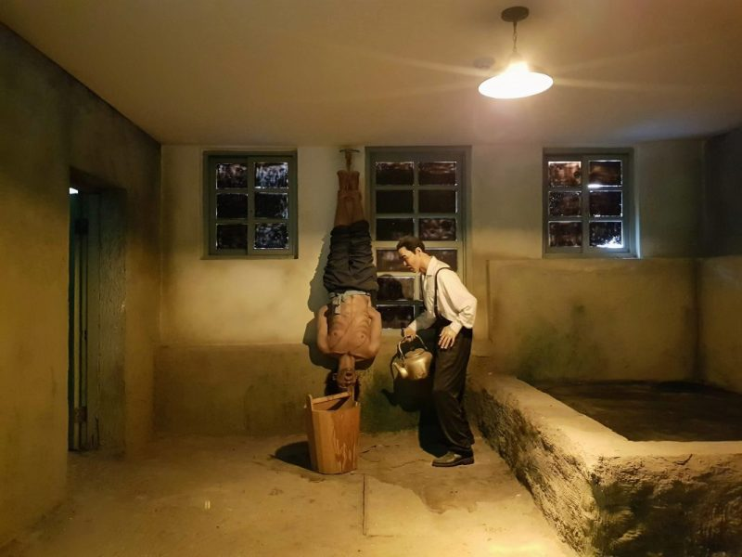
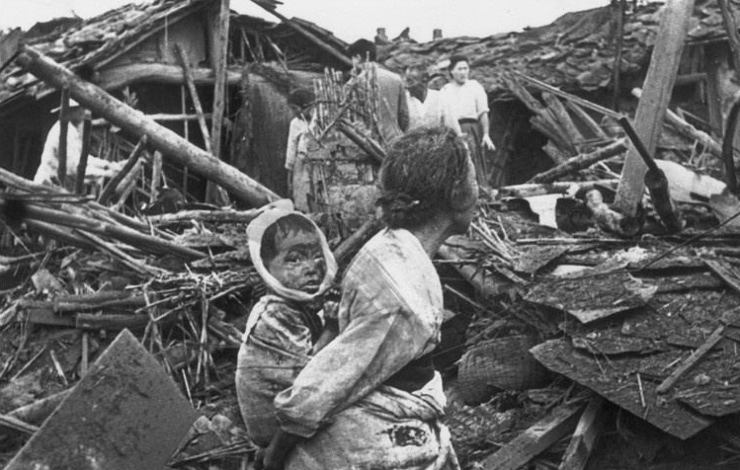
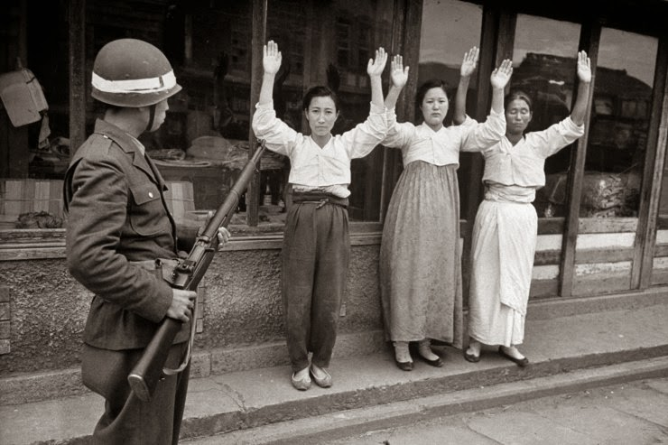
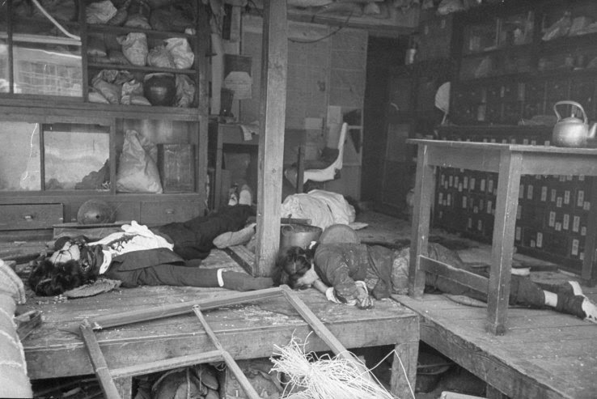
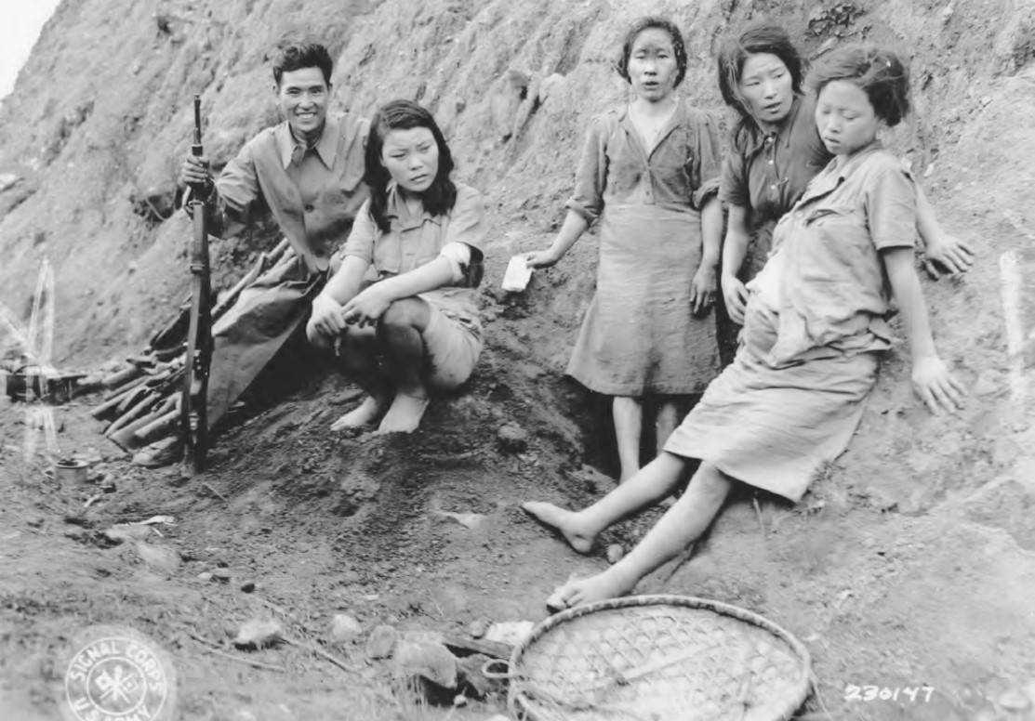
1. Cultural
Fig. 2.
Fig. 3.
Fig. 4.
Fig. 5.
Fig. 6.
Notes:
http://www.art-in-society.de/AS14/KOR2/Korean-war-prehistory.html

Slide 5
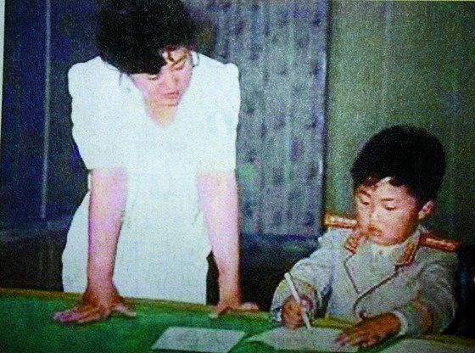
2. Political
Fig. 7
Notes:
http://www.art-in-society.de/AS14/KOR2/Korean-war-prehistory.html

Slide 6
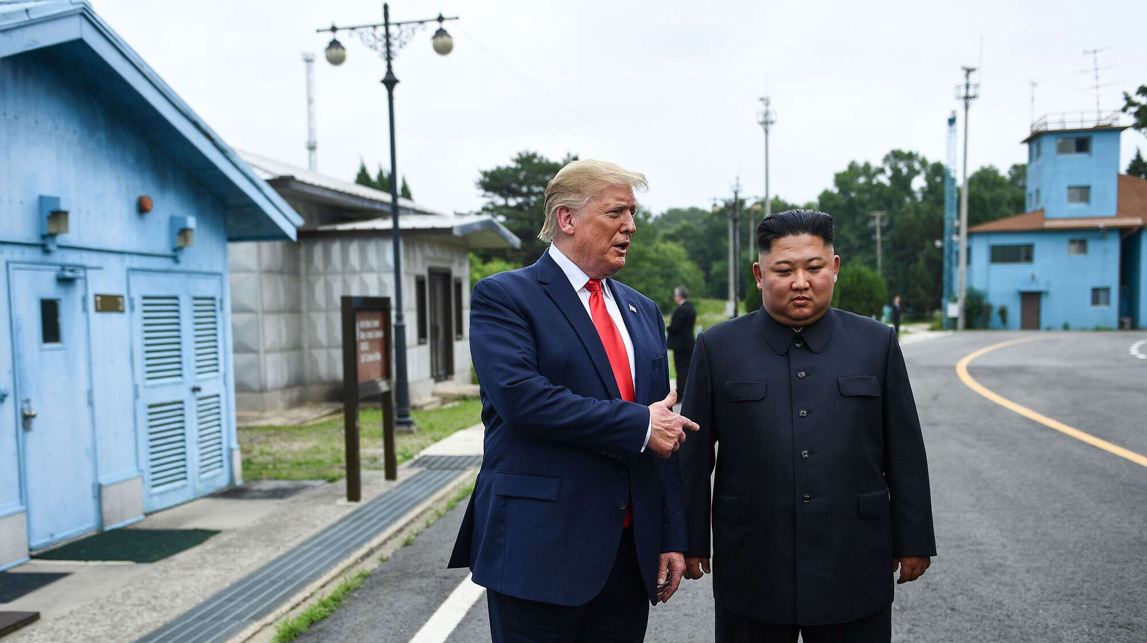
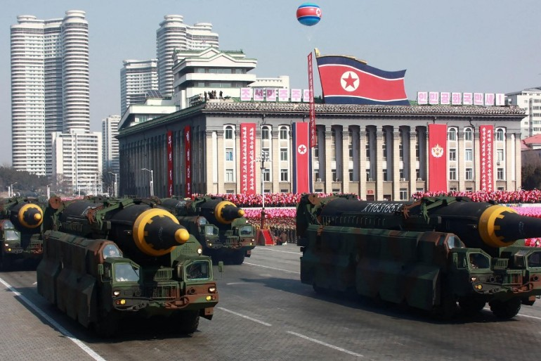
3. Foreign Affairs
Fig. 8.
Fig. 9.

Slide 7
Modified Strategy
Before
After
Domestic Initiative
Bilateral Relationship
Engage of International Institutions

Slide 8
Why would South Korea want the unification?

Slide 9
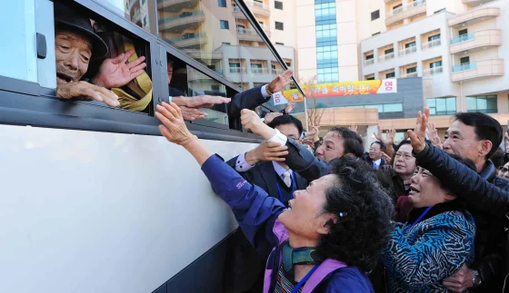
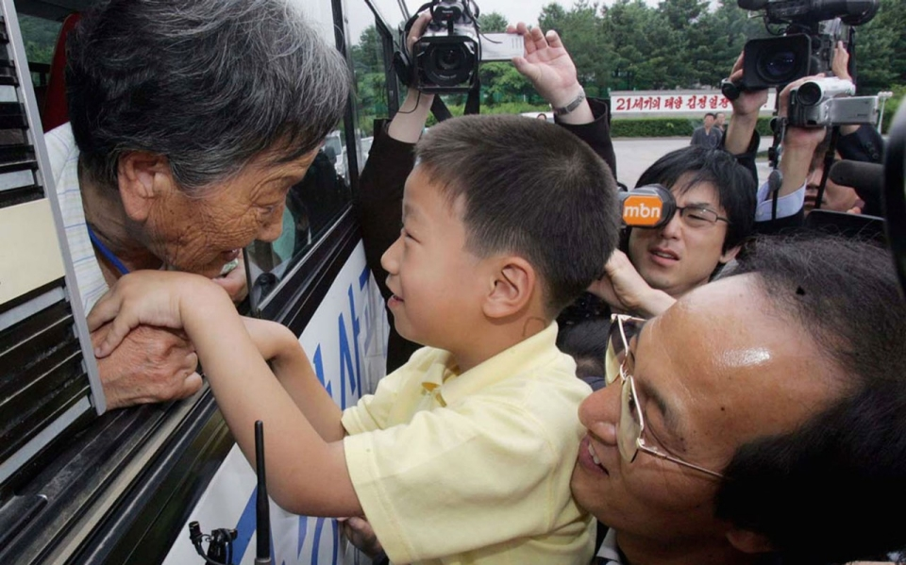
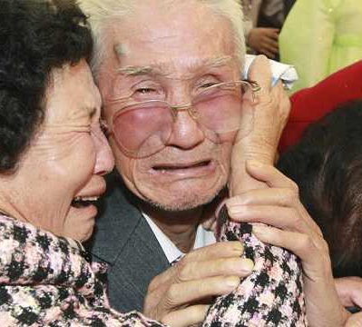
Fig. 10.; Fig. 11.
Fig. 12.; Fig. 13.

Slide 10
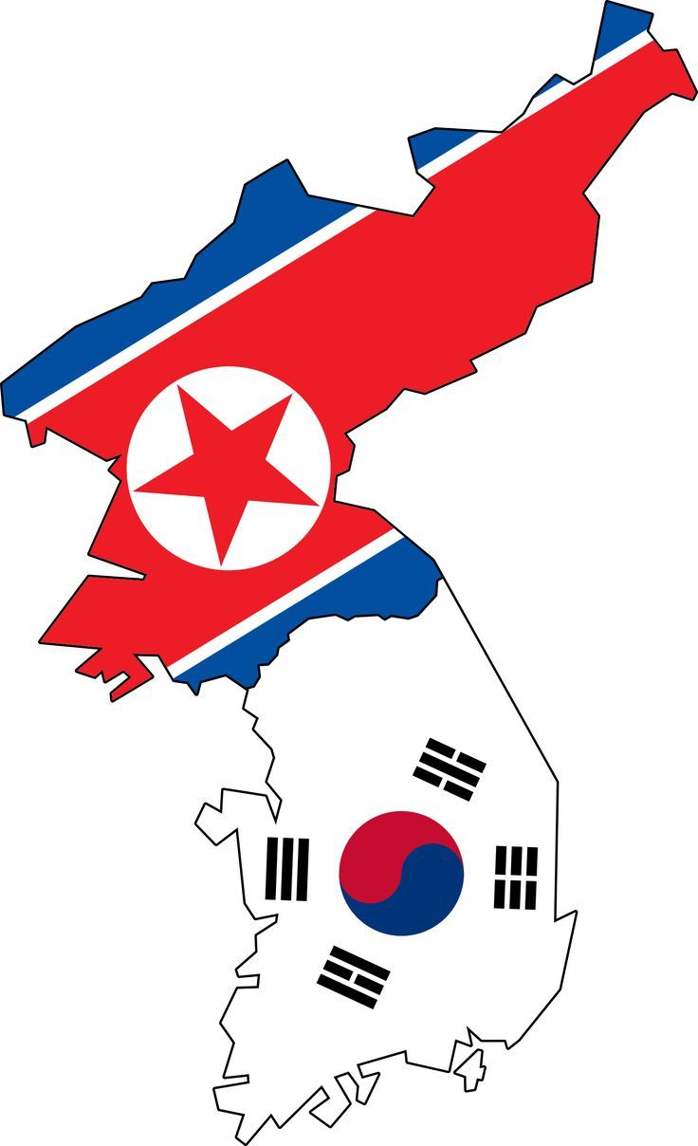
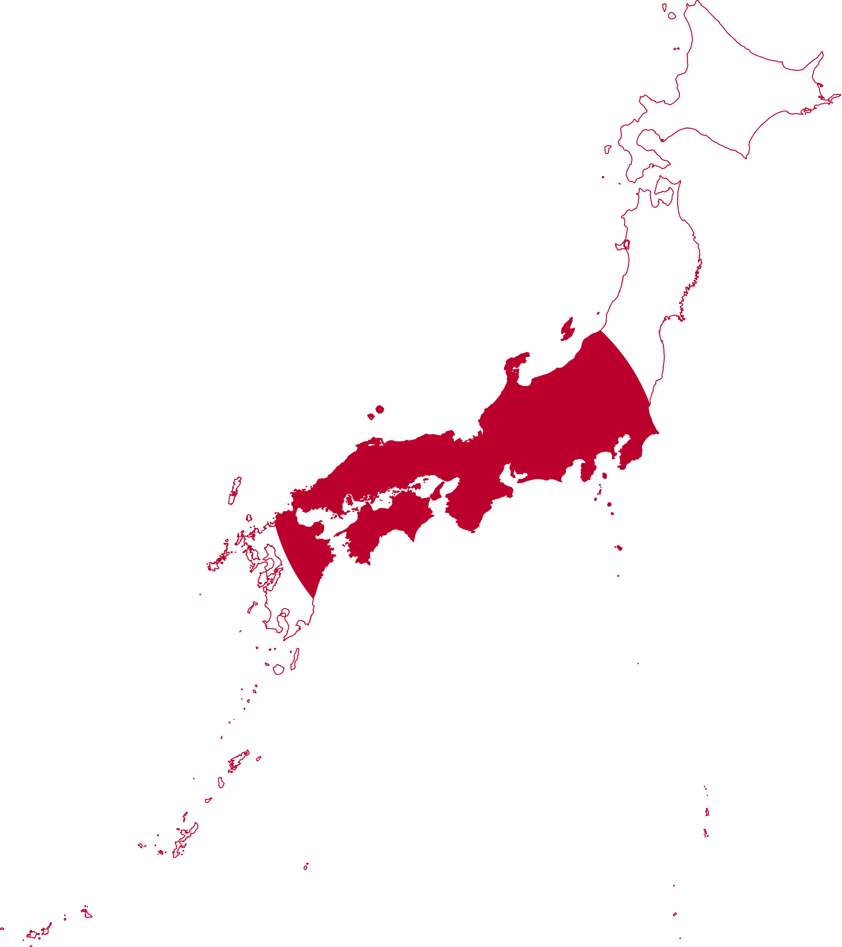
Application
Fig. 14.
Fig. 15.

Slide 11
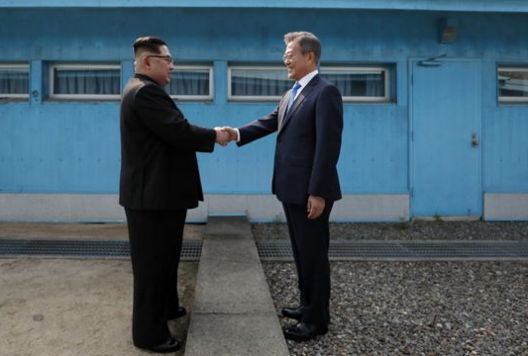
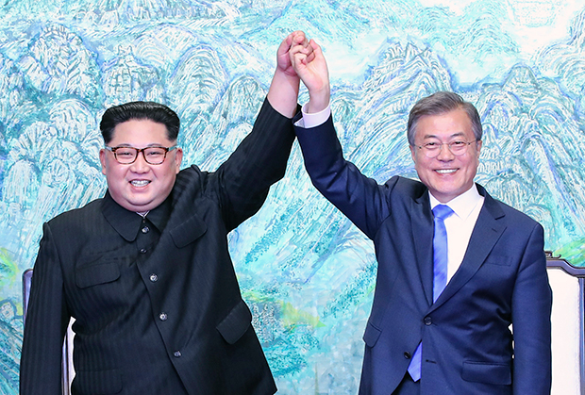
Fig. 16.
Fig. 17.

Slide 12
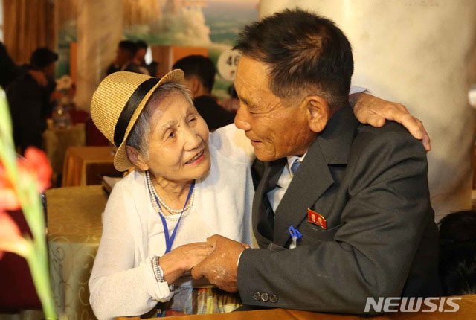
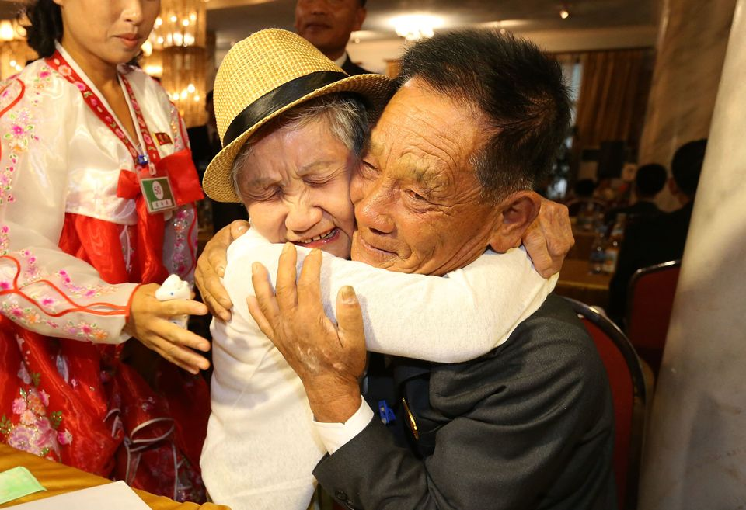
Fig. 19.
Fig. 20.

Slide 13
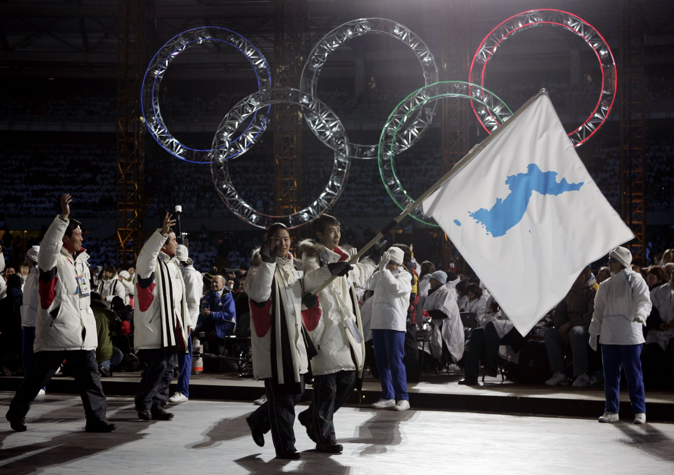
Fig. 21.

Slide 14
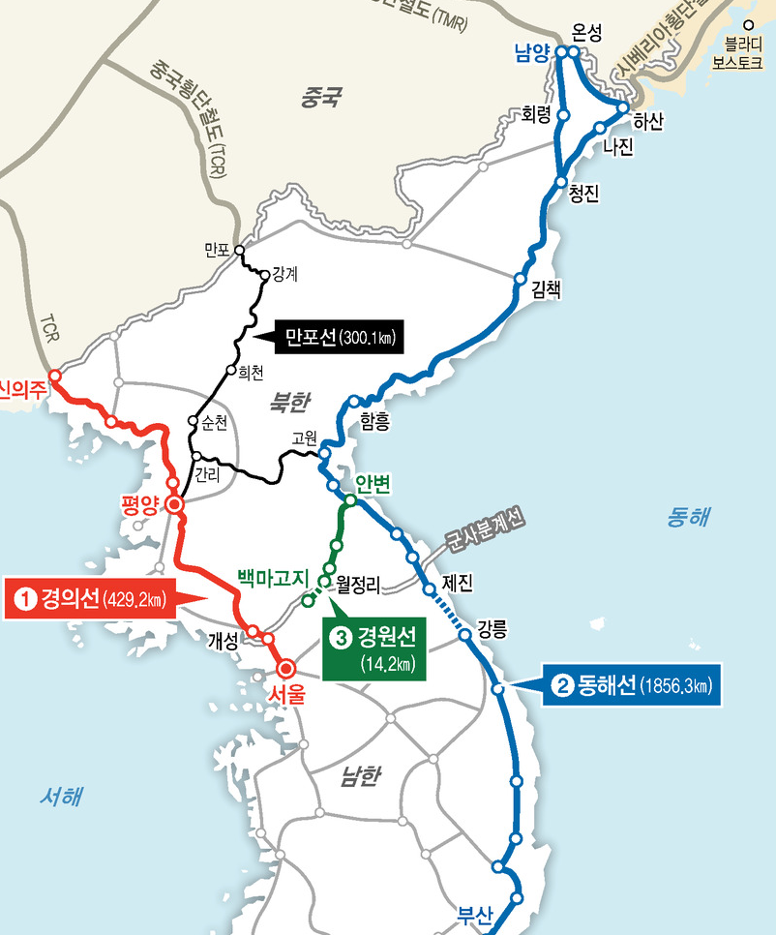
Fig. 18.

Slide 15
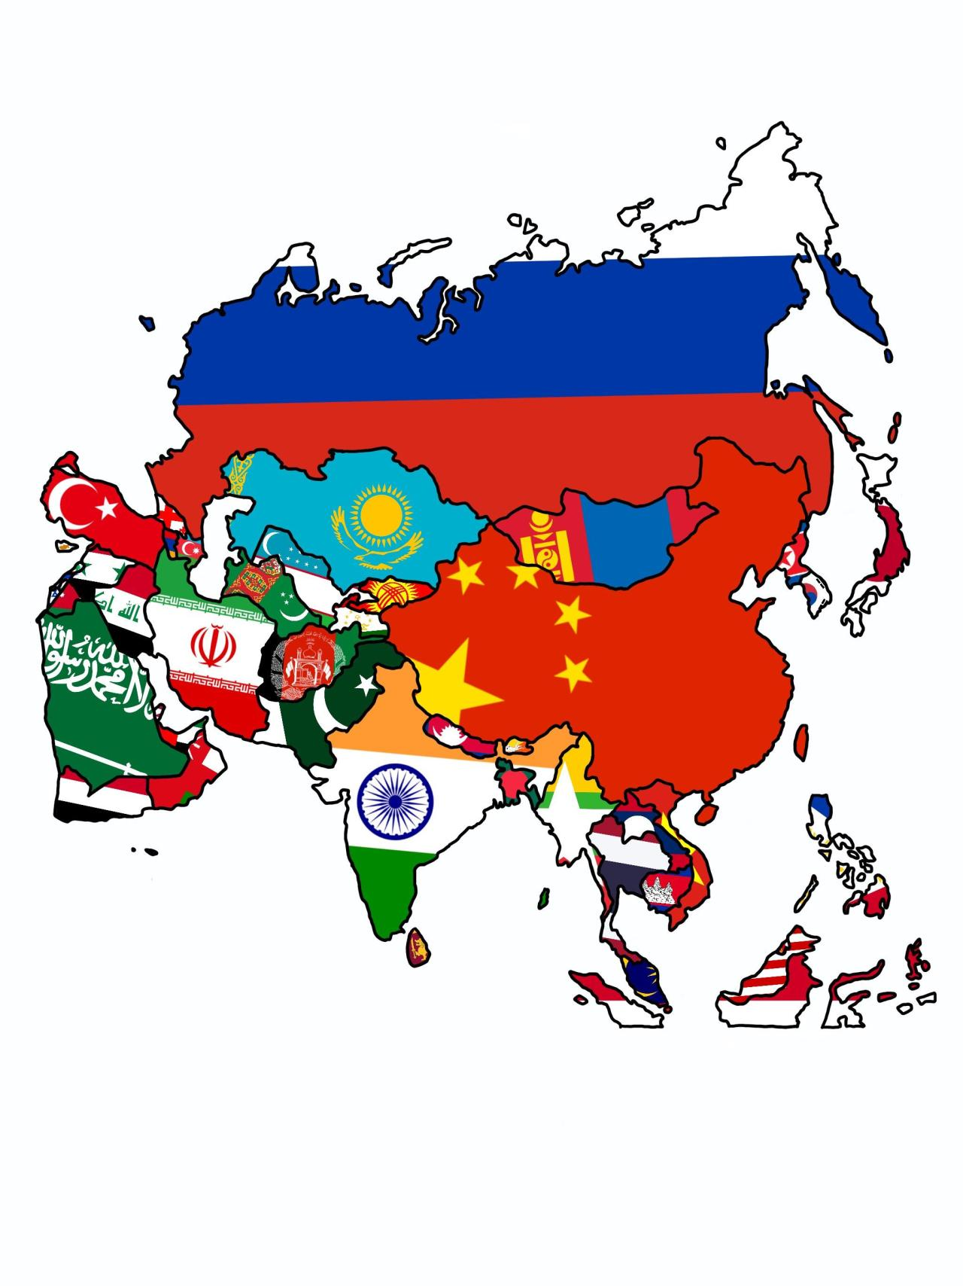
Asian NATO
Fig. 22.

Slide 16
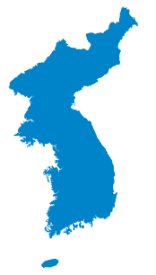
Fig. 23.
Fig. 24.

Slide 17
Q&A

Slide 18
References
Figure 1. A photo of German territory before its unification. (Photograph by Vivid Maps. German is still divided by east and west. n.d., https://vividmaps.com/germany-is-still-divided-by-east-and-west/)
Figure 2. A photo of South Korean teenage sex slavery pregnant and a Japanese soldier. (Photograph by Charles H. Hatfield. Teaching about the Comfort Women during World War II and the Use of Personal Stories of the Victims. September 7, 1994, https://www.asianstudies.org/publications/eaa/archives/teaching-about-the-comfort-women-during-world-war-ii-and-the-use-of-personal- stories- of-the-victims/)
Figure 3. A photo of Japanese soldiers torturing a South Korean (Photograph by Alfredo Jimenez. Behind bars by choice in South Korea. January 27, 2011., https://www.stripes.com/living/behind-bars-by-choice-in-south-korea-1.migrated)
Figure 4. A photo of armed (Photograph by Art in Society. The Pre-History of the Korean War. n.d., http://www.art-in-society.de/AS14/KOR2/Korean- war-prehistory.html)
Figure 5. A photo of South Korean civilian’s housing attacked by Japanese armed soldiers (Photograph by Art in Society. The Pre-History of the Korean War. n.d., http://www.art-in-society.de/AS14/KOR2/Korean-war-prehistory.html)
Figure 6. A photo of South Korean civilian holding her baby during a diastral era under the Japanese control (Photograph byhttps://www.quora.com/How- many-Koreans-were-killed-by-Japanese-torture-during-WWII
Figure 7. A picture of young Kim Jong-un and his mother (Photograph by Yonhap News. Kim Jong-un’s late mother made public in video clip. June 10, 2012., http://www.koreaherald.com/view.php?ud=20120610000244)

Slide 19
Figure 8. A picture of Donald Trump, president of the US president, and Kim Jong-un at the 38 parallel. (Photograph by Brendan Smialowski. Read the ‘Love Letters’ Donald Trump Traded with North Korean Dictator Kim Jong Un. September 1-, 2020., lhttps://people.com/politics/read-the-love- letters- donald-trump-traded-with-north-korean-dictator-kim-jong-un/)
Figure 9. A picture of nuclear weapon carried on tanks in Pyeongyang, North Korea. (Photograph by Asia Media International. North Korea: Nuclear Orientalism and the Hermit Kingdom. March 1, 2021., https://asiamedia.lmu.edu/2021/03/01/north-korea-nuclear-orientalism-and-the-hermit- kingdom/)
Figure 10. Family members seeing each other for the first time since the Korean war at the North Korea 3-day Summit. (Retrieved from ABC News: Korea Pool Photo, North Korean Son Kwon Geun, center, weeps with his South Korean relatives as he bids farewell after the Separated Family Reunion Meeting at Diamond Mountain resort in North Korea, Oct. 22, 2015. North and South Korean officials are meeting to map out details for what would be a highly emotional reunion of families separated since the 1950-53 Korean War, October 22, 2015., //abcnews.go.com/International/time-running-south-koreans-hoping-reunite-family-north/story?id=56339952 )
Figure 11. Family members seeing each other for the first time since the Korean war at the North Korea 3-day Summit. (Retrieved from NBC News: Reuters, North Koreans on a bus wave to their South Korean relatives as they bid farewell after a three-day family reunion in 2010 at the Mount Kumgang resort in North Korea, 2010. https://www.nbcnews.com/news/asia/north-south-korean-families-separated-war-hold-reunions- n22526)
Figure 12. Family members seeing each other for the first time since the Korean war at the North Korea 3-day Summit. (Lee Hun-Koo, South Korean Choi Gye-Wol (L) kisses the hand of her grandson Kim Chol-Bong as her son Kim Young-Nam watches, before she returns to her South Korean home after the Separated Family Reunion Meeting on June 30, 2006 at Diamond Mountain in North Korea, June 30, 2006. http://america.aljazeera.com/articles/2013/9/20/north-korea-indefinitelysuspendsfamilyreunificationwithsouth.html)
Figure 13. Family members seeing each other for the first time since the Korean war. (Retrieved from Fox News: Korea Pool, North Korean Kim Jin- Won (centre) cries with his South Korean relatives as they bid farewell following their three-day separated family reunion meeting at Mount Kumgang resort on the North's southeastern coast, near the border, on November 1, 2010. South and North Korea agreed Friday to go ahead with reunions next month for families separated for decades by the 1950-53 Korean War, Seoul said, November 1, 2010, https://www.foxnews.com/world/rival-koreas-strike-deal-on-family-reunions-seoul)
Figure 14. Flags of North and South Korea on the Korean Peninsula. (Clipartmax, Big Image - North And South Korean Flags, n.d., https://www.clipartmax.com/middle/m2K9A0m2K9A0b1G6_big-image-north-and-south-korean-flags/)

Slide 20
Figure 15. A visual of Japan. (Photograph by Washiucho, Flag-map of Japan, April 1, 2019, https://commons.wikimedia.org/wiki/File:Flag- map_of_Japan.svg)
Figure 16. A demonstration of the political ties between North and South Korea. (Photograph retrieved from Getty Images: Korea Summit Press Pool, North Korean Leader Kim Jong Un, left, and South Korean President Moon Jae-in shake hands over the military demarcation line upon meeting for the Inter-Korean Summit on April 27, 2018 in Panmunjom, South Korea, April 27, 2018, https://archive.kpcc.org/news/2018/04/27/82594/kim-moon-pledge-end-to-korean-war-and-denucleariza/ )
Figure 17. A demonstration of the political ties between North and South Korea. (Photograph by Getty Imags, North Korean leader Kim Jong Un (L) and South Korean President Moon Jae-in (R) pose for photographs after signing the Panmunjom Declaration for Peace, Prosperity and Unification of the Korean Peninsula during the Inter-Korean Summit on April 27, 2018, April 27, 2018, https://time.com/5397851/north-south-korea-third- summit-peace/ )
Figure 18. A photo of a train route that connects South Korea and North Korea (Photograph by Newspim. 남북관계 교착상태 탓? … 남북철도 노선 윤곽, 9월 이후로 연기 . April 22, 2022. https://www.newspim.com/news/view/20200422000390)
Figure 19. Image of two family members being briefly reunited in the family reunification summit. (Yonhap via Reuters, North and South Korean family members meet during a reunion at North Korea’s Mount Kumgang resort, near the demilitarized zone (DMZ) separating the two Koreas, North Korea, August 20, 2018, https://www.reuters.com/article/us-northkorea-southkorea-reunions-idUSKCN1L502P)
Figure 20. Image of two family members being briefly reunited in the family reunification summit. (Photograph by O Jongchang, Lee Geium-seom, 92, of South Korea wrapped her arms around her son Ri Sang-choi, a 71-year-old North Korean, for the first time in more than 60 years, n.d., https://www.nytimes.com/2018/08/20/world/asia/north-south-korea-family-reunions.html)
Figure 21. Image of the North and South Korean athletes marching under the One Korea flag at the Olympics. (Photograph by Amy Sancetta, North and South Korean athletes marched together during the opening ceremony of the 2006 Winter Olympics in Turin, Italy, February 10, 2006, https://www.nytimes.com/2018/01/17/world/asia/north-south-korea-olympics.html)
Figure 22. For the purpose of seeing Asia and the different countries it represents. (Maps on the Web, Asian flags, July 11, 2020, https://mapsontheweb.zoom-maps.com/post/623351845359861762/i-spent-a-lotta-time-on-this-guys)
Figure 23. One Korea Peninsula. (Himasaram, CC BY-SA 3.0 <http://creativecommons.org/licenses/by-sa/3.0/>, via Wikimedia Commons)
Figure 24. The North and South Korean flags side by side to depict oneness. (Business Standard, Flags of North and South Korea, n.d., https://www.business-standard.com/article/international/north-and-south-korea-brace-for-strong-typhoon-120082600536_1.html)

