Slide 1
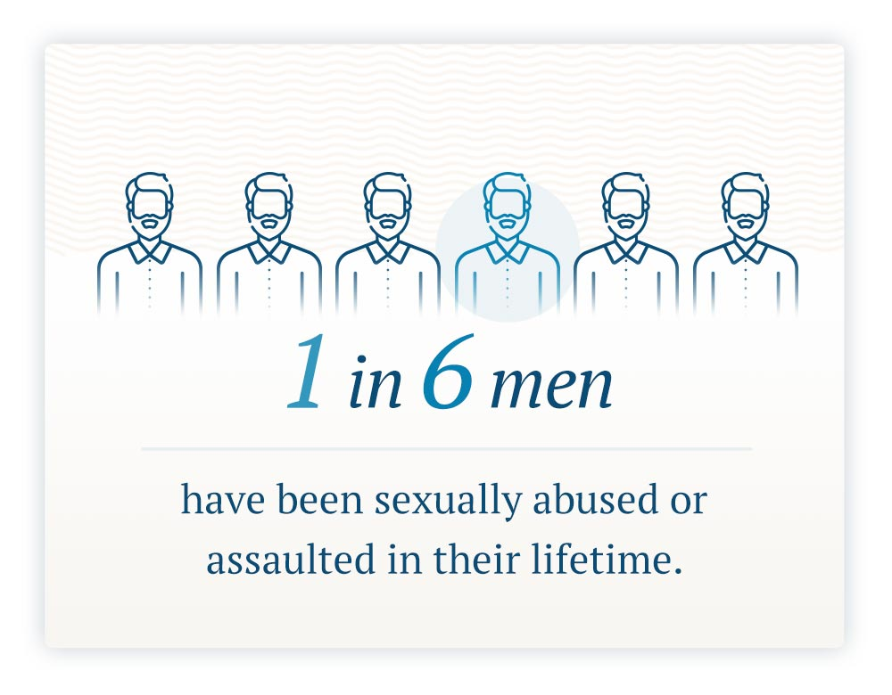
Men Do Not Cry: The Silent Problem of Male Sexual Assault
Leslie Knight, Rachel Joseph, and Aimée Houghton
Introduction
Abstract
Findings
Research into male-on-male sexual assault (SA) and female-perpetrated sexual assault of males is grossly lacking in comparison to the research conducted on male-on-female SA and same sex female-perpetrated SA, especially in the adult population. The reality of male victimization is examined. Nurses can learn to better accommodate males who report victimization in the acute care setting. Further research is needed for this patient population.
Victims of a male sexual assault experience stigmata which can negatively impact the healthcare they receive. With the female population receiving overwhelming support and research into the female victimization, the male population has been disregarded in the realm of victimization. Previous research into the victimization of males has covered childhood abuse and the affects children face (physically, mentally, and socially) as well as how those children deal with their trauma as adults. However, adult male victimization has yet to be thoroughly researched as a stand-alone topic. This could be due to the toxic masculine stereotype that men are always looking for a sexual encounter. We analyzed an accumulation of 14 peer-reviewed articles using key words such as male sexual violence, male sexual assault, and treatment for males of sexual assault. The utilized research articles provided insight into predatorial behaviors, male victimization mental health concerns, treatment for these males, and practical ways nurses can better accommodate them in the acute care setting. By examining specific verbiage when speaking with male victims, nurses can become more knowledgeable about the precise needs for this specific patient population. Nurses will then be better prepared to provide individualized, optimum care and education for the patients seeking physical and mental health services on the occurrence of adult male victimization. ​
Education is key in pre-victimization stage.
Educating the community about key topics such as who is at risk and providing methods of protection can be life changing in dire situations.
Vital education should be offered on the meaning of consent, including the meaning of “no.”
Post-victimization safety could include provision of prophylactic medications to prevent Sexually Transmitted Infections and providing the client with mental health resources.
History
336 B.C.
1962
1900 B.C.
There are accounts of sexual violence against males dating back as early as 1900 B.C. in the accounts of Sodom and Gomorrah.
Alexander the Great became king after a male servant was raped and the previous king chose to not punish the accused which lead to the murder of that king.
The first march for homosexual rights occurred in 1962 as the number of openly homosexual males in the U.S. increased. The stigma of being homosexual was perceived in a negative connotation.
The HIV epidemic in the United States is purported to have started in 1981. HIV was closely associated with the homosexual community, and the stigma of homosexuality being increased.
2006
The start of the Me Too movement began in 2006 which contributed to the false concept that women are the “ideal victim.”
1981
Conclusions
Male sexual assault is less reported than female sexual assault.
About 66.3% of males are estimated to have experienced some form of sexual assault.
There is a significant lack of research regarding adult male victims of sexual assault.
Nurses can be better equipped to support these men when needs arise.
Purpose
Future Research
Identify the incidence and prevalence of male sexual victimization, contributing factors, perceived stigmata, associated complications, resources to help the victims, awareness and preventive measures, and the role of nurses in the care of this population.
The mental health and trauma associated with male sexual abuse should be researched.
Effective interventions to help these men will allow them to cope effectively.
Nurses’ ability to understand and support these men must be explored.
Methods and Results
Methods
Fourteen articles were reviewed
Search terms: male sexual assault, treatment for males of sexual assault, Nurse’s role
Results
Males were reluctant to discuss the victimization until an average of 20-25 years post victimization.
Males tend to question their sexuality post assault and question if they wanted the assault based on physiological responses.
Stereotypical gender roles may play a part in reluctance to report because males are “supposed to be strong.”
The most effective form of mental health treatment was found to be Eye Movement Desensitization and Reprocessing (EMDR).
References and/or Acknowledgments
1 2 3 4 5 6 7 8 9 10 11 12 13 14
1 2 3 4 5 6 7 8 9 10 11 12 13 14
Depraetere, J., Vandeviver, C., Beken, T. V., & Keygnaert, I. (2020). Big boys don’t cry: A critical interpretive synthesis of male sexual victimization. Trauma, Violence, &Abuse, 21(5), 991–1010.https://doi.org/10.1177/1524838018816979
Ellis, A. E., Simiola, V., Mackintosh, M. A., Schlaudt, V. A., & Cook, J. M. (2020). Perceived helpfulness and engagement in mental health treatment: A study of male survivors of sexual abuse. Psychology of Men & Masculinities, 21(4), 632-642. https://doi.org/10.1037/men0000313
1in6 (2020). Sexual abuse and assault of boys and men: Confidential support for men. 1in6. Https://1in6.org/
https://www.cdc.gov/injury/features/sexual-violence/index.html
A
B
C
(1in6, 2020. Https://1in6.org/)
(1in6, 2020. Https://1in6.org/ )
Contact
Leslie Knight:
lnknight@liberty.edu
(210) 551-1513

