Slide 1
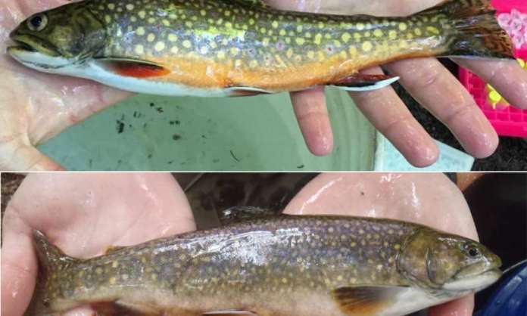
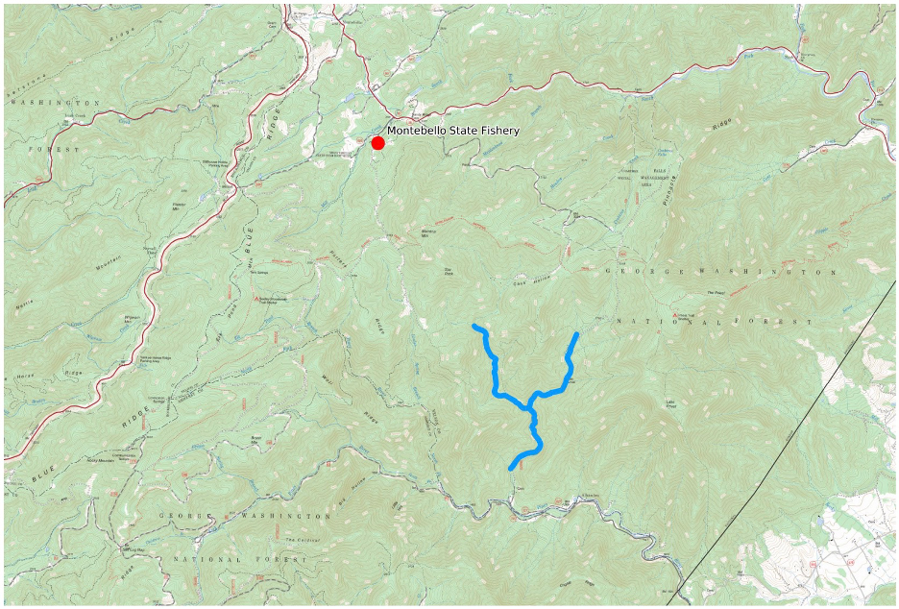
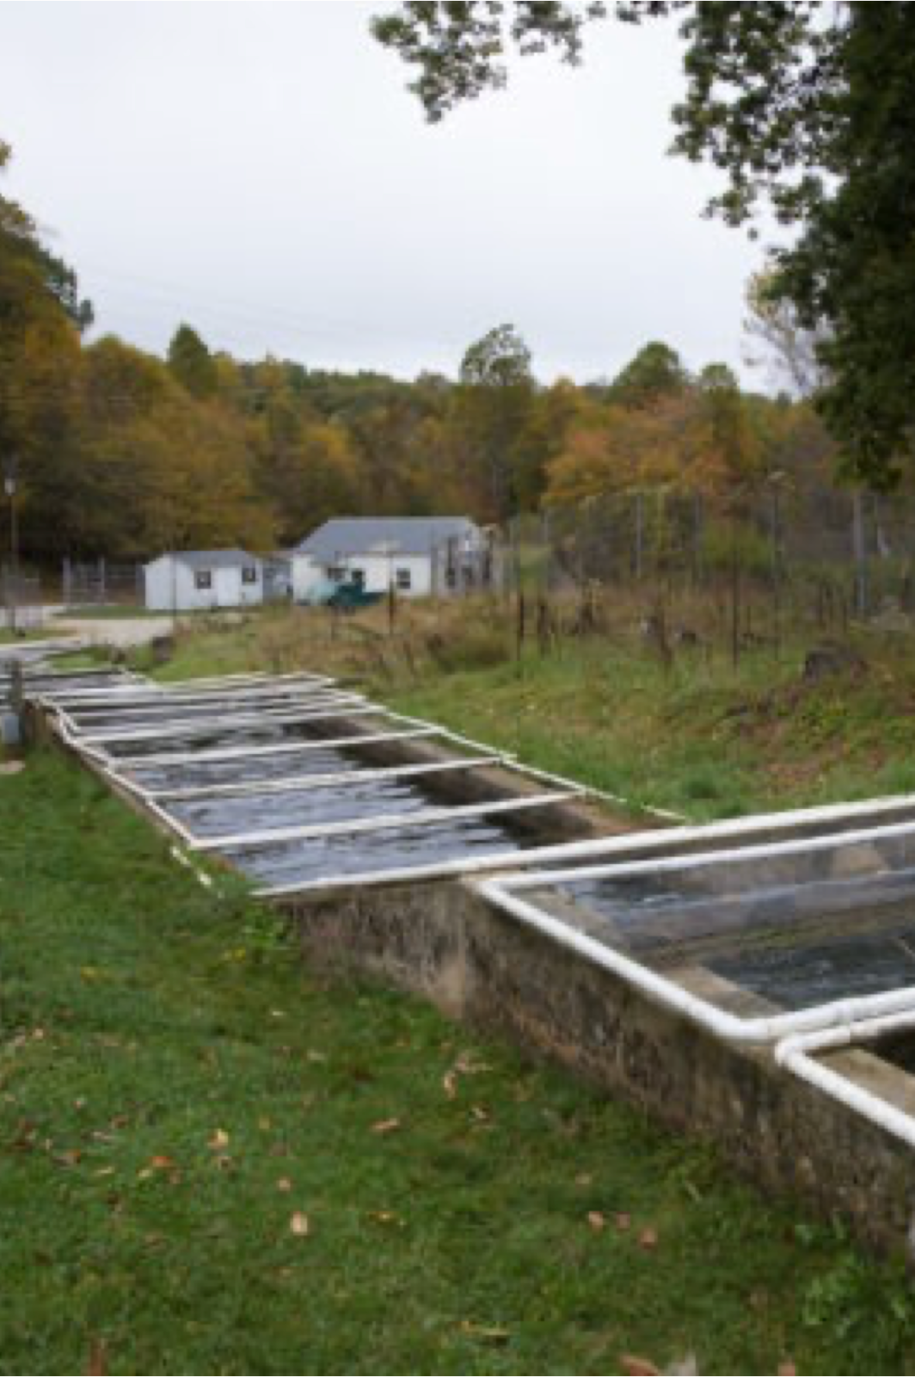
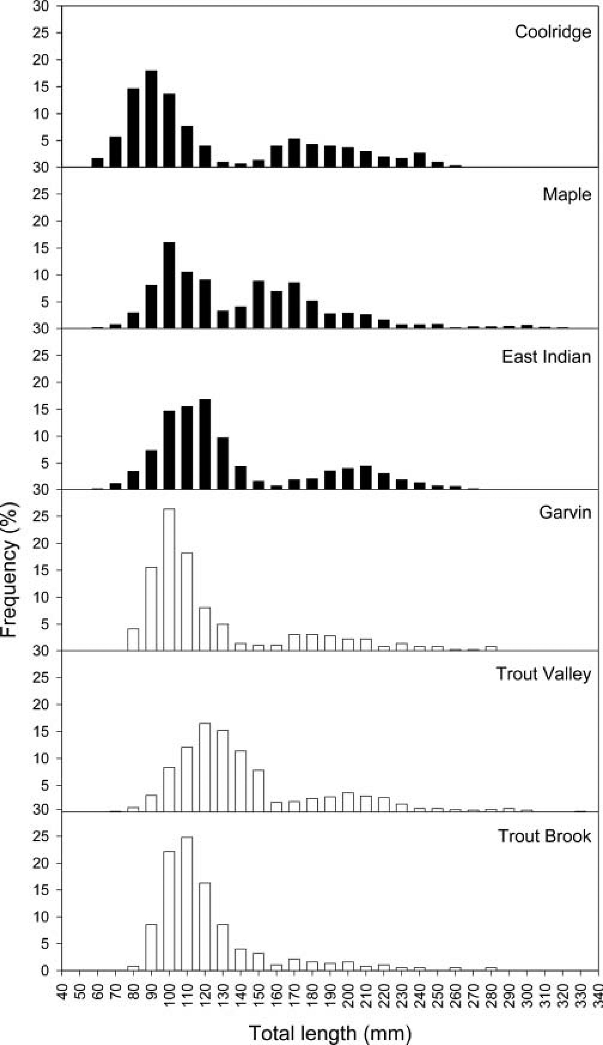
Investigating the genetic and morphological differences between stocked brook trout
(Salvelinus fontinalis) and stream bred brook trout populations in Central Virginia.
Maxwell Galbraith, Morgan Lowe, Jonah Sheridan, Elijah Stanley, Matthew Becker, & Kyle Harris
Background
Salvelinus fontinalis (Brook Trout) are a trout species that is native to the mountains of Eastern United States. Brook trout are a sensitive and valuable indicator species in many pristine watersheds, because of their sensitivity, many brook trout populations are slowly declining. The decline of wild brook trout populations has been a widely researched topic in recent years. Each watershed experiences differing factors that could be to blame for the decline of their particular population (Beer, Cornett, Austerman, Trometer, Hoffman, & Bartron 2019). Two presumably significant factors of their decline are invasive species and unethical stocking. This research study is focused on furthering the understanding of the effect that stocking trout has on stream – bred, native trout. A meaningful piece of understanding the dynamic between these two categories of trout is observing their similarities and differences. These observations will ideally contribute to the data pool pertaining to this topic and catalyze further study and discussion about stocking trout.
Figure 1. Wild and Hatchery Brook Trout (W.D., 2020)
Literature Gap and Objectives
Methods and Study Design
Broader Impacts
The main gap in literature for this project is that differences between stock and wild brook trout have not been studied in the rivers and streams around Lynchburg, VA. Our group is planning to fish in Shoe Creek and Piney River and see if there is a difference between size, introgression, and diet of the stocked fish rivers and the wild caught ones.
The brook trout population on the east coast needs management and attention. Our research team hopes to contribute to the conservation of brook trout in central Virginia by providing a detailed observational study of the relationship between captive – bred brook trout and stream – bred brook trout. Stocked trout are known to be inherently different than wild trout, with that said, our results will potentially tell us just how different and in what ways. Knowing more about the variation between these two categories of trout and how they interact with one another, we hope to present that information in a way that is supplemental to the conversation surrounding the stocking of trout.
R
Expected Results
Genetic difference between stocked and native Brook Trout
Stocked trout not living long enough to reproduce therefore no genetic impact on the native population
Difference in the stomach content of stocked and native Brook Trout.
Size and weight difference between stocked and native Brook Trout.
Figure 4. Fin clip procedure (DNR, 2022)
A
B
Created by Jonah Sheridan; Research Locations (CalTopo)
References and Acknowledgements
C
Beer, S. D., Cornett, S., Austerman, P., Trometer, B., Hoffman, T., & Bartron, M. L. (2019). Genetic diversity, admixture, and hatchery influence in Brook Trout (Salvelinus fontinalis) throughout western New York State. Ecology and evolution, 9(13), 7455–7479. https://doi.org/10.1002/ece3.5237
Bronte, C. R., McKee, P. C., Holey, M. E., Toneys, M. L., & Haver, P. E. (2006). Relative survival of lake trout stocked at different sizes and quality in Lake Michigan. Journal of Great Lakes Research, 32(2), 386–394
DNR - management units - 169.62.82.226. (n.d.). Retrieved April 4, 2022, from http://169.62.82.226/dnr/0,4570,7-350-79136_79236_80245---,00.html
King, T. L., Lubinski, B. A., Burnham-Curtis, M. K., Stott, W., & Morgan, R. P. (2012). Tools for the management and conservation of genetic diversity in brook trout (Salvelinus fontinalis): Tri- and tetranucleotide microsatellite markers for the assessment of genetic diversity, phylogeography, and historical demographics. Conservation Genetics Resources, 4(3), 539–543. https://doi.org/10.1007/s12686-012-9603-z
Hoxmeier, R. J., Dieterman, D. J., & Miller, L. M. (2015). Brook Trout Distribution, genetics, and population characteristics in the Driftless Area of Minnesota. North American Journal of Fisheries Management, 35(4), 632–648. https://doi.org/10.1080/02755947.2015.1032451
RT PCR/ Qpcr DNA testing. indiamart.com. (n.d.). Retrieved April 4, 2022, from https://www.indiamart.com/proddetail/rt-pcr-qpcr-dna-testing-23933714373.html
Sheridan, J. (2022). Research Locations. CalTopo. CalTopo. Retrieved 2022, from
https://caltopo.com/map.html#ll=37.81812,-79.11032&z=13&b=f16a.
Virginia Department of Wildlife Resources. (2022). Montebello Fish Hatchery. Virginia DWR. Retrieved 2022, from
https://dwr.virginia.gov/fishing/fish-stocking/state-hatcheries/montebello-fish-hatchery/.
W. D., By, Donald Willis (2020, January 20). How to tell the difference between stocked and wild trout. Flylords Mag. Retrieved April 4, 2022, from https://flylordsmag.com/how-to-tell-the-difference-between-stocked-and-wild-trout/
Figure 2. Motebello State Hatchery (Virginia DWR, 2022)
Figure 3. Trout Length (Hoxmeier, 2015)
Figure 5. RT PCR/Qpcr DNA testing. (indiamart.com, 2022)

