Slide 1
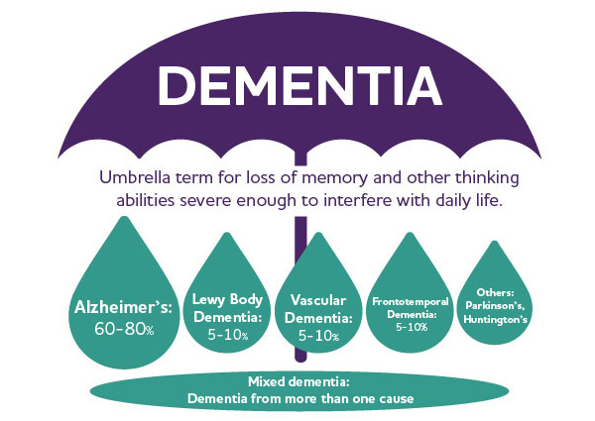
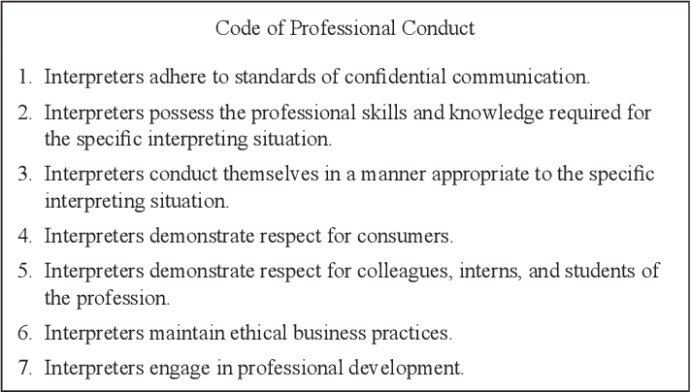
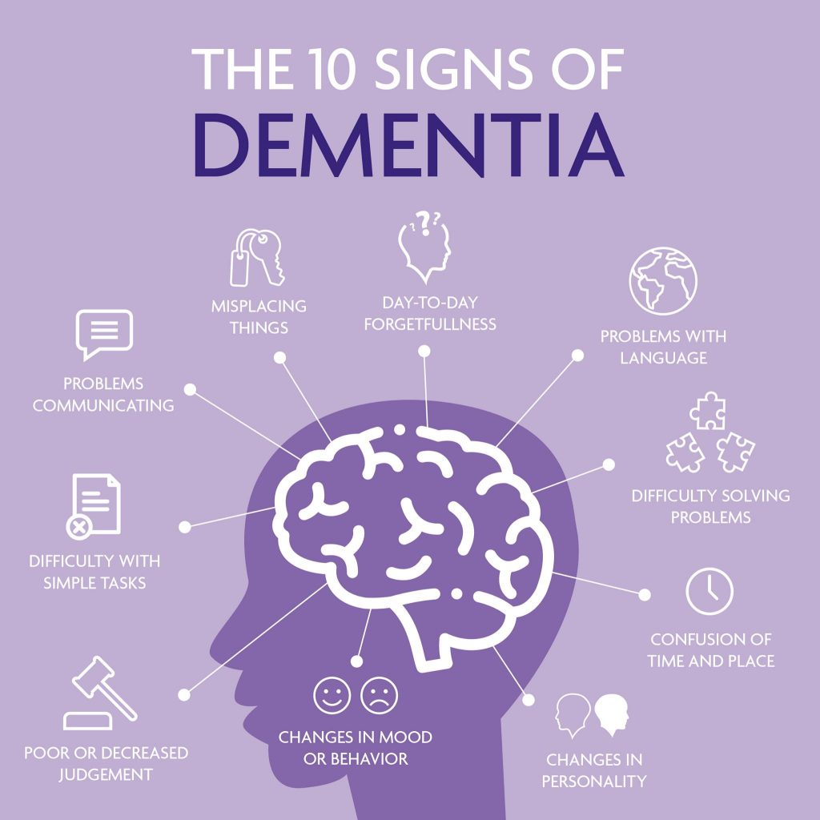
The Effects of Dementia on Signed Language Production
for d/Deaf Clients Communicating with Sign Language Interpreters
Alayna Wade
Theoretical Abstract
Introduction
Survey Questions
The job of an interpreter is to facilitate communication and provide equal access for both d/Deaf and hearing clients. However, there are challenges interpreters might face that requires adjustment to their interpreting approach. One of these challenges includes working with populations that have memory loss that affects language production and comprehension, caused by dementia. Like elderly hearing persons, many d/Deaf individuals experience degenerative memory loss due to dementia, which affects their ability to produce and comprehend signed languages. This study proposes a theoretical research approach aimed at collecting data on the experiences of interpreters working with d/Deaf persons with dementia in order to understand the interpreting process.
When looking at the interpreting profession, there is an initial idea that the process of interpreting is standardized, regardless of consumer, when in reality, many factors affect language and communication. One such factor may be the presence of a degenerative brain disease such as dementia and/or Alzheimer’s. Cognitive diseases like dementia and Alzheimer’s greatly affect memory and daily living activities, including communication. When examining how memory loss affects a person’s language production and understanding, there are challenges that present themselves in the interpreting process. These challenges may call for adjustments that interpreters need to make to convey messages accurately and ensure bilateral understanding. These challenges to language production for individuals with dementia may also create frustration between interpreters and d/Deaf clients, presenting a need for a solution. The theoretical study being proposed will be conducted through a questionnaire, asking participants about their experiences working with d/Deaf clients who have dementia, if there were adjustments made to the interpreting process to navigate memory loss affecting language. The survey will also ask interpreters if they believe preclusive actions (e.g., specialized training in working with individuals with memory loss or better language assessments for d/Deaf clients with dementia), would be beneficial and allow for the best communication. The findings will allow for the assessment of the interpreting process between Signed Language Interpreters and d/Deaf clients with dementia and establish a possible need for change in interactions with d/Deaf clients and their interpreters.
Note: the term d/Deaf will be used throughout the study to include those who are physically deaf and those who are apart of the Deaf community
Results
Demographics
What is your age?
What is your gender?
What is your current state of residence?
What is the highest level of education you have received?
Experience
What qualifications do you currently hold as it pertains to the interpreting profession?
How many years of experience do you have interpreting for elderly clients?
How many years of experience do you have working for clients who have dementia and/or memory loss?
When working with d/Deaf clients with dementia and/or memory loss, have you had to adjust your approach to interpreting?
If yes, what changes were made? Were they successful or unsuccessful in terms of language comprehension for the d/Deaf client?
Opinion-based Questions
Do you believe that additional training in working with clients with memory loss would be beneficial to the interpreter?
Do you believe that additional training in working with clients with memory loss would be beneficial to d/Deaf clients?
Do you believe that effective screening for dementia would be beneficial to the interpreting process?
Do you believe that effective screening for dementia would aid d/Deaf clients in expressing and comprehending language during the interpreting process?
Literature Review
Dementia
dementia is a degenerative brain disease that leads to cognitive decline in primarily the elderly population. This cognitive degeneration effects many daily activities, including language production and comprehension (Rantapää, M., & Pekkala, S; 2016).
It is estimated that 35 million people all over the world have dementia and it affects 5 to 10% of the elderly population (Banovic, S., et al.; 2018).
Deaf with Dementia
d/Deaf persons with dementia experience language difficulties such as “impaired repetition and naming, a reduced ability to produce and comprehend fingerspelled words, and a tendency to produce short simple sentences” (Rantapää, M., & Pekkala, S; 2016).
There is a low early detection rate of dementia in the d/Deaf population, which greatly affects beneficial treatment that if applied early on can increase the chances of better outcomes (Young, A., et al.; 2016).
While there is effective screening for hearing persons experiencing dementia, there is no research on an effective screening tool for d/Deaf persons who use American Sign Language to communicate.
The Interpreting Process
Understanding how memory loss impacts language production and comprehension is necessary when interpreting for d/Deaf individuals with dementia, as it may call for adjustment of the interpreting process and/or extra support needed for effective communication.
Having knowledge of low early detection rates amongst the d/Deaf population is important for interpreters to understand for possible interpreting situations that might arise with a d/Deaf client experiencing memory loss that might not be diagnosed with dementia.
Figure 1. What Is Dementia?
The figure above breaks down the term “dementia” and what type of memory loss the degenerative brain disease may fall under. “What Is Dementia?” Alzheimer's Disease and Dementia, https://www.alz.org/alzheimers-dementia/what-is-dementia.
Figure 2.
RID Code of Professional Conduct. “Code of Professional Conduct.” Registry of Interpreters for the Deaf, 24 Apr. 2018, https://rid.org/ethics/code-of-professional-conduct/.
Future Work
Assess the experiences of interpreters to establish the needs for both interpreters and d/Deaf clients
Formulate solutions regarding the ease of interpreting with d/Deaf clients who have dementia
Create an interpreting model that results in effective communication and ease of understanding when working with d/Deaf clients with dementia
Present the need for better screening and design a screening tool for d/Deaf ASL users.
1 2 3 4 5 6 7 8 9 10 11 12 13 14
1 2 3 4 5 6 7 8 9 10 11 12 13 14
Methods
A
B
References
The proposed research question asks whether the current approach to interpreting for d/Deaf persons with dementia needs to be changed or adjusted to better bilateral understanding. The proposed study will take a theoretical survey approach. The survey will be utilized to collect data relevant to the study being conducted. Participants of this survey will be limited to American Sign Language interpreters that have had experience facilitating communication for d/Deaf clients with dementia. These criteria were chosen to ensure the responses are relevant and accurate. The survey will be sent out via email as well as posted to social media interpreting groups asking for anyone meeting the criteria to fill out the survey.
The survey will help determine essential information regarding the interpreters’ experience, their backgrounds, and their opinions on possible solutions to make the interpreting process easier and conducive to conversation comprehension. Once the data is collected, it can be applied to create a better interpreting model for working with groups such as d/Deaf persons with dementia, and/or can be used to design a better screening tool for ASL users.
Banovic, S., Zunic, L. J., & Sinanovic, O. (2018). Communication Difficulties as a Result of
dementia. Materia socio-medica, 30(3), 221–224. https://doi.org/10.5455/
msm.2018.30.221-224
Minna Rantapää, Ira A. Virtanen & Seija Pekkala (2021). Supportive interaction between formal
caregivers and Deaf people with dementia, Educational Gerontology, 47:8, 369-382,
DOI: 10.1080/03601277.2021.1988447
Young, A., Ferguson-Coleman, E. and Keady, J. (2016). Understanding dementia: effective
information access from the Deaf community's perspective. Health Soc Care Community,
24: 39-47. https://doi-org.ezproxy.liberty.edu/10.1111/hsc.12181
C
Figure 3.
Image of brain with gears and heart, image of arrows, and image of human head with brain retrieved from Microsoft PowerPoint.
Figure 4. Symptoms of Dementia
Displayed in the figure above are examples of daily activities that can be impacted by dementia, including difficulty communicating and language comprehension. “Symptoms of Memory Loss.” Glasgow Memory Clinic, 23 Sept. 2021, https://glasgowmemoryclinic.com/about-memory-impairement/symptoms-memory-loss/.

