Slide 1
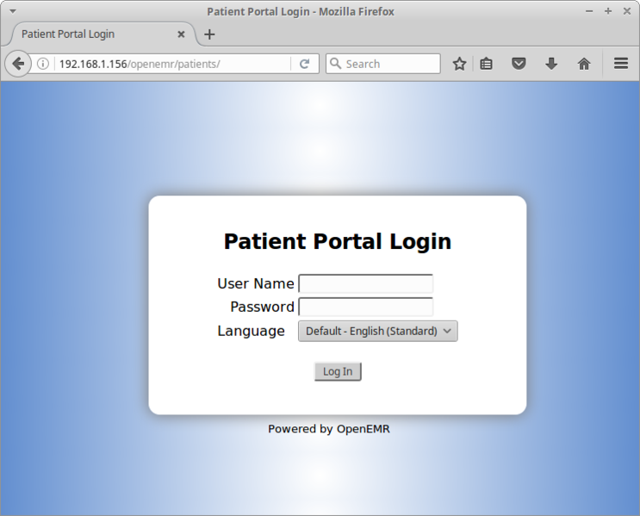
Electronic Patient Portals: Promotion of Access by Healthcare Workers
Dena Todd
Abstract
Introduction and Research Question
Patient Portal System Features
Schedule Medical Appointments
Refill Medications
Pay Bills
View Lab & Diagnostic Results
Secure Messaging
Health Education
Most recently, many healthcare facilities across the nation are overwhelmed with providing care for COVID-19 patients during the pandemic. According to peer-reviewed publications, interest in patient portals has increased exponentially due to the pandemic as patient and healthcare workers use virtual technologies as a means to enhance communication (Coughlin et al., 2017; Fujioka et al., 2020; Shaw et al., 2021). Studies show the primary strategy for maintaining access to health services during the pandemic has been to “rapidly virtualize, creating systems of health care that rely on telephone visits, video visits, and methods of asynchronous communication such as email, SMS text message, and patient portal messages” (Shaw et al., 2021, p. 2). Some healthcare systems are directing patients to the portal to review their COVID-19 test results which is a reasonable option since patient portals provide 24-hour access to personal health information and can reduce stress levels due to communication delays (Coughlin et al., 2017). With this in mind, the research focused on addressing the question, what strategies can healthcare workers deploy in order to promote patient access?
The use of technologies within healthcare settings has become an essential part of patient care. The Health Information for Economic and Clinical Health (HITECH) Act of 2010 contained requirements for healthcare providers to ensure the Meaningful Use (MU) of electronic health records. More specifically, electronic patient portal (EPP) systems were a part of this legislation since health organizations needed to demonstrate they were providing patients with access to their personal health information. A major concern was that healthcare organizations not offering EPP access were at risk for losing federal funding. This integrative review explores strategies which can be deployed in order to best promote EPP access for patients. The review clearly reveals the benefit of patient portals and how patients have improved access to their medical information including medications, laboratory results, diagnostics, and medical appointments. When healthcare workers promote EPP, they are upholding ethical principles, ensuring care coordination, reducing costs associated with hospital readmissions, and empowering patients to be involved in their care.
A
A
Created by Dena Todd Patient Portal Features
This Photo by Unknown Author is licensed under CC BY-SA-NC
This Photo by Unknown Author is licensed under CC BY-NC
Future Work
Methods
Future research is needed in the area of design and implementation of patient portals systems. Interestingly, the American Medical Informatics is “establishing and promoting gold standards for the design and implementation of patient portals” as well as holding “vendors and healthcare organizations accountable” for digital services provided to patients (Zhao et al., 2017, p. 2019). This is of utmost importance for future research since the systematic reviews revealed this is the most common barrier of not having an interface system that is user-friendly. Consumers expect the same digital experience from healthcare as they receive from other businesses (Ringel, 2019).
Conclusion
The integrative review process used the conceptual framework by Whittemore and Knafl (2005) which helped to guide decisions relative to selection of articles, data collection, and results review as well as analysis of the literature. This is critical since integrative reviews “have the potential to build nursing science, informing research, practice and policy initiatives” (Whittemore & Knafl, 2005, p. 546). The literature search included rigorous research within multiple data bases of the Jerry Falwell Library (JFL) to locate articles published within the last ten years which were scholarly peer-reviewed journals. Melnyk’s Level of Evidence tool was used to appraise the articles. Twenty-three articles were selected representing all levels of evidence with inclusion criteria aimed at articles written in English, specific to the adult population and full-text sources. Articles excluded were relative to usage of portals for research purposes and collection of data. This systematic process helped with knowledge transformation and application of the findings within healthcare settings.
The integrative review clearly reveals the need for healthcare workers to play an active role in supporting patients and their caregivers with accessing portal systems. More specifically, one research study found that “provider endorsement was one of the most influential factors impacting patients’ adoption of the patient portal” (Han et al., 2019, p. 2). Strategies should be implemented to promote portal access such as educational interventions, marketing campaigns, and improved communication regarding features of the patient portal system (Arcury et al., 2017; Kooij et al., 2018; Lyles et al., 2020; O’Leary et al., 2016; Zhao et al., 2017). Interestingly, the increased use of technologies during the COVID-19 pandemic has improved portal acceptance rates and empowered patients to access their personal health information. Notably, technology-based services help “improve access, quality, and health outcomes” which aligns with the Institute of Medicine (IOM) recommendations (Fujioka et al., 2020, p. 1).
C
4 4.5 5 5.5 6 6.5 7
Acknowledgments
I would like to acknowledge my doctoral Chair, Dr. Cindy Goodrich, who has dedicated endless hours of time to provide support during my DNP journey. I consider Dr. Goodrich a life-long friend, mentor and sister in Christ who exemplifies the essence of a faithful servant of God.

