Slide 1
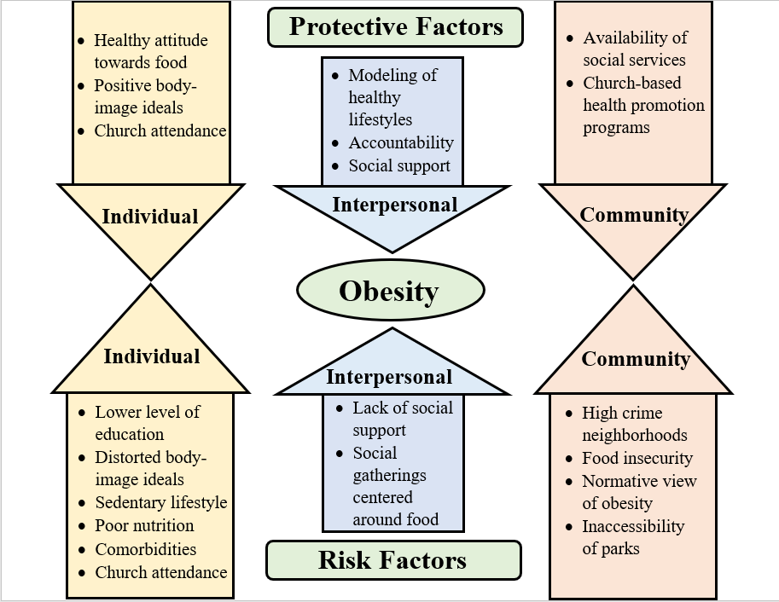
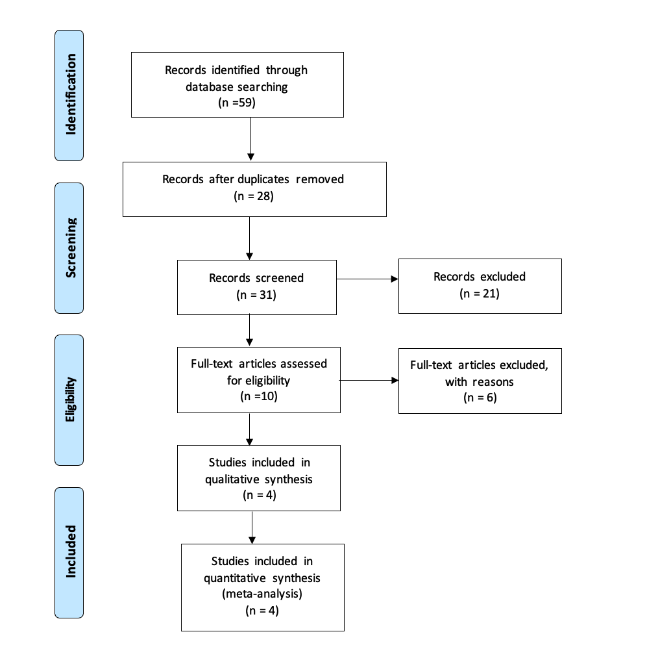
Addressing Obesity: A Call for Church Involvement
Kathrine Riley, Julia Remelgado, Giordana Morales-Spier, M.P.H.
Background
Results
Obesity tripled worldwide since 1975.
2016: internationally, > 650 million adults in the obese category.
340,000,000 children between the ages of 5 and 19 affected.
39,000,000 children <5 years old affected.
Factors within church communities, individual, interpersonal, and community impact the prevalence of obesity.
Modeled behaviors provided encouragement to the rest of the community fostering a desire for accountability and an effective area of support.
Integrative literature review revealed significant gap in research regarding how churches address chronic health problems.
Foundation of this information empowers churches by raising awareness of this disparity.
Using the risk protective model, the results from the four articles had common themes when compared side by side. The most significant theme found was that risk factors largely outweighed the protective factors, highlighting the need for research in this area.
Individual, interpersonal, and community factors were the categories analyzed.
Individual risk factors varied greatly from study to study. The main risks were low socioeconomic status, lack of education and knowledge regarding health, and food poor nutrition. Other factors included unhealthy attitude toward food, genetic predispositions, and mental health disorders that impacted physical health.
Interpersonal risk factors found were difficulty finding work-life balance which caused families to resort to easy quick foods that were nutritionally lacking. Other factors were lack of social support and social gatherings that were focused on food.
Community risk factors included high crime neighborhood where the residents would be unable to go outside safely for physical exercise. Another large risk factor was obesity is viewed as normal.
The largest protective factors were trust in the church, accountability, and social support. When a church leader modeled healthy behavior, the congregation felt more inclined to also begin a healthy lifestyle.
Research Question
Using the risk protective model, what influences obesity in terms of church involvement?
Methods
Future Work
More research regarding how the church handles the issue of obesity.
Assessment of community to include all factors that have impact in the community (e.g. people, resources, geographical location, socioeconomic status etc.).
Planning according to data gathered, culture of the community, and at a level where the plan meets the community where they are.
Implementation of the developed health programs by churches.
Collaboration with local churches to analyze results of the health program implementation.
1 2 3 4 5 6 7 8 9 10 11 12 13 14
Figure 2. Synthesis of Risk and Protective Factors of Obesity
1 2 3 4 5 6 7 8 9 10 11 12 13 14
A
B
Figure 1. Prisma Method
Research: Integrative Literature Review
Search Term:
("faith based organizations" OR "church" OR "religious group" OR "Christian organization")
AND (obesity or overweight or fat or obese or unhealthy weight or high bmi)
AND (“determinants” OR “risk factors” OR “contributing factors” OR “social determinants” OR “predictors” OR “ecological”)
Databases:
CINAHL Plus = 9
MedLine Plus = 22
Academic Search Ultimate = 26
APA PsycArticles: 2
Author, Year | Study Design
Pradeilles et al., 2016 | Case Study
Enriquez et al., 2019 | Cross-sectional Study
Sattin et al., 2015 | Randomized Controlled Trial
Lynch et al., 2019 | Surveillance Study
References
Acosta Enríquez, M. E., Uribe Salas, F. J., Baek, J., Sierra Archbold, J. P., & Carrillo, G. (2019). Association between life-style behaviors and health outcomes in Adventist and non-Adventist adolescents in Mexico: a pilot study. BMC Public Health, 19(1), 1–9. https://doi.org/10.1186/s12889-019-8042-0
Johnson, A., C., and Mincey, K., D., (2017). Obesity epidemiology trends by race/ethnicity, gender, and education: National health interview survey, 1997–2012. HHS Author Manuscripts. (45)4. 571-579. https://www.ncbi.nlm.nih.gov/pmc/articles/PMC5599163/?_escaped_fragment _=po=20.2381
Lynch, E. B., Williams, J., Avery, E., Crane, M. M., Lange-Maia, B., Tangney, C., Jenkins, L., Dugan, S. A., Emery-Tiburcio, E. E., & Epting, S. M. (2020). Partnering with Churches to Conduct a Wide-Scale Health Screening of an Urban, Segregated Community. Journal of Community Health, 45(1), 98–110. https://doi.org/10.1007/s10900-019-00715-9
Pradeilles, R., Rousham, E. K., Norris, S. A., Kesten, J. M., & Griffiths, P. L. (2016). Community readiness for adolescents’ overweight and obesity prevention is low in urban South Africa: a case study. BMC Public Health, 16(1), 1–12. https://doi.org/10.1186/s12889-016-3451-9
Sattin, R., Williams, L., Dias, J., Garvin, J., Marion, L., Joshua, T., Kriska, A., Kramer, M., & Venkat Narayan, K. (2016). Community Trial of a Faith-Based Lifestyle Intervention to Prevent Diabetes Among African-Americans. Journal of Community Health, 41(1), 87–96. https://doi.org/10.1007/s10900-015-0071-8
WHO, (2021). Obesity and overweight. World Health Organization. who.int/news-room/fact-sheets/detail/obesity-and-overweight.
C
Table 1. Characteristics of Articles Utilized

