Slide 1
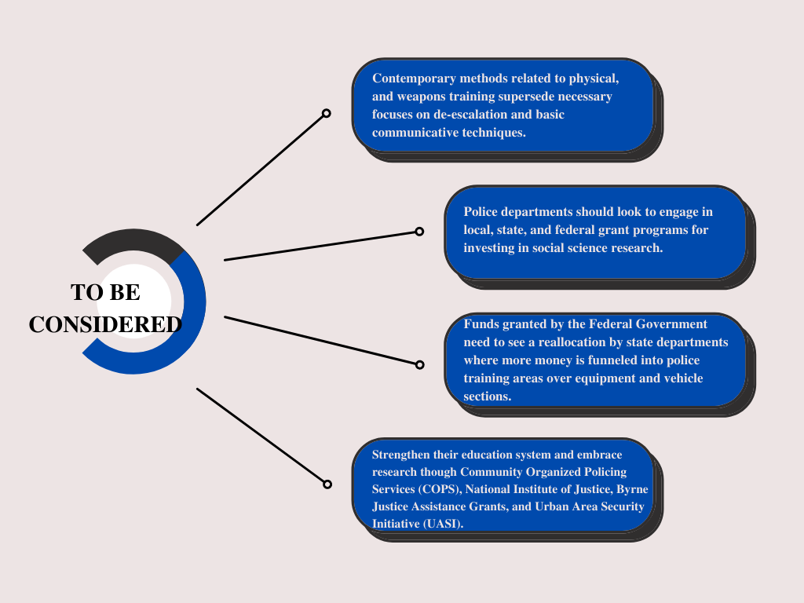
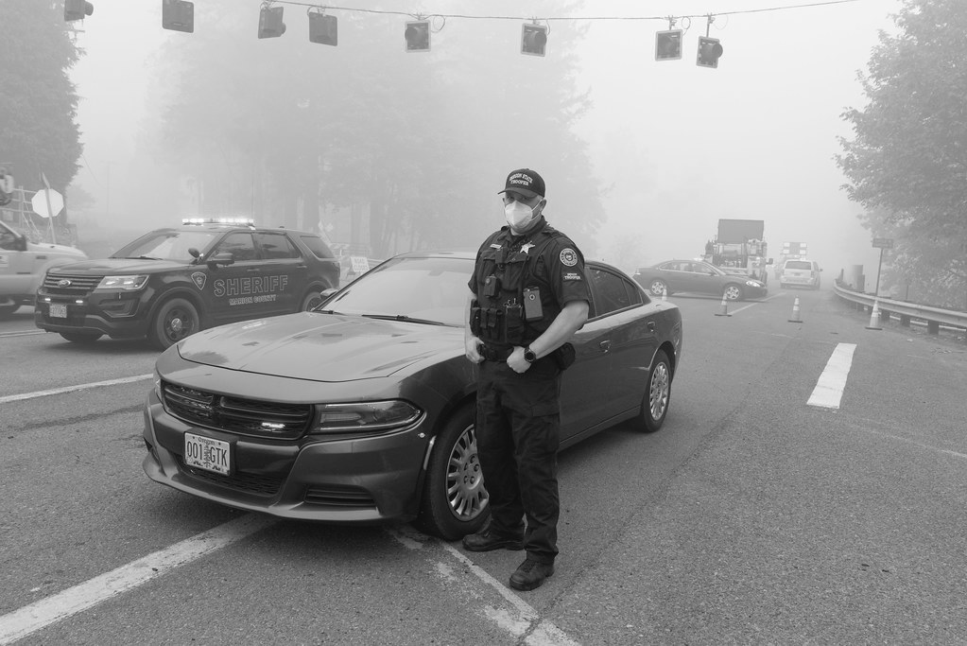
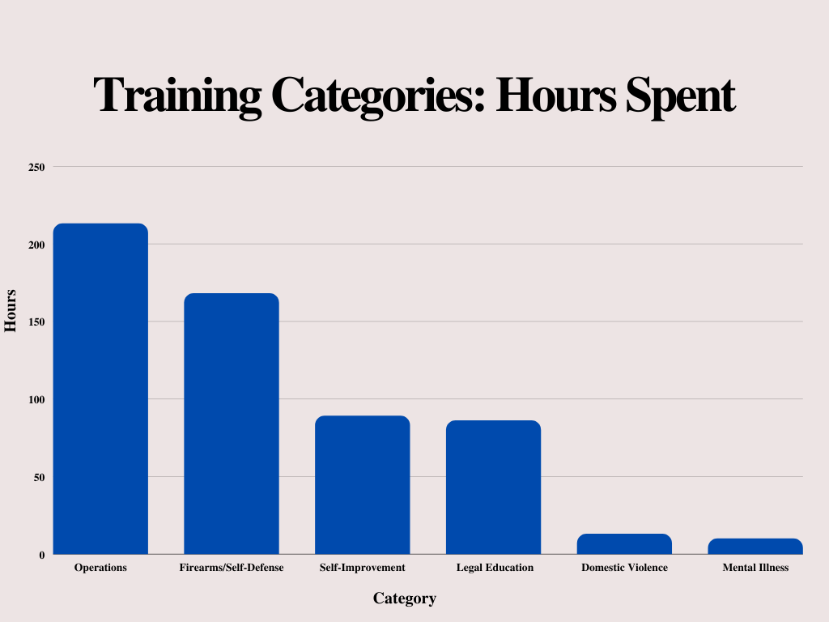
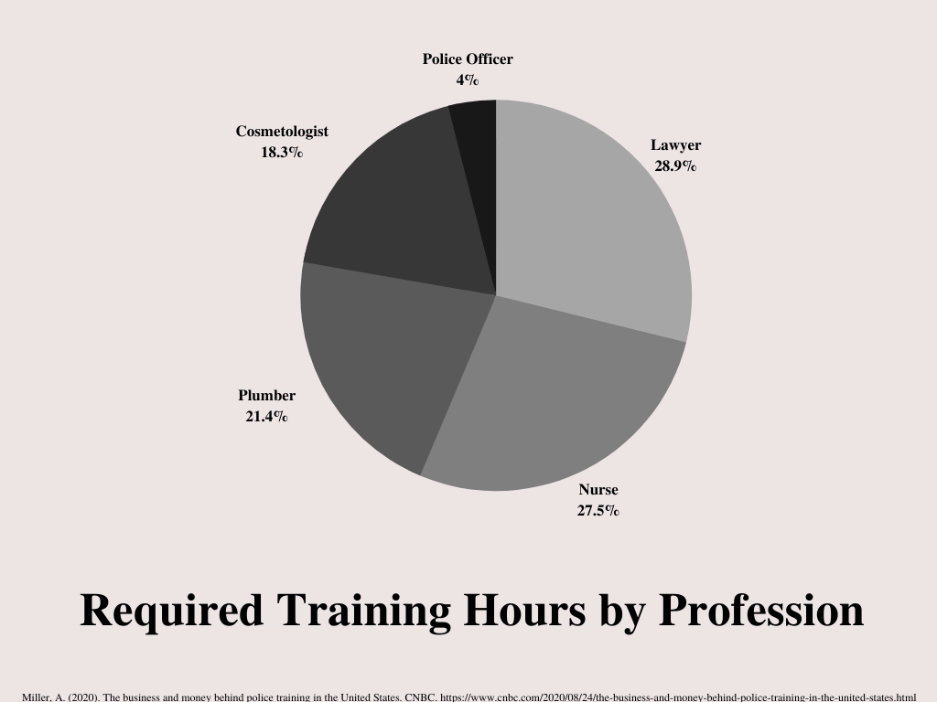
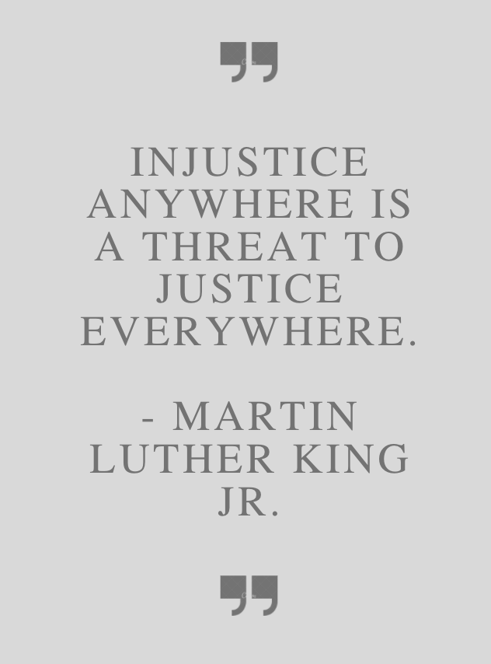
Reforming a Flawed System: Concepts for Modern Police Training, Education and Research
by: Bridget M. Gallagher
Abstract
Conclusion
In light of the numerous law enforcement incidents that have plagued the United States within the last decade, intense discussion on the nature and structure of police training and education has been initiated by lawmakers and civilians alike. Steps toward new legislation have been taken, but there remains an absence of serious action in backing it. Recommendations span from defunding the police to the implementation of major regulations in correcting behavior, but each, like most gray area topics, is met with a variety of consequences and a lack of long-lasting benefits to be recognized. The significant theme that has been developed is the quality of training and education for law enforcement. It is common to be executed in a way that emphasizes the “soldier” role that police officers are not meant to maintain. Instead, there must be an emphasis on the guardian role. These traits are developed through proper training in stress and non-stress situations, de-escalation skills, and general awareness. These concern the state of social standards and tensions, historical implications, and the nature of a community that has come to expose the missing pieces that remain vital in solving the police brutality epidemic. State governments should look to alternate funding methods and reallocate grant opportunities to readjust areas of weakness in the quality, standards, and necessary research for police academy training and education.
Figure 1:
Law enforcement on scene
The current model, method, and function of law enforcement are inefficient and threaten the continuation of social unrest within the United States. By adopting a plan to reorganize the areas to which state, federal, and private funds are going within law enforcement budgets, a transformation in the effectiveness of basic and complex training of police officers and lucrative and in-depth studies on expanding educational content to these individuals is essential. Among levels in both state and federal areas, a change is happening. To progress as a society, a shift in focus and embracing awareness of the struggles of others is needed to strengthen each other and the United States as a whole.
(1) In consideration of all presented data and discussion initiated by this evaluation, the most effective policy alternative is to shift monetary funds towards updating educational and training standards with state and local law enforcement cells. Utilizing this method is significant in changing a militarized, low-quality, and inefficient method of training into one that emphasizes the importance of reducing tensions through de-escalation to avoid misunderstanding or unnecessary violence. Concerning the second alternative, its overall purpose is to advance knowledge and research within social sciences to present more effective programs overall.
(2) With this, it is recommended that, under the first alternative, the second must become integrated to further the development of sufficient growth. It falls under the educational category of the first alternative. The increased funding provides an increase in trained professionals and researchers to work with programs in stress, or the real-time training of officers, and non-stress, practical, and ethical classroom learning areas.
(3) Emphasizing the importance of college education before and while entering the law enforcement field as well as incorporating higher education standards in the academy has been reported to have several benefits. Studies show that officers that acquired college degrees are less likely to use force on both verbal and physical levels and use their weapons while on duty. From a societal standpoint, a college education places these individuals in diverse environments where they interact with individuals from various walks of life. This is extremely valuable in transforming false or biased assumptions based on race, gender, or sexual orientation. If partnered together, quality of content may initiate the proposal of new ideas to be tested and an overall decrease in police brutality occurrences.
(4) In supporting this notion, the dynamic nature of proper and well-rounded educational opportunities helps develop leaders, teaches considering the value of emotion and circumstances, differentiates between right and wrong, and creates bridges to work with others to solve a common issue altogether.
Note. From "Law enforcement on scene" by OregonDOT, n.d., retrieved from https://creativecommons.org/licenses/by/2.0/?ref=openverse. CC BY 2.0
Research Question
Federal and domestic communities within the United States raise a highly relevant question on the basis of injustice: What policy alternatives are to be used to ameliorate the inconsistent, unprofessional, and unacceptable methods of action used by law enforcement?
Adjustments for quality police training and education are the most shared attributes across the legislative proposal spectrum. The greatest challenge resides in that most law enforcement institutions are mismatched networks sponsored by varying federal, state, and private entities. There are no federally mandated training programs and no national standards. On a global level, the United States has the poorest and lowest police training standards and quality requirements compared to other nations. Most state academies are provided funding by the related state itself, but several federal grant programs assist in this area as well. Only a small sum of that money is invested in police training. When analyzing the breakdown of where these funds are going, a large amount is put towards equipment, salaries, and benefits. Studies show that a majority of negotiations concerning funding cuts often lead to training programs being hit the hardest. Another issue brought to light is the number of hours spent training in academies. Many curriculums and methods are not systematically evaluated and tend to be outdated in social awareness and fail to consider the state of community climates. Researchers have studied the characterization of training and highlight that a number of programs utilize militarized methods, leading to forms that fail to recognize the weight of baseline de-escalation and communication skills in high-stress and non-stress scenarios. This issue has been one of the most prominent details in almost every high-profile case.
Miller, A. (2020). The business and money behind police training in the United States. CNBC. https://www.cnbc.com/2020/08/24/the-business-and-money-behind-police-training-in-the-united-states.html
Future Work
To study and explore the variety of academy curricula and content within major city departments across the United States.
In-depth analysis of law enforcement in the international realm.
Explore the impact and benefits of community outreach by law enforcement for implementing social awareness and adaption to modern culture.
Research quantitative and qualitative reasoning behind defunding and/or abolishing law enforcement and what it would look like in communities in the 21st century.
1 2 3 4 5 6 7 8 9 10 11 12 13 14
1 2 3 4 5 6 7 8 9 10 11 12 13 14
Methods
References
(1) Alternative: Targeted federal grants and funds should be reallocated into revitalizing and updating police training and education programs over other heavily funded areas. By doing so, opportunities for integrating quality police training methods based on the data of research and professionals that focus on updating standards regarding the state of technology, tools, social climate, and a variety of other factors that characterize current affairs. This leads to greater safety for both citizens and police officers alike. A structured and consistent training curriculum with hardline standards set by the States will aid in moving away from a "mix and match" form used in training and education today.
(2) Alternative: Police departments must look to engage new grant programs and work with the federal government to invest in effective social science research. This type of task falls to the responsibility of the states, as they could negotiate with officials on the national level to develop coherent research opportunities in their sphere of influence and, on the local scale, filter current methods. Working with and emphasizing skills that explore beyond control and defense, such as areas psychological in essence, will open doors in cognitive, emotional, social, and moral fields.
A
B
United States Congress. (2021). Legislative Responses for Policing-State Bill Tracking Database. National Conference of State Legislatures.
The Institute for Criminal Justice Training Reform. (2021). Not Enough Training — The Institute for Criminal Justice Training Reform. The Institute for Criminal Justice Training Reform.
Department of Justice. (2021). Police-Community Relations Toolkit: Policing 101. Department of Justice.
Urban Institute. (2018). Criminal Justice Expenditures: Police, Corrections, and Courts. Urban Institute
The Institute for Criminal Justice Training Reform. (2021). Not Enough Training — The Institute for Criminal Justice Training Reform. The Institute for Criminal Justice Training Reform.
Preston, C. (2020). Police training is broken. Can it be fixed? The Hechinger Report.
Barr, A., & Broady, K. (2021). A better path forward for criminal justice: Police reform. Brookings Institution.
Rydberg, J., & Terrill, W. (2010). The Effect of Higher Education on Police Behavior. Police Quarterly, 13(1), 92–120.
C

