Slide 1
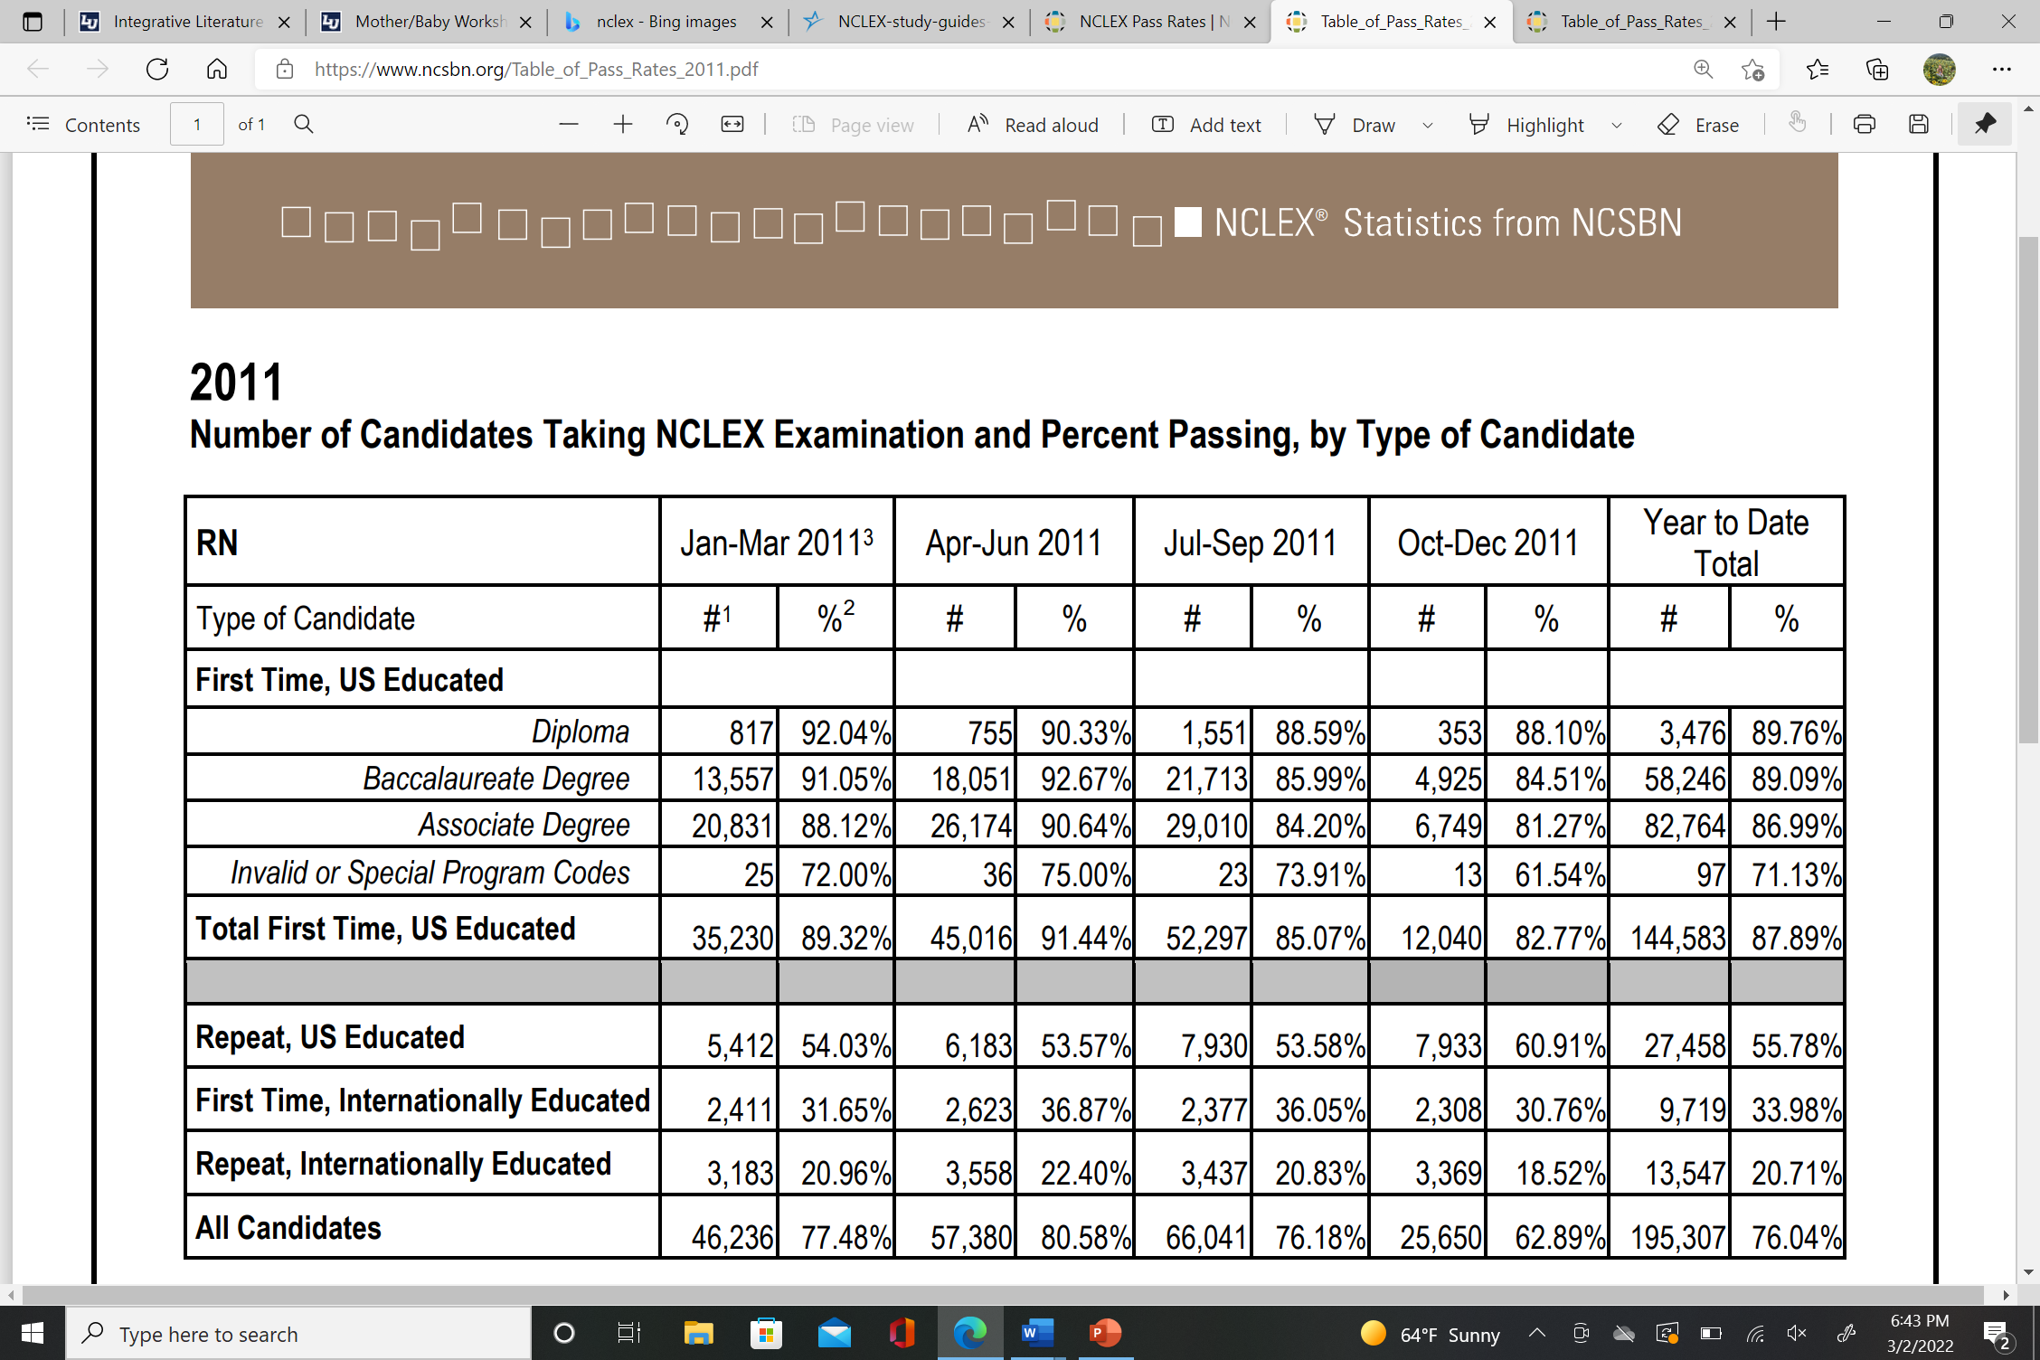
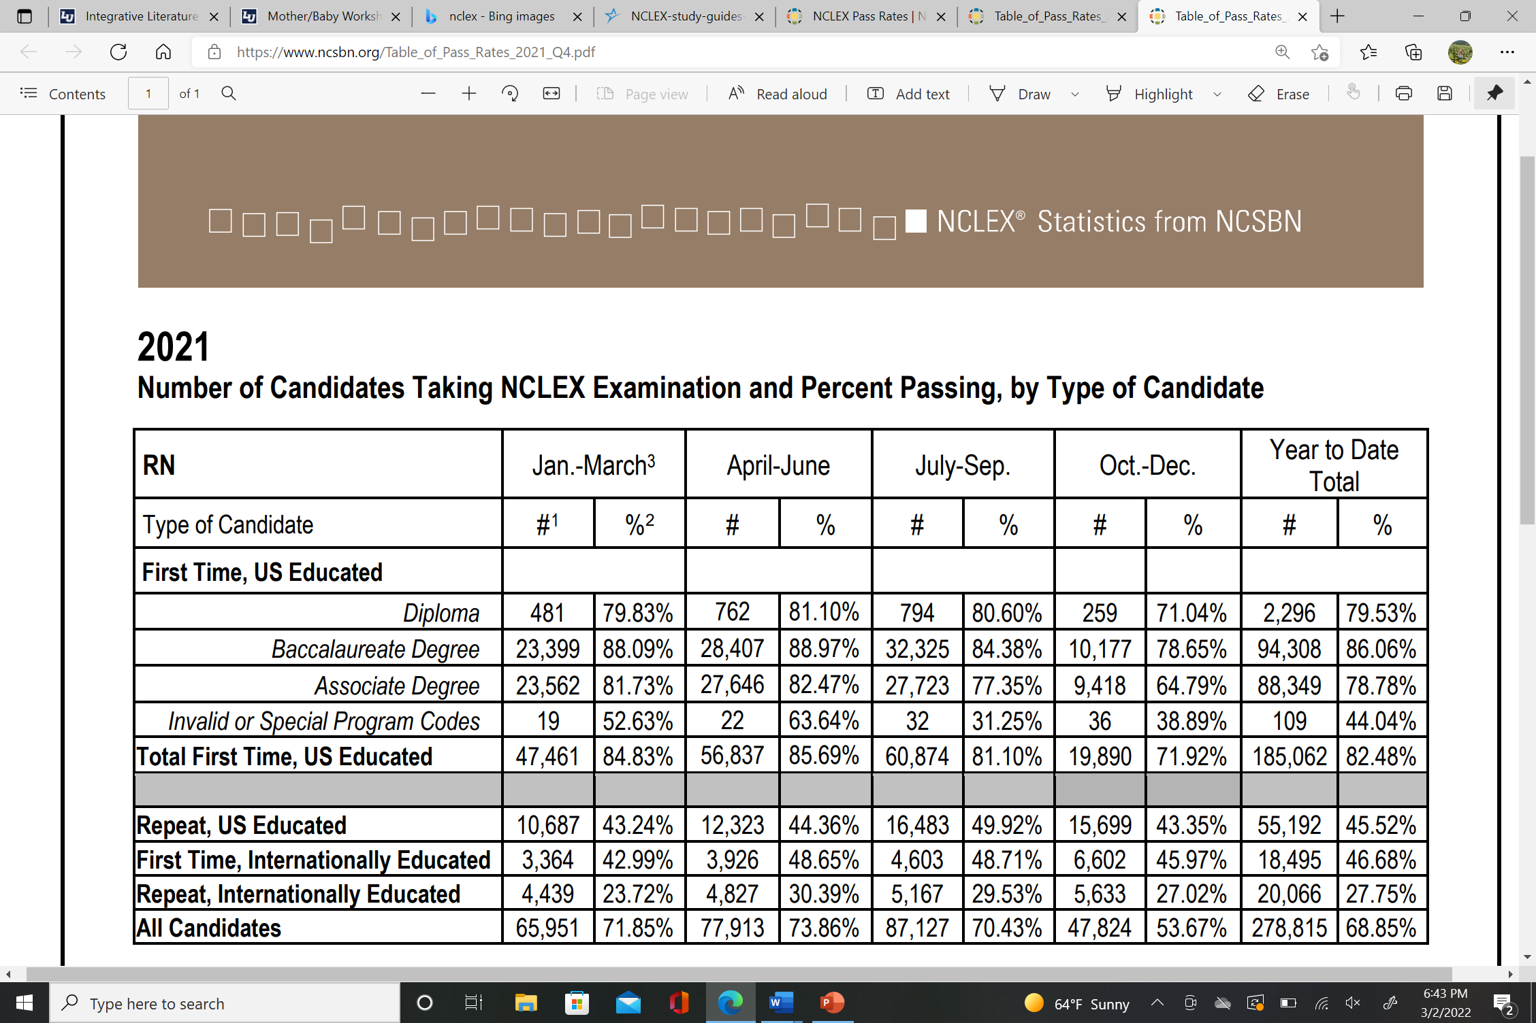
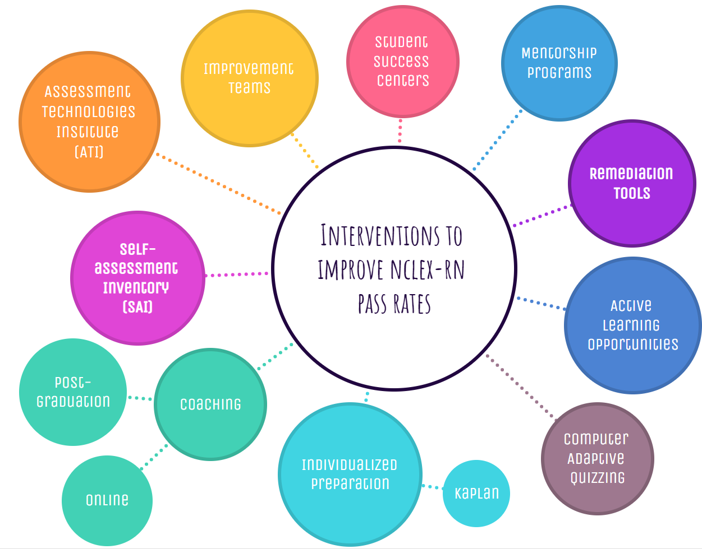
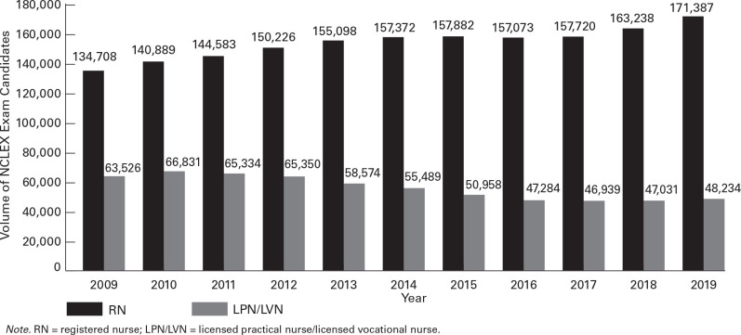
Strategies to Improve NCLEX Pass Rates in an
Undergraduate Program: A Systematic Review
Kaylyn B. McAninch, MSN, RN kbrooks57@liberty.edu (434)-665-3594
Abstract
Supporting Evidence
Evaluation and Analysis
Figure 2
2011 Number of candidates taking NCLEX examination and percent passing, by type of candidate
The National Council Licensure Examination for Registered Nurses (NCLEX-RN) examination success rates highlight if a nursing program is effectively educating students to become knowledgeable, competent, and safe nurses
Continuously reviewing NCLEX-RN pass rates and striving to improve them is a major goal of most nursing programs
Factors that impact NCLEX-RN pass rates must be carefully examined by nurse educators to address issues that hinder pass rates
On going declining NCLEX-RN pass rates will impact nursing students’ futures, nursing programs survival, and the discipline of nursing
This systematic literature review examined existing studies for factors that impact students’ success on NCLEX-RN and strategies to increase NCLEX-RN pass rates
Factors included student characteristics and nursing program attributes in relation to NCLEX-RN pass rates
Interventions that improve NCLEX pass rates include student success centers, mentorship programs, coaching, individualized NCLEX preparation (ex Kaplan Learning Integrated Course), computer adaptive quizzing, active learning opportunities, improvement teams, Assessment Technologies Institute (ATI), Self-assessment Inventory (SAI), and remediation tools while group learning was linked with NCLEX failure (Lown & Hawkins, 2017)
Student factors that impact NCLEX pass rates include critical thinking abilities, HESI and ACT scores, socioeconomic status, undergraduate course grades, number of questions answered on the NCLEX, gender, GPA, amount of recommended preparation, readiness examination score, and preparation test scores
Nurse educators’ perspectives are important to examine
Nursing programs need to use these existing interventions by molding them to meet their program’s mission and philosophy, listen to their nurse educators’ perspectives, and alleviate the negativity associated with student-based factors
B
Introduction
Note. From “2011 Number of candidates taking NCLEX examination and percent passing, by type of candidate, by National Council of State Boards of Nursing, 2021, retrieved from https://www.ncsbn.org/1237.htm
NCLEX-RN pass rates are the gold standard for assessing a program’s quality and accreditation as passing the NCLEX-RN examination on the first attempt is vitally important for nursing schools and students (Monroe & Dunemn, 2020)
The NCSBN found that there is an ongoing decline in NCLEX-RN first time pass rates. (Johnson et al., 2017)
Figure 3
2021 Number of candidates taking NCLEX examination and percent passing, by type of candidate
Implications for Future Research
Educators should be aware of the factors that influence pass rates
Research on GenZ student factors and impact of COVID-19 on NCLEX pass rates
Compare the first-time pass rates of foreign educated nurses and US educated nurses
Explore organizational factors that impact NCLEX pass rates; for example: a ‘Healthy work environment’ and NCLEX pass rates ‘
Methods
Question: How can nurse educators improve NCLEX-RN pass rates?
Databases: ProQuest, Elsevier, and Wiley Nursing Forum
Inclusion criterion: full-length, scholarly, and peer-reviewed journal articles, English language, and within five years old
Exclusion criterion: newspaper articles, dissertations, theses (plural), and book reviews
Keywords: “NCLEX”, “NCLEX style question”, “NCLEX pass rate”, and “NCLEX undergraduate program”
References & Acknowledgements
Davis, J. H., & Morrow, M. R. (2021). Professional preparation: Faculty practices for NCLEX-RN success. Nursing Science Quarterly, 34(4), 360–365. https://doi.org/10.1177/08943184211031581
Johnson, T., Sanderson, B., Wang, C., & Parker, F. (2017). Factors associated with first-time NCLEX-RN success: A descriptive research study. Journal of Nursing Education, 56(9), 542-545. http://dx.doi.org.ezproxy.liberty.edu/10.3928/01484834-20170817-05
Lown, S. & Hawkins, L. (2017). Learning style as a predictor of first-time NCLEX-RN success. Nurse Educator, 42 (4), 181-185. http://doi.org/ 10.1097/NNE.0000000000000344.
Monroe, H. E., & Dunemn, K. (2020). Determining postgraduation readiness to take the NCLEX-RN. Journal of Nursing Education, 59(2), 101-106. http://dx.doi.org.ezproxy.liberty.edu/10.3928/01484834-20200122-09
National Council of State Boards of Nursing (2021). NCSBN’s environmental scan COVID-19 and its impact on nursing and regulation. Journal of Nursing Regulation, 11(4), S1-S36. https://doi.org/10.1016/S2155-8256(21)00002-8
NCLEX Pass rates. NCSBN. (2022). Retrieved March 2, 2022, from https://www.ncsbn.org/1237.htm
Acknowledgement
I would like to thank Dr. Rachel Joseph for her assistance with this research.
Figure 1
Interventions to improve NCLEX-RN pass rates
Note. From “2021 Number of candidates taking NCLEX examination and percent passing, by type of candidate, by National Council of State Boards of Nursing, 2021, retrieved from https://www.ncsbn.org/1237.htm
Figure 4
Ten-year trend of U.S. RN and LPN/LVN first-time NCLEX takers, 2010–2019
Photo created by Kaylyn McAninch
Note. From “Ten-year trend of U.S. RN and LPN/LVN first-time NCLEX takers, 2010–2019” by National Council of State Boards of Nursing, 2021, retrieved from https://doi.org/10.1016/S2155-8256(21)00002-8

