Slide 1
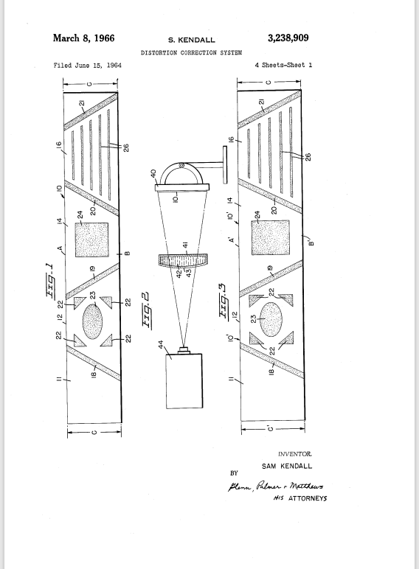
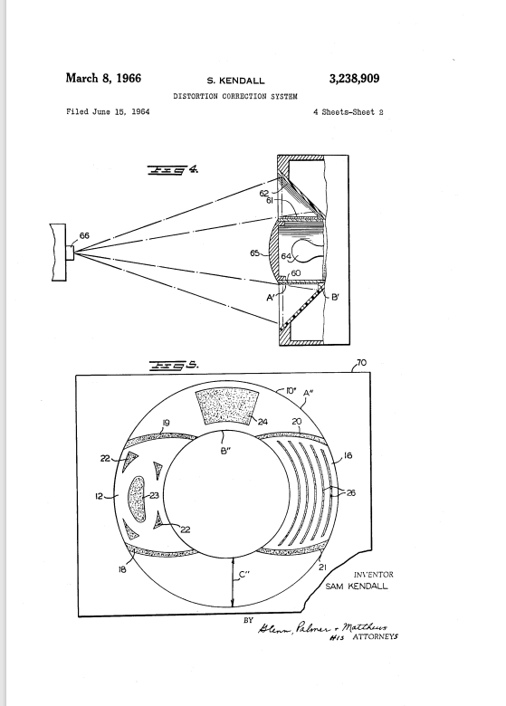
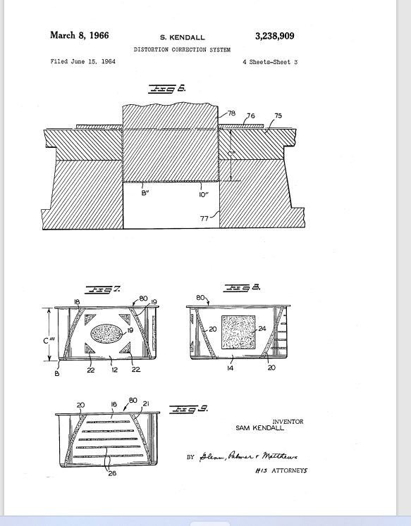
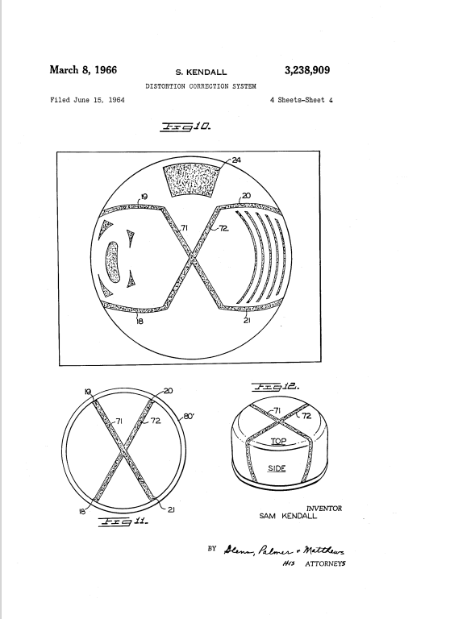
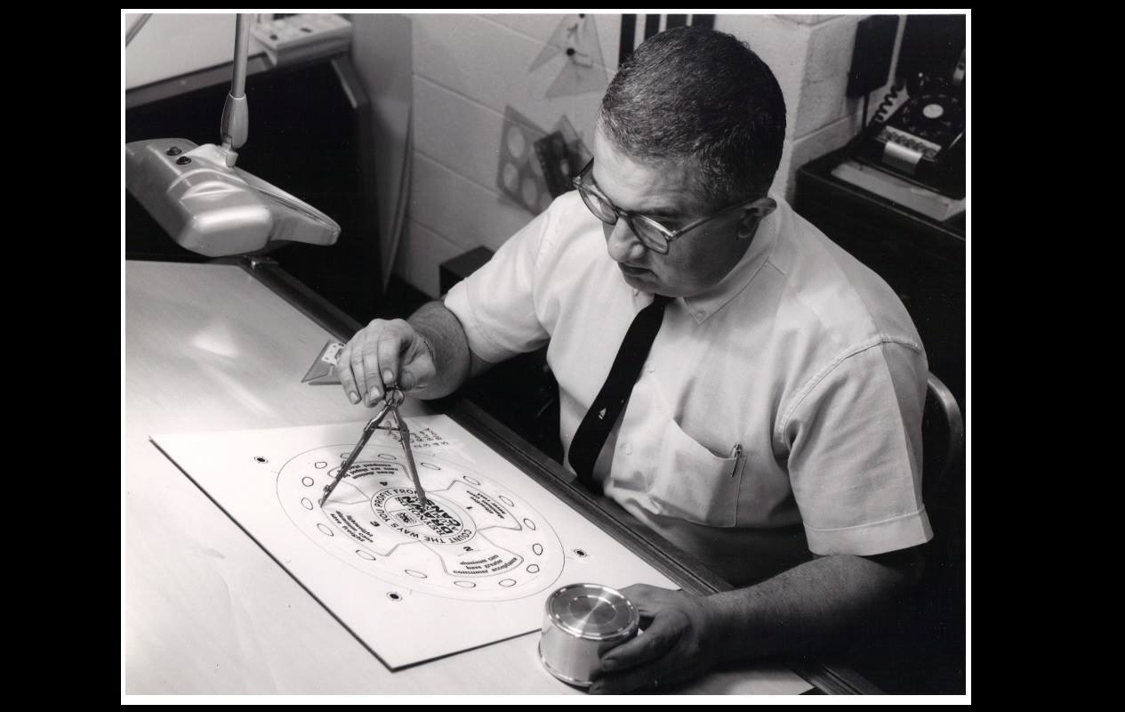
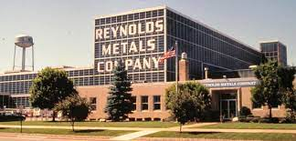
https://patentimages.storage.googleapis.com/c8/fe/aa/cfeae1ad3aefae/US3238909.pdf
Kendall’s Upside Down Lithography: Reynold’s Metals Company, Starkist Tuna, and one Commercial Artist’s Role in the Development of Modern Marketing
Kevan D. Keane
Abstract
Sam Kendall-Courtesy of Timothy Kendall, his son, Herndon, Virginia, 2020
Results and/or Conclusion
Starkist Tuna is one of the primary companies packaging canned tuna ready for sale in the average grocery store. However, few have taken into account the means by which their cans have become so mainstream. The process of creating the stackable cans and the man behind the efficiency of the can’s artwork to catch the attention of consumers often go unnoticed. The name of the man who developed the process of printing the tuna onto cans is Sam Kendall, who did so as an employee of Reynolds Metals Company in Richmond, Virginia. His story is an illustration of the role of everyday people in the development of market change.
Results
Starkist Tuna was innovative in that it found a way for Americans to eat tuna on a larger scale, when prior to the twentieth century most did not like how it tasted. They used a process of refrigeration, canning, and suggested recipes that popularized tuna in the average household during the early to mid-twentieth century. Reynolds Metals Company assisted in their success with the use of aluminum for cans. However, images of tuna on cans would often come out distorted. Finally, Sam Kendall, a Reynolds Metals commercial artist in Richmond, Virginia, pioneered a way to reverse the process resulting in distorted images. He patented a distortion correction system that initially positioned the label in a distorted fashion, with the distortion resolving itself in an “iron-on”-like fashion during the process in which it was placed on the can. The cans Kendall used had one lid on the bottom, which made the tops smaller, and resulted in cans that would easily “nest” in grocery stores. His design of the Pillsbury can was very similar, as was his design of the Fresca bottle. However, Kendall’s patent was “for hire” which meant that though his name was on it and allowed to be, he collected no royalties due to his use of Reynolds’ Metals Company’s time and equipment.
Conclusions
Starkist Tuna popularized the tuna fish as a staple of the American diet. Reynolds Metals Company made the product more marketable in stores through the use of aluminum cans. Sam Kendall, one of their employees, helped with the design of the labels by placing them for labeling in a distorted fashion that would soon correct itself when the label was placed, much like an “iron-on” process in shirts today. Though Kendall gets little to no recognition for the work he did, if it were not for him, stackable cans would not be popular in grocery stores today.
B
Table 1. Calculated growth rate of E. coli MG1655 and E. coli MG1655 ∆qseC on individual carbon sources. The particular growth rates are shown along with the relative advantage that the strain has without the sensory kinase QseC.
Introduction and/or Research Question
A
Starkist Tuna owes much of its commercial success to the method of stackable cans that a commercial artist for Reynolds Metals Company in Richmond, Virginia, created. His name was Sam Kendall. The author undertook the effort of discovering what Kendall did to increase the efficiency of the tuna can and its artwork, as well as what contribution it made to Starkist’s success as a company.
All patent images taken from Sam Kendall Patent at https://patentimages.storage.googleapis. Com/c8/fe/aa/cfeae1ad3aefae/US3238909.pdf/.
Figure 3. Competitive fitness advantage.
Quantification of fitness was based on the direct comparison of log CFUs of one species to another. There was a significant fitness advantage of group A, if not even more with group B through overcoming colonization resistance.
Future Work
Interview with any descendants of Martin Bogdanovich
More history on refrigeration in America
Research on the use of aluminum in America after the Civil War
History of labeling in American grocery stores
Sam Kendall-Courtesy of Timothy Kendall, his son, Herndon, Virginia, 2020 (photo taken 1967 in Richmond, Virginia)
Image of Charlie the Tuna taken from http://www.starkist.com/.
MG1655
References and/or Acknowledgments
B
1 2 3 4 5 6 7 8 9 10 11 12 13 14
Methods
Keane, Kevan D. “Interview with Andy Mecs, Starkist Executive.” September 30, 2020.
. “Interview with Julie K. Keane.” Quinton. September 24, 2020.
. “Interview with Timothy Kendall.” Herndon. September 28, 2020.
Kendall, Sam. “Method of Preparing Pre-Distorted Images for Decorating a Shaped Blank.” Google Patents. Accessed August 28, 2020. https://patents.google.com/patent/US4956906A/en.
Reynolds, Jr., Richard S. “Opportunity in Crisis”: The Reynolds Metals Story. Newcomen Society of North America: New York, 1956.
Starkist. “All About Charlie.” http://starkist.com/charlie/all-about-charlie. Accessed October 4, 2020.
O’Connor, Sean M. “Hired to Invent vs. Work Made for Hire: Resolving the Inconsistency Among Rights of Corporate Personhood, Authorship and Inventorship.” Seattle University U.L. 2012. 1227-1246.
Ong Yan, Grace. “Wrapping Aluminum.” Design and Culture. 4. 3 (2012). 299-324.
Perchard, Andrew. “This Thing Called Goodwill: The Reynolds Metals Company and Political Networking in Wartime America.” Enterprise and Society (2019).
The author researched the history of Reynolds Metals Company as well as Starkist Tuna, and also interviewed some of Kendall’s surviving children. In the process, the author was able to learn much about how Reynolds Metals Company contributed to the success of commercial sales and how Starkist Tuna was able to rise. In addition, he also learned much about Kendall as a worker and his innovations, as well as how they contributed to modern marketing.
A
B
Log10 Optical Density at 600nm
Image of Reynolds Metals taken from https://www.facebook.com/508610485989115/photos/reynolds-metals-factory-ground-was-broken-for-this-plant-in-february-of-1942-rey/731884193661742/

