Slide 1
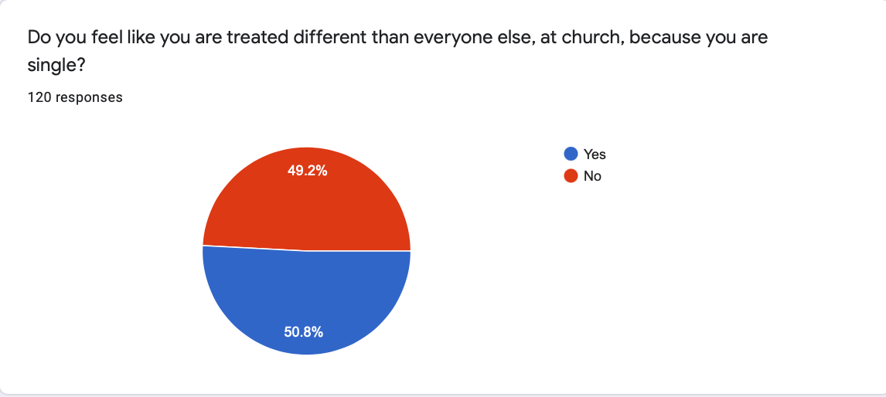
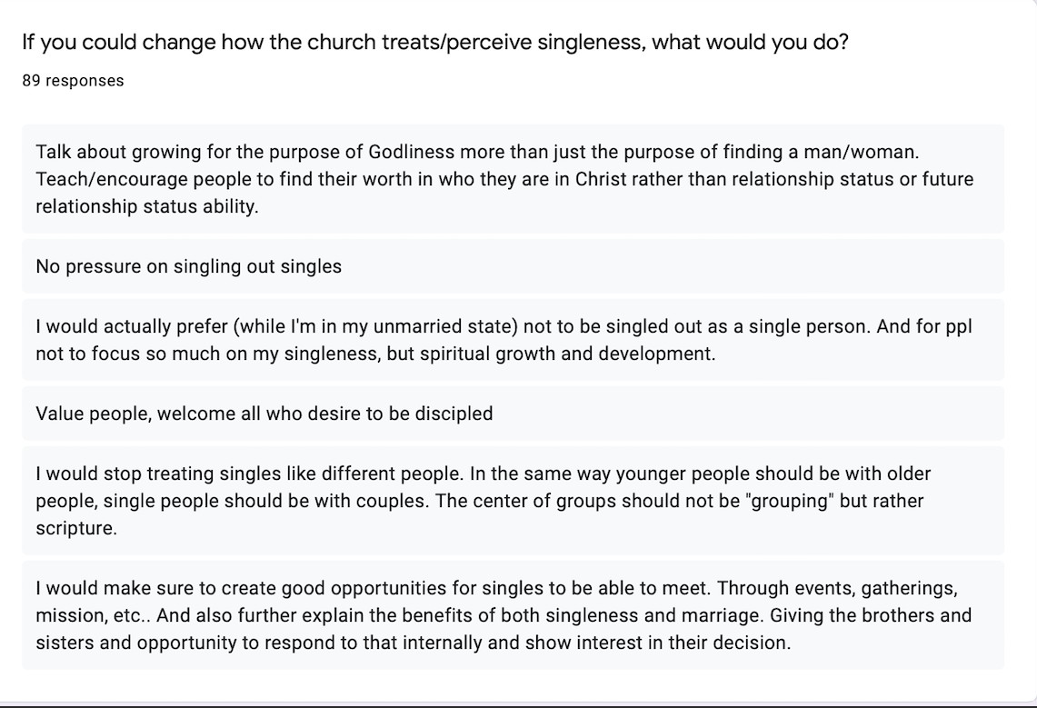
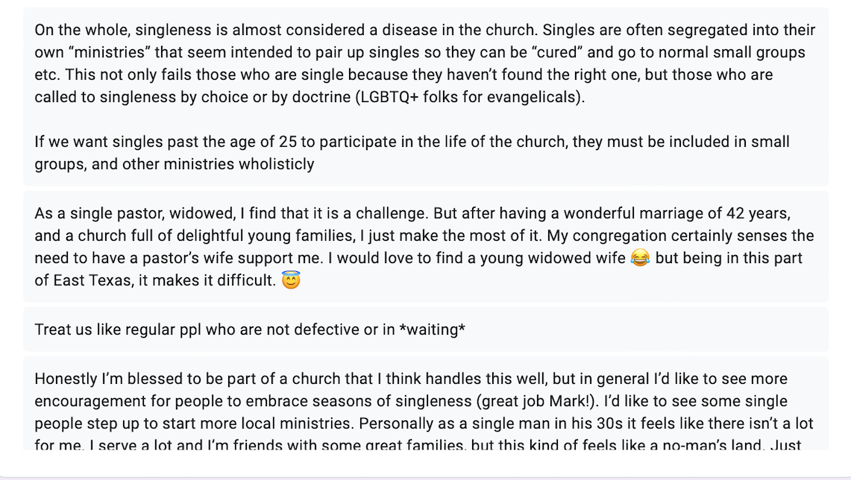
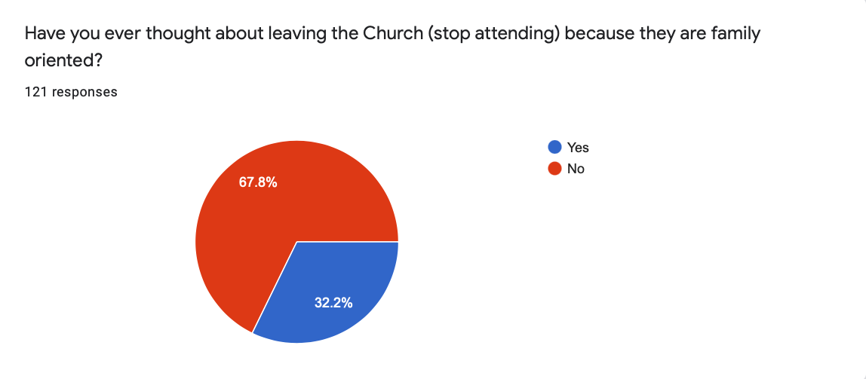
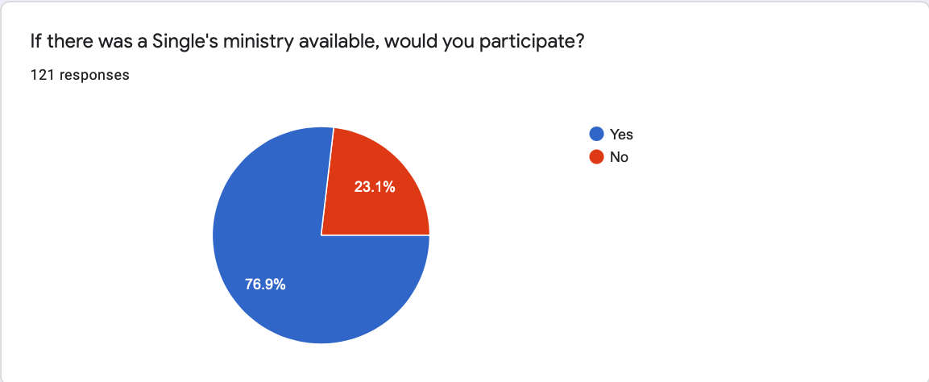
Singleness in the Church: A Call to Consider How Christianity Views Singleness
Maria Rodriguez Pulliza
Abstract
Singleness in the Church Survey: Results
Results and Conclusion
Abstract: More than 20% of Scripture was written by single men. Jeremiah, Daniel (presumed), Paul and others who became widowers while serving Yahweh. Likewise, 100% of Scripture is about a God who became man for 30+ years -and never married. Yet, the Church has elevated marriage over singleness to the point of marginalizing singleness as a problem to be solved. Pastors design books and sermons about singleness that, though they aim to help, say nothing new to the single, and because it is talking about a season of life that they have left behind, married people tend to disregard. This is how the Church, inadvertently, treats singles as undesirable people to be around and thus, making them feel as if there was something wrong with them as human beings. There is no reason for a single person to feel rejected, forgotten, inferior, irrelevant, or anything alike in/by the Church. Thus, a a few (as shown in the sample assessed) feeling this way, is more than the Church can afford for the sake of God’s Kingdom.
A
Results
The vocabulary utilized in sermons, articles, podcasts, books, and other means of reaching single Christian people suggest a level of inferiority to this status, in contrast to marriage. Over 100 single adult Christians’ survey, confirmed they feel excluded by fellow lay members because they are not married. More than half of them considered leaving the Church altogether because of marginalization due to their singleness. The pressure this behavior causes, and the lack of ministry opportunities for singles, influence them into marital relationships that are far from godly or good for them. Single people, on the other hand, react to the pressure because they desire to feel seen, valued and serviceable for the Church, but they are overlooked for not having a spouse. Moreover, even though pastors, speakers, authors, etc., recognize that the Church disregard singles, and elevate marriage over singleness, they continue to do nothing to change the culture.
Conclusion
An analysis of the data shows the imperative need for the Church to equate singleness and marriage for the sake of godly covenantal relationships that enhances the growth of the kingdom of God. The purpose of the Church is to make disciples of all nations (Matthew 28:18-20), and that includes single people. In order to change this culture, and equate singleness and marriage, Churches ought to develop (or adopt) a Singles’ Ministry that would minister to these group, just as they would children, youth, men, women, couples, etc. Churches must also consider single people for leadership positions, based on their maturity, education and spiritual qualifications –not their singleness.
B
D
B
Research Question
A
This research seeks to answer two key questions:
1. What are the main consequences of this ‘marriage is superior to singleness’ or ‘singleness is wrong’ culture in the Church?
2. What needs to be done to change such culture?
Survey questions:
Do you feel like you are treated different than everyone else, at church, because you are single?
Have you ever thought about leaving the Church (stop attending) because they are family oriented?
If there was a Single’s ministry available, would you participate?
If you could change how the church treats/perceives singleness, what would you do?
Figure 1
1. Believe they have ulterior motives
2. Don’t include them in Sermons
3. Don’t talk to them as adults
4. Convey the message that singleness is a sin
5. Believe they are doing something wrong, or something is wrong with them
6. Assume they are involved in sexual sin
7. Conveys the message that sanctification only comes through marriage
8. Don’t allow them to lead
9. Group them in the wrong age group
10. Don’t serve them
10 Ways the Church Marginalizes Singles
C
By: Brenda Rogers
Future Work
Assess the correlation between pressure to get married by the Church and Divorce rates (within the Church).
Assess the effects of this type of treatment in people that died to their homosexual attractions for Christ.
Assess the effects of this type of treatment in people who chooses singleness because of trauma. Does it perpetuate the trauma?
Have several Churches adopt a Singles’ Ministry, Assess their singles’ growth and Contrast it with those of Churches that do not have a Singles’ Ministry.
Evaluation of Literature, Sermons and Other Sources
Pastor Andrew Matrone | Red Rock Church | Sermon: “How to Steward Your Singleness – Let’s Talk Relationships” | “Single years are not disposable, do not waste.” | He assumes that going from relationship to relationship is out of pleasure instead of the desire to find something meaningful and just not finding it. Sermons like his perpetuates the feeling of missing out and messing up.
Dr. Abraham Kuruvilla & Ms. Kari Stainback | The Table at Dallas Theological Seminary | Podcast: “Singleness in the Local Church” | Dr. Kuruvilla: “single by choice, for life, unto Christ and in community.” “The protestant Church seems to be sympathizing with Luther, who said that fornication was more honoring to God than celibacy” | Dr. Kuruvilla has been told that he is not qualified for ministry for being single, because the Church believes they cannot remain continent.
Pastor Rob Ketterling | River Valley Church | Sermon: “God designed the Family: Singleness in the Church” | Mentions and asserts Brenda Rogers’ 10 ways the Church marginalizes singles.* | His Church still has no program for single people over the age of 31 y/o. His title implies God dislikes singles.
Tiffany Dawn | Popular YouTuber | “Hey Church, Let’s Stop Shaming Single People” | “There’s a mold in the Church, and if you don’t fit in the mold, the mold is not question -You are” | She begins to give advice advise to Singles not to the church. Perpetuating the unchanging culture.
Jonathan Bennet | Author of The Popular Man | “Ring By Spring- Definition and Meaning of This Saying” | “Why Ring By Spring?: to experience normal relationships.. The only way you can live together, hang out alone, and generally have a normal relationship? Get married!”. “Finally, people tend to follow along with others in their chosen environments. So, if you’re in a place where traditional values rule, you are taught that sex is great, but only within marriage, and everyone else is getting engaged and married, the natural instinct is to follow along.” | Is Dr. Kuruvilla correct in his assessment of the Protestant Church? Do we consider fornication (living together?) better than a life of singleness?
Methods
MG1655
This research evaluates a variety of literature, sermons, podcasts and other Church ministers that have spoken in the matter of Singleness in the Church, and contrast it with a short survey, in which single people shared about how they are treated by the Church. This research further investigates how other Christian communities, i.e., Christian Universities, perpetuates this culture by promoting marriage through campaigns like “Ring by Spring”, and how this further affects the view of singleness in the Church.
Table 1 shows the Evaluation of Literature, Sermons, podcasts, etc.
Speaker’s name, Ministry, Title, Key Notes, Contrasting Notes.
Figure 1 shows the ‘10 Ways the Church Marginalizes Singles’. An excerpt from an article many of the speakers in Table 1 mention, either directly or indirectly.
B
1 2 3 4 5 6 7 8 9 10 11 12 13 14
A
B
References and/or Acknowledgments
Bennet, Jonathan. The Popular Man. “Ring By Spring- Definition and Meaning of This Saying”. https://thepopularman.com/ring-by-spring-definition-meaning-saying/
Dawn, Tiffany. “Hey Church, Let’s Stop Shaming Single People”. https://youtu.be/Af5xKI7lLPg
Ketterling, Rob. River Valley Church. Sermon: “God designed the Family: Singleness in the Church”. https://youtu.be/lnu2jsrquRg
Kuruvilla, Abraham & Kari Stainback. The Table at Dallas Theological Seminary Podcast: “Singleness in the Local Church”. https://youtu.be/kmGu2AZb6G8
Matrone, Andrew. Red Rock Church. Sermon: “How to Steward Your Singleness – Let’s Talk Relationships”. https://youtu.be/enqexet7jCs
Rogers, Brenda. iBlieve. “10 Ways We Unintentionally Make Singles Feel Invisible in the Church”. https://www.ibelieve.com/relationships/10-ways-we-unintentionally-make-singles-feel-invisible-in-the-church.html
Table 1

