Slide 1
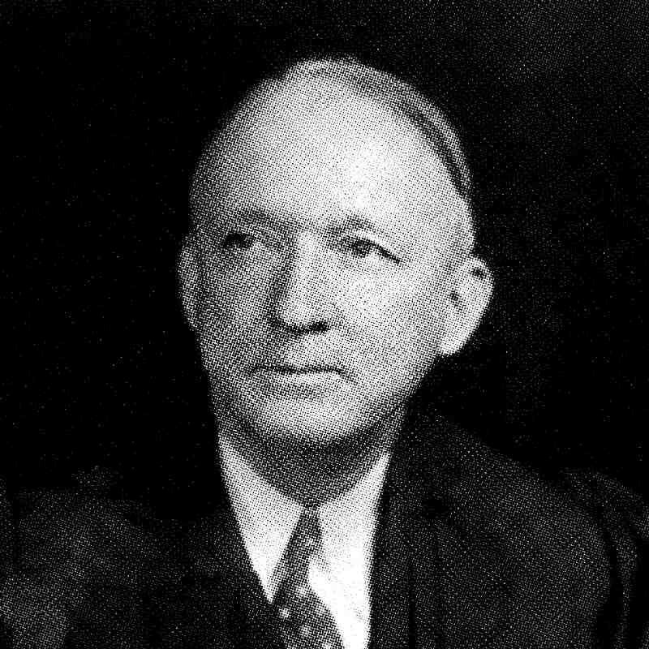
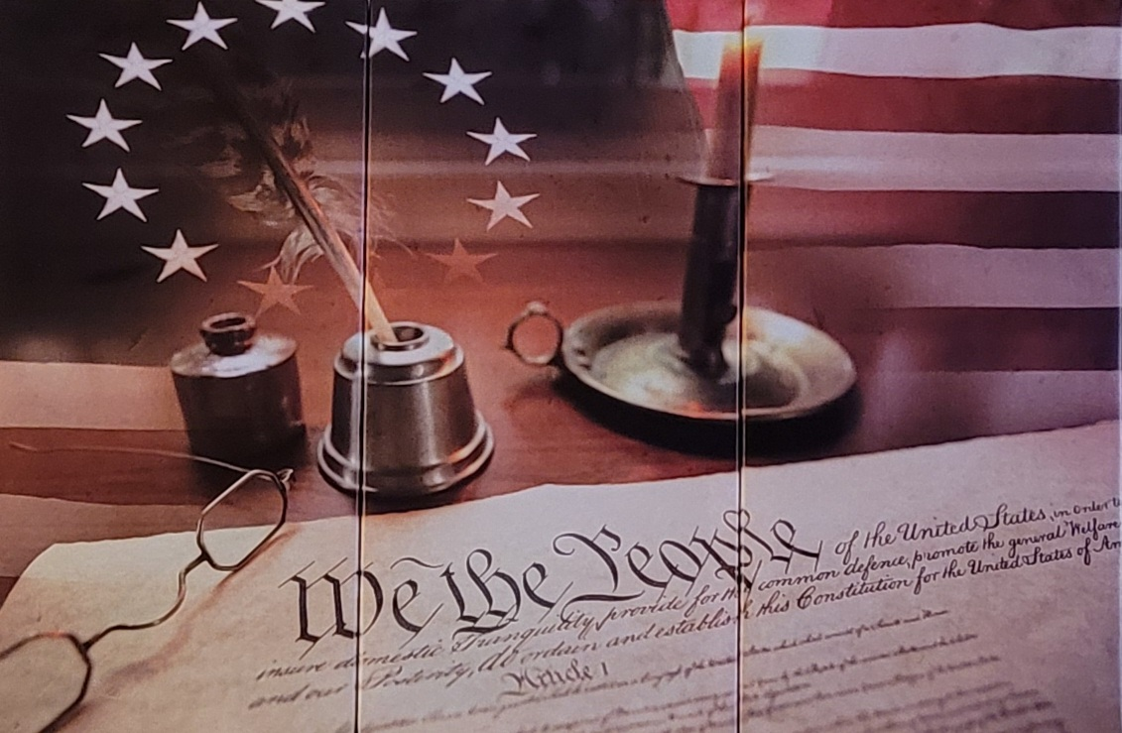
Church-State Relations: The Protection of Conscience
Against Governmental Encroachment
Jennifer Decker
Abstract
Justice Hugo Black, Thomas Jefferson, and the First Amendment
Conclusion
In the fall of 1801, the Danbury Baptist Association wrote to President Thomas Jefferson expressing their concern that as a minority denomination in the state of Connecticut, what religious privileges they enjoyed, they did so as favors granted to the state, not as inalienable rights. Jefferson’s reply on January 1, 1802 established the classic “wall of separation” theme in American Church-State relations. Jefferson stated, “…religion is a matter which lies solely between man & his God…” that the legitimate powers of government extend only to actions, not opinions, and penned the now famous words, “a wall of separation between Church & State.” In the United States Supreme Court case Everson v. Board of Education (1946), Justice Hugo L. Black’s majority opinion added the phrase “high and impregnable” to Jefferson’s words. While Black and Jefferson would agree that the First Amendment to the United States Constitution created a wall of separation between Church and State, the modern interpretation takes this to mean that the government needs protection from religion. This interpretation relies heavily on selected words or portions of writings from the Founders themselves, particularly Jefferson, but these words and portions of writings are often examined in isolation. The Founders, when examining their writings as a whole and not in isolation, intended the opposite, for this to be a protection for the people against governmental encroachment on their conscience.
While Thomas Jefferson’s words in his 1802 letter to the Danbury Baptist Association and in “A Bill for Establishing Religious Freedom” could be taken to mean he believed that religious matters ought to be kept out of state affairs, if taken in isolation, a wider examination of Jefferson’s writings, as well as the writings of his contemporaries, show that the Founders intended for there to be a separation of Church and State as a protection for the people against encroachment by the government on their freedom of conscience. Further examination of the earliest American colonial governmental documents show that religion was intertwined with civil governances, thus creating a tradition in America of religion being interwoven with matters of the state. Scholars such as Daniel L. Dreisbach and Mark David Hall agree that Justice Hugo L. Black’s addition of the words “high and impregnable” to Jefferson’s words “a wall of separation between Church & State” have helped to create a modern interpretation of Church-State relations that is contrary to the Founders’ intent. The Founders intended to protect the American people’s freedom of conscience from being infringed upon by the dictates of other men through civil laws, not as a protection for the government from religious beliefs.
Nicandro Iannacci, “Hugo Black: Unabashed Partisan for the Constitution,” Constitution Center, (August 12, 2019), https://constitutioncenter.org/blog/hugo-black-unabashed-partisan-for-the-constitution/ (accessed March 12, 2022).
“Thomas Jefferson,” The White House: Presidents, n.d., https://www.whitehouse.gov/about-the-white-house/presidents/thomas-jefferson/ (accessed March 12, 2022).
Author’s photograph, February 2022
Associate Justice Hugo L. Black
1946
Thomas Jefferson
1802
Amendment I, United States Constitution
Ratified December 15, 1791
“The First Amendment has erected a wall between church and state. That wall must be kept high and impregnable. We could not approve the slightest breach.”
“Believing with you that religion is a matter which lies solely between Man & his God, that he owes account to none other for his faith or his worship, that the legitimate powers of government reach actions only, & not opinions, I contemplate with sovereign reverence that act of the whole American people which declared that their legislature should "make no law respecting an establishment of religion, or prohibiting the free exercise thereof," thus building a wall of separation between Church & State. Adhering to this expression of the supreme will of the nation in behalf of the rights of conscience, I shall see with sincere satisfaction the progress of those sentiments which tend to restore to man all his natural rights, convinced he has no natural right in opposition to his social duties.”
“Congress shall make no law respecting an establishment of religion, or prohibiting the free exercise thereof…”
A
Future Work
Research Questions
Founders on Church-State Relations
An examination of the influences on James Madison’s development of constitutional thought, and those who were subsequently influenced by his conclusions on the concepts of freedom and liberty.
An examination of the inclusion of theistic affirmations and establishment clauses in the state constitutions written or revised in the Revolutionary era.
Thomas Jefferson
James Madison
George Mason
Gouverneur Morris
Modern interpretations of Jefferson’s “a wall of separation between Church & State” rely heavily on his 1802 letter to the Danbury Baptist Association and selected sections of his 1789 “A Bill for Establishing Religious Freedom.” Did the framers of the Constitution, however, intend for their to be a “high and impregnable” wall of separation – forever barring religious opinion on state affairs? Did Justice Hugo L. Black’s majority opinion in 1946 (Everson v. Board of Education) distort the intentions of the Founders?
In his 1779 “A Bill for Establishing Religious Freedom,” Jefferson argued that no man is infallible and his conscience should neither be altered by the government, nor should anyone’s conscience make them more or less fit for civil servitude than anyone else.
In Query XVII of his 1785 Notes on the state of Virginia, Jefferson wrote, “The legitimate powers of government extend to such acts only as injurious to others. But it does me no injury for my neighbour to say there are twenty gods, or no god. It neither picks my pocket nor breaks my leg.”
In a 1787 letter to Madison, he wrote, “I own I am not a friend to a very energetic government. It is always oppressive.”
In his 1785 “A Memorial and Remonstrance Against Religious Assessments,” Madison stated that a Virginia bill calling for the taxation of Virginians in order to pay salaries of teachers of the Christian religion an “abuse of power,” arguing that conscience was a natural right, and the prohibition of the free exercise of that natural right would be to force men to follow the dictates of other men rather than the duty towards their Creator.
In his 1776 draft for the Virginia Declaration of Rights, adopted nearly a month before the Declaration of Independence, Mason wrote in Article 16 “That religion, or the duty which we owe to our Creator and the manner of discharging it, can be directed by reason and conviction, not by force or violence; and therefore, all men are equally entitled to the free exercise of religion, according to the dictates of conscience; and that it is the mutual duty of all to practice Christian forbearance, love, and charity towards each other.”
Detested Catholics, Quakers, and Calvinists.
Opposed an anti-Catholic article in the plan of reconciliation adopted by the Provincial Congress of New York in 1775, as well as anti-Catholic amendments to the New York constitution that were proposed by John Jay.
Held the government of Pennsylvania in contempt when it interfered with the Quakers’ freedom of conscience by harassing them for refusing to take up arms.
A strong opponent of religious tests for office, arguing against them being included as a requirement to hold public office both in New York and at the Constitutional Convention of 1787.
References
“Articles, Lawes, and Orders, Divine, Politique, and Martiall for the Colony of Virginae.” In The Sacred
Rights of Conscience: Selected Readings on Religious Liberty and Church-State Relations in the
American Founding. Edited by Daniel L. Dreisbach and Mark David Hall, 84-86. Carmel: Liberty Fund,
Inc., 2009.
Danbury Baptist Association, “To Thomas Jefferson from the Danbury Baptist Association (after 7 October
1801).” National Archives: Founders Online. c. October, 1801.
https://founders.archives.gov/documents/Jefferson/01-35-02-0331 (accessed June 3, 2021).
Dreisbach, Daniel L. “A New Perspective on Jefferson’s Views on Church-State Relations: The Virginia
Statute for Establishing Religious Freedom in its Legislative Context.” The American Journal of Legal
History 35, no. 2 (April 1991): 172-204.
Dreisbach, Daniel L. Thomas Jefferson and the Wall of Separation Between Church and State. New York:
New York University Press, 2002.
Frazer, Gregg. “Gouverneur Morris and Theistic Rationalism in the Founding Era.” In Faith and the Founders
of the American Republic. Edited by Mark David Hall and Daniel L. Dreisbach, 203-21. New York:
Oxford University Press, 2014.
“Fundamental Orders of Connecticut (1638-39).” In The Sacred Rights of Conscience: Selected Readings on
Religious Liberty and Church-State Relations in the American Founding.” Edited by Daniel L.
Dreisbach and Mark David Hall, 88-89. Carmel: Liberty Fund, Inc., 2009.
Hall, Mark David. “Madison’s Memorial and Remonstrance, Jefferson’s Statute for Religious Liberty, and the
Creation of the First Amendment.” American Political Thought 3, no. 1, (2014): 32-63.
Iannacci, Nicandro. “Hugo Black: Unabashed Partisan for the Constitution.” Constitution Center, August 12,
2019. https://constitutioncenter.org/blog/hugo-black-unabashed-partisan-for-the-constitution/ (accessed
March 12, 2022).
Jefferson, Thomas. “Notes on the State of Virginia.” In Jefferson: Writings. Edited by Merrill D. Peterson.
New York: Penguin Random House, 2011.
Jefferson, Thomas. “To James Madison: Paris, 20 December 1787.” In Jefferson: Writings. Edited by Merrill
D. Peterson, 915-16. New York: Penguin Random House, 2017.
Jefferson, Thomas. “To the Danbury Baptist Association, 1 January 1802.” National Archives: Founders
Online. January 1, 1802. https://founders.archives.gov/documents/Jefferson/01-36-02-0152-0006
(accessed June 3, 2021).
Madison, James. “A Memorial and Remonstrance Against Religious Assessments.” National Archives:
Founders Online. June 20, 1785. https://founders.archives.gov/documents/Madison/01-08-02-0163
(accessed May 22, 2021).
“The Bill of Rights: A Transcription.” National Archives. September 25, 1789. https://www.archives.gov
/founding-docs/bill-of-rights-transcript?_ga=2.219386905.1879370166.1618089110-
1143424329.1606573141 (accessed April 8, 2021).
“The Laws and Liberties of Massachusetts.” In The Sacred Rights of Conscience: Selected Readings on
Religious Liberty and Church-State Relations in the American Founding. Edited by Daniel L. Dreisbach
and Mark David Hall, 89-102, Carmel: Liberty Fund, Inc., 2009.
“The Mayflower Compact, 1620.” In The Sacred Rights of Conscience: Selected Readings on Religious
Liberty and Church-State Relations in the American Founding. Edited by Daniel L. Dreisbach and Mark
David Hall, 86-87. Carmel: Liberty Fund, Inc., 2009.
“Thomas Jefferson.” The White House: Presidents. n.d. https://www.whitehouse.gov/about-the-white-house/
presidents/thomas-jefferson/ (accessed March 12, 2022).
Methods
I began by examining two primary documents: Jefferson’s 1802 letter to the Danbury Baptist Association and his “A Bill for Establishing Religious Freedom.” I examined primary documents from other notable Founders: James Madison, George Mason, and Gouverneur Morris. The examination of primary documents also included documents establishing the early governmental systems in the American colonies, including “Articles, Lawes, and Orders, Divine, Politique, and Martiall for the Colony of Virginae,” “The Mayflower Compact,” “Fundamental Orders of Connecticut,” and “The Laws and Liberties of Massachusetts,” to see if there was a tradition of separating religious matters from state affairs. These seventeenth century documents were also chosen for the role they played in establishing the tradition of representative government, constitutionalism, and republicanism in America. Finally, I consulted secondary sources from scholars on the Founders, constitutional thought, and Church-State relations, such as Daniel L. Dreisbach, Mark David Hall, and Gregg Frazer, to examine their interpretations on Church-State relations and the Founders’ intent.
Early Governing Documents
Articles, Lawes, and Orders, Divine, Politique, and Martiall for the Colony in Virginea (1610-1611)
The Mayflower Compact
(November 11, 1620)
Fundamental Orders of Connecticut
(1638-1639)
The Laws and Liberties of Massachusetts
(1647)
Governing document for the colony of Virginia, the first in the New World.
The first eight articles of the document, except the fourth, all pertain to God and religious mandates in the colony.
Interwove the church into the colony’s civil laws.
Often described as the first written constitution in America.
Declared that the Plymouth colony was established, first and foremost, for the Glory of God and the Advancement of the Christian Faith.
Stated that a government is to be established in order to maintain and preserve liberty and the purity of the gospel of Jesus Christ.
Stated that God requires a government to be established, by the consent of the governed, in order maintain the peace and union of such people.
Referenced God giving His people of Israel a political government in order to establish criminal and civil laws.
Stated that a distinction between the laws of God and the laws of men became a “snare,” as to do so mis-applies a higher importance to civil authority, and no human laws tend to the common good of man as well as the law of God.

