Slide 1
Recommendations for Improving the Practice of Instructing an Online Pre-Health Course at a Private University
Dr. Kimberly M. Smith
Dr. Cristina Dube, Sponsor
Liberty University
School of Education
Liberty Research Week 2022

Slide 2
Liberty Research Week - Applied
Goals of Applied Research
Mixed-Method Research Design
Practical Application Solution

Slide 3
Introduction to the Problem
Virtual instruction in the online section of the pre-health class was not optimal.
78% of students in person earned an A
62% of online students earned an A
(T. Blalock, personal communication, April 6, 2021)

Slide 4
Introduction to the Problem
Problem Statement: The problem was that virtual instruction in the online section of a prehealth class at a private university was not optimal.
Purpose Statement: The purpose of this study was to provide recommendations for improving the practice of instructing online prehealth course students at a private university.
Central Research Question: How can the practice of instructing an online prehealth course be improved at a private university?

Slide 5
LITERATURE REVIEW
Engage the Learner (Arghode et al., 2018)
Adopt Instructional Technology and ICT (Almarashdeh, 2016)
Synchronous Instruction (Bettinger et al., 2017)
Support and Professional Development (Batista et al., 2017)

Slide 6
Procedures
Systematic Processes to Avoid Bias (Claxton & Michael, 2020)
Informed Consent
Institution Permission Obtained

Slide 7
Procedures
Qualitative & Quantitative Data Collection
Qualitative & Quantitative Data Analysis

Slide 8
Findings
Interview Findings
Survey Findings
Focus Group Findings

Slide 9
Findings
Interview Findings
Survey Findings
Focus Group Findings

Slide 10
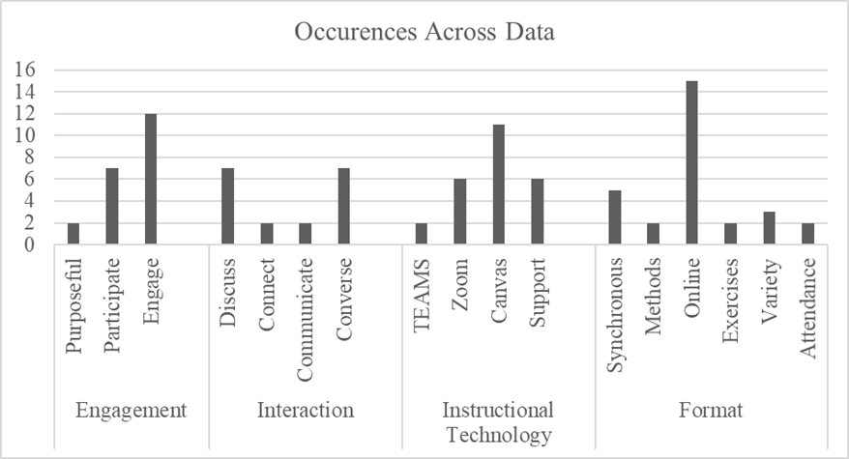
Findings
Interview Findings:
Engagement
Interaction
Instructional
Technology
Format

Slide 11
Findings
Interview Findings
Survey Findings
Focus Group Findings

Slide 12
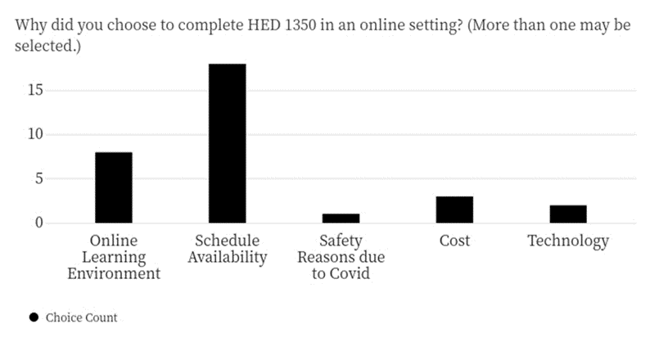
Findings
Survey Findings:
prehealth course
Why did students choose to take the prehealth class online?

Slide 13
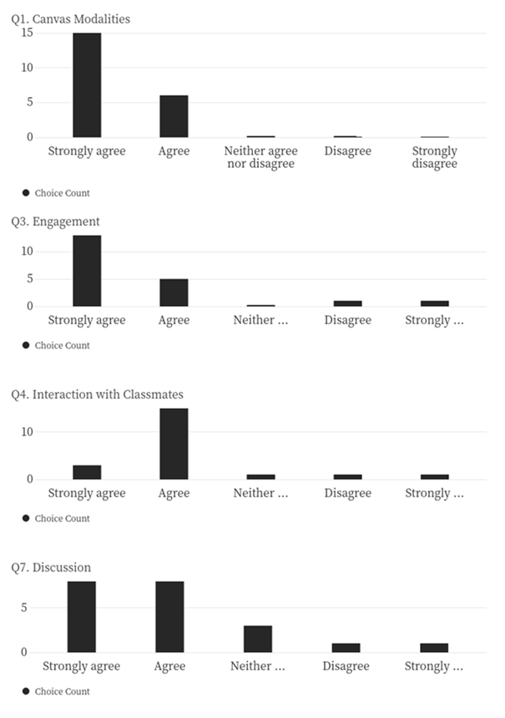
Findings
Survey Findings:
Online Course Lacks Engagement.
Online Course Could Benefit from Increased Opportunities for Communication & Interaction.

Slide 14
Findings
Interview Findings
Survey Findings
Focus Group Findings

Slide 15
Findings
Focus Group Findings:
Themes | Code Words | Occurrences Across Data
Engagement | Engage | 3
 | Participate | 2
Connection | Connect | 3
 | Virtual Office Hours | 4
Instructional Tools | Zoom | 6
 | Canvas | 6
 | Training | 2
 | Flipgrid | 3
 | Time | 7
Format | Online | 3
 | Asynchronous | 5
 | Synchronous | 6
 | Variety | 2
Engagement
Connection
Instructional Tools
Format

Slide 16
Recommendations
Central Research Question: How can the practice of instructing online PreHealth course students be improved at a private University?
Recommendation 1: Incorporating (blending) synchronous instruction elements into the online PreHealth asynchronous course
Recommendation 2: Providing targeted professional development for instructors to enhance learner engagement in an online setting utilizing instructional technology
Notes:
In short, answer your Central Research Question. Write each recommendation concisely. Include three to five recommendations. You will elaborate on the recommendations on the slides that follow

Slide 17
Resources and Funds ($0)
University Instructional Designers in the Learning Design Library Service
Recommendation 1: Incorporating (Blending) Synchronous Instruction Elements
Recommendation 2: Providing Targeted Professional Development for Instructors

Slide 18
Roles and Responsibilities of Stakeholders
Recommendation 1:
Incorporating (Blending) Synchronous
Instruction Elements
Instructors
Students
Instruction-al Designers

Slide 19
Timeline for Recommendation 1
5/30/22 Introduce Concept of Synchronous Instruction
6/2/22 Peruse Canvas Faculty Learning Hub
8/22/22 Discuss Desired Outcomes and Synchronous Elements as a Team
6/6/22 Attend “Learning to Build Your Canvas Course” Professional Development
6/7/22 Integrate Synchronous Learning Activities into Asynchronous Canvas Course

Slide 20
Roles and Responsibilities of Stakeholders
Recommendation 2:
Providing Targeted Professional
Development for Instructors
Program Director
Instruc-tional Design Staff
Instructors

Slide 21
Timeline for Recommendation 2
5/30/22 Introduce Instructional Technology Professional Development Opportunities
6/8/22 Attend “Baloo Print” Professional Development
8/22/22 Teach Re-vamped Online PreHealth Course
7/11/22 Attend “Canvas: Understanding the Discussions Redesign” Professional Development
7/12/22 Build Canvas Course and Consult with Instructional Designers
12/12/22 Debrief and Reassess Effectiveness of Online PreHealth Course

Slide 22
Evaluation Plan
Revise Canvas Course Blueprint
Teach PreHealth Course Online
Disaggregate Data of Student Grade Outcomes
Debrief to Discuss Perceived vs. Actual Effectiveness
Attend Instructional Technology Professional Development

Slide 23
Summary
Goal of this multi-method applied research study
Uncover factors that impacted instruction and student outcomes in the online PreHealth course at the private university so that instruction could be improved
Enhancements to improve the instruction in the online PreHealth course
Synchronous Learning Opportunities Blended in with Asynchronous Elements
Instructional Technology Professional Development

Slide 24
References
Almarashdeh, I. (2016). Sharing instructors experience of learning management system: A technology perspective of user satisfaction in distance learning course. Computers in Human Behavior, 63, 249–255.
Arghode, V., Brieger, E., & Wang, J. (2018). Engaging instructional design and instructor role in online learning environment. European Journal of Training and Development, 42(7/8), 366–380. https://doi.org/10.1108/EJTD-12-2017-0110
Batista, S., Pedro, N., Agonacs, N., Fonte, M., Oliveira, N., & Matos, J. F. (2017). Evaluation of teacher training satisfaction: A critical factor for technology integration in higher education. Proceedings of the European Conference on Games Based Learning, 580–584.
Bettinger, E. P., Fox, L., Loeb, S., & Taylor, E. S. (2017). Virtual classrooms: How online college courses affect student success. American Economic Review, 107(9), 2855–2875. https://doi.org/10.1257/aer.20151193
Claxton, B. & Michael, K. (2020). Conducting Applied Research in Education. Kendall Hunt Publishing Company.

Slide 25
Liberty University School of Education Faculty, Especially Dr. Dube, Thank you!
Questions?
Dr. Kimberly M. Smith
Dr. Cristina Dube, Sponsor
Liberty University
School of Education
Liberty Research Week 2022

