Slide 1
In Pursuit of a Universal High Performance Computing Optimization Methodology
Reid Prichard and Dr. Wayne Strasser
Liberty University
Spring 2022

Slide 2
What is High-Performance Computing?
HPC Cluster
Computers
…
Machine 1
Machine 2
Machine N
CPU cores
1
2
X
1
2
Y
1
2
Z
…
…
…
High-Performance Computing (HPC) refers to the use of multiple computers (“nodes”) working together to perform advanced calculations, such as scientific simulations
Each computer has many CPU cores
Each core on each computer works in parallel on the same problem
Key takeaway: HPC involves many cores working on a single task

Slide 3
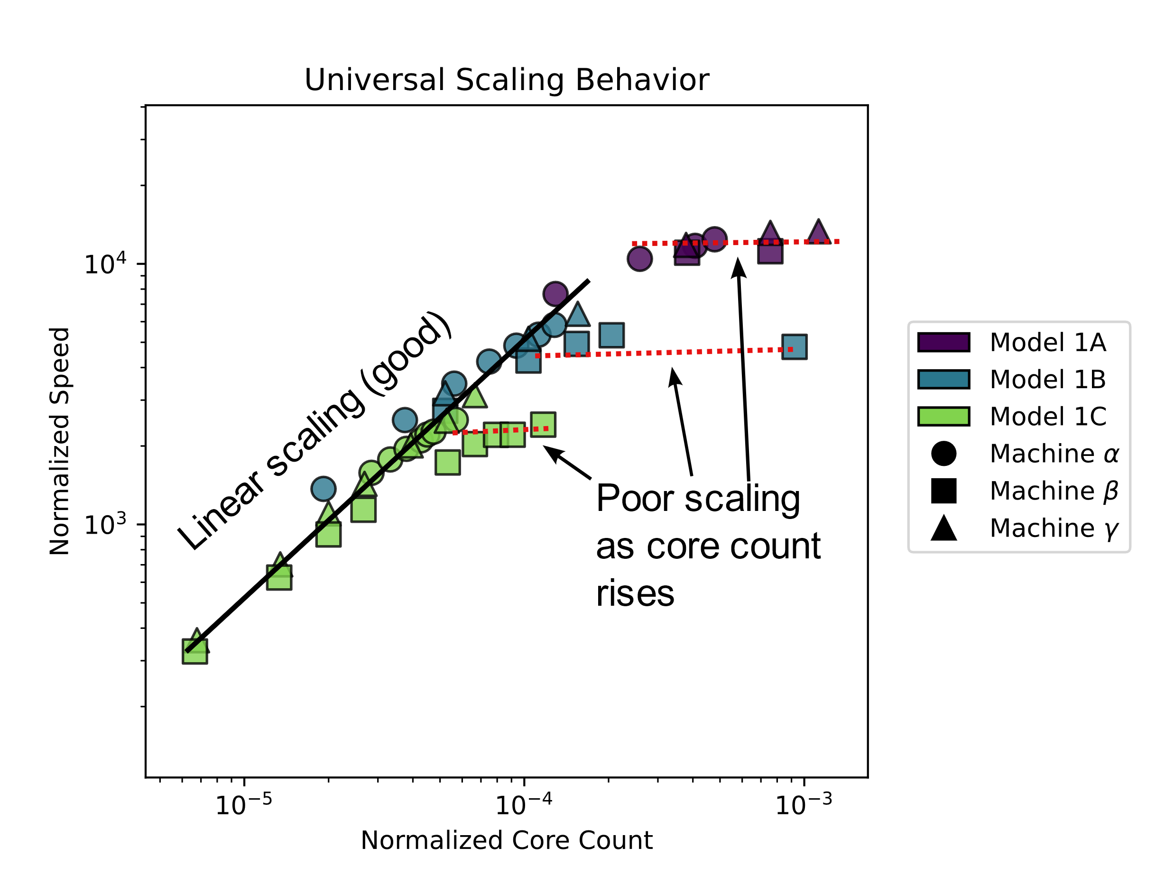
What Does “Scaling” Mean?
Ideally, using more cores should make a simulation proportionally faster
In reality, diminishing returns are often observed
Think about a group project where the work is split perfectly evenly (the dream, right?)
If you start to increase the number of group members (so each person’s share drops), eventually productivity will begin to fall
“Scaling”/“scalability” refers to how performance changes as more CPU cores are used
Many factors affect scalability, such as:
Computer hardware
Calculation type
Computational model details

Slide 4
The Optimization Problem
HPC can be extremely expensive
A single study can easily cost $10-100k
Even on fast hardware, it can take months to perform a single simulation
As such, optimization is crucial
When using HPC, you have two objectives:
Minimizing core-hours (cheaper results)
Minimizing earth-hours (faster results)
Several variables can be controlled:
Machine type
Cloud computing offers many different hardware configurations
Different machines exhibit qualitatively different behavior and have different hourly costs
You rarely/never know a priori which machine type is best for a given model
Machine count
You can choose to use any number of machines
Generally, it is faster to use more machines
Depending on scalability, total cost will often increase as machine count rises
“Undersubscription”
Each machine has a fixed number of CPU cores that work in parallel
Counterintuitively, it is often faster to leave a few cores unused
This is rarely considered
In this research, we observed up to a 20% speedup by optimally undersubscribing hardware
Testing is necessary to determine the optimum undersubscription for each individual case

Slide 5
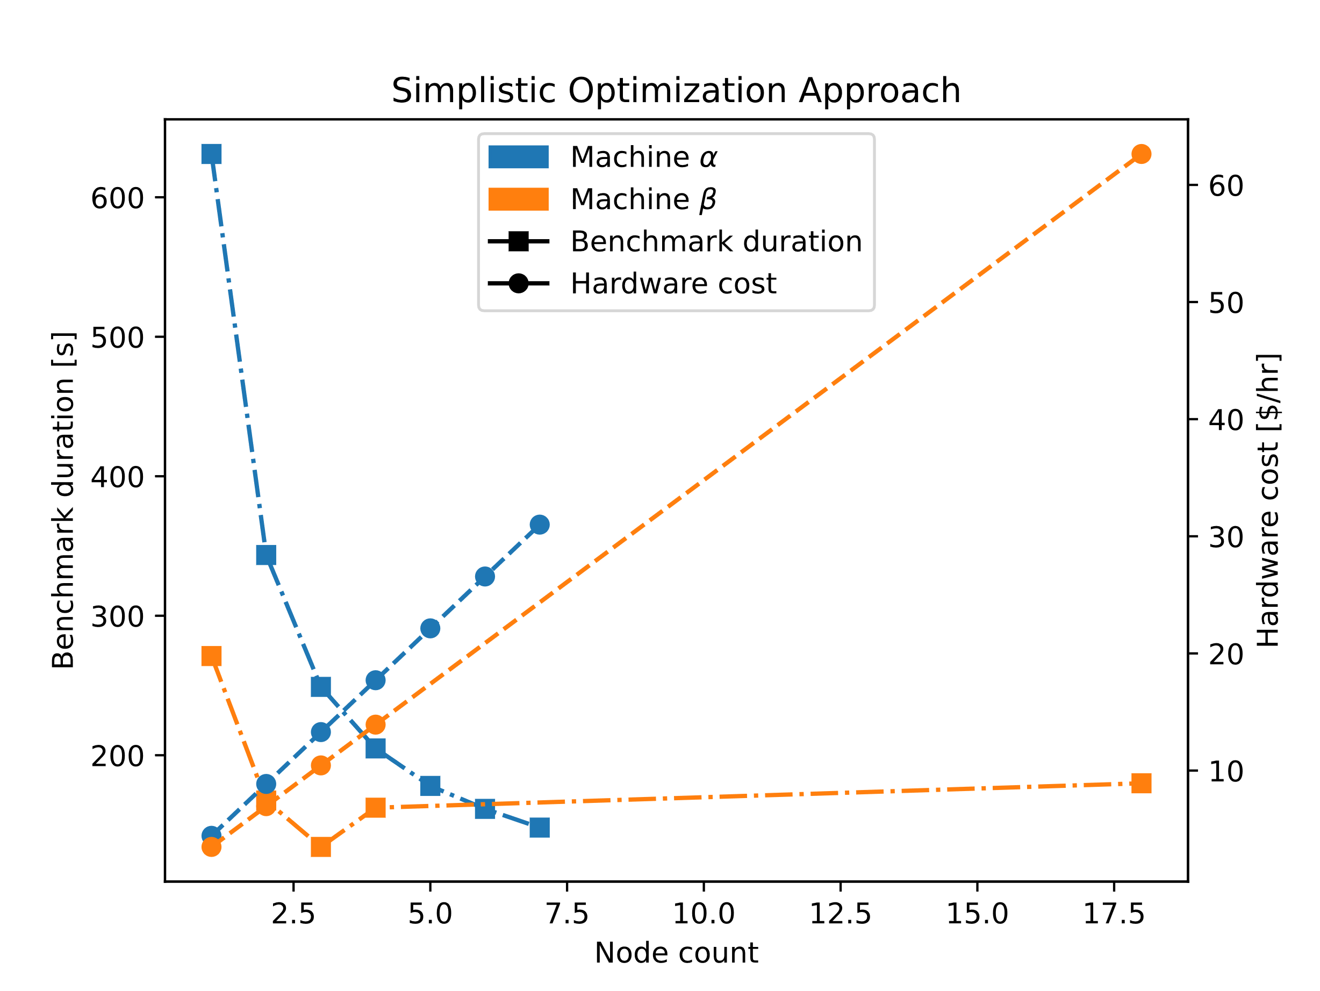
A Naïve Analysis Method
It is first necessary to perform “benchmarking” – testing to measure how each variable affects objectives
However, simply having the data is only the first step
With so many variables and goals, it is difficult to make sense of the results
In a multivariable optimization problem, there is no “best” solution
Instead, you must choose a solution based on your specific needs
As such, it is important to be able to understand the data at a glance
A line plot (on right) is a good first step, but it is far from ideal
One major issue is that the two measured quantities – test duration and hourly cost – do not represent the two optimization goals
At a glance, which option is cheapest?
Which is fastest?

Slide 6
Normalization
While benchmark duration is a usable indicator of speed, hardware hourly cost does not indicate simulation cost
Hourly cost is only half the picture
Total simulation cost is a function of both hourly cost and simulation speed
To address this, we created two normalized variables
Normalized runtime: $\tilde{t}=\frac{\text{benchmark} \text{duration}}{\text{computed} \text{solution} \text{time}}$
Normalized cost: $C=\frac{\left(\text{node} \text{cost}\text{/}\text{hr}\right)×\left(\text{node} \text{count}\right)×\tilde{t}}{3600}$
It is desirable to decrease both quantities:
If $\tilde{t}$ decreases, the simulation will compute in less time
If C decreases, the simulation will cost less, regardless of its speed

Slide 7
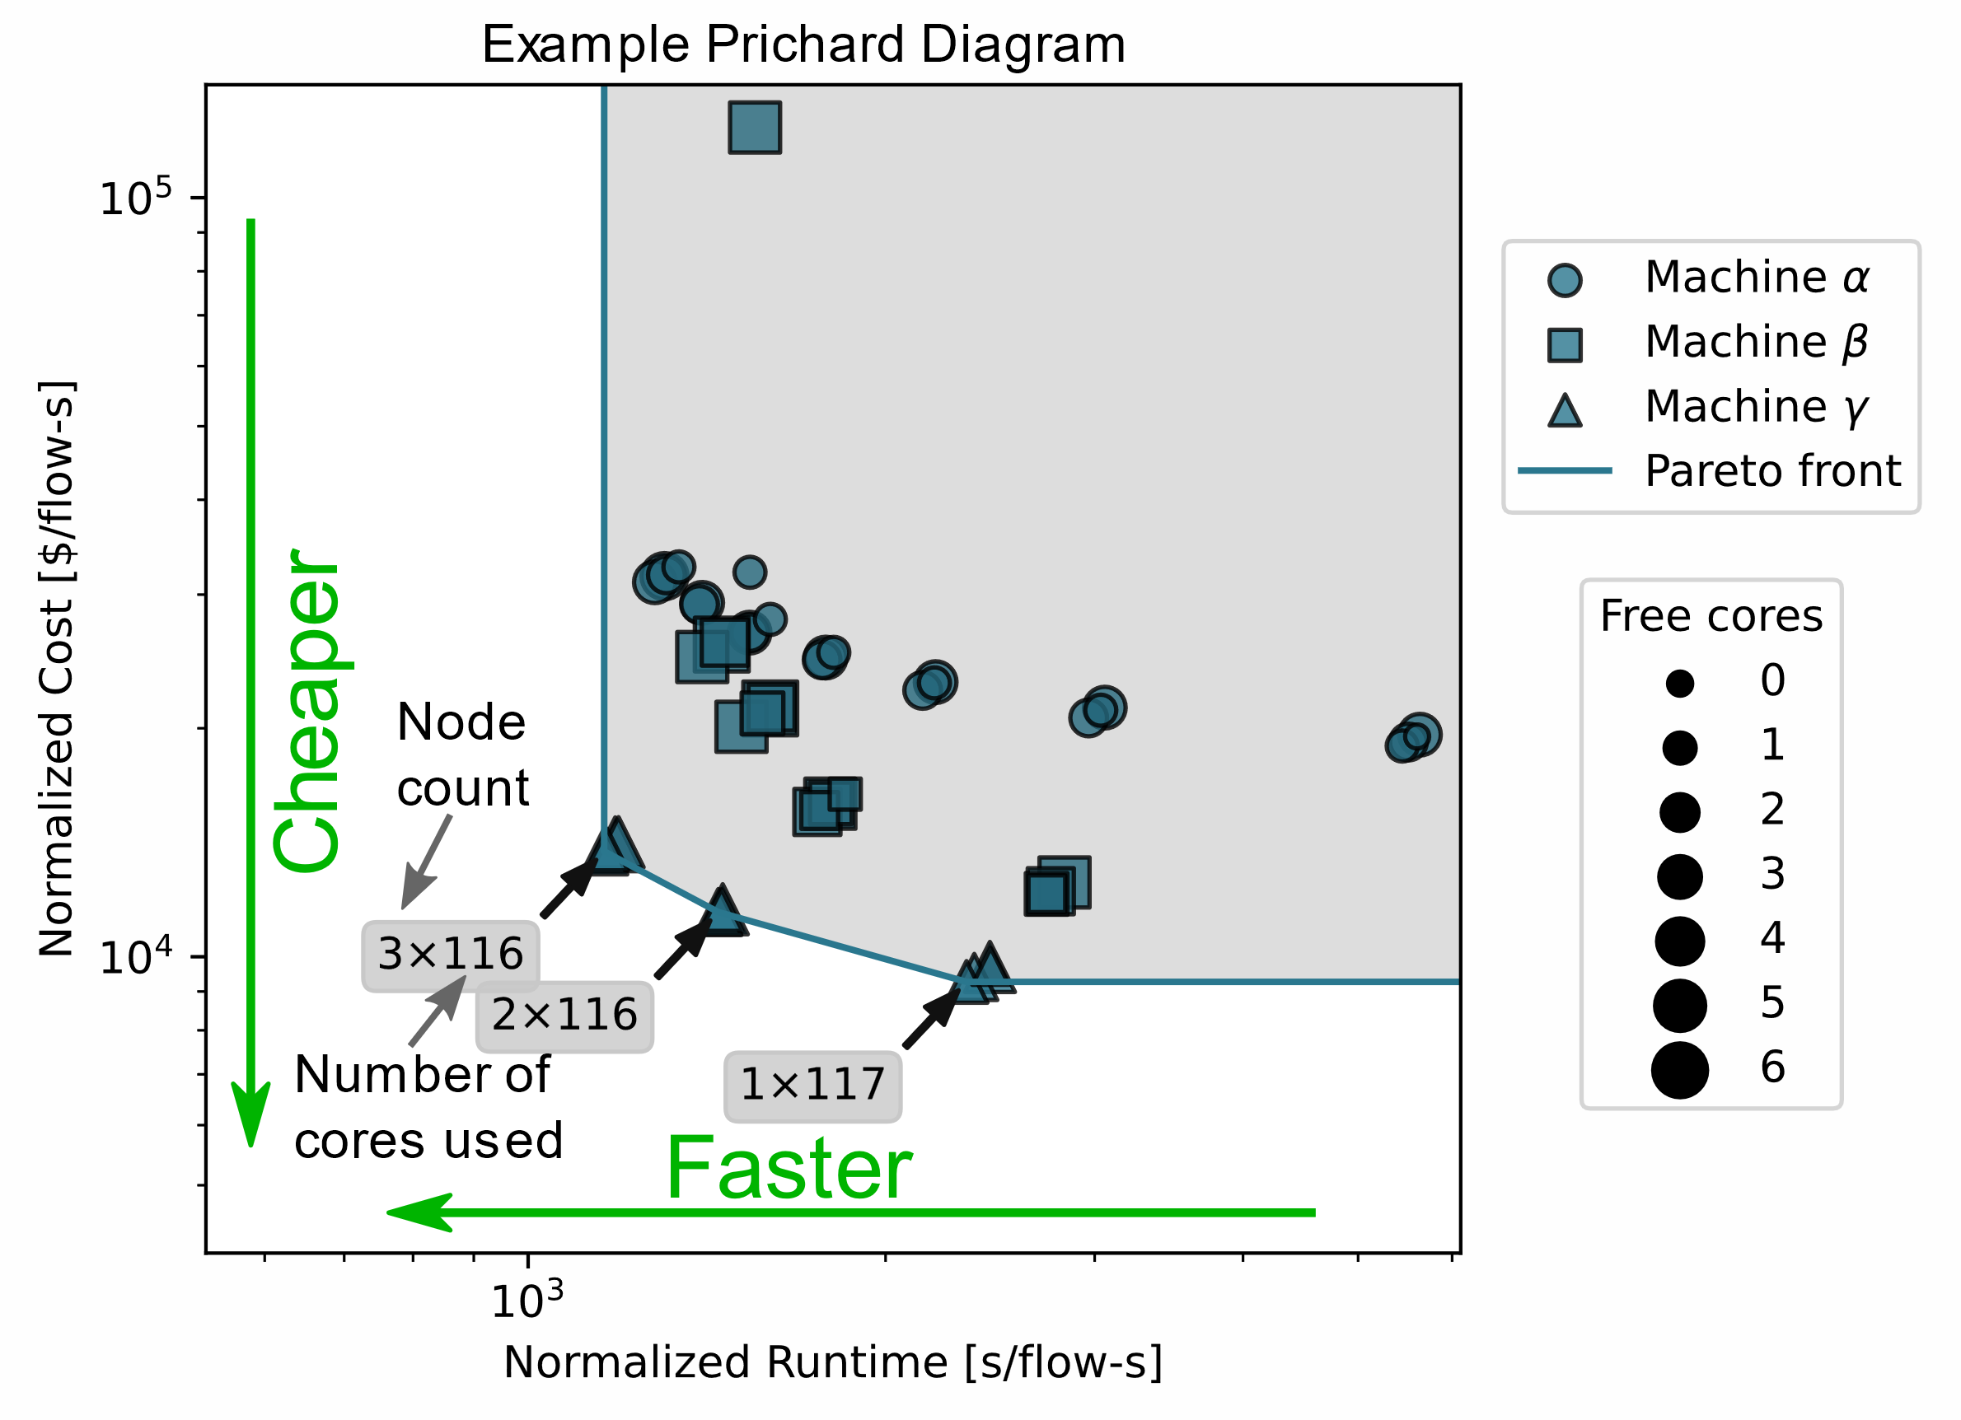
The Prichard Diagram
The Prichard Diagram represents the data as a Pareto front of $C$ and $\tilde{t}$
Any point along the front is an optimal solution
Points behind the front are suboptimal and should never be chosen
The Prichard Diagram allows a HPC user to quickly choose the solution that fits their needs
In this case, the Prichard Diagram narrows down a sea of data to just three optimum solutions
For example, if cost were most important, the best choice would be:
The machine type denoted $α$
1 node
117 cores per node

Slide 8
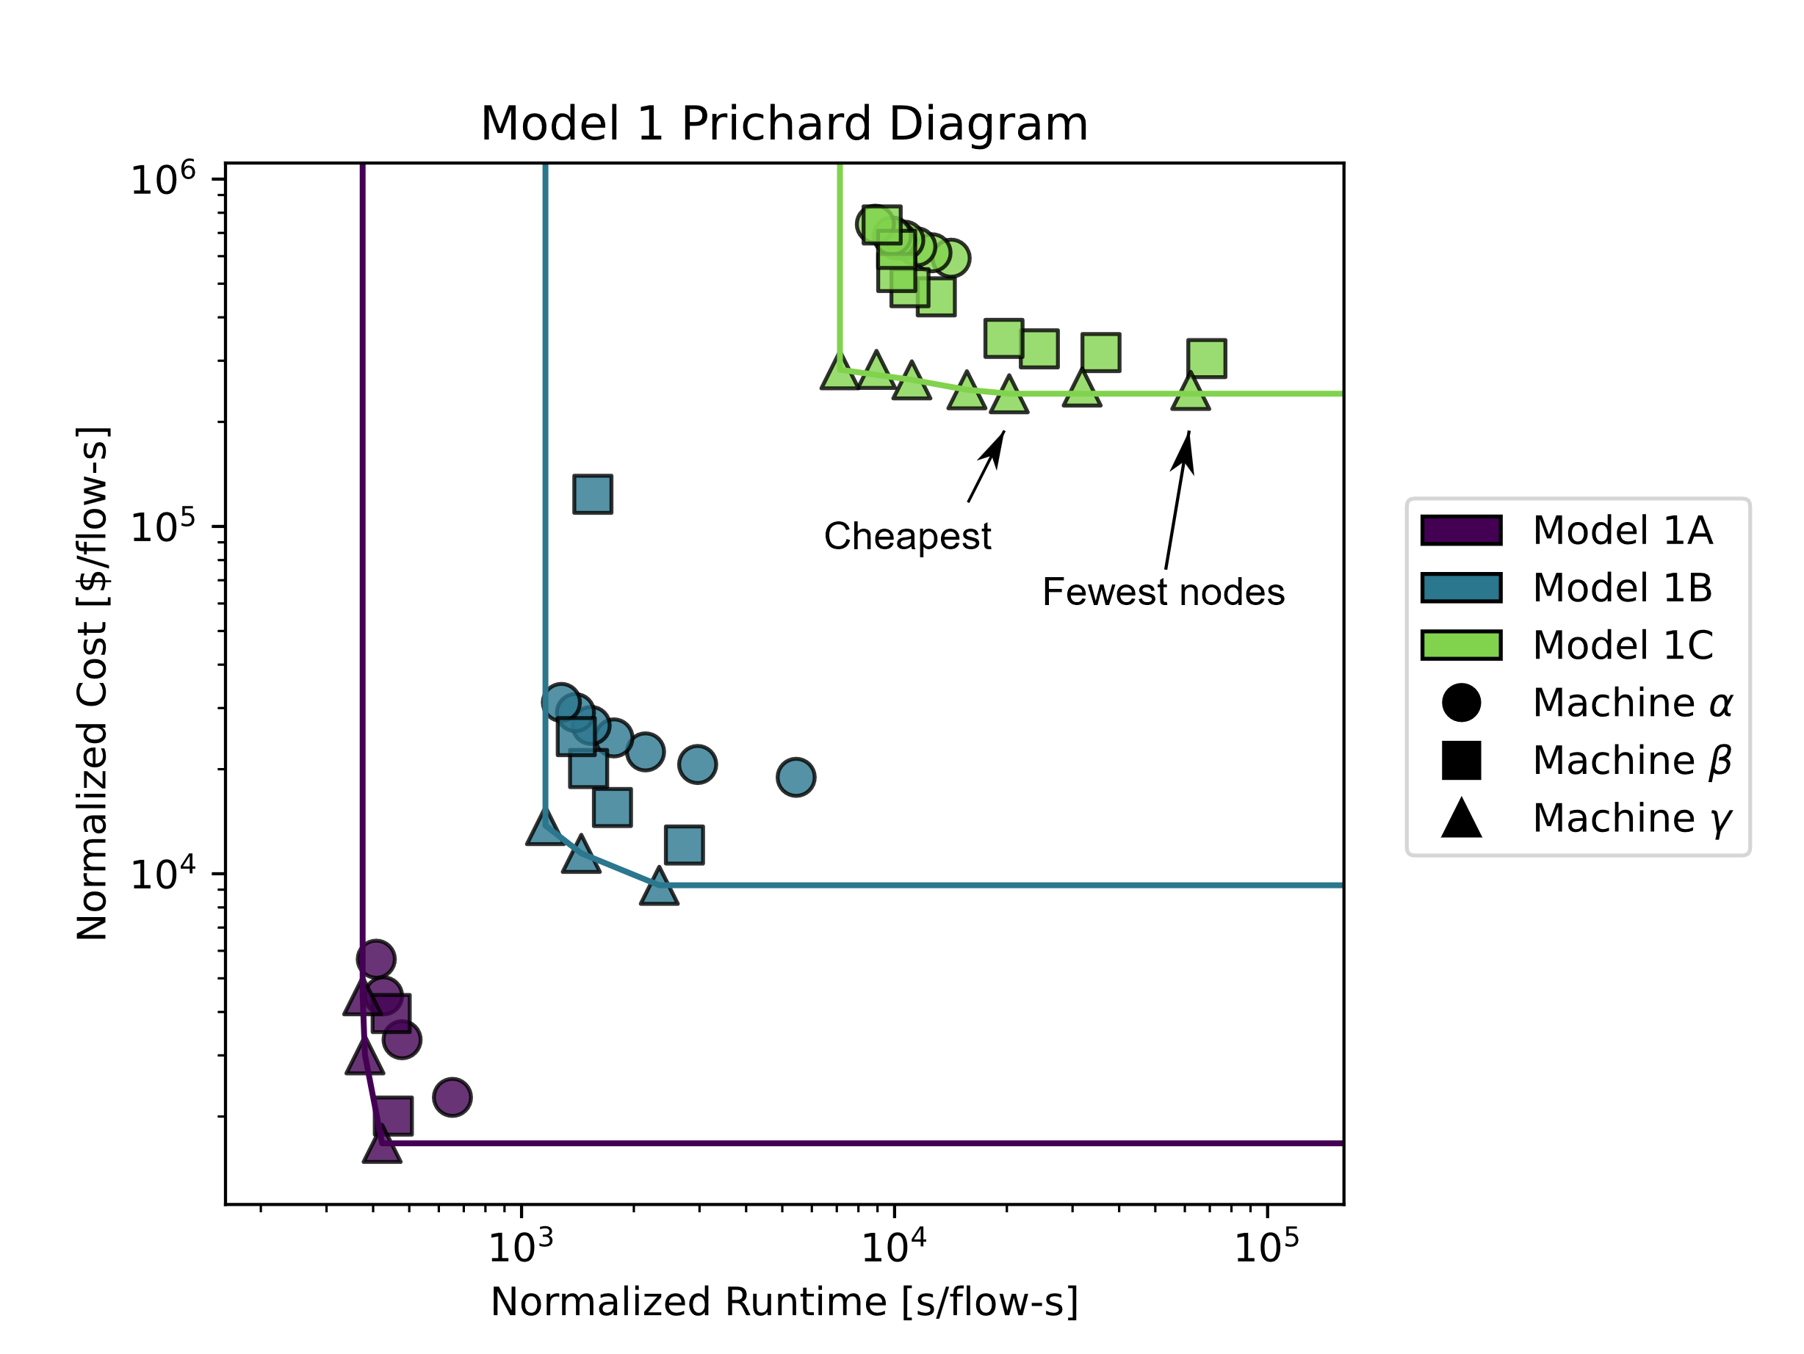
Comparison of Varying Computational Rigor
Models “1A”, “1B”, and “1C” are different versions of the same simulation in order of increasing computational rigor
As rigor increases, load per core rises and scaling becomes more favorable (flatter Pareto front)
If too many cores are used, negative scalability can be observed (more cores = slower)
Model 1C demonstrates superlinear scaling
Negative scalability

Slide 9
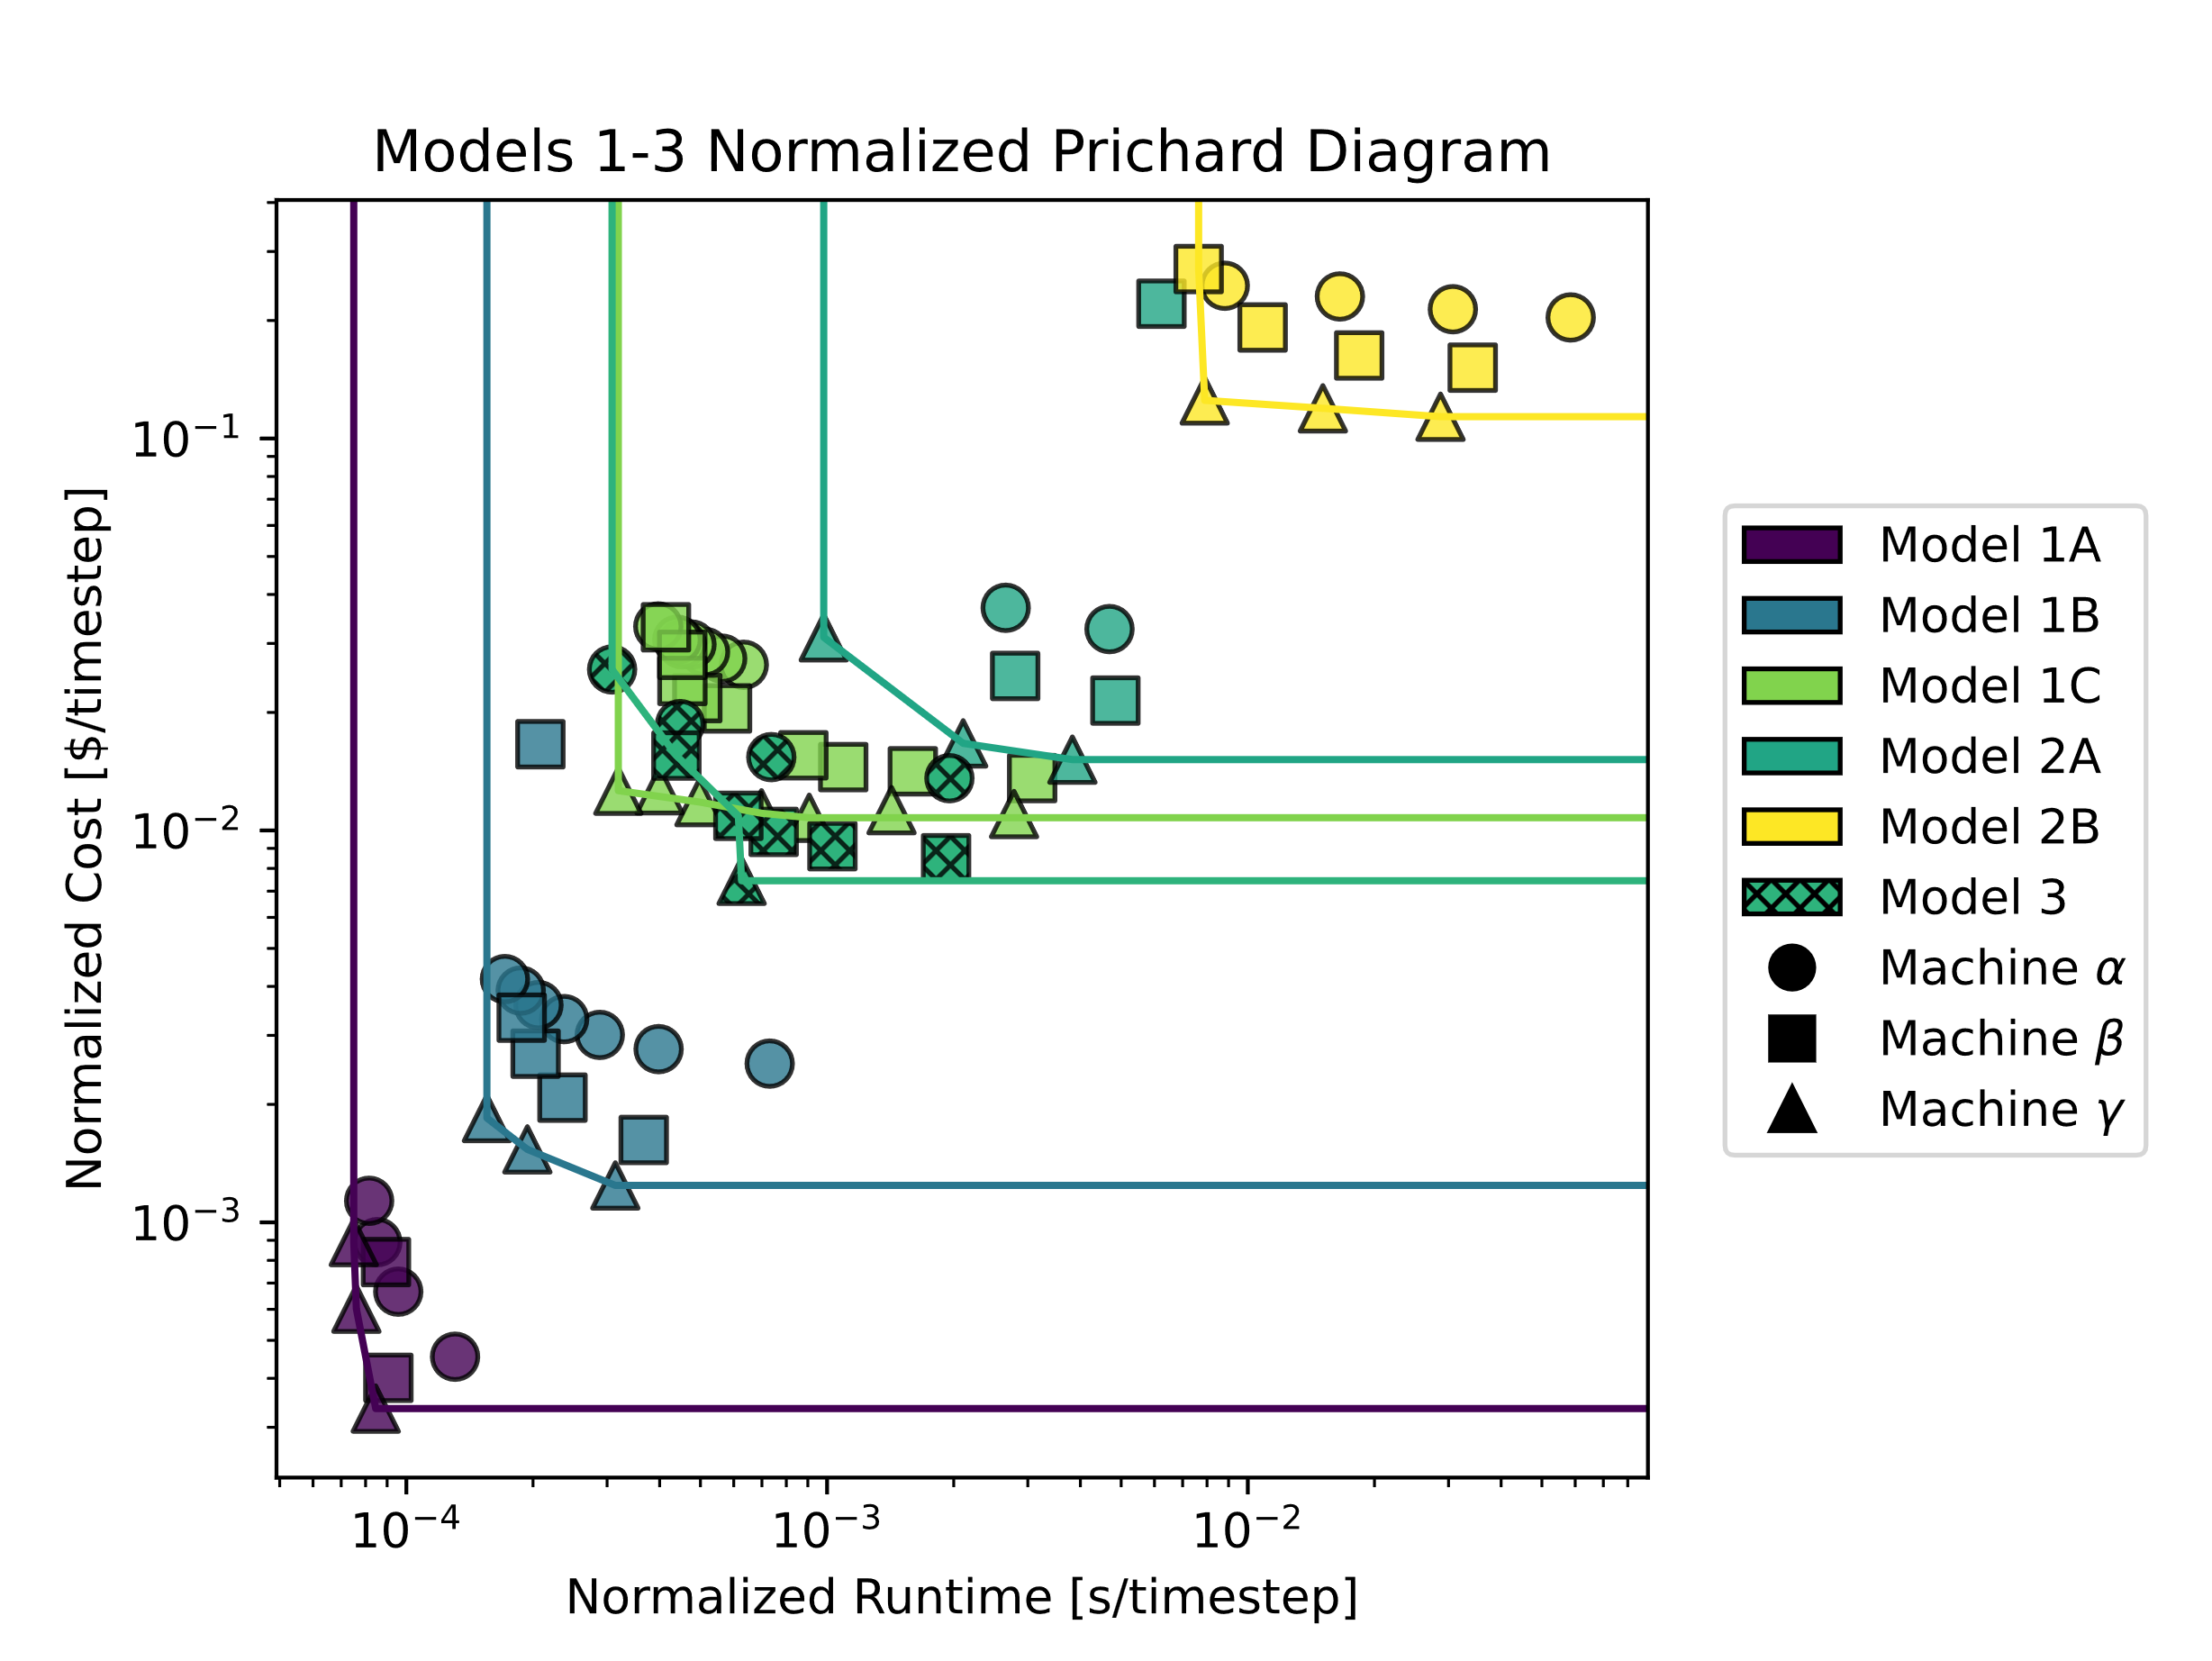
Universal Behavior in Various Models
The Prichard Diagram can be used to compare disparate models’ scaling behavior
The color of the markers represents computational rigor ranging from purple (low) to yellow (high)
We compared data from 3 unique models
Trends are visible; in future research we will quantify those trends

Slide 10
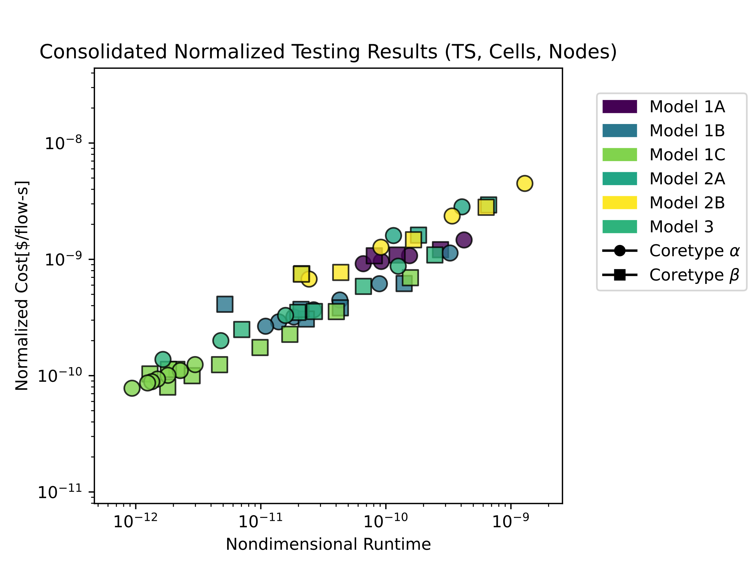
Normalization
Our next goal is to condense various models into a single trendline
This would allow us to predict optimality of new models, saving time and money associated with benchmark testing

Slide 11
Conclusions
When using HPC resources, even a small improvement to efficiency can save days of waiting and thousands of dollars
A robust, intuitive optimization technique is necessary
The Prichard Diagram allows rapid comparison of the effects of three variables on two objectives
Looking forward, we plan to seek universal scaling behavior to allow prediction of optimality without benchmarking first

Slide 12
Questions?

