Slide 1
Forgiveness and Agape Love Intervention on Psychological Well-Being
Ashley Mason, B.S., OMS-II
Chansoon Lee, Ph.D.

Slide 2
Research Teams
PI: Chansoon Lee, Ph.D.
Linda Mintle, Ph.D.
Ashley Mason, B.S., OMS-II
Adam Nakamoto, B.S., OMS-II
Robert Enright, Ph.D., University of Wisconsin-Madison
Jiahe Wang Xu, M.S., University of Wisconsin-Madison
Notes:
Dr. Enright…

Slide 3
Acknowledgment
We would like to thank the LUCOM Center for Research for funding our research.
We would also like to thank Deans of three schools, Business, Law, and Osteopathic Medicine for approving the data collection as well as Dr. Tiffany Towne, Ms. Sarah O’Brien, and Ms. Barb Lutz for assisting to collect data.
We would like to thank all participants in a year project.
Notes:
(acknowledge funding)

Slide 4
Agenda
4
Methods
1
Rationale
5
Results
3
Forgiveness & Agape Love Learning Program
2
Research Questions
4

Slide 5
Rationale
Notes:
Figure 1. Creative thinking ideas brain innovation concept, light bulb on yellow background. From European Partnership for Democracy. N.d. Retrieved from https://epd.edu/about-us/creative-thinking-ideas-brain-innovation-conceptlight-bulb-on-yellow-background/.

Slide 6
Rationale
Student Reports of Stress Prior to COVID-19
“3 out of 4 college students reported experiencing at least one stressful event that led to mental health issues, suicidal thoughts, or self-harm over the past year” (Harvard Medical School, 2018).
Student Reports of Stress During the Pandemic
“85% of college students experienced increased levels of stress and/or anxiety during COVID-19” (TimelyMD, 2020).
Negative impacts of poor psychological well-being on students’ relationships and academic performance
Positive impacts of forgiveness intervention on people’s mental health
Notes:
The ongoing pandemic has exacerbated stress and mental health concerns in most populations, but especially young adults.
Figure 2. The 2020 Student Experience Survey shows post-secondary students’ engagement with learning has dropped. From Panache. 30 Aug 2021. Retrieved from https://economictimes.indiatimes.com/magazines/panache/students-are-under-stress-due-to-pandemic-heres-how-online-mindfulness-training-can-help-them/articleshow/85765619.cms?from=mdr.

Slide 7
Rationale
“Forgiveness is one’s willingness to abandon one’s right to resentment, negative judgment and indifferent behavior toward one who unjustly hurt us, while fostering the undeserved qualities of compassion, generosity and even love toward him or her.”
“Agape Love is a moral virtue in which a person willingly and unconditionally offers goodness to another or others, in need, for the good of the other(s). There is a giving of the self to the other(s) that is understood, motivated, willed, and acted upon toward other people in such a way that the actions cost the one expressing that love.”
Dr. Robert Enright
Notes:
Dr. Enright defined Forgiveness as ..
According to him, “Agape Love is ..
Figure 3. Dr. Robert D. Enright, Ph.D. Co-founder, International Forgiveness Institute. From International Forgiveness Institute. N.d. Retrieved from https://internationalforgiveness.com/team/.

Slide 8
Research Questions
Can the Forgiveness and Agape Love Learning Program develop students’ moral virtues?
Can the Learning Program increase students’ well-being?
Do spirituality and religiosity influence the effect of the Learning Program on students’ well-being and moral virtues?
Intervention Program
Moral Virtues
Psychological
Well-being
Spirituality
Religiosity
Notes:
The diagram is the conceptual framework, with which three major research questions were developed.
The first one is about the effect of the forgiveness intervention program on the development of students’ moral virtues.
The second question is about the effect of the intervention program on students’ psychological well-being directly and indirectly through moral virtues.
The last question is about the moderate effect of the spirituality and religiosity on the relationship between intervention program and moral virtues or psychological well-being.

Slide 9
Forgiveness & Agape Love Learning Program

Slide 10
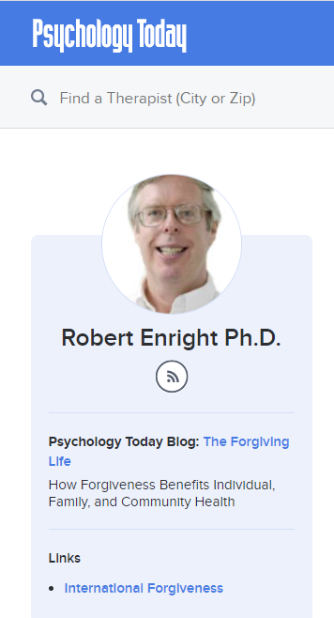
Forgiveness and Agape Love Learning Program
Notes:
The contents for the online learning course were drawn from Dr. Enright’s books, “8 keys to forgiveness”, “the forgiving life”, “forgiveness is a choice”, and his blog, The Forgiving Life on Psychological Today.
Figure 4. 8 Keys to Forgiveness. From Amazon. N.d. Retrieved from https://www.amazon.com/Keys-Forgiveness-Mental-Health/dp/0393734056.
Figure 5. The Forgiving Life. From Amazon. N.d. Retrieved from https://www.amazon.com/Forgiving-Life-Overcoming-Resentment-Lifetools/dp/1433810913.
Figure 6. Forgiveness is a Choice. From International Forgiveness Institute. N.d. Retrieved from https://internationalforgiveness.com/product/forgiveness-is-a-choice/.
Figure 7. Dr. Robert Enright Bio. From Psychology Today. 2022. Retrieved from https://www.psychologytoday.com/us/contributors/robert-enright-phd#:~:text=He%20is%20the%20author%20of,to%20Forgiveness%2C%20and%20Forgiveness%20Therapy..

Slide 11
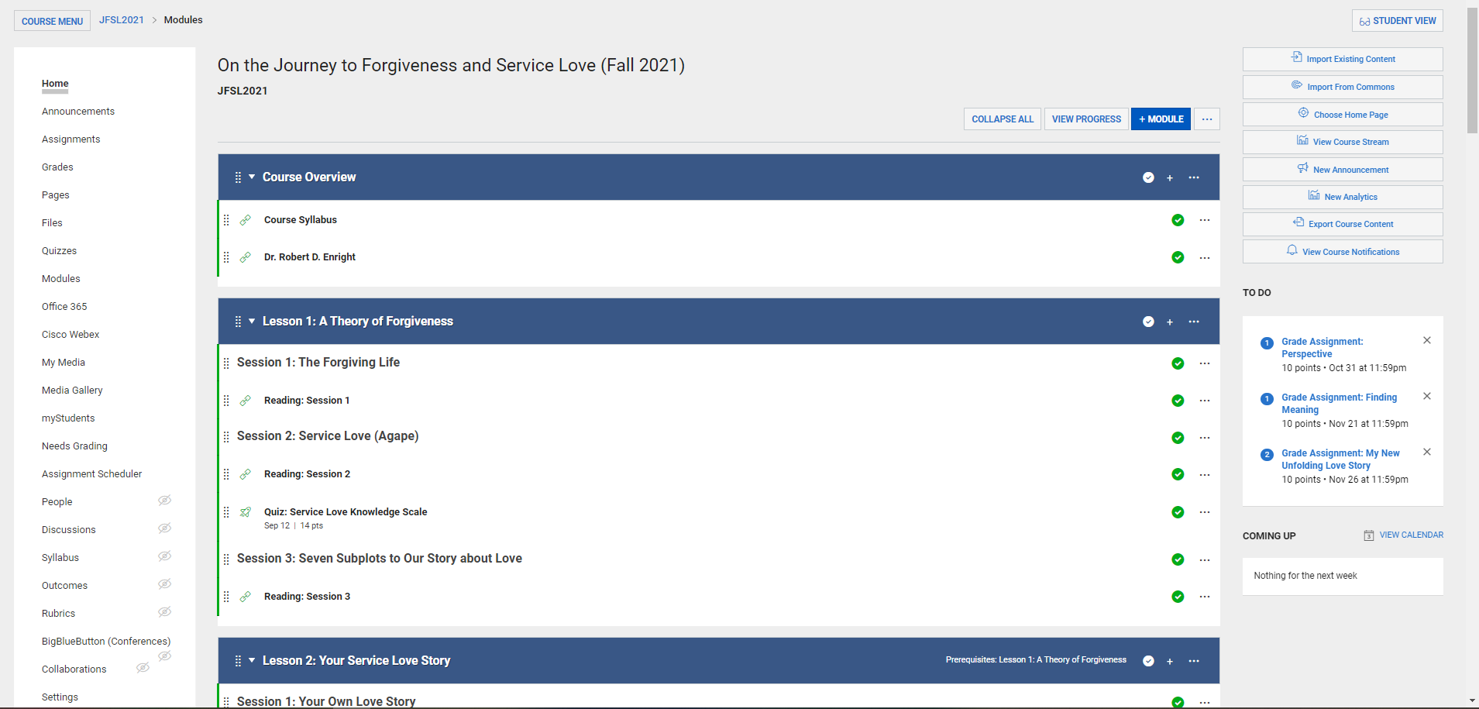
Forgiveness and Agape Love Learning Program
Notes:
This is the home page of the course in Canvas. The learning course consists of 12-week modules. The modules are open sequentially for 12 weeks, one module for a week. Each module has readings, and 8 of 12 modules have an assignment, for example, writing a short essay to reflect what they have read.

Slide 12
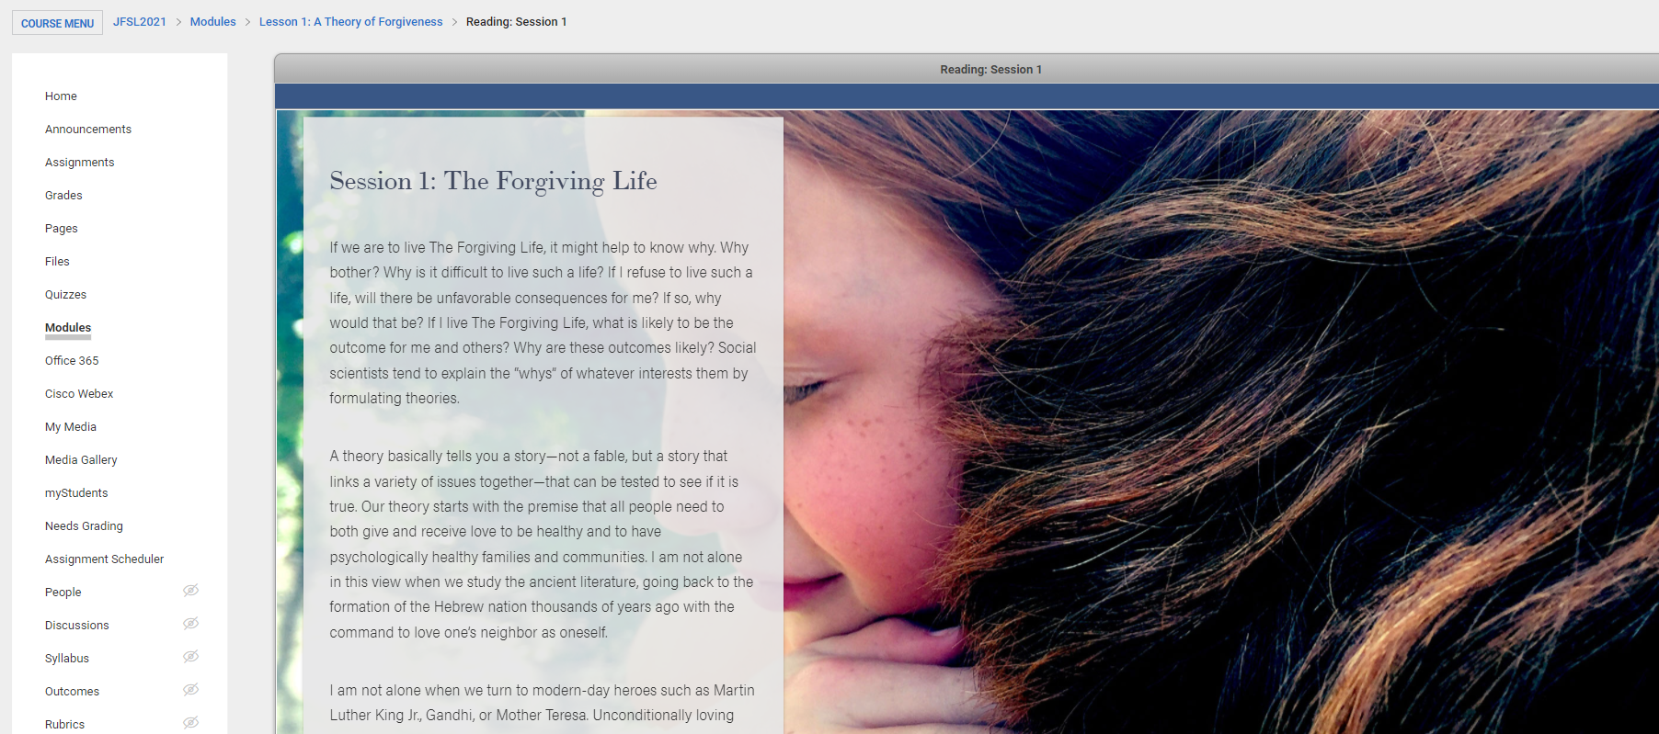
Forgiveness and Agape Love Learning Program

Slide 13
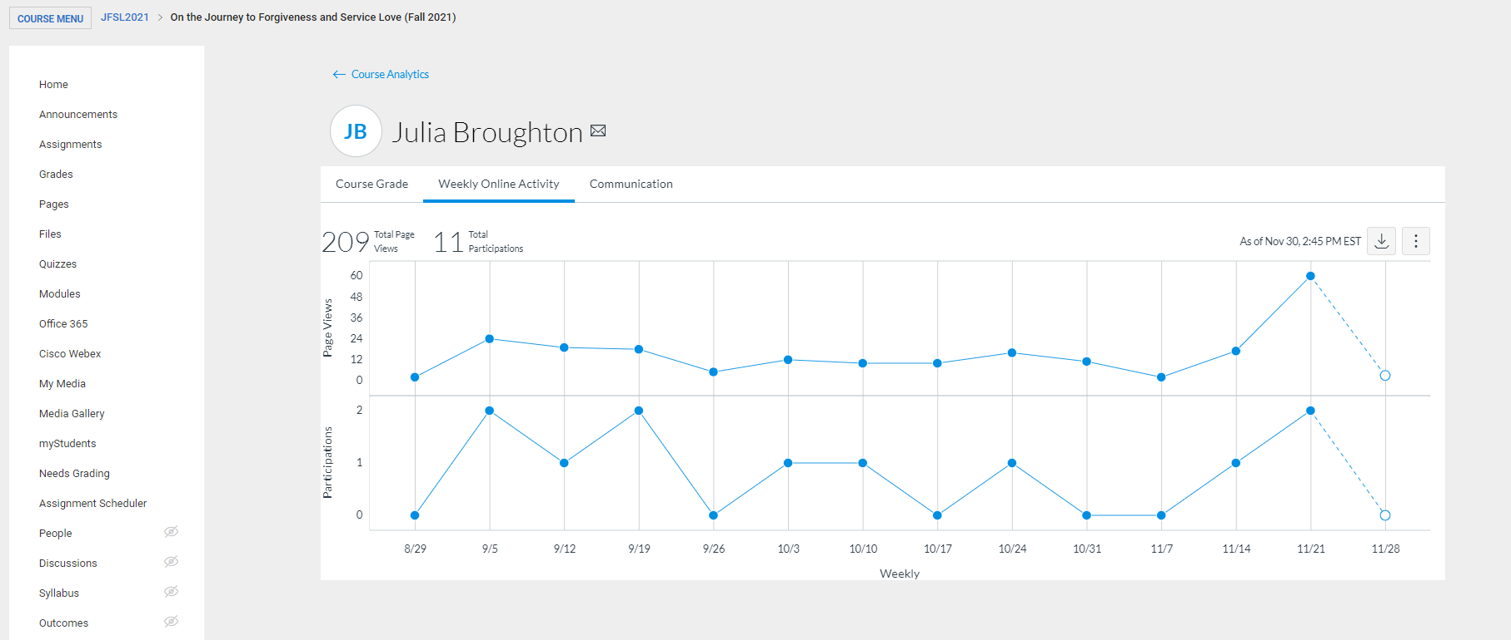
Forgiveness and Agape Love Learning Program
Notes:
Student researchers check students’ activities through the new analytics in Canvas and prompt them to finish readings and assignment on Fridays.

Slide 14
Methods

Slide 15
Project Roadmap
IRB Approval
Pre-Survey
Post-Survey
Follow-up Survey
Start: Mar. 2021
Start: Aug. 2021
Start: Dec. 2021
Start: Apr. 2022
3 Months
Interview
Exp. Group
Interview
Cont. Group
Developing
Course Contents
Creating
Surveys
2 Months
12 Weeks
12 Weeks
Start: Jan. 2021
Building
Online Courses
Recruiting
Participants
Online Learning
Online Learning
Experimental Group
Control-turn to-Experimental Group
Start: July 2021
Start: Sep. 2021
Start: Jan. 2022
Notes:
This is the roadmap for our project.
After receiving the IRB approval, we recruited participants.
During these times, our team developed course contents, created surveys, and built online courses in Canvas, which is the LU’s learning management system.
Then, we conducted the pre-survey. The experimental group has taken a 12-week online learning program during the Fall semester. Every week, our research team checked their progress and prompted them to finish readings and assignments, such as writing a short essay.
During this time, we also analyzed the data from the pre-survey.
After 12 weeks, all participants will be asked to take the post-survey. Then, the control group turned to the experimental group to take the 12-week online learning program during the Spring semester. This is for proving all participants with the benefit of the learning program on forgiveness and agape love.
During this time, we will conduct interviews with some selected participants from the experimental group. Also, we will present the research at conferences.
After the control-turn to-experimental group finishes the learning course, all participants will take the last survey.
After the third survey, we will conduct interviews with some selected participants from the control group. The conference presentations and paper submission to journals will be done.

Slide 16
Participants
Recruited Participants
College of Osteopathic Medicine
School of Business
School of Law
Completed the 12-week Forgiveness Learning Program
Current Experimental Group
Experimental Group
52
32
75
23
195
152
Dropped out
77
56
Control Group
Current Control Group
Completed Pre-Survey
Completed Post-Survey
Notes:
195: consent -> 152: pre-survey -> 88: post-survey
151 students in medical, law, and business schools at Liberty University participated in the project. I chose these three schools, because professionals who deal with people having business problems, legal problems, or medical issues need to practice empathy and compassion.
The participants were randomly assigned to either the experimental group or control group after matching them with their major, gender, agape love scores, and forgiveness scores from the pre-survey.

Slide 17
Measures
Demographic Questions
Enright Service love (Agape) Inventory Short Form (36 items) (Enright, 2020)
Enright Forgiveness Inventory Short Form (30 items) (Enright et al., 2021)
Ethnic Prejudice Scale (Bonab et al., 2020)
Herth Hope Index (Herth, 1992)
Rosenberg Self-Esteem Scale (Rosenberg, 1965)
The Toronto Empathy Questionnaire (Spreng et al., 2009)
PROMIS Short Forms for Anger (5 items), Anxiety (8 items), and Depression (8 items)
Intrinsic Spirituality (Hodge, 2003)
Duke University Religion Index (DUREL) (Koenig & Bussing, 2010): Organizational, Non-Organizational, and Intrinsic Religiosities.
Notes:
In addition to demographic questions, we used 13 measures, including Agape Love, Forgiveness, Prejudice, Hope, Self-Esteem, Empathy, Anger, Anxiety, Depression, Intrinsic Spirituality, and Organizational, Non-organizational, and intrinsic religiosities.

Slide 18
Analysis
Descriptive Statistics (Pearson Correlation Analysis)
Multivariate Analysis of Variance (MANOVA)
Dependent Variables: all measures
Independent Variable
Gender: Male vs. Female
Repeated Measure Analysis of Variance (ANOVA)
Dependent Variables: each measure
Independent Variable
Within-Subject: Time
Between-Subject: Group (Experimental vs. Control)
Statistical Software
R ver. 4.1, SPSS ver. 27

Slide 19
Results: Pre-Survey Data

Slide 20
Results of Pre-Survey Data
Correlations with Agape Love
Measure | Pearson’s r | p
Empathy | 0.34 | <0.01
Hope | 0.24 | <0.01
Intrinsic Spirituality | 0.20 | 0.01
Organizational Religiosity | 0.19 | 0.02
Non-Organizational Religiosity | 0.18 | 0.03
Measure | Pearson’s r | p
Prejudice | -0.24 | <0.01
Anger | -0.20 | 0.01
Depression | -0.18 | 0.03
Notes:
There were no significant correlations in the pre-survey between Forgiveness and the other scales, but there are many significant correlations when comparing our other scales to agape love. Hope, Empathy, and the religious scales demonstrated positive correlations with Empathy having the strongest correlation.
Empathy is an especially important characteristic for those looking to go into people-centered careers. Recent research revealed that medical students actually have declining levels of empathy as they progress through their training. By increasing levels of agape love, we may find higher levels of empathy.
Dr. Lee: you could start saying: we examined the relationship between Agape Love and Psychological well-being variables.

Slide 21
Results of Pre-Survey Data
Male (N=52) vs. Female Students (N=96)
F (13, 134) = 3.30, p < 0.01; Wilk’s ⋀ = 0.76
There was at least one statistically significant difference in measures
between female and male students.
Notes:
Using a one-way MANOVA, we found at least one significant interaction effect between the scores of female and male students.

Slide 22
Results of Pre-Survey Data
Measure | Male Mean (SE) | Female Mean (SE) | p value
Anxiety | 16.79 (0.98) | 22.78 (0.72) | p < 0.01
Hope | 40.98 (0.77) | 38.46 (0.56) | p = 0.01
Intrinsic Spirituality | 8.03 (0.33) | 7.01 (0.24) | p = 0.01
Intrinsic Religiosity | 12.69 (0.43) | 11.51 (0.32) | p = 0.03
Empathy | 47.90 (0.98) | 50.47 (0.72) | p = 0.04
Depression | 13.85 (1.03) | 16.53 (0.76) | p = 0.04
Organizational Religiosity | 4.77 (0.19) | 4.28 (0.14) | p = 0.04
Non-Org. Religiosity | 4.40 (0.22) | 3.84 (0.16) | p = 0.04
Self-esteem | 20.15 (0.76) | 22.07 (0.56) | p = 0.05
Note. N = 148; the alpha level = 0.05; Mean = Estimated marginal mean; SE = Standard Error
Notes:
Anxiety was highest in females, while males were higher in these other scales
[Anxiety has been shown to be higher in females in other studies as well]
[Hope was found to be higher in males in another study, but there were others that showed no significant difference.
View of STUDY ON HOPE: AN ANALYSIS | Journal of Social Sciences and Humanities (jsshuok.com)]
[Religiosity was found to be the opposite in other studies – females are known to be higher in religiosity
Risk and Religion: An Explanation of Gender Differences in Religiosity on JSTOR]

Slide 23
Results: Pre- & Post-Survey Data

Slide 24
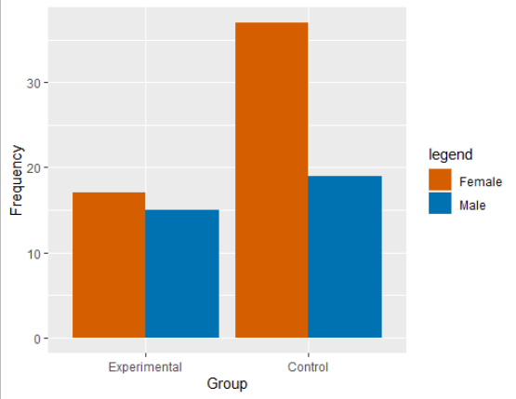
Results of Pre- & Post-Survey Data
66%
Business
Medicine
34%
Law
53%
Law
47%
N = 88

Slide 25
Results of Pre- & Post-Survey Data

Slide 26
Results of Pre- & Post-Survey Data
 |  | Control Group | Group | Experimental Group
Category | Measure | M | (SD) | M | (SD)
Moral Virtue | Agape Love | 0.82 | (12.48) | 1.12 | (9.01)
 | Forgiveness | 2.25 | (22.18) | 12.00 | (20.25)
Positive | Empathy | 0.30 | (4.21) | 0.44 | (5.05)
Negative | Prejudice | 0.09 | (5.41) | -1.00 | (6.29)
 | Anxiety | -0.55 | (6.45) | -1.44 | (5.91)
Religiosity | Intrinsic Spirituality | 0.17 | (0.65) | 0.35 | (1.07)
 | Intrinsic Religiosity | -0.14 | (1.71) | 0.06 | (1.95)

Slide 27
Results of Pre- & Post-Survey Data
Experimental (N = 32) vs Control Group (N = 56)
Repeated Measure ANOVA for the Forgiveness Score
Time x Group: F (1, 86) = 4.19, p = 0.04; Wilk’s ⋀ = 0.95
There was a statistically significant interaction effect of time and group in the forgiveness score.

Slide 28
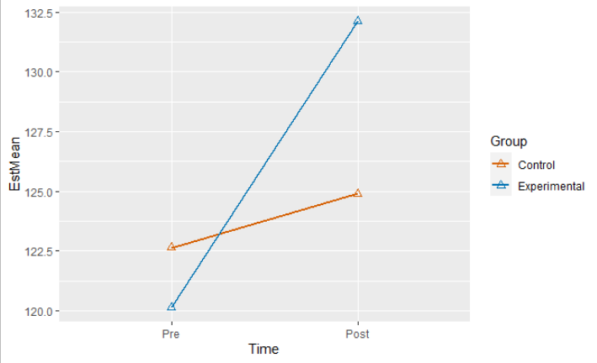
Results of Pre- & Post-Survey Data
Time x Group for the Forgiveness Score

Slide 29
Discussion
Limitations
Generalizability
Small Sample Size
Online Program
Contribution
Benefits for college students
Future Implementation
Improve character development
Improve psychological health and moral virtues
Notes:
As for limitations, one issue that often arises in studies is generalizability. Will our study findings be applicable for other universities? Our study is being conducted at a religious university, and so our participant population primarily consists of those affiliated with a religion.
Another limitation is that only three schools (medicine, business, and law) are represented. And there are only 4 students from law.
Finally, the study intervention entails an online program. This has been more convenient with the pandemic and also ease of access, however, the benefits may or may not be as great as an in-person program.

Slide 30
Questions?
Thank You!
ammason4@liberty.edu

