Slide 1
Tobacco Use and Experimentation among Parents and middle school students, Gratiot Co., MI, 2004, 2009, & 2014
Som Subba, Zachary Unger, & Victoria Watson

Slide 2
Introduction
Cigarette smoking is the leading cause of preventable disease and death each year in the US ¹
Smoking tobacco products accounts for nearly 480,000 deaths each year
In 2019, it was estimated that 34.1 million adults smoked cigarettes ¹
Smoking has declined by from 21% since 2005 to 14% in 2019 ²
About 24% of adults in Gratiot County smoke, whereas as Michigan’s prevalence is 20% ³
Health data from 2012 on Gratiot county show:
25.4% of women smoked when the national prevalence for men was 17.9%
27.6% of men smoked when the national prevalence for women was 22.2% ⁴

Slide 3
Methods
Obtained the prevalence of:
One parents smoking, both parents smoking, kids who experimented with smoking male smokers compared to female smokers
Obtained the odds ratio of:
Children experimenting with smoking when having at least one parent smoking
Children experimenting with smoking when both parents smoked
Discarded any incomplete data
Secondary observational study utilizing prevalence data
Retrospective case control design used for odds ratio

Slide 4
Results 2004
45.4% of students lived with one or more parents that smoked
36.5% of fathers smoked
29.9% of mothers smoked
105 (19.8%) students lived with two parents that smoked
135 (25.5%) students lived with one parent that smoked
82 (60.7%) of fathers
53 (39.3%) of mothers
45 (9.4%) of kids experimented smoking
24 boys experimented
26 girls experimented
36 had at least one parent that smoked (72%)
22 lived with two parents that smoked
14 lived with one parent that smoked
3 lived with a father that smoked
11 lived with a mother that smoked
14 lived with two parents that did not smoke

Slide 5
Results 2009
66.7% of students lived with one or more parents that smoked
37.4% of fathers smoked
29.4% of mothers smoked
176 (36.1%) students lived with two parents that smoked
148 (30.4%) students lived with one parent that smoked
93 (62.8%) of fathers
55 (37.2%) of mothers
45 Students experimented smoking
26 boys experimented
19 girls experimented
15 lived with two parents that smoked
16 lived with one parent that smoked
7 lived with a father that smoked
9 lived with a mother that smoked
14 lived with two parents that did not smoke

Slide 6
Results 2014
69.3% students lived with one or more parents that smoked
36.5% of father smoked
32.8% of the mothers smoked
101 students lived with both parents who smoked
100 students lived with one parent who smoked
58 (58%) of Fathers
42 (42%) of Mothers
17 Students experimented smoking
15 boys experimented
2 girls experimented
7 lived with both parents who smoked
5 lived with one parent who smoked
4 were fathers
1 was a mother
5 live with both parents who did not smoked

Slide 7
Results of Odds Ratio
2004 Data
OR of child experimenting with at least one parent smoker: 3.5
OR of child experimenting with both parents smoking: 3.7
2009 Data
OR of a child experimenting with at least one parent smoker: 2.8
OR of a child experimenting with both parents smoking: 2.0
2014 Data
Or of child experimenting with at least one parent smoker: 2.1
Or of child experimenting with both parents smoking: 2.8

Slide 8
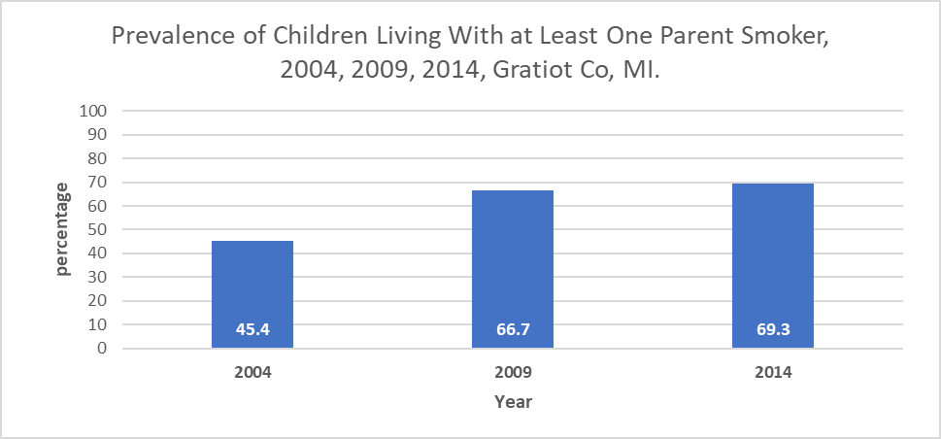
Final Results

Slide 9
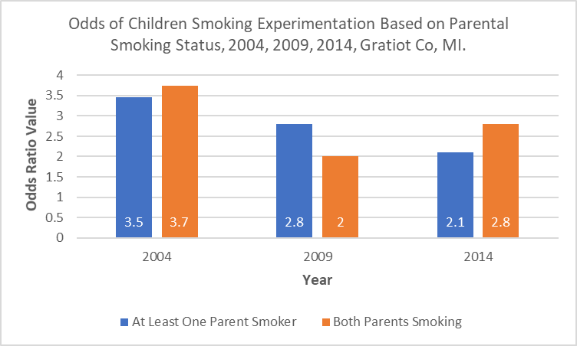
Final Results cont.

Slide 10
County Health Rankings Data Discussion
Adult Smoking(Prevalence)⁵
Gratiot County: 24%
Michigan: 20%
United States: 16%
Median Household Income
Gratiot County: $51,000
Michigan: $59,500
United States: $71,900

Slide 11
Discussion
Major findings
Prevalence of smoking among children who live with one parent
Increase in prevalence throughout 2004 - 2014 from 45.4 - 69.3%
The odds ratio of children experimenting with both parents smoking
greater OR = 3.7 in 2004 and 2014 OR = 2.8, OR = 2.0 in 2009 lower than OR of 2004 and 2014
Additional studies ⁶
OR = 1.72 one parent smoking, OR= 2.73 two parents smoking
Limitations
Strengths
The availability of the data through various years
Weakness
Unreliability, small data, missing data
E-cigarettes and vaping were not accounted for
Relative risk cannot be calculated
Reporting bias (social desirability)

Slide 12
Recommendations
Collect more data for more years
Assess data for high school students
Take in account data on e- cigarettes and vaping products
Find ways to garner trust among priority population for accurate response data
Better management of tobacco distribution/sales in Gratiot County

Slide 13
Reference
National Center for Chronic Disease Prevention and Health Promotion (US) Office on Smoking and Health. The Health Consequences of Smoking—50 Years of Progress: A Report of the Surgeon General. Atlanta (GA): Centers for Disease Control and Prevention (US); 2014.
Cornelius ME, Wang TW, Jamal A, Loretan CG, Neff LJ. Tobacco Product Use Among Adults — United States, 2019. MMWR Morb Mortal Wkly Rep 2020;69:1736–1742. DOI: http://dx.doi.org/10.15585/mmwr.mm6946a4external icon.
County Health Rankings & Roadmaps. County Health Rankings & Roadmaps. https://www.countyhealthrankings.org/app/michigan/2021/rankings/gratiot/county/outcomes/overall/snapshot. Published 2021. Accessed November 30, 2021.
Healthdata.org. http://www.healthdata.org/sites/default/files/files/county_profiles/US/2015/County_Report_Gratiot_County_Michigan.pdf. Published 2021. Accessed November 30, 2021.
Kingery KL. County Health Rankings & Roadmaps. J Youth Dev. 2018;13(3):259-263.
Bee J, Jere M, Britton J. Exposure to parental and sibling smoking and the risk of children smoking uptake in childhood and adolescence; a systematic review and meta-analysis. PubMed. https://thorax.bmj.com/content/thoraxjnl/66/10/847.full.pdf. February 15, 2011. Accessed December 1, 2021.

