Slide 1
Casein kinases are required for the stability of the glucose sensing receptor Rgt2 in yeast
Daniel Bloor and Jeong-Ho Kim*
Department of Biology & Chemistry
Liberty University

Slide 2
Glucose metabolism
Most important metabolic fuel for virtually all organisms
Glucose molecule can cycle through respiration, in the presence O₂, or fermentation in its absence
Aerobic respiration: efficient oxidation process generating 36 molecules ATP
Fermentation: yields ethanol or lactic acid and CO2, producing 2 molecules ATP
Figure 1. Glucose molecule. Retrieved from https://upload.wikimedia.org/wikipedia/commons/c/c6/Alpha-D-Glucopyranose.svg

Slide 3
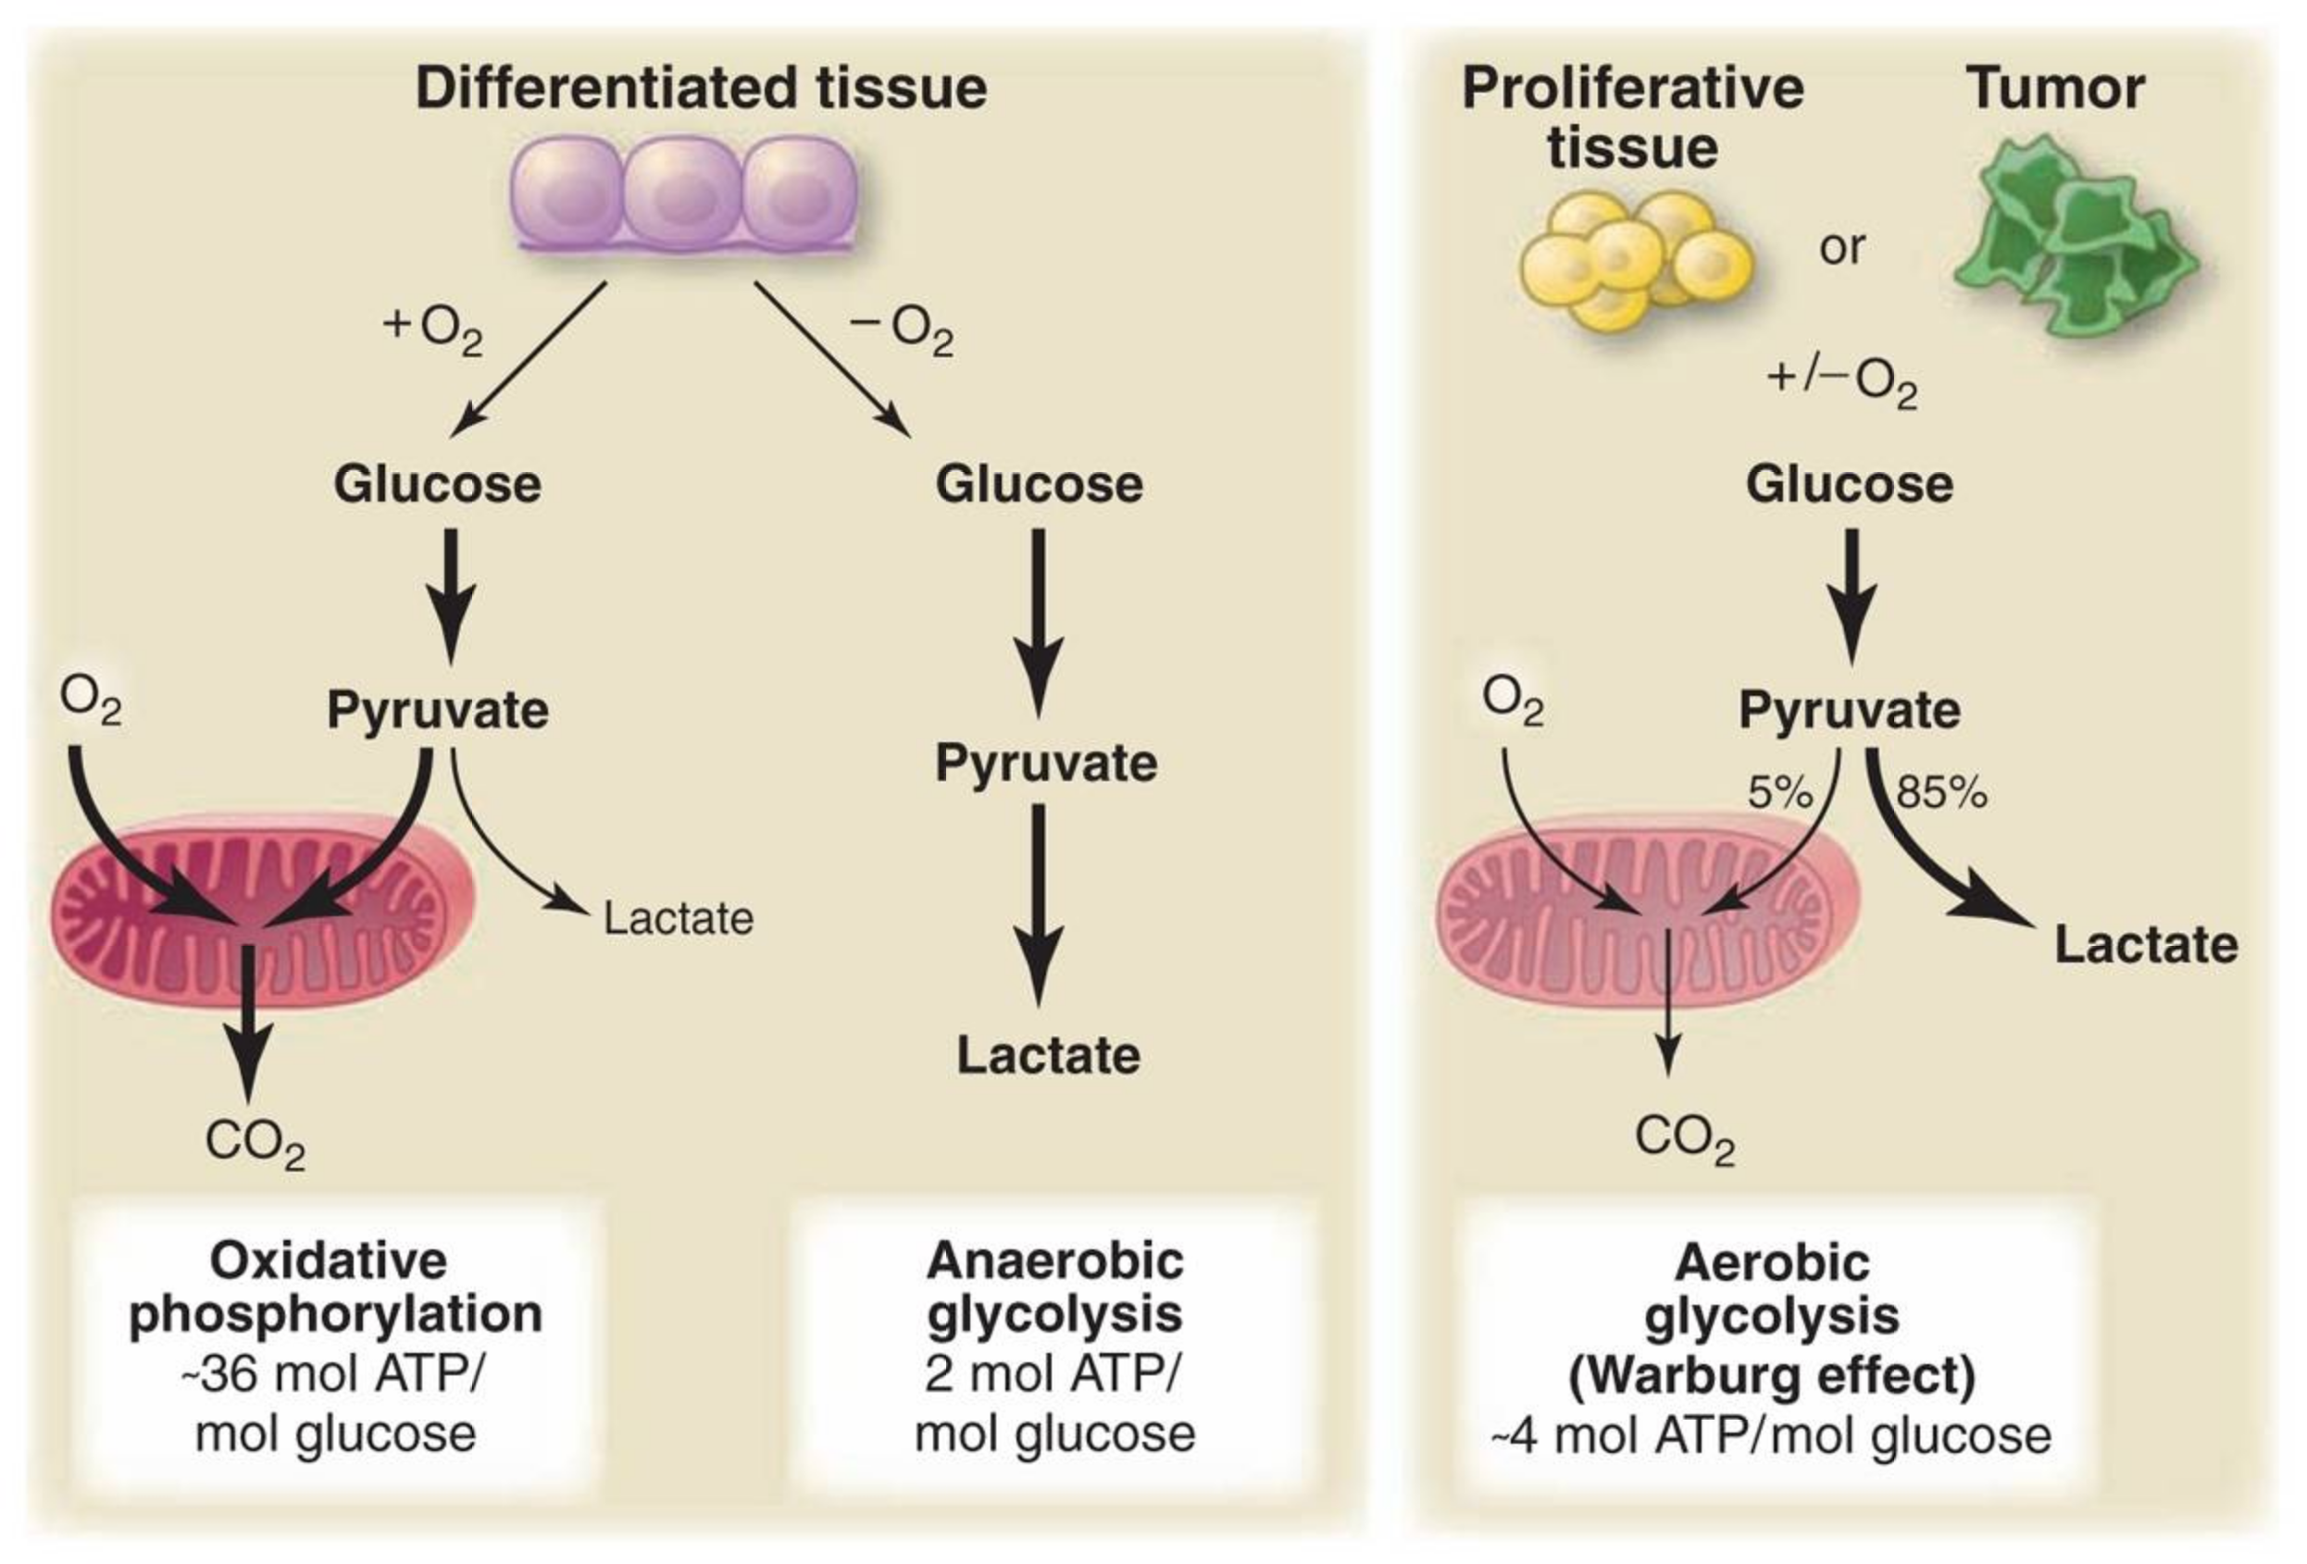
Yeast as a model organism
Single-celled eukaryotic microorganism
Operate according to “Warburg effect”
Warburg effect observed in cancer cells,
regardless of O₂ presence
Yeast produce ethanol where cancer cells
generate lactate
Figure 2. Metabolic pathways. Retrieved from https://www.crossfit.com/essentials/understanding-the-warburg-effect-the-metabolic-requirements-of-cell-proliferation

Slide 4
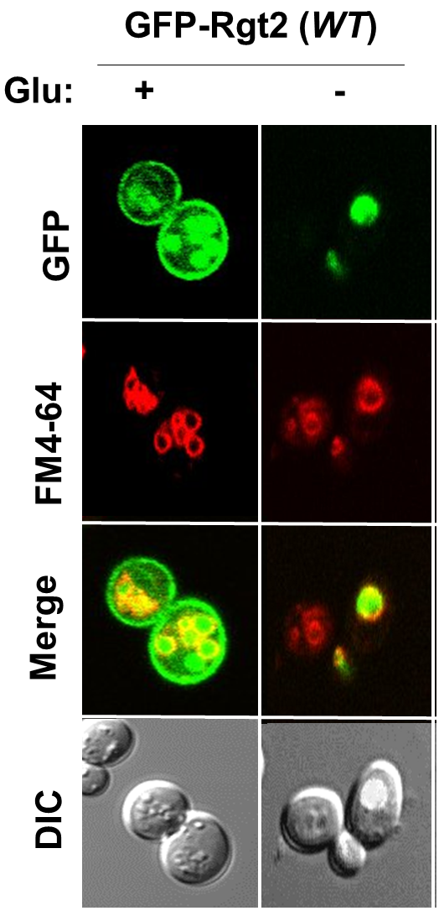
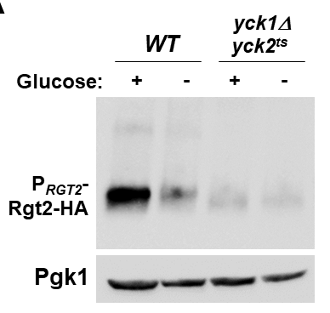
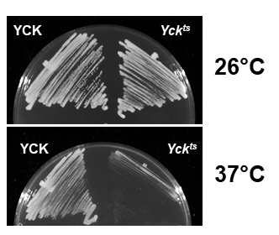
The glucose receptor Rgt2 is unstable in a yck-ts strain
Figure 3. Graphic and photos by Daniel Bloor
A
B
Glucose
Rgt2
Snf3
YckI
(CK1γ)
C
Glucose
Transporters
NUCLEUS

Slide 5
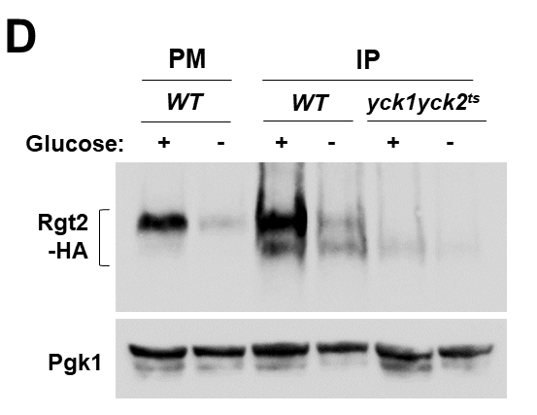
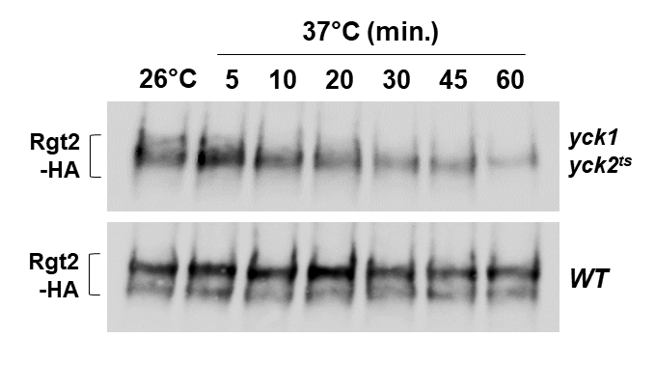
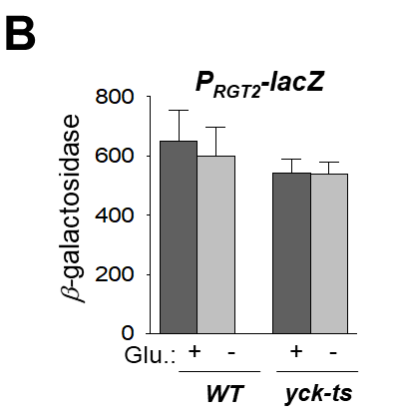
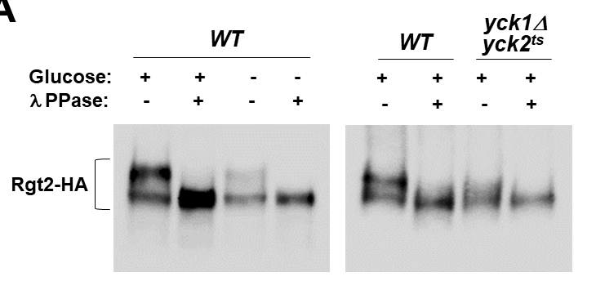
Yck phosphorylation Rgt2 is required for its stability
Figure 4. Chart and photos by Daniel Bloor
A
B
C
D

Slide 6
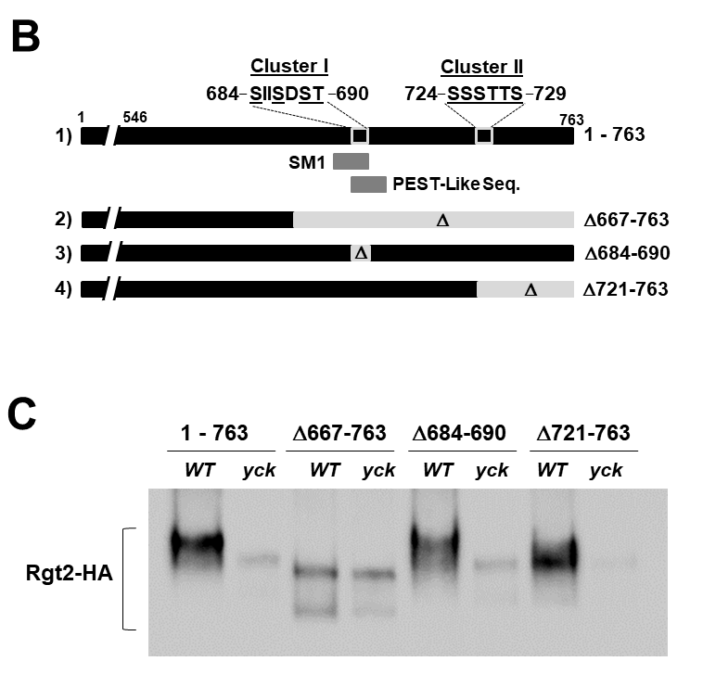
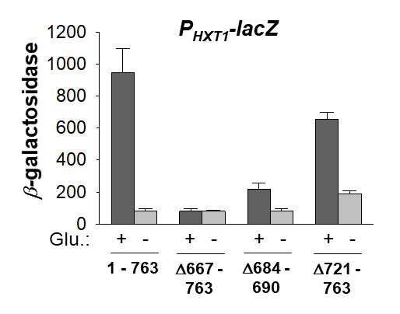
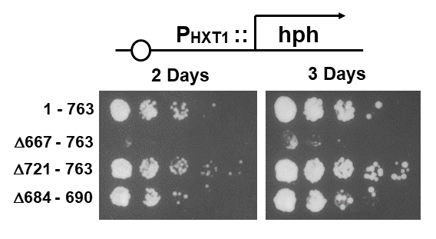
Rgt2 is phosphorylated in a Yck-dependent manner
Figure 5. Charts and photos by Daniel Bloor
A
C
D
B

Slide 7
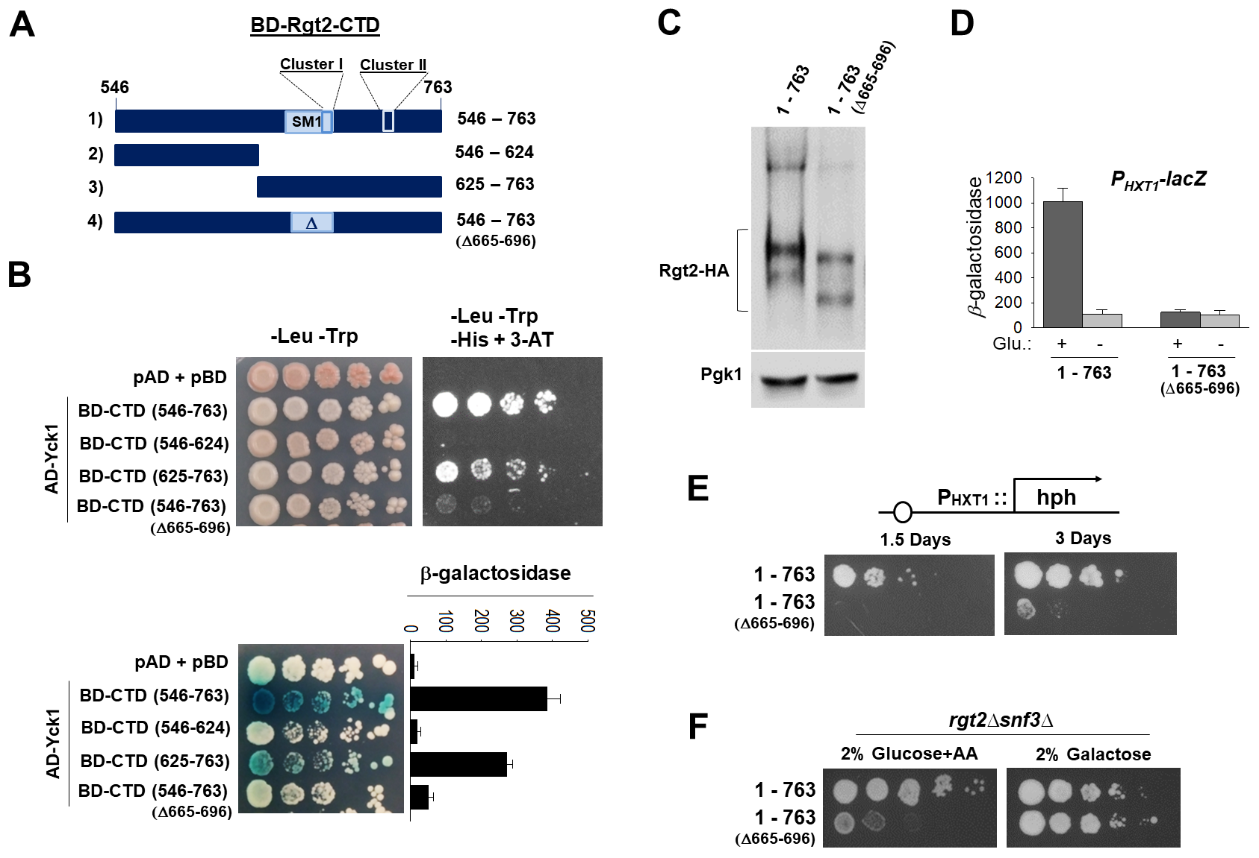
Rgt2 interacts with Yck through its C-terminal domain
Figure 6. Photos by Daniel Bloor
D
A
C
B
E
F

Slide 8
Conclusions
Cell surface levels of Rgt2 are significantly decreased in
glucose sensing defective mutants, including a yck mutant.
The C-terminal domain of Rgt2 is phosphorylated in a
Yck-dependent manner, and this is prerequired for the
stability of Rgt2
Rgt2 interacts with the Ycks through its C-terminal domain.

Slide 9
Future work
The Rgt2 interaction with Yck is glucose-dependent.
Why is this interaction disrupted in glucose-starved cells?
Rgt2 is degraded in a yck mutant.
What is its underlying mechanism?
Is the Snf3 glucose sensing receptor regulated in a similar manner to Rgt2?

Slide 10
Acknowledgements
Dr. Kim’s Lab Members
(Rebeca Rodriguez, Emma Mohler, Levi Mailloux, Sarah
Melton, and Dajeong Jung)
This work was supported by a National Institutes of Health Grant

