Slide 1
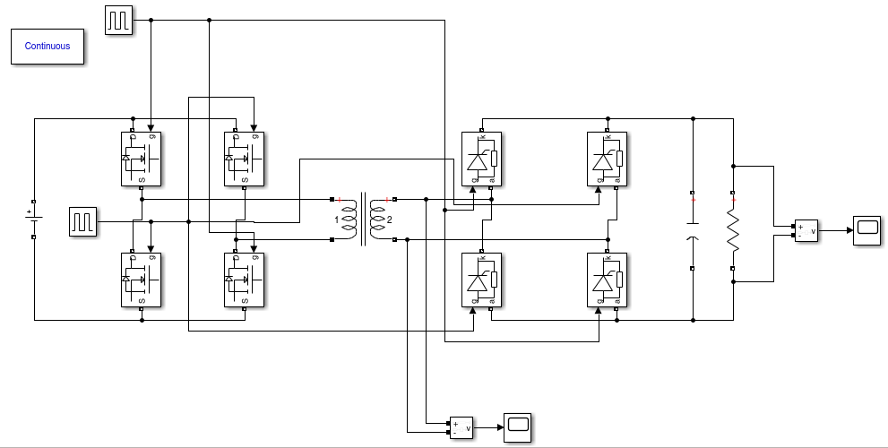
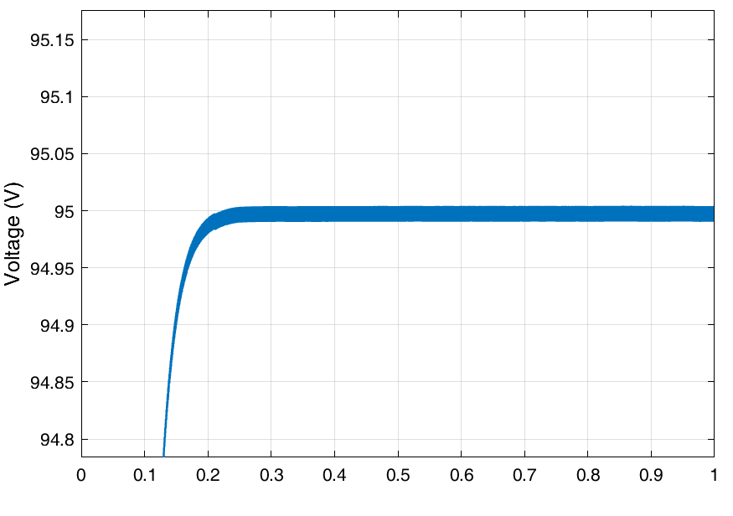
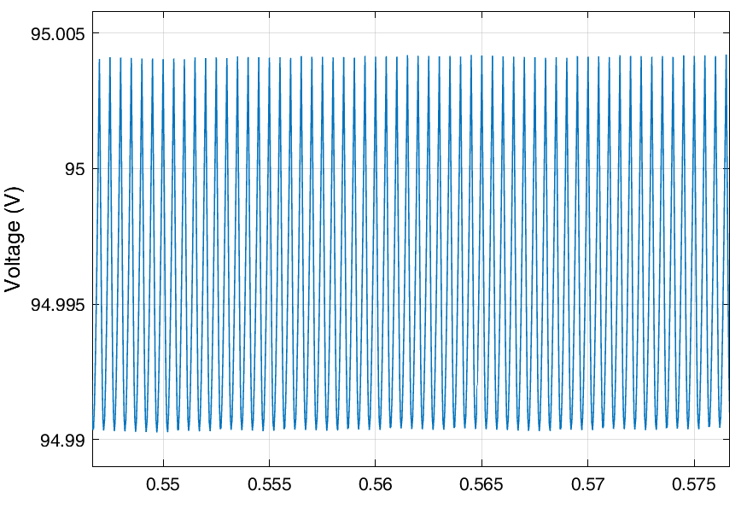
Simulation of a Dual Active Bridge Converter for Dielectric Elastomer Transducer Applications
TRACER
Lab
Isaac Liu & Dr. Hector Medina
Introduction
Dielectric
elastomer
Preliminary Observations
Objective: To develop and simulate a dual active bridge converter for bidirectional control of dielectric elastomer transducers (DETs)
Approach: Use Simulink to model a dual active bridge converter.
Question: Is a dual active bridge converter a cost-effective means of priming DETs from a low-voltage source and removing any generated energy?
Research hypothesis: A dual active bridge converter is the most cost-effective and energy-efficient means of controlling a DET.
electrode
Applied Load
Applied Load
As the researcher does not know the specific application of the DEG (rather simply wants to build one), the circuit design should focus on choosing the simplest, yet efficient circuit.
Self-priming circuits, though simple in components compared to DABs, requires multiple cycles of DEG deformation before a high operating voltage is achieved. An energy collection circuit would also be required. Thus, the researcher selected the DAB as the initial circuit for his DEG design.
MATLAB Simulink effective yet complex tool for analysis of circuitry.
A
electrode
Expand DEG
B
D
Harvest
energy
Add charge
Voltage
$$E_{max}$$
Positive Charge
$$V_{in}$$
C
+ + + + + + + +
Remove load
Applied Load
Positive Charge
Applied Load
A, B
$$Q_{max}$$
− − − − − − − − −
+ + + + + + +
Negative Charge
− − − − − − −
Background
D
C
Negative Charge
Charge
The Potential
Dielectric transducers (DETs) can revolutionize multiple fields, from soft robotic actuators to wave energy generation [1,2]
DETs require specific electrical schemes to achieve their operation, the ideal circuit maximizes energy efficiency while avoiding excessive complexity.
This is particularly necessary for the Honor’s Thesis dielectric elastomer generator (DEG) work done by the presenter.
As seen in Figure 1 and 2, the circuit must be bidirectional – able to place a high-voltage charge on the DET and remove the energy as well.
The Problem
Circuits for DEGs are complex – with costly, high-voltage components which operate at low efficiencies.
This limits the application of dielectric elastomer generators—efficient, yet low-cost circuit designs must be developed for use in DEGs.
The Proposals
There are multiple options for DET circuit design: self-priming circuits and high-voltage circuits [3].
Self-priming circuits remove the need for an external, high-voltage source [4], but have lower overall efficiency.
High-voltage circuits have better overall efficiency but require a significant amount of input energy.
Figure 1. A diagram of a dielectric elastomer generator (Photo by Isaac Liu). State A shows the DEG in its undeformed state. An external load then expands the DEG from State A to State B. A charge is then deposited on the DEG (priming the DEG), leading to State C. The load is then removed and the DEG returns to its undeformed state from State C to State D, generating energy as electrostatic energy is proportional to dielectric thickness and inversely proportional to dielectric area. The energy is then removed, returning the DEG from State D to State A.
Figure 2. Triangular harvesting cycle as proposed by [2] (Photo by Isaac Liu). At State A, both switches are open. From State A to State B, the DEG is stretched and thus its capacitance increases to its maximum. From State B to State C, the DEG is primed with $V_{in}$. The DEG relaxes and returns to its minimum capacitance which transfers charges to $C_{S}$. Finally, from State D to State A, the system collects the energy.
Conclusion/Future Work
Future Work
Purchase components and print PCB
Model more complex DAB in Matlab Simulink
Test DAB on a dielectric elastomer generator
Test alternate control schemes
Conclusion
Different electric architectures were compared by analysis of the literature.
A Dual Active Bridge converter was selected due to its high efficiency and increased interest in the literature.
A basic Dual Active Bridge converter was modelled in Simulink – illustrated Simulink as a useful tool for analysis of circuitry for this application.
References and Acknowledgments
Initial Results
[1] Medina H, Farmer CW. Improved model for conical dielectric elastomer actuators with fewer electrical connections. Journal of Mechanisms and Robotics. 2020 Jun 1;12(3).
[2] J.-H. Youn, S. M. Jeong, G. Hwang, H. Kim, K. Hyeon, J. Park and K.-U. Kyung, "Dielectric elastomer actuator for soft robotics applications and challenges," Applied Sciences, vol. 10, p. 640, 2020.
[3] G. Moretti, S. Rosset, R. Vertechy, I. Anderson and M. Fontana, "A review of dielectric elastomer generator systems," Advanced Intelligent Systems, p. 2000125, 2020.
[4] T. McKay, B. O’Brien, E. Calius and I. Anderson, "An integrated, self-priming dielectric elastomer generator," Applied Physics Letters, vol. 97, p. 062911, 2010. [5] L. Eitzen, C. Graf and J. Maas, "Cascaded bidirectional flyback converter driving DEAP transducers," in IECON 2011-37th Annual Conference of the IEEE Industrial Electronics Society, 2011.
[6] Electronics Maddy Simulink Tutorial. “Simulation of a Dual Active Bridge Converter in MATLAB | SIMULINK”
[7] S. Chiba, K. Hasegawa, M. Waki, K. Fujita, K. Ohyama, Z. Kazuhiro, and S. Zhu, “Innovative elastomer transducer driven by Karman vortices in water flow,” J Mater Sci Eng A, vol. 7, p.121-35, 2017.
[8] T. Todorčević, R. van Kessel, P. Bauer and J. A. Ferreira, "A modulation strategy for wide voltage output in DAB-based DC–DC modular multilevel converter for DEAP wave energy conversion," IEEE Journal of Emerging and Selected Topics in Power Electronics, vol. 3, p. 1171–1181, 2015.
Acknowledgements
TRACER Laboratories
Liberty University Center for Research and Scholarship
Carson Farmer
Methods
Figure 3. Dual Active Bridge (DAB) Converter topology in MATLAB Simulink (Photo by Isaac Liu). By alternating MOSFET switches, a DC current can be broken down into an AC-like voltage. The voltage would then be transformed across the circuit (to a higher voltage), and then the switches on the other side of the circuit can convert the voltage back to a DC voltage source.
Analyzed different circuit topologies in the literature. Due to the lack of constraints which often limit an application to self-priming, I focused on high voltage circuits.
Evaluated DEG circuit architectures based on four aspects [5].
Must allow for bidirectional energy flow, as it must be able to deposit the initial charge on the DEG and collect the increased charge on the DEG.
Must be able to output a high voltage, in the range of several kilovolts.
Should use standard semiconductors, ones that are easy to purchase at low costs.
Must interface with standard power grid voltages.
Analyzed different circuit topologies in the literature. Due to the lack of constraints which often limit an application to self-priming, I focused on high voltage circuits.
Simulated DAB circuit in MATLAB Simulink.
Used a time step of 10 ms, MOSFET blocks, and Thyristor blocks.
1 2 3 4 5 6 7 8 9 10 11 12 13 14
1 2 3 4 5 6 7 8 9 10 11 12 13 14
A
B
Figure 4. Scope view of DAB output voltage signal (Photo by Isaac Liu). Subplot A shows how the voltage signal gives an appearance of being constant, but zooming in to the view in Subplot B, one can see how the voltage signal oscillates in an AC form.

