Slide 1
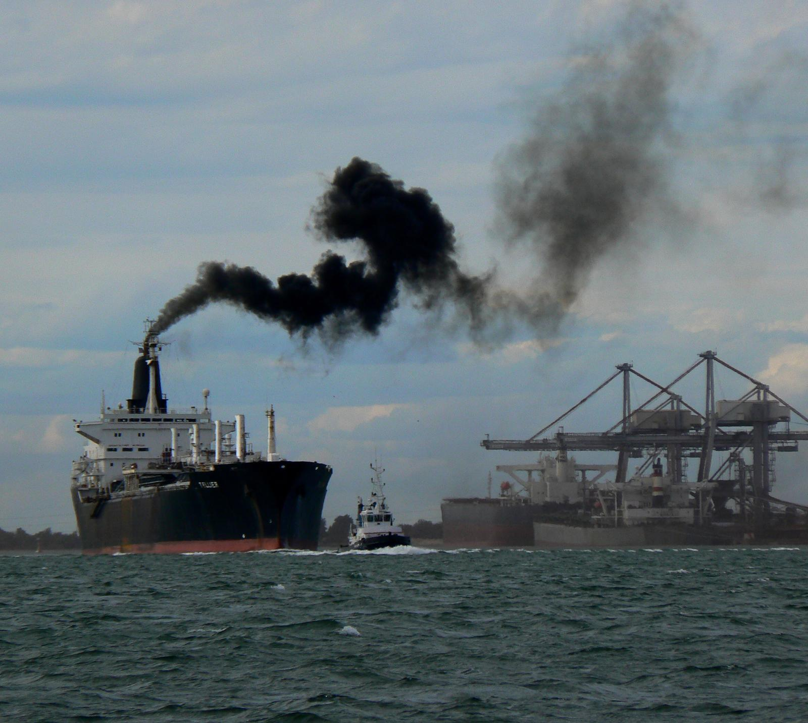
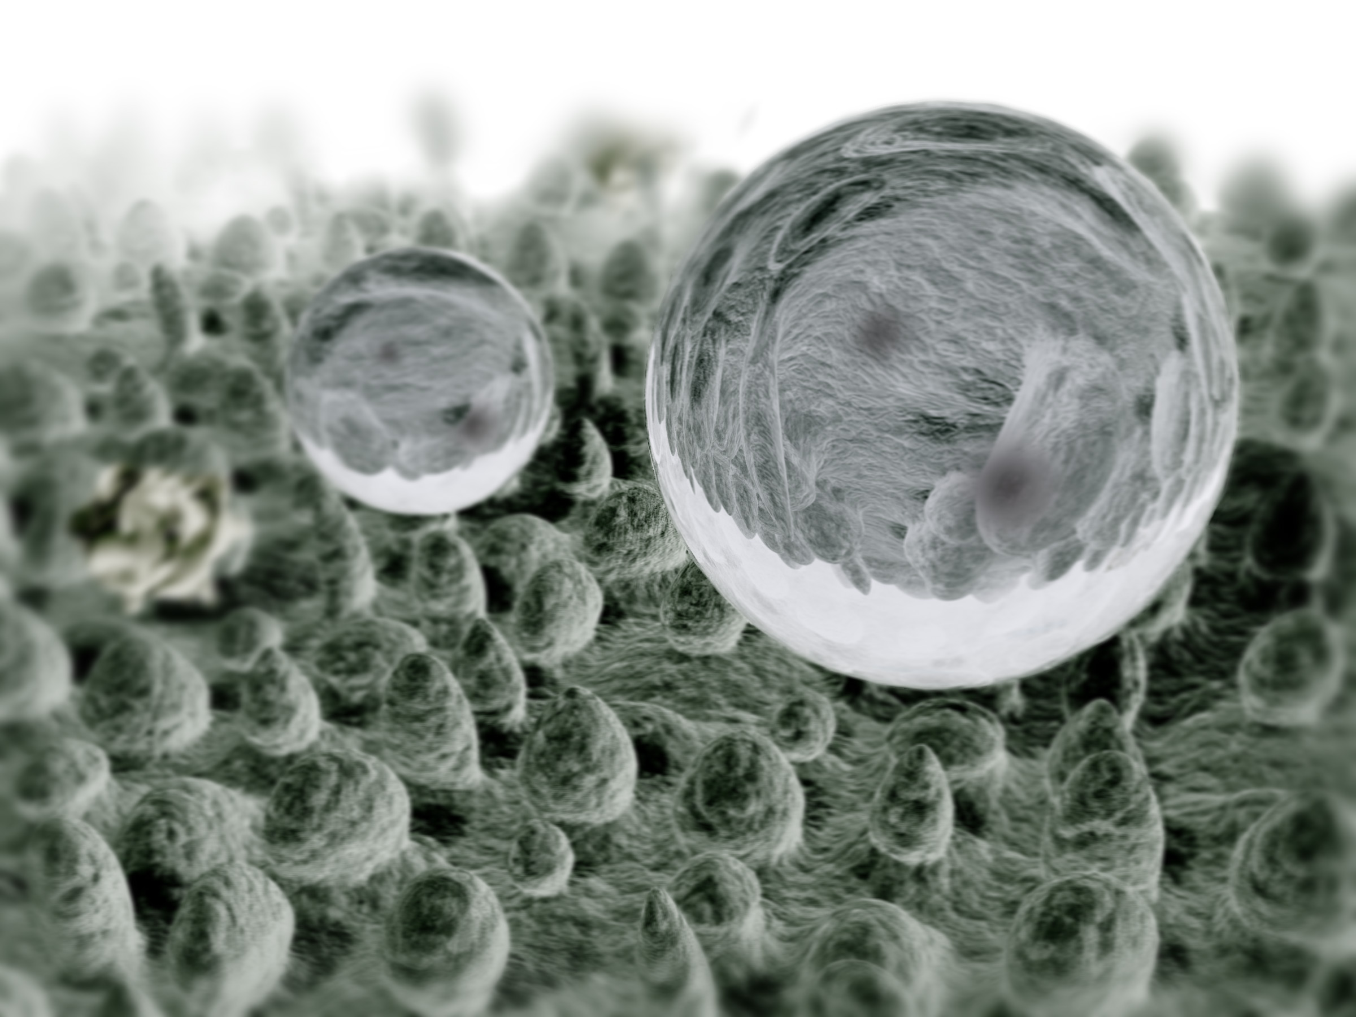
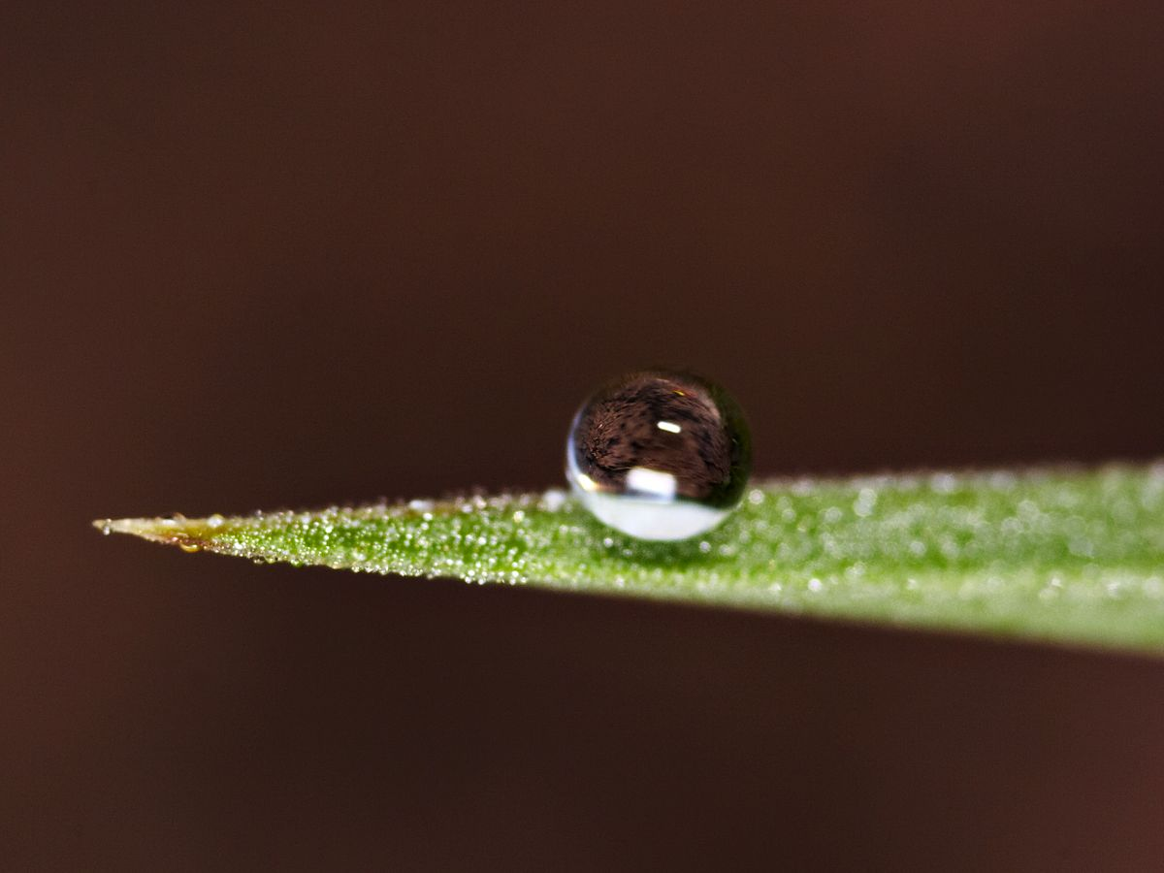
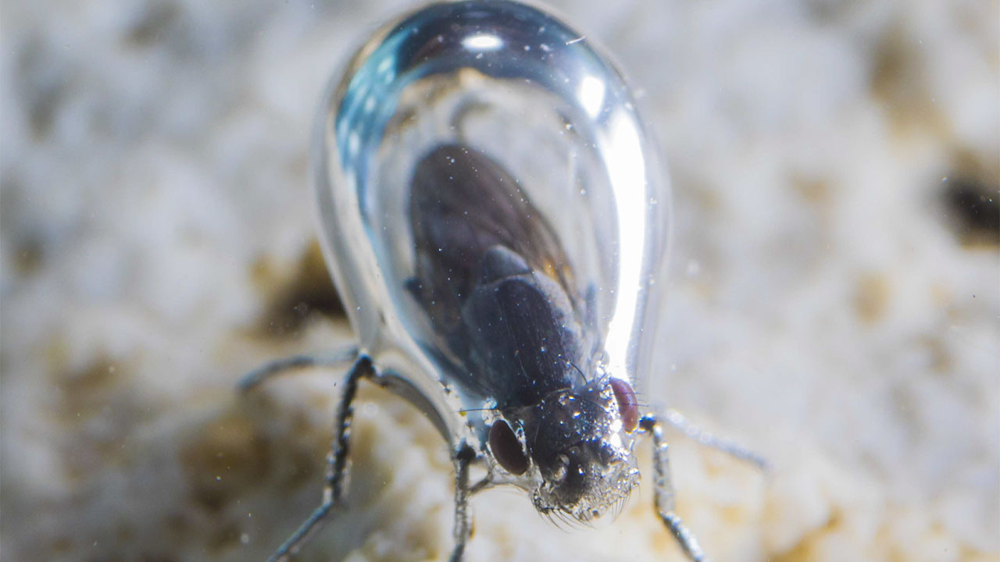
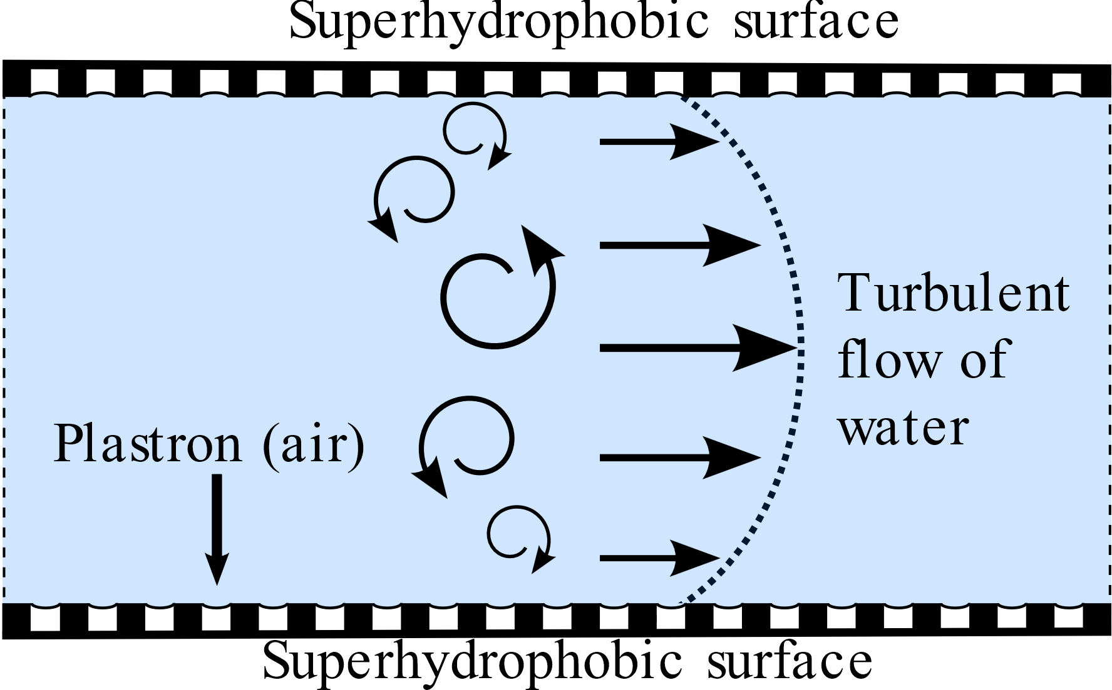
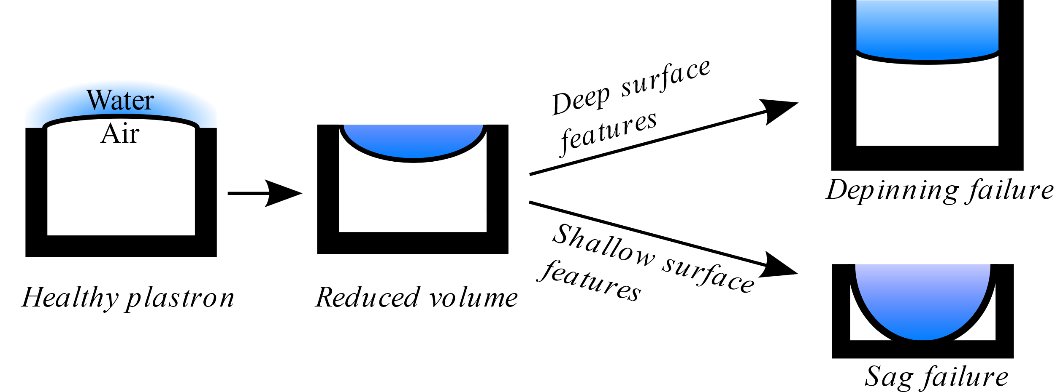
Simulation of Superhydrophobic Surface Plastron Collapse
Reid Prichard and Dr. Wayne Strasser
Background
Methodology
The shipping industry produces particulate emissions attributed to 400,000 premature deaths and 14 million cases of childhood asthma annually [1].
Additionally, the industry produces 3% of global CO2 emissions, 13% of SOx emissions, and 15% of NOx emissions.
Reducing fuel consumption would save thousands of lives and combat climate change, not to mention the financial savings for shipping operators.
This research will be performed with a simulation technique called Computational Fluid Dynamics (CFD).
CFD breaks a fluid volume into many small pieces, like the pixels on your computer screen. These pieces are called “cells”.
It is possible to calculate flow through a single cell using fundamental fluid mechanics equations.
This is done for each cell, then the solutions can be stitched together into a cohesive picture of the entire domain.
Because turbulent structures play an important role in plastron failure, we will use a CFD method called Direct Numerical Simulation (DNS).
DNS uses cells that are very small (in this case, roughly 1 µm), so resolution is very high. This is computationally very expensive, but it reveals the smallest possible motions in the fluid.
By default, DNS only simulates one type of fluid. We need to simulate three – air, water, and water vapor – so we will use the Volume Of Fluid (VOF) multiphase model.
Because the shape of the air-water interface is important, we will use Piecewise Linear Interface Construction (PLIC).
Droplet on lotus leaf
Droplet on blade of grass
Superhydrophobic Surfaces
SuperHydrophobic (SH) surfaces are surfaces with microscale features, such as hairs, that repel water and attract air.
SH surfaces are found in nature; the lotus leaf is a well-known example.
When an SH surface is submerged, air bubbles (known as “plastrons”) cling to it.
Because air is less viscous than water, SH surfaces can reduce drag on a ship’s hull by up to 75%.
However, plastrons quickly disappear in the ocean, causing their drag reduction to be short-lived.
Plastron failure is a primary barrier to implementing SH surfaces on large ships.
Several mechanisms have been identified that contribute to plastron failure:
Dissolution of air into the water [1]
Shear stress on the interface [2]
Compression of the plastron by normal stresses
Wetting of the surface by capillary condensation [X]
However, the relative importance of these various mechanisms is unknown.
Plastron failure has never been comprehensively modeled.
Figure 1: A ship producing damaging particulate emissions (soot). These emissions are linked to 400,000 premature deaths annually. Superhydrophobic surfaces can reduce fuel consumption and thereby decrease emissions.
Air bubble (“plastron”) on diving fly
Figure 2: Superhydrophobic surfaces in nature. These surfaces repel water so strongly that air clings to them when submerged, as shown by the diving fly.
Challenges
While the flow past a ship’s hull might have a friction Reynolds number (${\text{Re}}_{τ}$) of 4,000, computational expense restricts us to a maximum of ${\text{Re}}_{τ}=400$. This is …………
The physics of the various mechanisms of plastron failure have vastly different time scales.
Advective motion is on the order of 10 nanoseconds.
Condensation is on the order of 10 seconds.
This vast difference (9 orders of magnitude) makes it impossible to model both effects without exorbitant computational expense.
To overcome this, we plan to artificially increase rates of mass transfer to reduce the timescales of evaporation and condensation.
The CFD tool we plan to use, OpenFOAM, does not natively have the capability to model evaporation/condensation when using VOF and PLIC. We plan to program our own evaporation/condensation routine; if this fails, our fallback is to use a different tool (ANSYS Fluent).
Figure 4: A schematic of our computational domain. The domain is a channel flow with superhydrophobic surfaces along the top and bottom walls. The inlet and outlet are periodic boundary conditions, and a constant streamwise pressure gradient produces flow.
References
Research Objectives
[1] Sofiev, M., Winebrake, J. J., Johansson, L., Carr, E. W., Prank, M., Soares, J., Vira, J., Kouznetsov, R., Jalkanen, J.-P., and Corbett, J. J., 2018, “Cleaner Fuels for Ships Provide Public Health Benefits with Climate Tradeoffs,” Nat Commun, 9(1), p. 406.
[2] Daniello, R. J., Waterhouse, N. E., and Rothstein, J. P., 2009, “Drag Reduction in Turbulent Flows over Superhydrophobic Surfaces,” Physics of Fluids, 21(8), p. 085103.
[3] Park, H., Sun, G., and Kim, C.-J. “CJ,” 2014, “Superhydrophobic Turbulent Drag Reduction as a Function of Surface Grating Parameters,” J. Fluid Mech., 747, pp. 722–734.
[4] Gose, J. W., Golovin, K., Boban, M., Mabry, J. M., Tuteja, A., Perlin, M., and Ceccio, S. L., 2018, “Characterization of Superhydrophobic Surfaces for Drag Reduction in Turbulent Flow,” J. Fluid Mech., 845, pp. 560–580.
[5] Bobji, M. S., Kumar, S. V., Asthana, A., and Govardhan, R. N., 2009, “Underwater Sustainability of the ‘Cassie’ State of Wetting,” Langmuir, 25(20), pp. 12120–12126.
[6] Aljallis, E., Sarshar, M. A., Datla, R., Sikka, V., Jones, A., and Choi, C.-H., 2013, “Experimental Study of Skin Friction Drag Reduction on Superhydrophobic Flat Plates in High Reynolds Number Boundary Layer Flow,” Physics of Fluids, 25(2), p. 025103.
[7] Jones, P. R., Hao, X., Cruz-Chu, E. R., Rykaczewski, K., Nandy, K., Schutzius, T. M., Varanasi, K. K., Megaridis, C. M., Walther, J. H., Koumoutsakos, P., Espinosa, H. D., and Patankar, N. A., 2015, “Sustaining Dry Surfaces under Water,” Sci Rep, 5(1), p. 12311.
Our primary objective is to computationally model plastron failure in turbulent channel flow. In doing so, we will:
Visualize a plastron failure event.
Quantify the relative importance of each of the four failure mechanisms.
Neither of these things has been done in literature.
We will study multiple simple surface morphologies, such as square posts, square holes, streamwise grooves, and spanwise grooves.
We will simulate two different Reynolds numbers to gain some understanding of the relative importance of turbulent and viscous forces.
Figure 5: An illustration of the general process of plastron failure.
Notes:
Figure 1 is from Vapotherm, Inc. https://vapotherm.com/felix1/
Figures 2-5 are original creations of the author.

