Slide 1
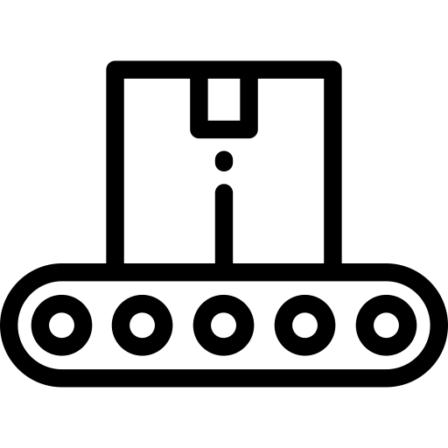
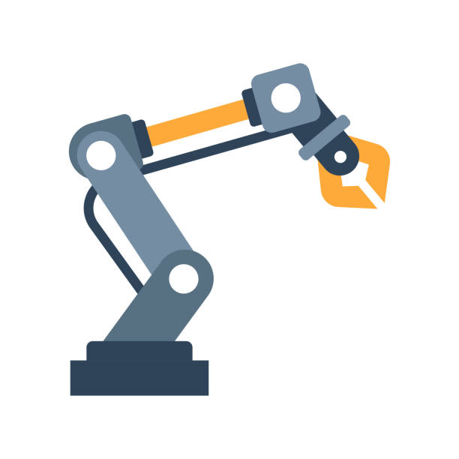
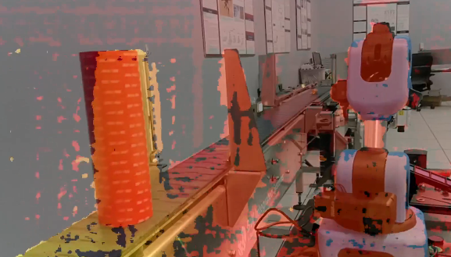
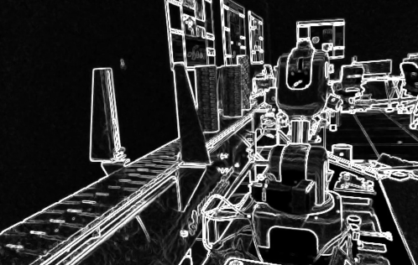
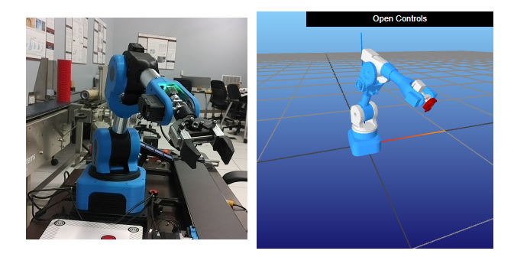
Cyber-Physical Systems for Smart Manufacturing Education
Carson Farmer & Dr. Hector Medina
Abstract and/or Background
Results and Conclusion
Engineer education requirements must continue to change in response to an increased need from industry to drive the fourth industrial revolution, or the so-called Industry 4.0. The term Industry 4.0 was originally established as part of an elaborate strategy to foster the advancement of current manufacturing facilities into smart factories. These advancements include the integration of cyber-physical systems, cloud computing, artificial intelligence and other innovative technologies characterized as internet-connected, data-centric, autonomous, and simulation-based. As we enter this new industrial paradigm, engineering students must be equipped with the knowledge and tools to function in this rapidly changing workplace. This research project focuses on the development of interactive learning modules and curriculum for topics relevant to Industry 4.0, particularly on Smart Manufacturing. The development of such curriculum for engineering students poses several challenges as each individual engineering discipline traditionally focuses on concepts from a single engineering domain. For Smart Manufacturing, however, students must be skilled in multiple disciplines to excel. In its initial phase, this research involves developing a remote system for controlling an armed robot, utilizing advanced computer vision for depth processing of a manufacturing line, and the development of automated conveyor belt system. This research aims to bridge the gap between the classroom and manufacturing space. The current challenges in the development of the research involves the presentation and interactivity of students who are unfamiliar with these new concepts. This research hopes to create a way for students to be exposed to experiential learning on topics related to Smart Manufacturing.
Results:
Thus far, the smart manufacturing curriculum has provided a -significant advantage for testing and developing novel methods for teaching Industry 4.0 concepts. The current iteration of the system allows for students to interact and control a robotic arm along with simulating a selected number of dynamic systems pertaining to smart manufacturing. The testing of the software within the research group has allowed for a better understanding of the requirements for building and deploying interactive software at a larger scale than a lab test. The development of the system has the chance to change how students learn advanced manufacturing concepts and the curriculum used.
Conclusions
With continued development in the area of smart manufacturing education, the aim is to incorporate further improvements to the existing system. These improvements will allow for students to have more access to remote equipment along with more opportunities to learn machine learning and statistics appropriate to manufacturing. Incorporating the current smart manufacturing technologies will allow for further research on the best methods to teach students skills relevant to smart manufacturing. As students are required to learn more advanced techniques for entering Industry 4.0, the interactive curriculum approach will allow for students to be exposed to the techniques required for entering Industry 4.0.
Industry 1.0: Mechanization of manufacturing
Industry 2.0: Production Line and Electrification of Manufacturing
Industry 3.0: Automation and introduction of robots to manufacturing
Industry 4.0: Machine Learning, computer vision, and Connected Devices (Internet of Things)
Progression of Industrial Manufacturing
Figure 1. As technology has become more pervasive in manufacturing, the workforce needs students equipped with state of the art knowledge for managing and operating equipment in Industry 4.0 (Photograph by Carson Farmer.)
Introduction
Starting during the first industrial revolution, manufacturing has shifted been shifting away from human intervention (Industry 1.0) to a more autonomous and connected manufacturing process (Industry 4.0) [1]. The shift in manufacturing technology has required students and educators to keep pace with the rapidly changing technology. Industry 4.0 is currently characterized by modular, autonomous, and networked cyber-physical systems [2, 3]. The addition of robots to manufacturing occurred during the Third Industrial Revolution [2]; yet, the connection of multiple autonomous systems with intelligent software characterizes the approach of Industry 4.0. As students graduate and enter the workforce, they are required to be equipped with the skills required to function in Industry 4.0. More than ever, students of multiple engineering disciplines are expected to have a working knowledge of machine learning (ML), electro-mechanical systems, dynamical systems modeling, and programming [4]. Adding new topics to engineering curricula has challenged educators for how to adopt the new material while covering the required topics [5]. Furthermore, the COVID-19 pandemic has challenged the status quo for education by forcing teacher and universities to adapt to new online platforms for teaching traditionally hands-on courses [5]. The move to an online platform has created new opportunities for the development of remote systems for both those in academia and in the manufacturing industry. Some attempts to create tools for teaching Industry 4.0 topics include TIPHYS [6] for VR based teaching and Lab@Home for virtual hardware access [7]. With the research undertaken for this study builds on the framework developed by the TRACER Lab at LU for remote labs [8], the focus has been to combine both the remote aspect with real-world hardware components that students can interact with via simulations and remote-lab interfaces. To transition students and educators to the new paradigm of Industry 4.0, the tool aims to automates much of the learning process by analyzing student responses and tailoring coursework to the student. The ability for students to interactively learn topics relevant to Smart Manufacturing and Industry 4.0 better equips students for entering the workforce.
Future Work
Expand curriculum to cover more topic relevant to smart manufacturing
Develop simulation environments (conveyor belts, pick and place applications, etc.) for connected autonomous robotic arms.
Develop conveyor belt software for teaching students about object detection and computer vision.
Develop metacognitive techniques for understanding student response to presented material
Create auto-grading elements for portions of the smart manufacturing curriculum
Figure 2. With AI-enabled cameras, depth processing of a conveyor belt provides more information than traditional vision systems at a fraction of the computational cost. (Photograph by Carson Farmer.)
Figure 3. Utilizing AI accelerators, edge detection and object identification can happen faster and more accurately compared to traditional computer vision approaches. Exposing students to these new fields equips them to be prepared for entering the Industry 4.0 workforce. (Photograph by Carson Farmer.)
References
[1] Baygin, M., Yetis, H., Karakose, M. and Akin, E., 2016, September. An effect analysis of industry 4.0 to higher education. In 2016 15th international conference on information technology based higher education and training (ITHET) (pp. 1-4). IEEE.
[2] Kipper, L.M., Iepsen, S., Dal Forno, A.J., Frozza, R., Furstenau, L., Agnes, J. and Cossul, D., 2021. Scientific mapping to identify competencies required by industry 4.0. Technology in Society, 64, p.101454.
[3] Frank, A.G., Dalenogare, L.S. and Ayala, N.F., 2019. Industry 4.0 technologies: Implementation patterns in manufacturing companies. International Journal of Production Economics, 210, pp.15-26.
[4] Zheng, P., Sang, Z., Zhong, R.Y., Liu, Y., Liu, C., Mubarok, K., Yu, S. and Xu, X., 2018. Smart manufacturing systems for Industry 4.0: Conceptual framework, scenarios, and future perspectives. Frontiers of Mechanical Engineering, 13(2), pp.137-150.
[5] Cevik Onar, S., Ustundag, A., Kadaifci, Ç. and Oztaysi, B., 2018. The changing role of engineering education in industry 4.0 Era. In Industry 4.0: managing the digital transformation (pp. 137-151). Springer, Cham.
[6] Antonelli, D., D’Addona, D.M., Maffei, A., Modrak, V., Putnik, G., Stadnicka, D. and Stylios, C., 2019. Tiphys: an open networked platform for higher education on industry 4.0. Procedia CIRP, 79, pp.⁷⁰⁶⁻⁷¹¹.
[7] Monzo, C., Cobo, G., Morán, J.A., Santamaría, E. and García-Solórzano, D., 2020. Lab@ Home: The Open University of Catalonia Hands-on Electronics Laboratory for Online Engineering Education. Electronics, 9(2), p.222.
[8] Medina, H., Gentry, N. and Farmer, C., 2021. Remote Laboratory for Machine Learning Training of a Soft Actuator’s Control: A Case Study.
Methods
Figure 4. Using open source simulation tools, manipulation and visualization of a robotic arm allows for students to test their programs on a computer prior to deploying the model to real hardware. (Photograph by Carson Farmer.)
Computer Vision – Computer vision plays a key role in smart manufacturing. Computer vision equips machines with a sense of vision to understand and interact with the world. For the course, the OAK-D camera by Luxonis and the OpenCV and DepthAI Libraries allow for students to use well-respsected hardware and software to develop computer vision algorithms. For example, students are able to develop stereoscopic depth estimation (Fig. 2) and edge detection (Fig. 3) for a manufacturing line.
Conveyor Belt and Robotic Arm – The conveyor belt and robotic arm provide students with real-world experience to interact with manufacturing equipment. Providing students with access to real-world equipment allows for a deeper understanding of real-world equipment. Currently, the system is equipped with a Niryo Ned robotic arm and a large and small conveyor belt. The hope is for students to have access to real-world equipment for remote development.
Interactive Notebooks – By Pluto notebooks, students interact with a deployed server to change allowed values and see how changes correspond to system response. The interactive feedback for the notebooks allow for new approached to interactive learning.
The future of manufacturing education requires a shift to using interactive and online tools to teach students multi-disciplinary skills relevant to Industry 4.0.

